Slide 1
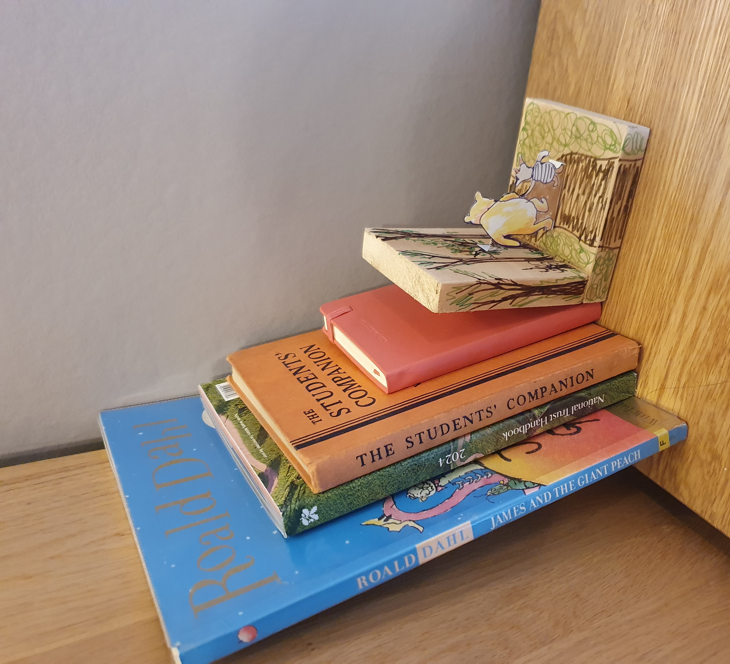
Design a Bookend
Designing and making a bookend for World Book Day

Slide 2
Stay safe
Whether you are a scientist researching a new medicine or an engineer solving climate change, safety always comes first. An adult must always be around and supervising when doing this activity. You are responsible for:
ensuring that any equipment used for this activity is in good working condition
behaving sensibly and following any safety instructions so as not to hurt or injure yourself or others
Please note that in the absence of any negligence or other breach of duty by us, this activity is carried out at your own risk. It is important to take extra care at the stages marked with this symbol:
⚠

Slide 3
Design Brief
What is a bookend?
Why use a bookend?
Who would use a bookend?
Your task is to design and make a bookend for World Book Day

Slide 4
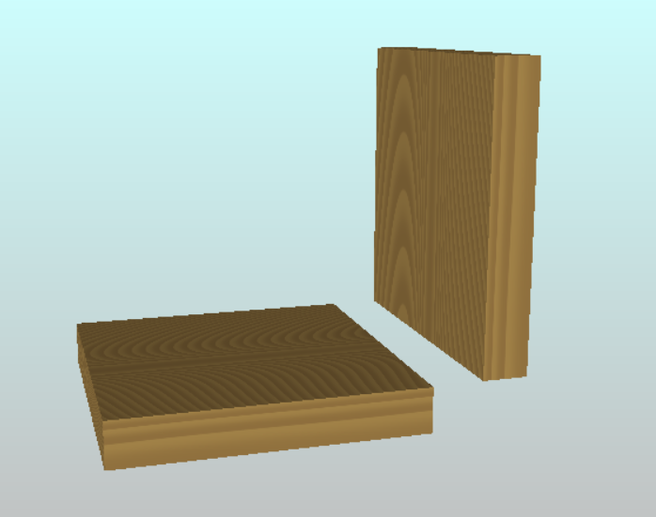
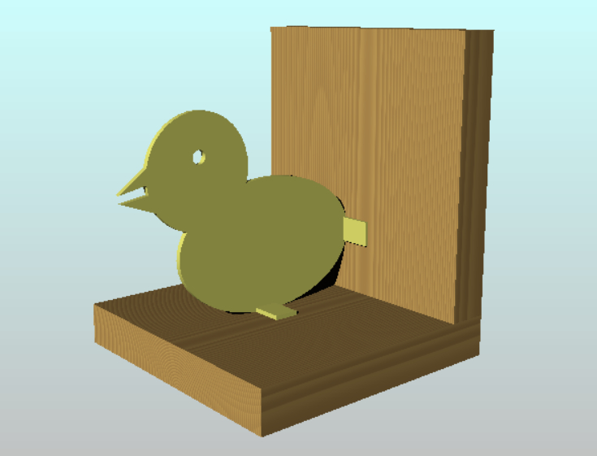
Design Criteria
The bookend will be made from two pieces of wood, forming an L-shape
It must have a shape or character made from card to make it interesting

Slide 5
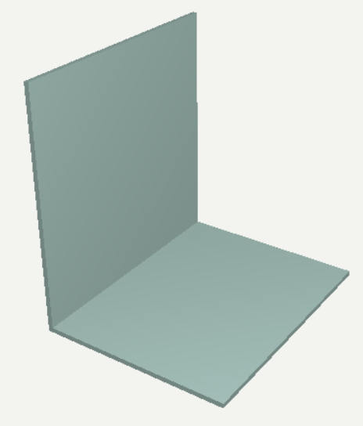
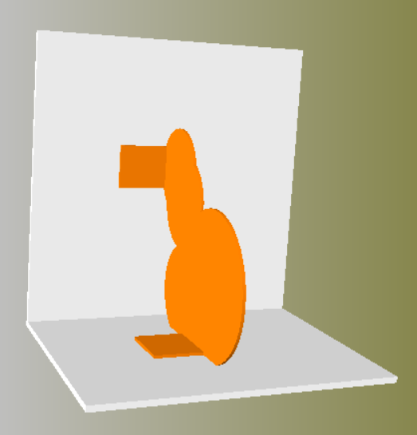
Designing your Bookend
⚠
Fold a piece of card to make the L-shape
On a piece of paper, draw, trace or copy the shape for the character
Add two tabs, so it can be attached to the L-shape
Cut out the shape using scissors
Stick it in place using sticky tape
Do you like it? Do you want to change it? Could it be improved?
Tabs
Notes:
The size of the L-shape and shape will depend upon the available timber. The cut shape can be removed and used as a template for the final product.

Slide 6
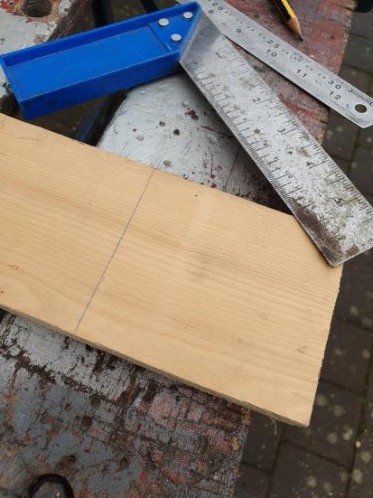
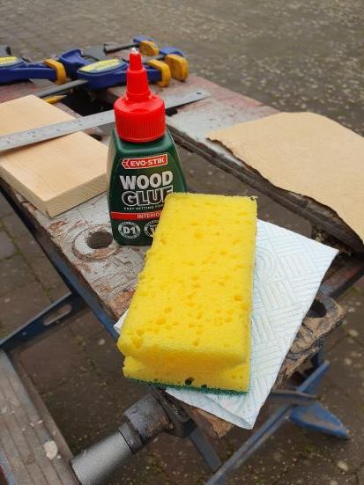
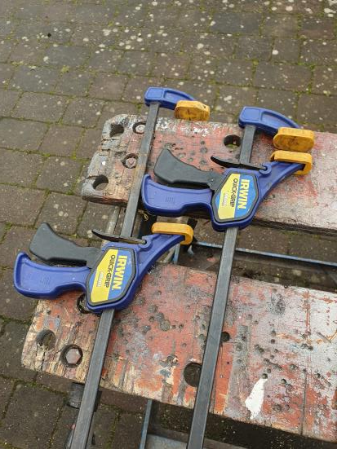
What you will need
some timber (wood)
a tri-square
a pencil
a saw
some sandpaper
wood glue
a damp sponge
some clamps
card
scissors
coloured pens
Notes:
Safety notes – tools can be heavy for younger children and may also have sharp edges. All activities will need close supervision.

Slide 7
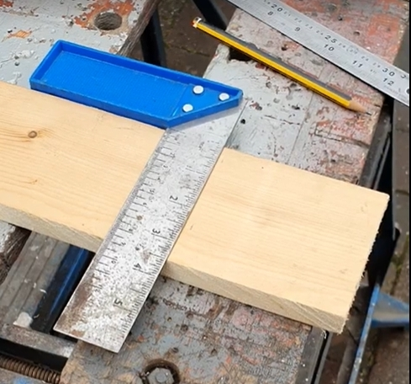
⚠
Marking out the Wood
Mark a line on the wood 100mm from the end
Use the tri-square to make sure it goes straight across the wood (otherwise your bookend will be wonky)
Notes:
If the wood is pre-cut, this section can be skipped
Safety notes – tools can be heavy for younger children and may also have sharp edges. All activities will need close supervision.

Slide 8
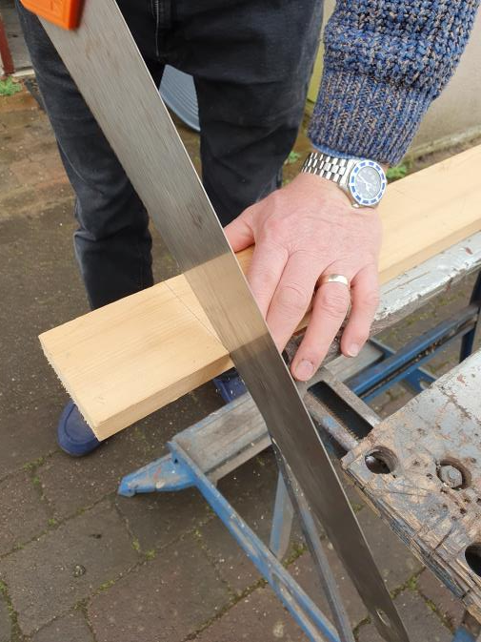
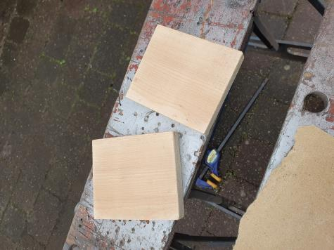
⚠
Sawing the Wood
Using the saw carefully cut down the line
You will need to do this twice, to make the two sides of the L-shape
Notes:
Safety notes – tools can be heavy for younger children and may also have sharp edges. All activities will need close supervision.

Slide 9
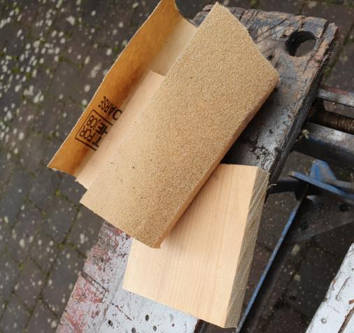
Sanding
⚠
Timber (wood) can have splinters
Splinters are small, sharp bits of wood that can stick in you - they need sanding off to give a smooth finish
Use a piece of wood wrapped in sandpaper as a ‘sanding block’ to sand the edges of your cut pieces
Notes:
Safety notes – tools can be heavy for younger children and may also have sharp edges. All activities will need close supervision.

Slide 10
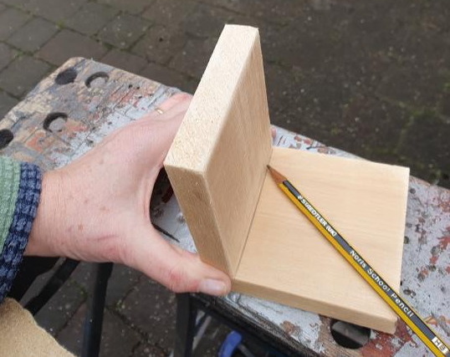
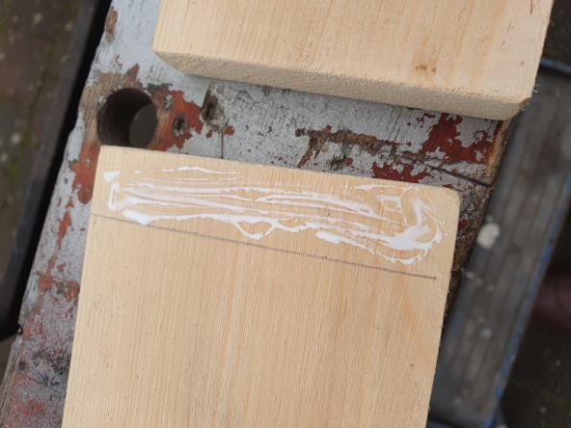
Making the Joint
⚠
The next step is gluing the two bits together - this sounds easy but it can be messy
Put one piece on top of the other (making the L-shape) and carefully mark a line where the join is
Put a little bit of glue on the place where the joint will be
Spread the glue out with a spreader
Notes:
The glue used should be PVA for interior use – this is the same glue used to stick paper together.

Slide 11
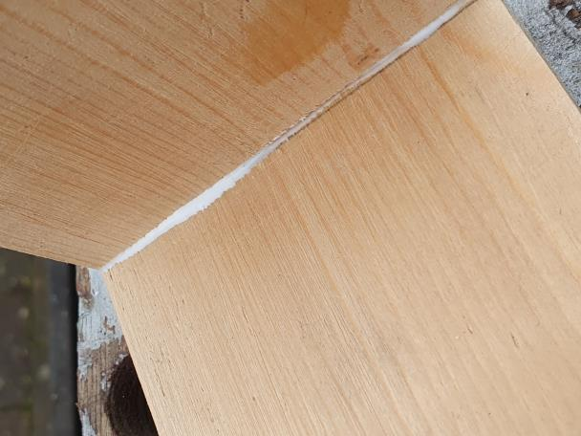
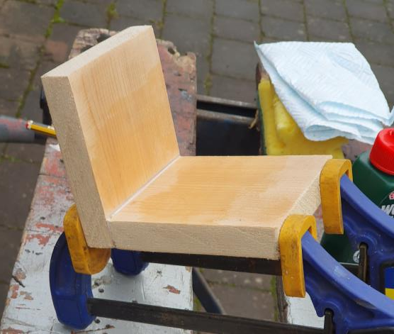
Clamping
⚠
Use the clamp to squeeze the two pieces of wood together where the glue is
Glue might ooze out of the joint - wipe it off quickly with a damp sponge or cloth
Wash your hands to remove any glue afterwards
Leave the glue overnight to dry

Slide 12
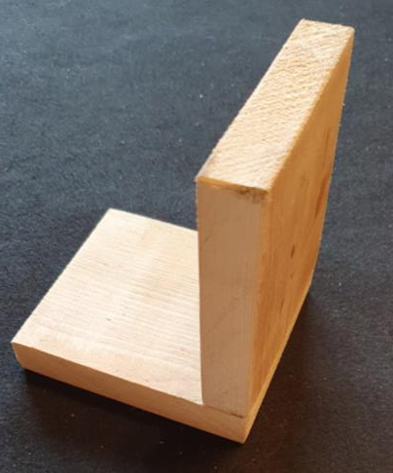
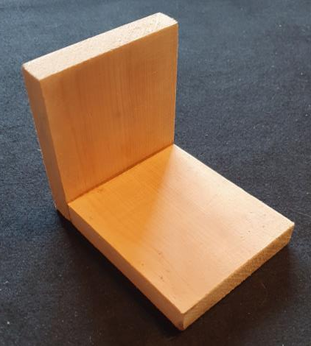
Decorating your Bookend 1
It’s up to you which way the bookend should stand
This way it will be taller
Or this way it will be longer

Slide 13
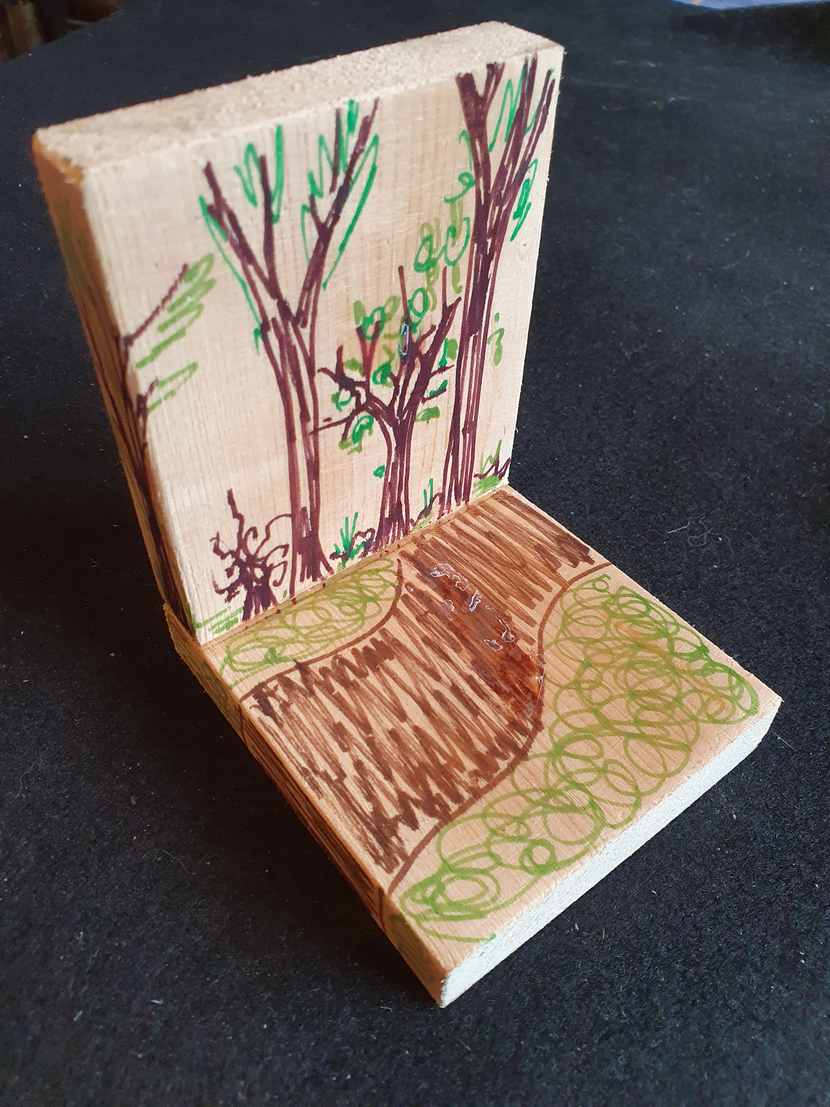
Decorating your Bookend 2
Using your design, decorate your bookend
Our design idea was ‘Winnie the Pooh’, as we love the book
For this bookend we chose to stand it tall.
We coloured in the wood to look like trees, as Winnie the Pooh lives in ‘Hundred Acre Wood’

Slide 14
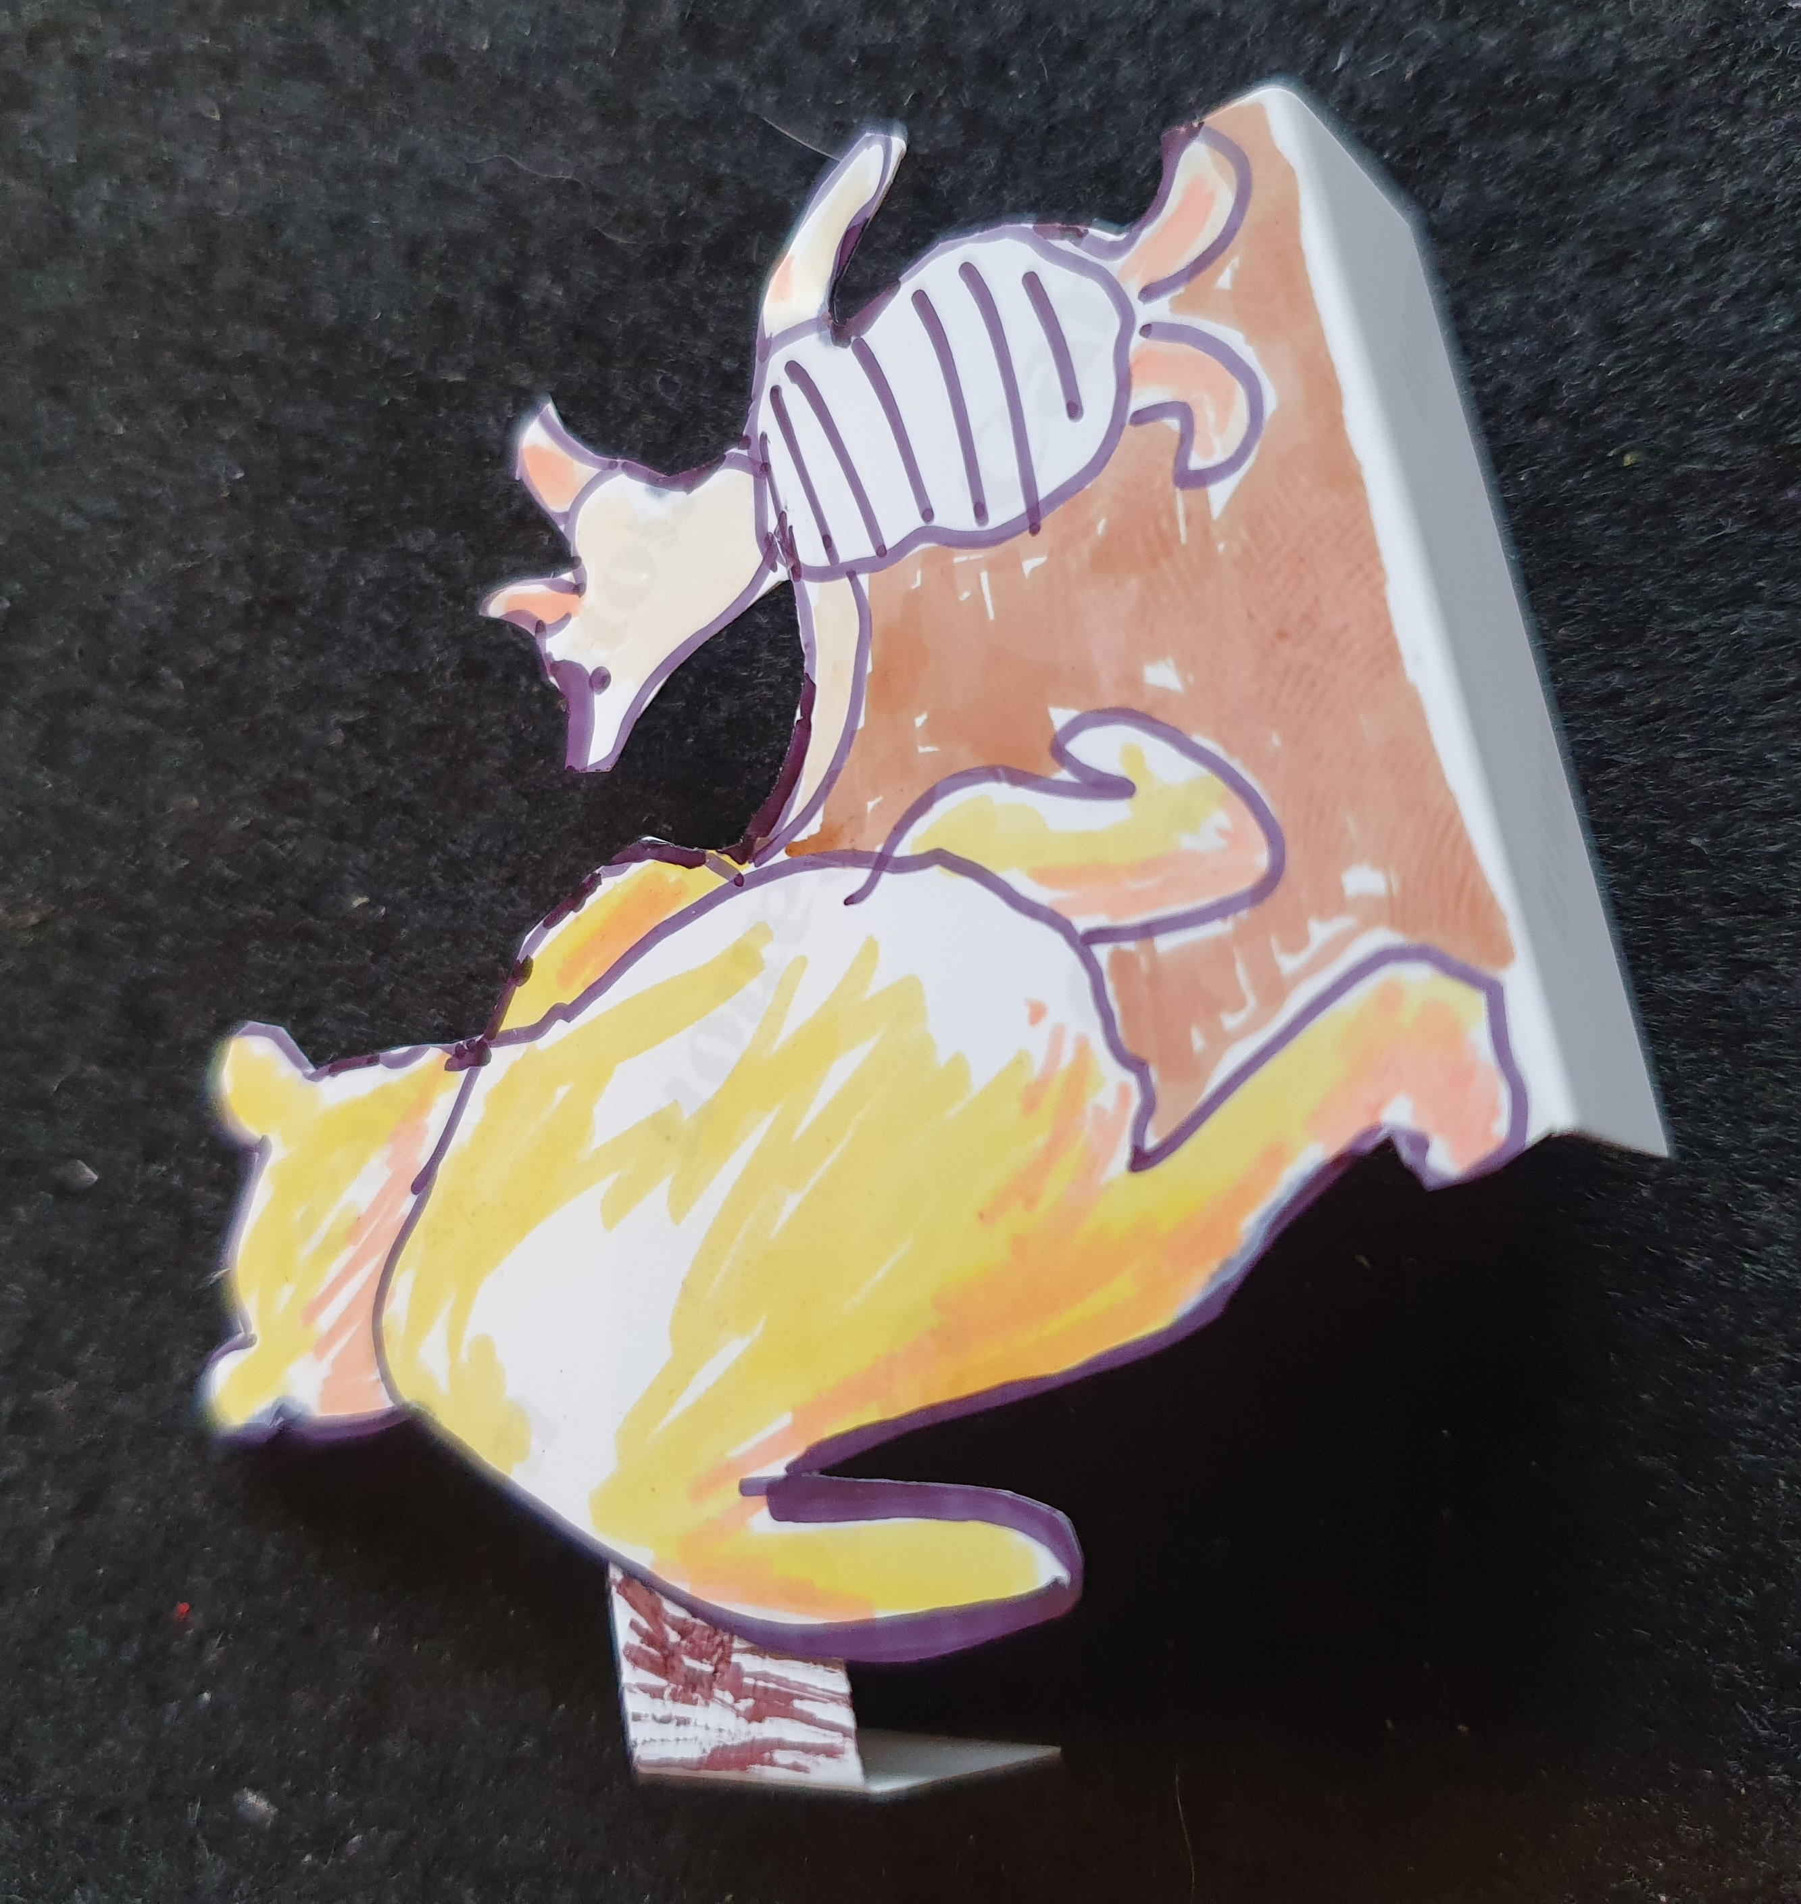
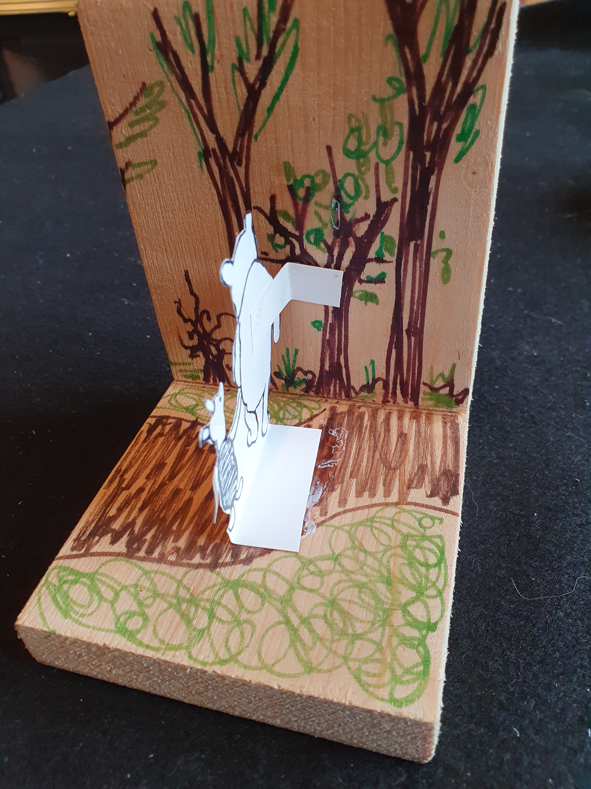
Decorating your Bookend 3
⚠
On our design, we copied Winnie the Pooh and piglet from a book
Use the paper version of your design as a template to draw the final version on card
Cut it out using scissors – remember to keep the tabs!
Add colour and detail
Glue your final design to the bookend

Slide 15
Testing your Bookend
When it is done, try your bookend with some books
With only one bookend you will need to prop the other end up with a wall or the end of a bookshelf

