Slide 1
Making Music with the BBC Micro:bit
Designing and programming a device that can used as a musical instrument in a class performance

Slide 2
Stay safe
Whether you are a scientist researching a new medicine or an engineer solving climate change, safety always comes first. An adult must always be around and supervising when doing this activity. You are responsible for:
ensuring that any equipment used for this activity is in good working condition
behaving sensibly and following any safety instructions so as not to hurt or injure yourself or others
Please note that in the absence of any negligence or other breach of duty by us, this activity is carried out at your own risk. It is important to take extra care at the stages marked with this symbol: ⚠
Notes:
Safety Warning

Slide 3
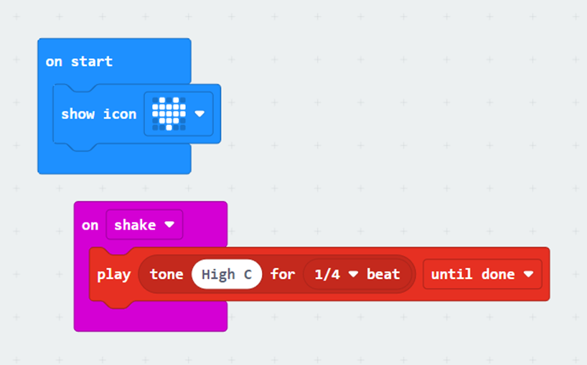
Starter
Look at the code
What do you think it does?
Run the code and see what it really does
Notes:
Teacher could deliver this starter using the PR of the PRIMM (Predict-Run-Investigate-Modify-Make) process:
Predict – show the code and ask students what it does.
Run – enter the code and run it in the simulator and then on the micro:bit and observe what it actually does.
This is a simple input/output program; when you shake the micro:bit (input) it plays a short note (output); this leads-in to the general principle of all other parts of this
activity, i.e. that you can use an input of any type to trigger a musical output. If the triggering and playback responds quickly enough, this can be used as part of a musical performance as a home-made instrument.

Slide 4
Design context
Playing music with others is a great way to improve memory and be creative
It’s also lots of fun!
What are the different parts of a typical piece of music?
Notes:
Explain to learners that the design context is what sets the scene for the project that they will be working on.
Learners could discuss technologies such as automated barriers, communication devices to let children know their parents/guardians have arrived etc.
Learners could discuss the different parts of a typical piece of music – e.g. rhythms, harmonies and melodies.

Slide 5
Design brief
Using the BBC micro:bit:
Design a programmable device that can be used to create a part in a piece of music
This will then be used with other people’s parts to create a class performance
Notes:
Explain that the design brief describes what it is they are going to do in their project.
Discuss the brief with learners and check they understand it.
Learners could analyse the design brief and/or criteria by producing a mind map or spider chart of their initial thoughts on how to solve the problem given.
Learners could be split into three groups.
Group 1 will create the rhythm parts of the performance.
Group 2 will create the harmony parts.
Group 3 will create the melodies.
It would also make sense for group leaders to be appointed, so each team can communicate with each other to ensure they are creating parts that would work with each other. Or the teacher could coordinate this.

Slide 6
Design criteria
Your device must be able to do one of the following:
Produce a rhythm in the form of a drumbeat
Play a harmony part using the chords A, D and E
Play a melody to go over the chords
It could also:
Include a metronome to help to keep time
Notes:
Assessment advice – learners could be assessed on how many of the design criteria they have managed to fulfil with their devices.
The ‘it could also’ criteria is intended to be harder and provide more challenge.
Learners could analyse the design brief and/or criteria by producing a mind map or spider chart of their initial thoughts on how to solve the problem given.
Learners could be split into three groups.
Group 1 will create the rhythm parts of the performance.
Group 2 will create the harmony parts.
Group 3 will create the melodies.
It would also make sense for group leaders to be appointed, so each team can communicate with each other to ensure they are creating parts that would work with each other. Or the teacher could coordinate this.

Slide 7
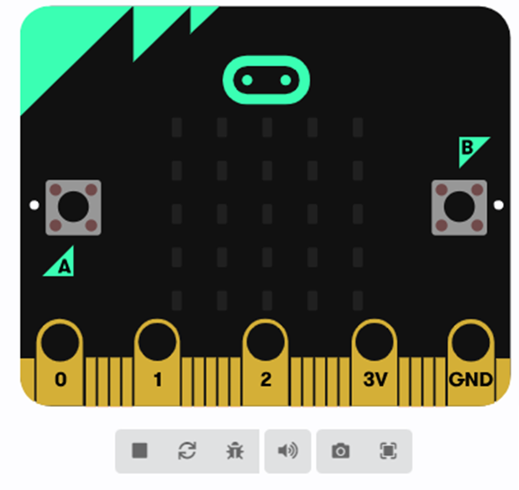
Your tasks (route 1)
⚠
Go to https://makecode.microbit.org
Click on ‘new project’
Write your code to meet the brief
Check your code works on screen (simulate)
Download it to your micro:bit
Perform your music with your group and the class!
Notes:
Learners can be taken through this in one of two ways:
Option 1 – Learners themselves create the code to meet the design brief, with help as required from the teacher. In this instance the main focus is the programming activity.
Option 2 – The example code is treated as pre-written and downloaded onto the micro:bits ‘as is’. In this instance the main focus is on the overall system and its use as part of the class musical performance.
Route option 1:
For lower ability learners the teacher could show the learners how to create the appropriate program step-by step.
The example programs can be used to help with this and to give examples for learners to follow as needed. These could be demonstrated working, prior to learners producing their own program, so they know what they are aiming to achieve.
Safety – always take care when using electrical or electronic devices. If something does not seem right, e.g. the circuit board is getting hot, take the power off and tell an adult immediately.
Class performance:
Learners may need to practice their different pieces in groups (e.g. the rhythm group will perform their rhythm part together first), then all groups will need to come together as a class for the class performance. They may need extra time and assistance to ensure all their parts fit well together and to ‘tweak’ them accordingly.

Slide 8
Your tasks (route 2)
⚠
Go to https://makecode.microbit.org
Drag the HEX file for the musical part you are creating into the project homepage to open it
Check it works on screen (simulate)
Download it to your micro:bit
Perform your music with your group and the class!
Notes:
Learners can be taken through this in one of two ways:
Option 1 – Learners themselves create the code to meet the design brief, with help as required from the teacher. In this instance the main focus is the programming activity.
Option 2 – The example code is treated as pre-written and downloaded onto the micro:bits ‘as is’. In this instance the main focus is on the overall system and its use as part of the class musical performance.
Route option 2:
Teacher will need to place the relevant example programs in a shared drive for learners to access and drag on screen, or have them opened and ready on screen for them in advance.
Learner will need to download the appropriate program onto the relevant micro:bit – e.g. drum:bit if they are creating a rhythm part, harmony:bit for harmony parts and melody:bit if they are creating a melody for the piece of music.
Safety – always take care when using electrical or electronic devices. If something does not seem right, e.g. the circuit board is getting hot, take the power off and tell an adult immediately.
Class performance:
Learners may need to practice their different pieces in groups (e.g. the rhythm group will perform their rhythm part together first), then all groups will need to come together as a class for the class performance. They may need extra time and assistance to ensure all their parts fit well together and to ‘tweak’ them accordingly.

Slide 9
Extension
Program a metronome that can be used to keep a common beat for the ‘instruments’
As a class, create several different musical pieces that could form a ‘concert’ for parents
Notes:
Once their main piece of music has been created as a class they could repeat the activity to create several pieces of music for a ‘concert’ that parents and/or teachers are invited to.

Slide 10
Starter example program
Notes:
This program is for the starter activity (slide 3).
To open this program:
Open https://makecode.microbit.org in a new browser window.
Click on ‘import’ and select ‘import file’. Then choose the HEX file to upload.
Or, drag the HEX file from your computer into the edit window or project homepage.
https://support.microbit.org/support/solutions/articles/19000065686
Versions of this program are provided for both Windows and Mac operating systems.

Slide 11
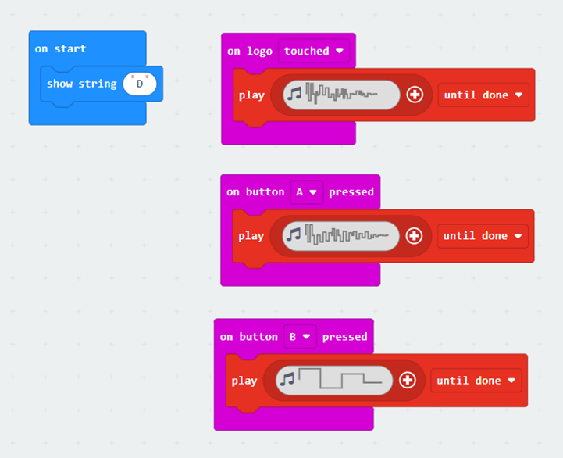
drum:bit example program
Notes:
This is the simplest of the three main programs to be written by learners. It builds on the starter activity and uses the pre-defined sounds of the sound synthesiser. It can be difficult to see which sound is selected in the sound synthesiser, but by clicking on the waveform and then pressing the gallery button, you can choose from a selection of percussive sounds.
Teachers could present the table of suggested input triggers from a table, and then get learners to choose an input trigger and an output sound, and connect them together in the code editor. All of the suggested input triggers have simple one-block event handlers, and playing a sound is one block of code. Teachers might also choose to get learners to build multiple triggers and sounds into their drum:bit (as we do in the worked example), so that they can build a complete multi-part drum-kit.
Note that many of the event handlers trigger on-release rather than on-press, so teachers might need to make sure learners know about this to prevent delays in sound production.
To open this program:
Open https://makecode.microbit.org in a new browser window.
Click on ‘import’ and select ‘import file’. Then choose the HEX file to upload.
Or, drag the HEX file from your computer into the edit window or project homepage.
https://support.microbit.org/support/solutions/articles/19000065686
Versions of this program are provided for both Windows and Mac operating systems.

Slide 12
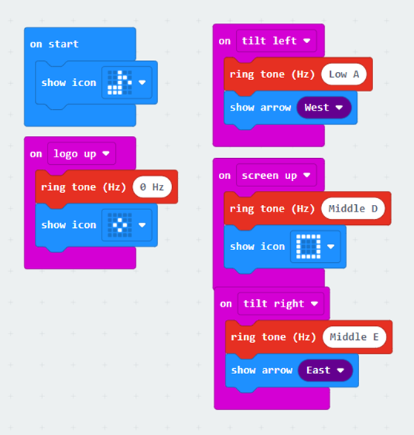
harmony:bit example program
Notes:
This can be used to generate 3 notes that naturally belong together in a musical piece; often this is called the '3 chord trick'. For example A, D and E are notes that can be used for a 3-chord trick. The micro:bit cannot play more than one note at a time, so it will only play the root notes of these three chords, but that is sufficient to harmonise with. The program uses gesture control so the micro:bit could be attached to a glove, shoe or hat.
To open this program:
1. Open https://makecode.microbit.org in a new browser window.
2. Click on ‘import’ and select ‘import file’. Then choose the HEX file to upload.
3. Or, drag the HEX file from your computer into the edit window or project homepage.
https://support.microbit.org/support/solutions/articles/19000065686
Versions of this program are provided for both Windows and Mac operating systems.

Slide 13
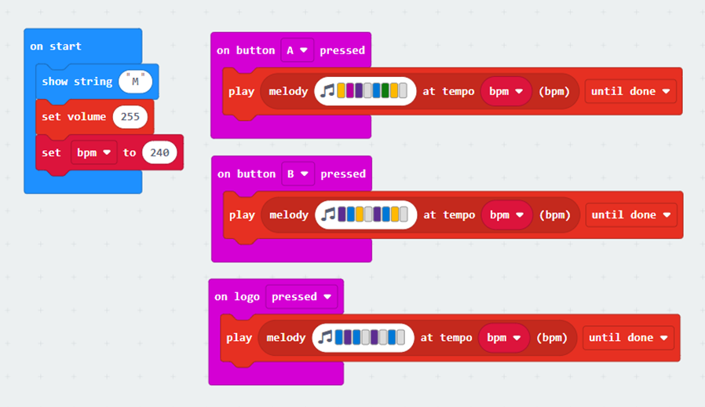
melody:bit example program
Notes:
This plays different programmed parts in a multi-bar musical piece, usually called part A, part B, and optionally part C. Different combinations of parts A B and C give different song structures. In this code, learners write their own 2 or 3 musical bar parts, and can then perform them in different orderings. In this example, button A plays part A, button B plays part B, and logo touch plays part C. The parts play once, to completion, when triggered.
There are a number of ways to build the parts of the melody – teachers could provide samples of the musical parts and get students to enter them, or they could describe some music theory and let them design their own; or a musically trained teacher would know how to compose simple pieces (opportunity to link with music lessons). The music grid is used as it is very visual and learners at this level will find it easy to use, although in this instance learners are limited to the key of C and a set 8/8 time signature. It does however provide a good starting point which can be expanded upon as desired.
If the limitation of being ‘stuck’ with the key of C needs to be escaped, teachers could get learners to use the Play Note blocks instead. They can then instruct them as to which notes appear in which key signature, and they can then compose or transcribe music in any key.
To open this program:
1. Open https://makecode.microbit.org in a new browser window.
2. Click on ‘import’ and select ‘import file’. Then choose the HEX file to upload.
3. Or, drag the HEX file from your computer into the edit window or project homepage.
https://support.microbit.org/support/solutions/articles/19000065686
Versions of this program are provided for both Windows and Mac operating systems.

Slide 14
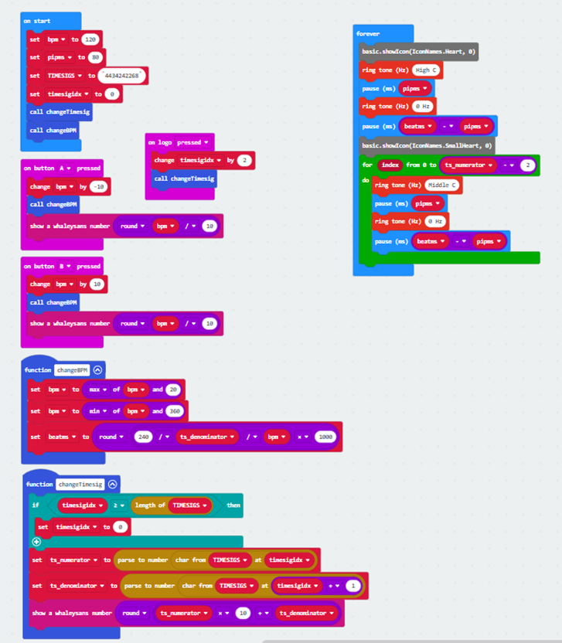
metronome:bit example program
Notes:
The metronome is provided code, and allows teachers to 'synchronise’ the playing of multiple instruments to a common beat. It starts at 120 beats per minute and a 4/4 time signature, which are the most common settings for that age group. It plays a high 'pip' on the beat at the start of the bar, and a low 'boop' for other beats in the bar, helping students to keep in sync with the beat and the bar structure of a performance. On the first beat of the bar, the metronome:bit shows a large heart icon, and on the other beats in a bar it shows a small heart icon. Thus there is also a visual clue for students as to when the bar starts.
The teacher can speed up or slow down the bpm, button A slows it down by 10 and button B speeds it up by 10. The display will show the first 2 digits of the bpm whenever you change it (so 120 displays as 12 and 60 displays as 06). The range of bpm is set as 20bpm and 360bpm.
The teacher can change the time signature of the metronome, which is especially useful if the class is trying to practice or perform an existing written piece of music notation with a specific time signature. Pressing the logo changes to the next time signature – this is important because the beat length and the number of beats in the bar is dictated by the time signature, and the 'pip' and 'boop' pattern will be created according to the selected time signature. So, while 4/4 an 2/2 are mathematically the same figure, musically they have a different sound (4/4 covers most traditional music, 2/2 is like a swing beat). The time signatures programmed are, in this order: 4/4 3/4 2/4 2/2 6/8, and when you get to the end and press the logo again it cycles back to 4/4. Each touch of the logo shows the time signature as a 2-digit number on the display.
Pressing the RESET button at the back will restore the metronome to 120bpm 4/4 time. Teachers could add new time signatures themselves by adding a pair of digits to the end of the TIMESIGS constant in the OnStart block, but note that single-digit numerators and denominators are only supported.
If showing this code to learners, use the actual program provided and zoom in on the different parts so they are clear for learners to see.
To open this program:
1. Open https://makecode.microbit.org in a new browser window.
2. Click on ‘import’ and select ‘import file’. Then choose the HEX file to upload.
3. Or, drag the HEX file from your computer into the edit window or project homepage.
https://support.microbit.org/support/solutions/articles/19000065686
Versions of this program are provided for both Windows and Mac operating systems.

