Slide 1
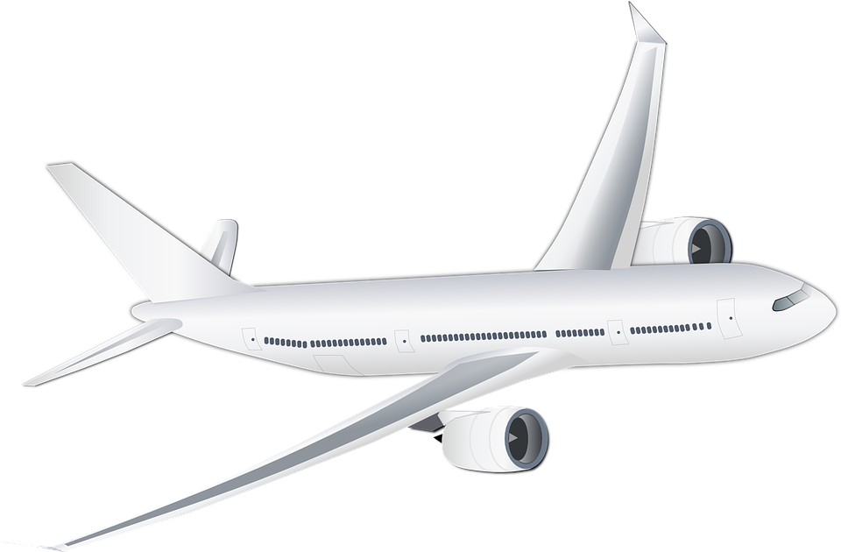
Design a sustainable aircraft

Slide 2
Stay safe Whether you are a scientist researching a new medicine or an engineer solving climate change, safety always comes first. An adult must always be around and supervising when doing this activity. You are responsible for: • ensuring that any equipment used for this activity is in good working condition • behaving sensibly and following any safety instructions so as not to hurt or injure yourself or others Please note that in the absence of any negligence or other breach of duty by us, this activity is carried out at your own risk. It is important to take extra care at the stages marked with this symbol: ⚠

Slide 3
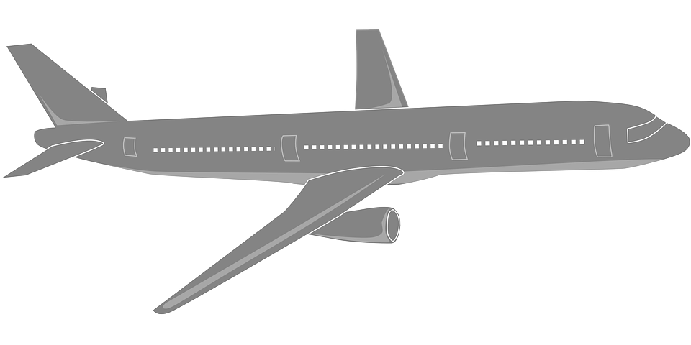
Design brief
Situation
Petrochemicals are likely to become more scarce in the future as the world’s oil resources are used up. This will affect the design of aircraft and how they are powered.
Brief
Design a passenger aircraft that could operate without the use of petrochemicals.
Notes:
Discuss the brief and design criteria with learners.

Slide 4
Design criteria
The aircraft must:
Use a sustainable alternative to petrochemicals to provide the thrust needed for flight.
Make use of appropriate new and/or modern materials.
Be aesthetically appealing.
Notes:
Discuss the brief and design criteria with learners.

Slide 5
Aircraft of the future designs
Use this space to sketch three ideas for your ‘aircraft of the future’.
Don’t forget to annotate your designs to show how they meet the design criteria!
Notes about design:
Notes:
Learners can use this sheet to present their ideas, annotations and supporting notes.

Slide 6
Final design
Select your best idea.
Produce a presentation drawing of the design that you have chosen.
Justify your choice.

