Slide 1
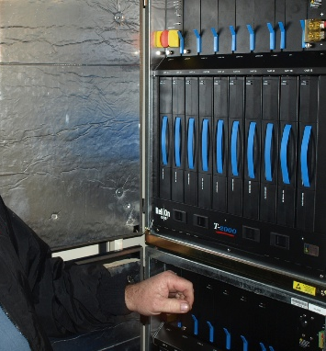
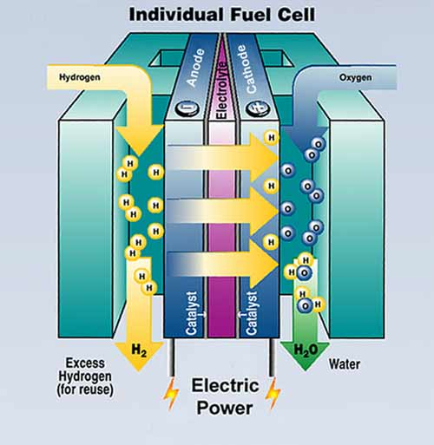
Fuel poverty calculation

Slide 2
In 2004, about 2 million households in the UK were in fuel poverty.
By 2008, an estimated 4.4 million households were in fuel poverty.
By April 2011, the number of households in fuel poverty had risen to 6.3 million. This is about 24% of all households in the UK.
The charity National Energy Action (NEA) have estimated that the total number of households in fuel poverty increased to 6.7 million in Oct 2022 and they expect it to reach 7.5 million households by April 2023.
What do you think is meant by the term
‘fuel poverty’?

Slide 3
Fuel poverty is defined as:
“when a household needs to spend
more than 10% of its income on energy,
in order to heat the house to an
acceptable standard”
The main causes of fuel poverty in the UK are:
poor energy efficiency in homes
low incomes
High fuel prices
Fuel poverty damages people’s quality of life

Slide 4
Estimated total number of UK households in fuel poverty
Numbers (millions)
Year

Slide 5
Breakdown of people living in fuel poverty by tenure
Breakdown of people living in fuel poverty by household size
Breakdown of people living in fuel poverty by youngest person in household

