Slide 1
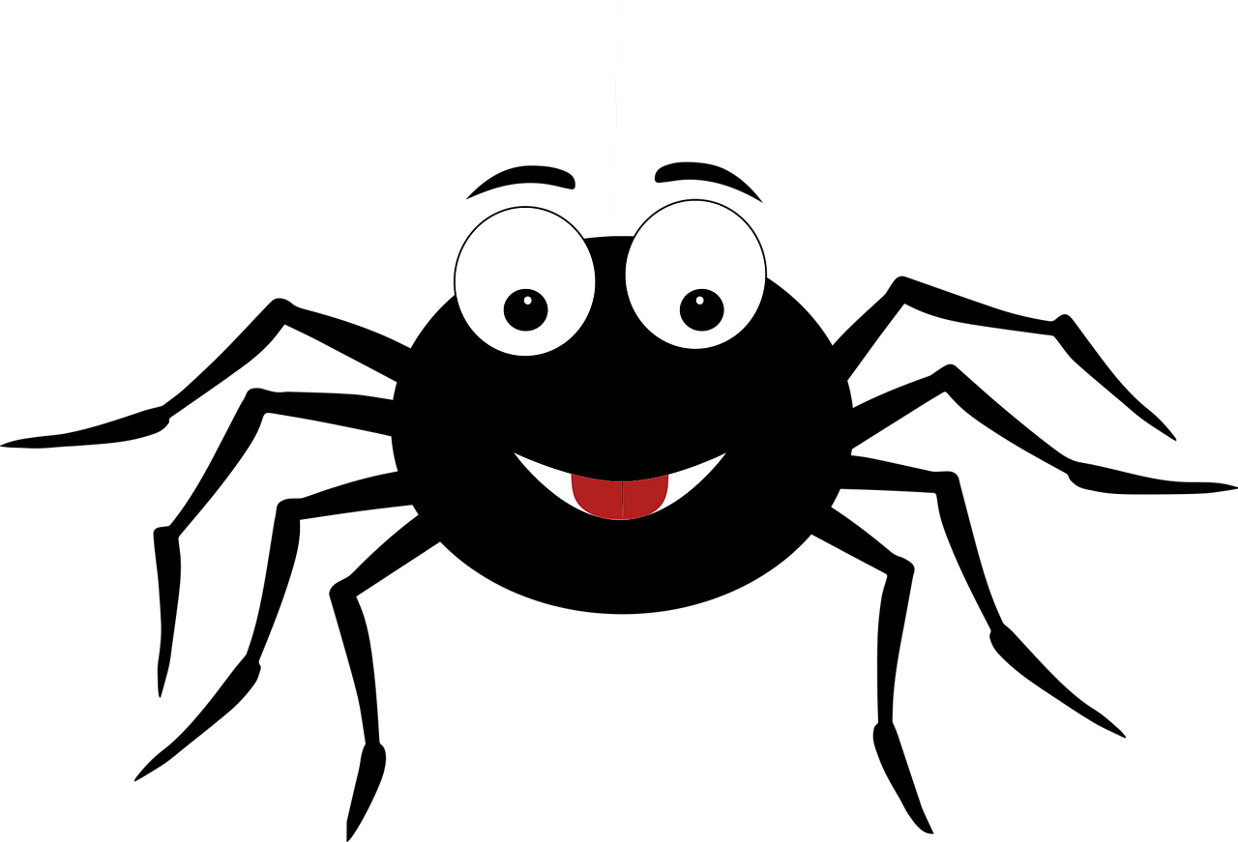
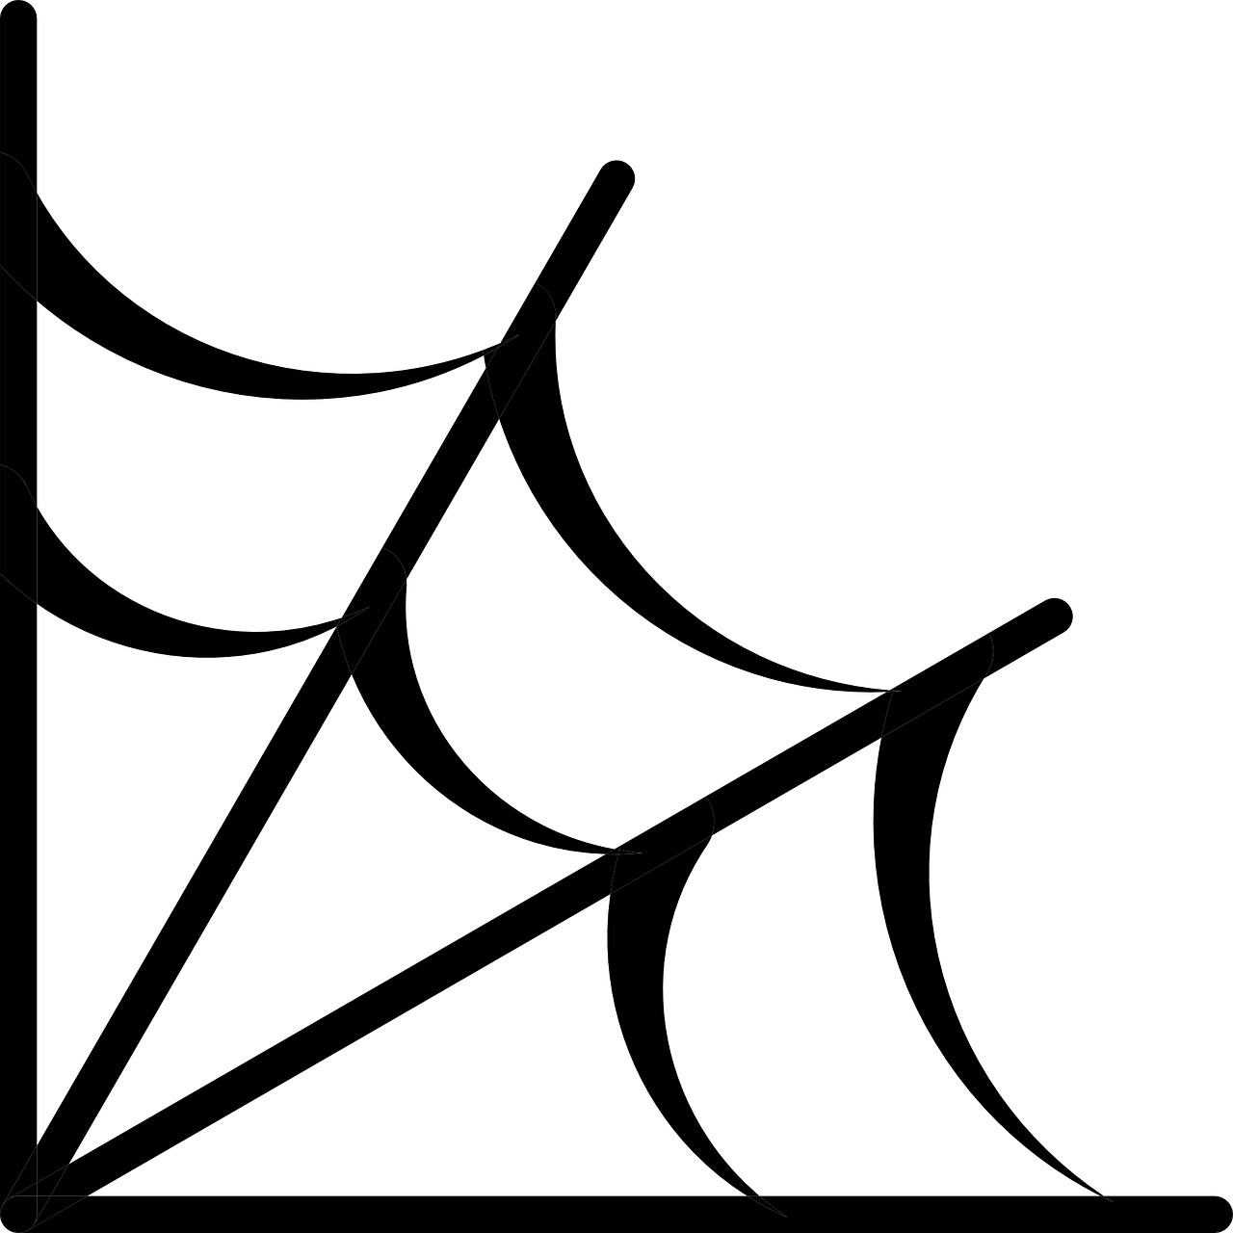
Make a spider’s web
Making an elegant trap for a spider in Halloween

Slide 2
Stay safe
Whether you are a scientist researching a new medicine or an engineer solving climate change, safety always comes first. An adult must always be around and supervising when doing this activity. You are responsible for:
ensuring that any equipment used for this activity is in good working condition
behaving sensibly and following any safety instructions so as not to hurt or injure yourself or others
Please note that in the absence of any negligence or other breach of duty by us, this activity is carried out at your own risk. It is important to take extra care at the stages marked with this symbol: ⚠
Notes:
Safety Warning

Slide 3
Where does Halloween come from?
Halloween is an old festival that dates back many centuries
First observed by the Scottish and Irish as ‘All Hallows Eve’, when it was believed the souls of the dead returned home
All Hallows Day is the 1st of November - it is a date that the Christian church uses to celebrate and honour the Saints of the church
So, All Hallows Eve is the 31st October, Halloween
Notes:
Explain the theme and origins of Halloween to learners.
Learners could be asked what they already know about Halloween and what they would like to learn about it during this activity.

Slide 4


Halloween today
Halloween was taken to the United States of America when many families moved there in the 19th Century
It was then expanded to include ‘Trick or Treat’ and dressing up
Across the world, people now decorate their houses with Halloween decorations such as pumpkin lanterns, witches’ cauldrons, bats and spiders’ webs
Notes:
Explain the theme and origins of Halloween to learners.
Learners could be asked what they already know about Halloween and what they would like to learn about it during this activity.

Slide 5
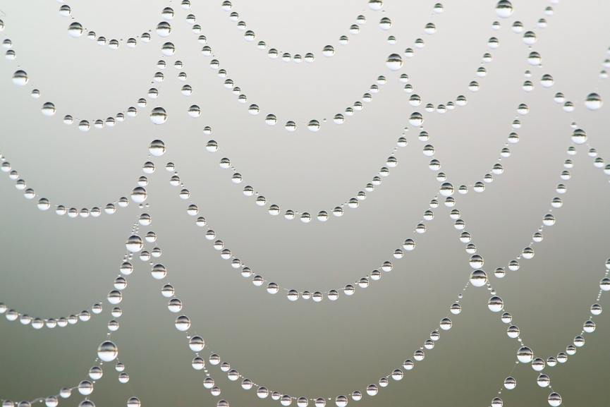
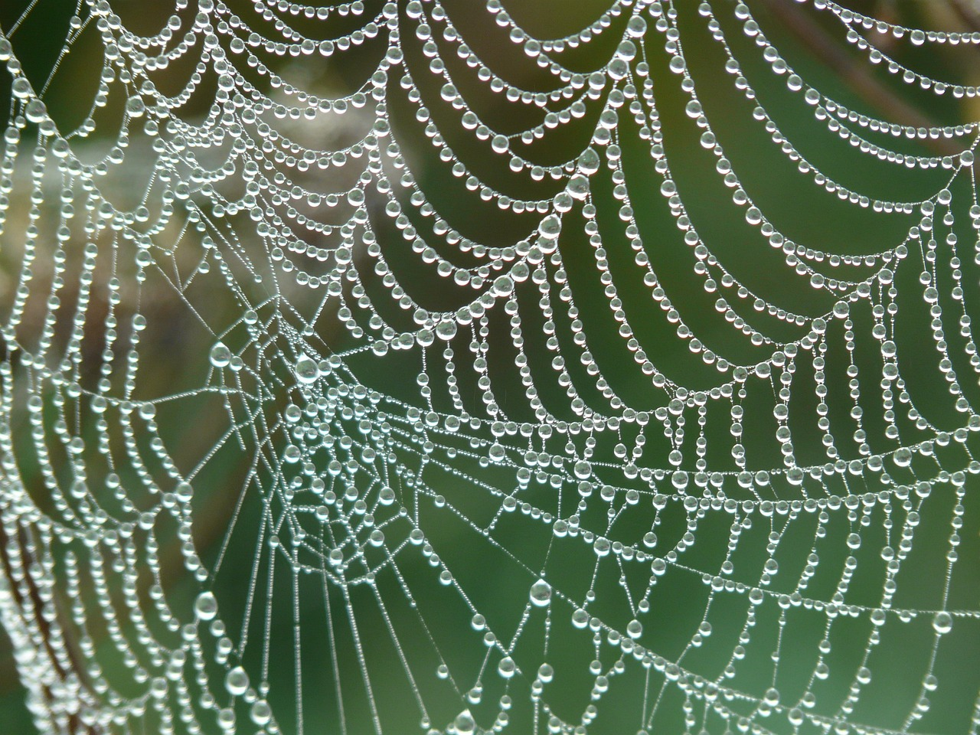
Why spiders?
Halloween is a time to pretend to be scared, and people are sometimes scared of spiders
They can appear suddenly and run across the carpet
They make webs that are sticky and hang around in a creepy way
Look at the examples of spiders’ webs on the next few slides
Notes:
Why do spiders make webs?
The next few slides show some of the work that spiders do to make their wonderful webs.
The best time to see them is in the morning, when they might have dew on them like the ones shown above.

Slide 6
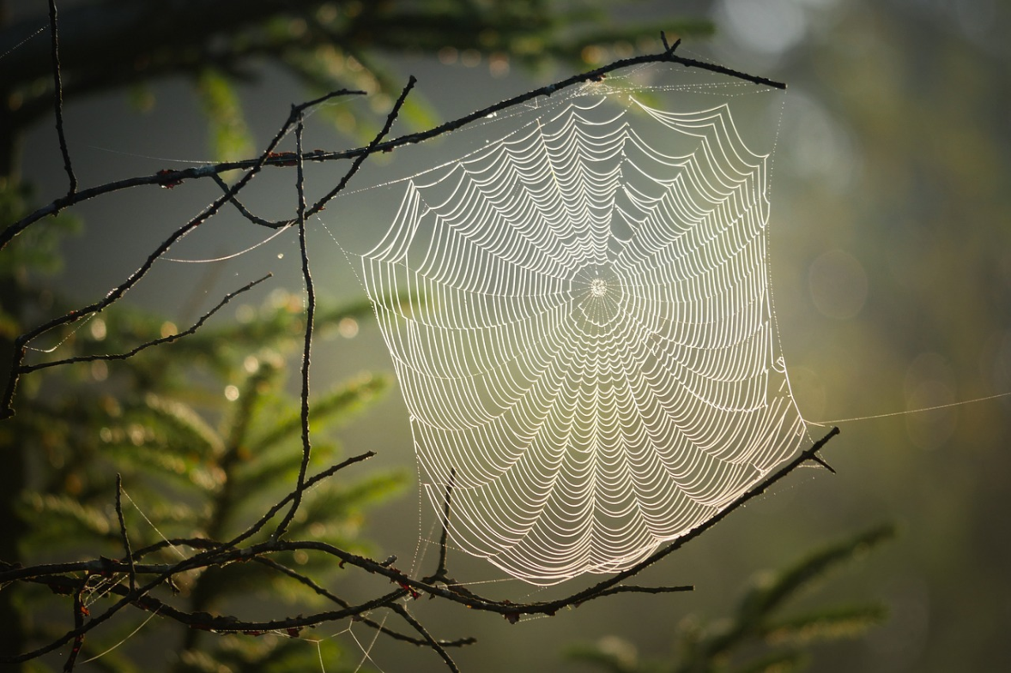

Slide 7
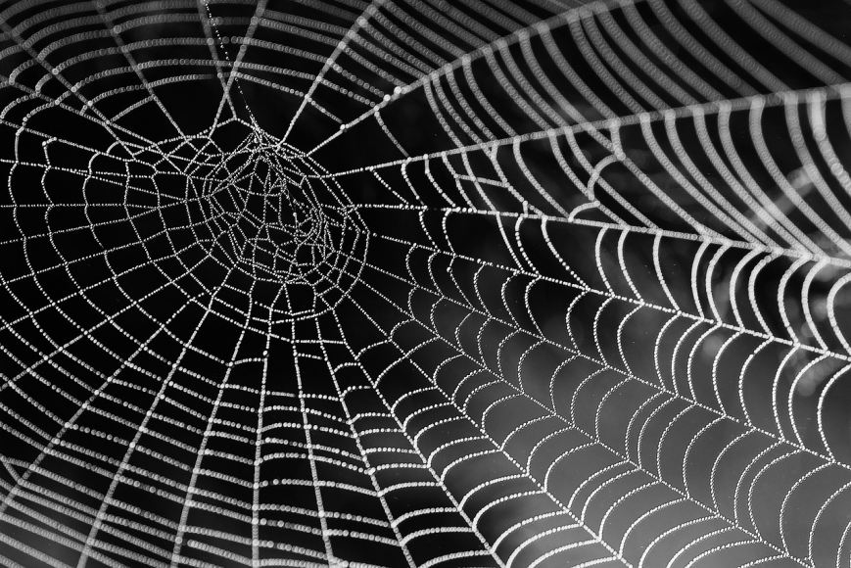
Notes:
This picture shows that the spider lays out lines or threads from the middle and then goes round and round in a spiral adding more threads

Slide 8
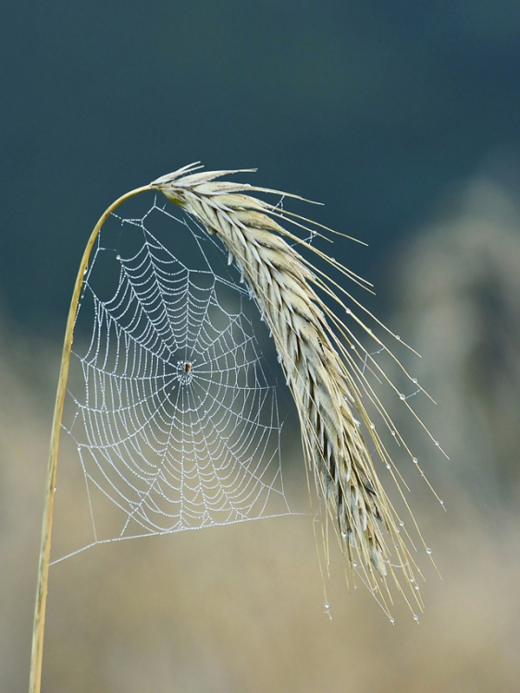
You are going to pretend to be a spider and make a web
Your task

Slide 9
Equipment and resources
⚠
String or wool
Scissors and/or craft knife
A large piece of corrugated cardboard e.g. from a box
Optional
  Spider cut-outs
  Googly eyes
  Glue gun or superglue
Notes:
Take care when using sharp objects such as a craft knife and/or scissors.
Rough textured yarn is best to use as the knots do not slip.
Spider cut out templates are given on presentation slide 21.
Corrugated cardboard is preferred due to its stiffness.

Slide 10
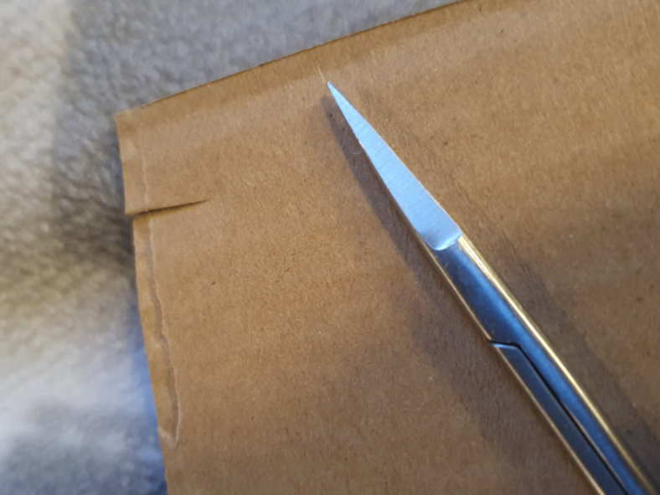

Step 1
⚠
Spiders start by making a strong fixing for their web
To do this, cut notches out of the edge of your cardboard as shown below

Slide 11
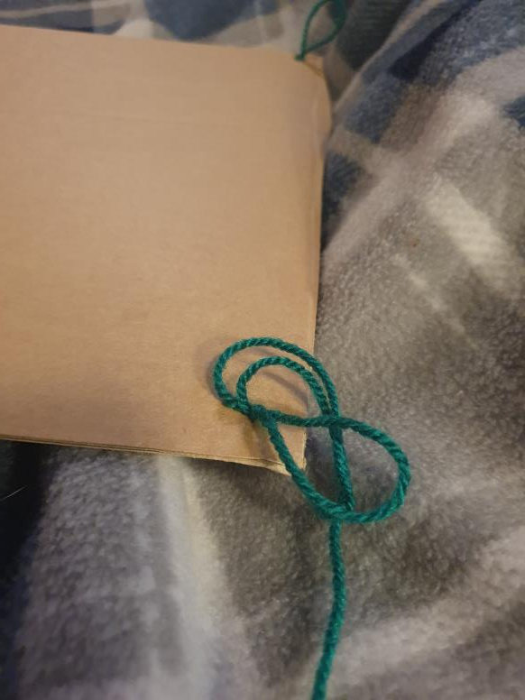
Step 2
Make a loop in the end of your thread to create a knot that will hold in the notch

Slide 12
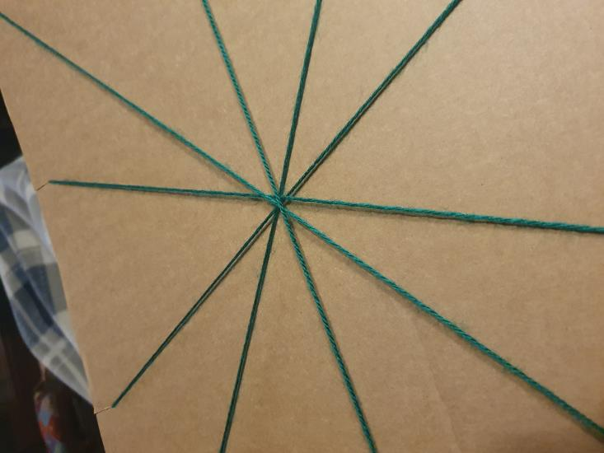
Step 3
Go backwards and forwards across the card to make a set of framework threads that cross in the middle

Slide 13
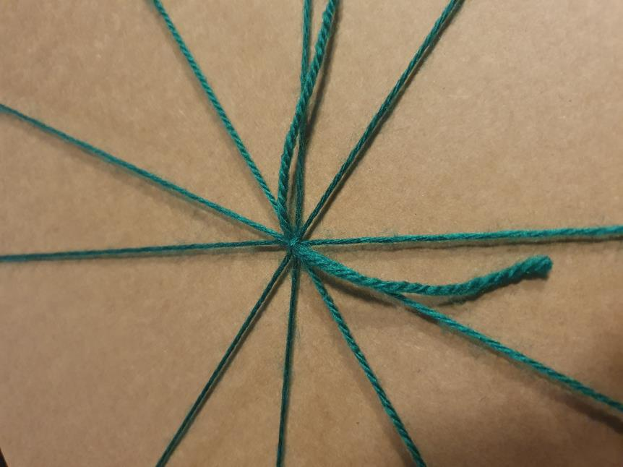
Step 4
Tie a knot with a new piece of thread, in the middle of the place where the threads cross

Slide 14
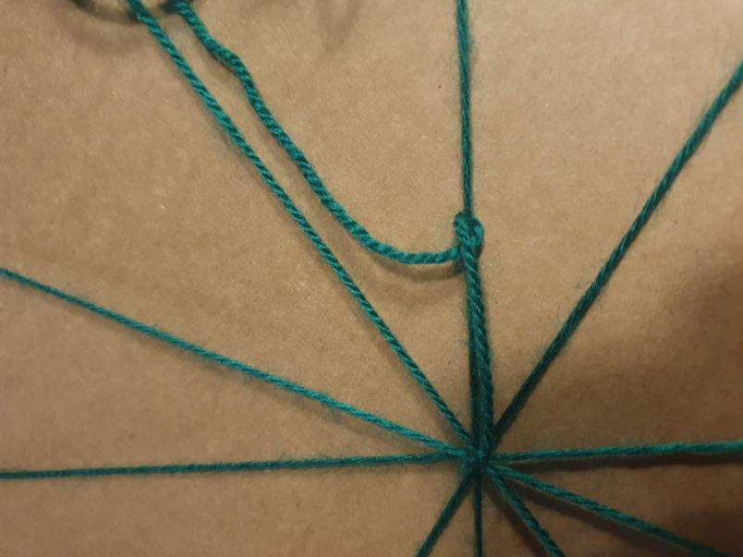
Step 5
Start working your way round the web, tying knots to keep the threads in place
How to tie the knots is shown in the next two slides

Slide 15
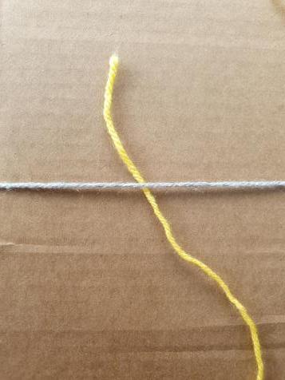
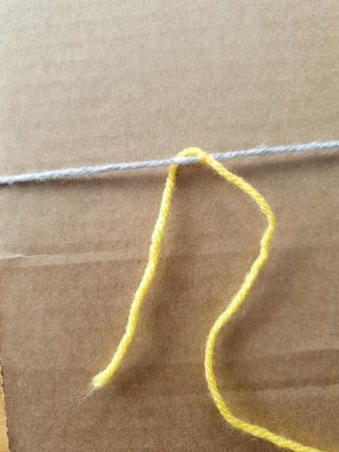
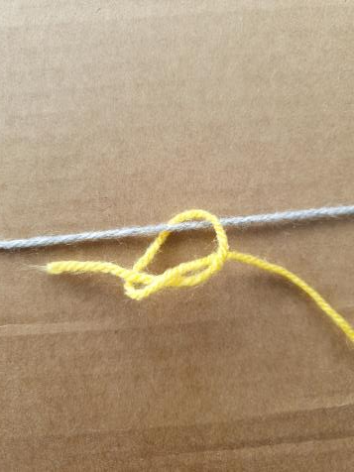
Tying the knots 1
The main threads that run out from the middle are shown here in grey and the web threads in yellow
Pass under the thread
Come back over the top
Tie a knot and pull tight

Slide 16
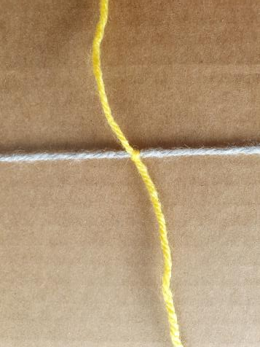
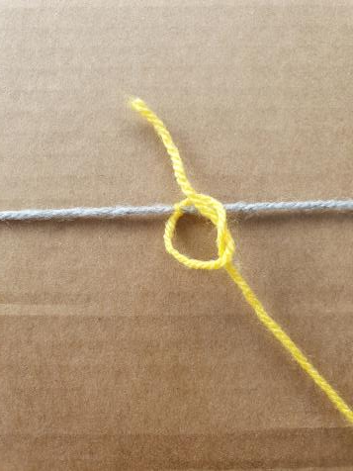
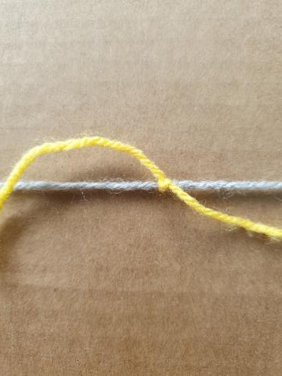
Tying the knots 2
The tight first knot
Run the thread round the other side and tie another knot
Pull tight

Slide 17
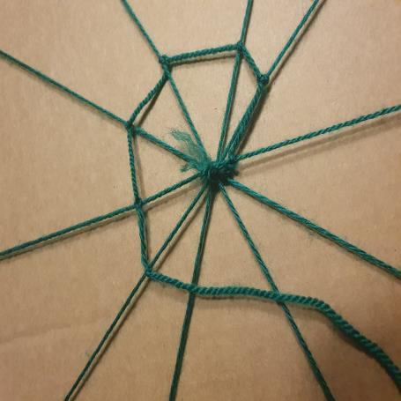
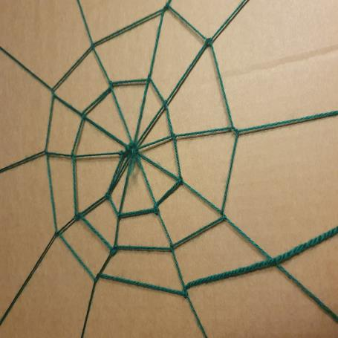
Step 6
Keep going round and round until you have made a web shape
This is just how those clever little spiders do it

Slide 18
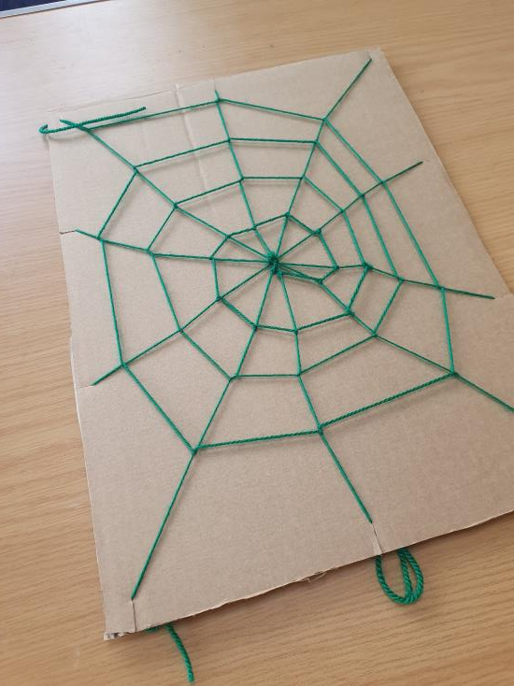
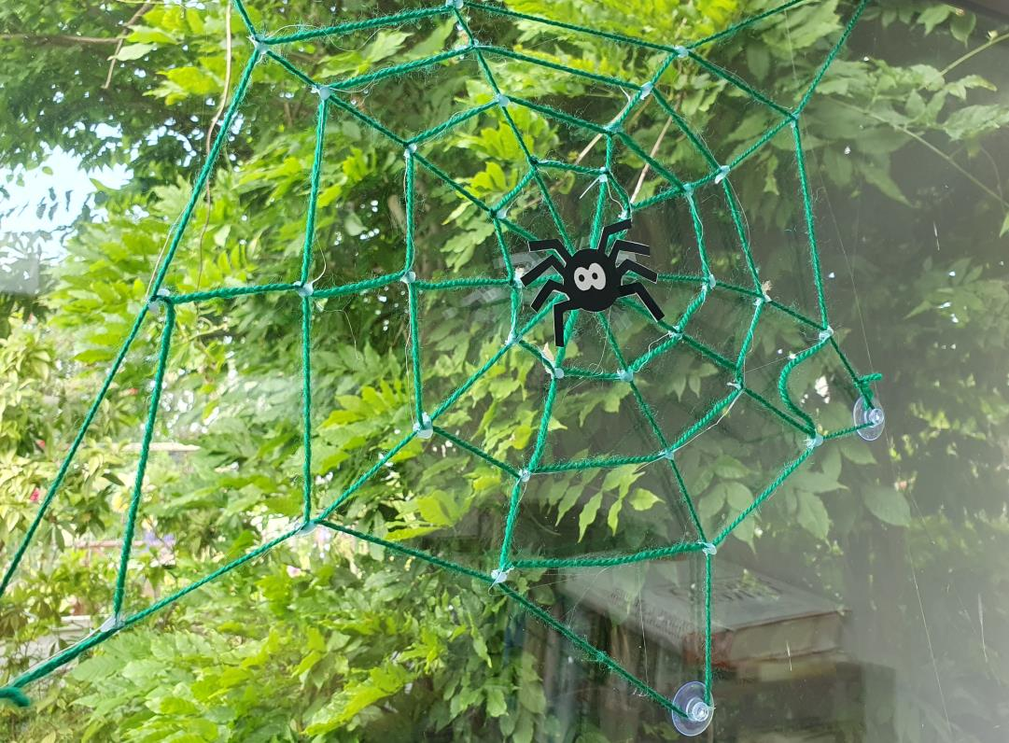
Finished Elegant Trap
This web can be used as a decoration just like this, on the card
Or you could also add a spider in the middle
Notes:
Finished example.

Slide 19


Plenary - what can we learn from spiders?
Suspension bridges are strong but light
Like spiders’ webs they reach across large gaps
Notes:
Discuss what can be learnt from how spiders make their webs. How could we use this in design and engineering?

Slide 20
Extension
The web could be made of different coloured threads, or luminous yarn on a black background
Take the web off the card and hang it up in a window
Make a large web as a group to catch your friends in
Notes:
When hanging the web, to make it more secure as a hanging decoration add a small blob of glue at each junction while it is still on the card

