Slide 1

Make a paper aeroplane launcher
Making a launching device to fly paper aeroplanes

Slide 2
Stay safe
Whether you are a scientist researching a new medicine or an engineer solving climate change, safety always comes first. An adult must always be around and supervising when doing this activity. You are responsible for:
ensuring that any equipment used for this activity is in good working condition
behaving sensibly and following any safety instructions so as not to hurt or injure yourself or others
Please note that in the absence of any negligence or other breach of duty by us, this activity is carried out at your own risk. It is important to take extra care at the stages marked with this symbol: ⚠
Notes:
Safety Warning

Slide 3
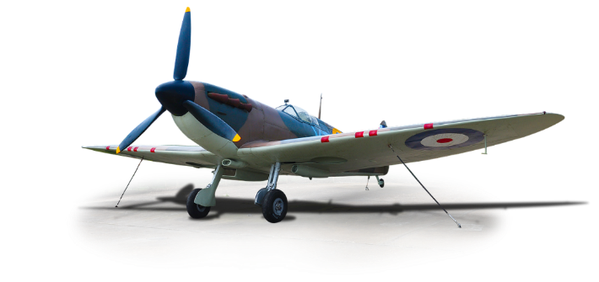
Aircraft in World War 2
The second world war happened between 1939 and 1945
Aircraft played an important part in the war, for both attack and defence
Many new designs of aircraft were developed
We are going to use the theme of flight to make a paper aeroplane and launcher
Notes:
The role of radio during the war: https://www.bbc.co.uk/bitesize/guides/zwscng8/revision/2
FM radio: https://en.wikipedia.org/wiki/FM_broadcasting

Slide 4

Equipment and Resources
⚠
Thick paper or card
Scissors
Pencil
Ruler
Elastic band
Paper clips
Tape or stapler
Notes:
Take care when using sharp objects such as a craft knife, scissors and pins.
The measurements given in these steps are based on a small 170 mm (L) x 120 (W) x 75 mm (D) shoebox – these could be adjusted for a bigger box (e.g. for a bigger window – steps 1-4).
Maths based extension: calculate the volume of the box used.
Alternative ways to make a pinhole camera/camera obscura:
https://www.youtube.com/watch?v=miuNl-O05Wo
https://www.youtube.com/watch?v=IJ2cUh0N1RI
https://www.youtube.com/watch?v=mqvwqweDk1I

Slide 5
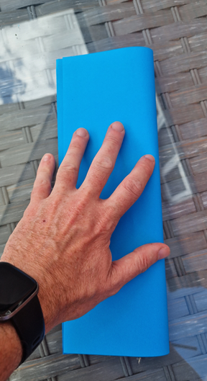
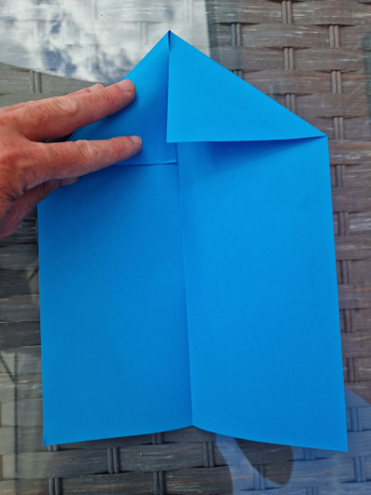
Paper aeroplane – Step 1
Place your A4 paper in portrait position
Fold in half as shown
Open up the paper and then fold both sides into the middle
Notes:
The following slides show how to make a pinhole camera.

Slide 6
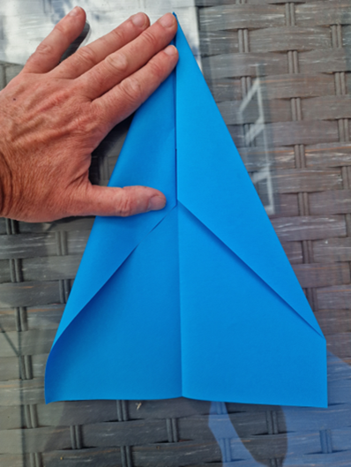
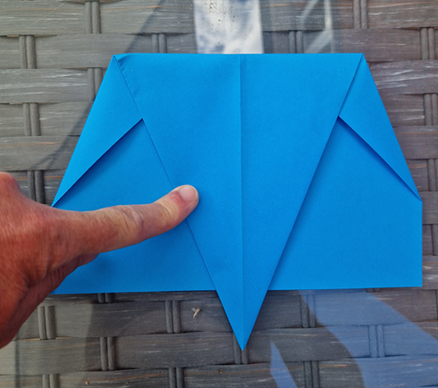
Paper aeroplane – Step 2
Next fold both sides again into the middle
Then fold point downwards as shown
Notes:
Take care when using a craft knife.
Learners may need assistance with this stage.

Slide 7
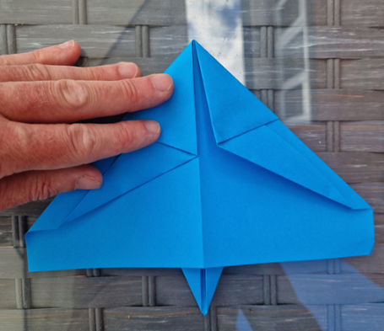
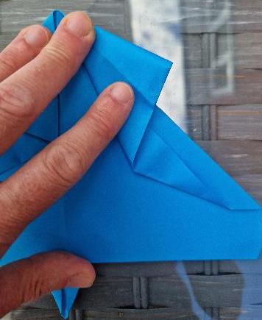
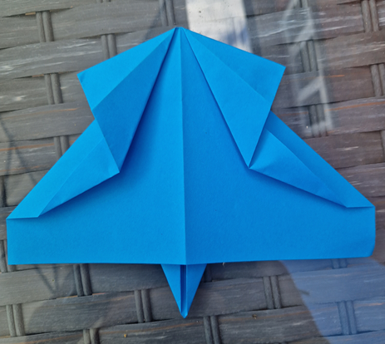
Paper aeroplane – Step 3
Turn paper over and fold again into centre
Fiddly bit – now open the flaps to form second picture
Notes:
Take care when using scissors.
Teacher could discuss sustainability issues when cutting to avoid wasting wax paper.

Slide 8
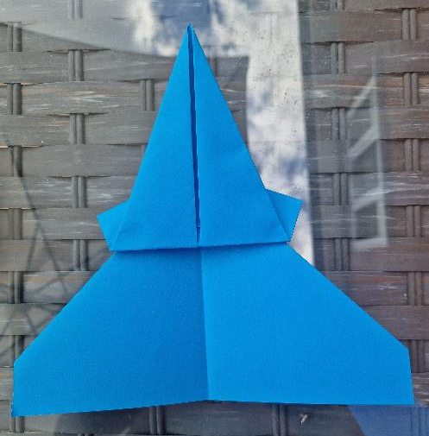
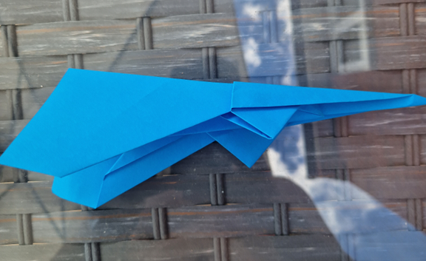
Paper aeroplane – Step 4
Turn it over again and fold the pointed end upwards to the line shown here
Fold in half inwards again
Notes:
Take care when using scissors.
This creates the camera screen.

Slide 9
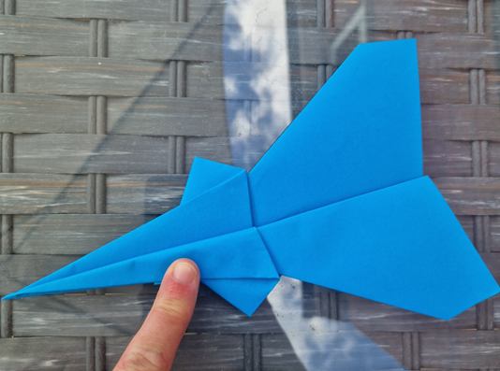
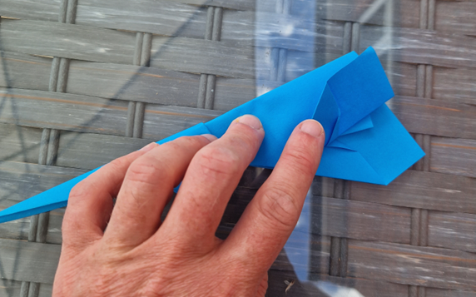
Paper aeroplane – Step 5
Fold wing inwards, turn paper over and repeat second side
Your plane is almost complete – fold the wing tips to give it some stability

Slide 10
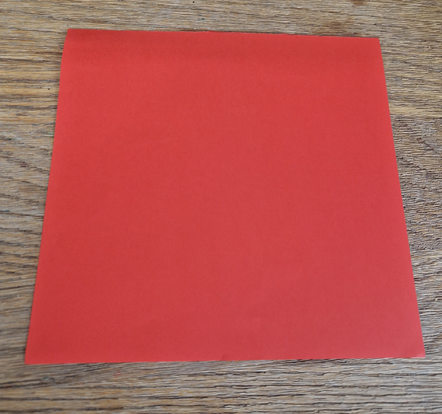
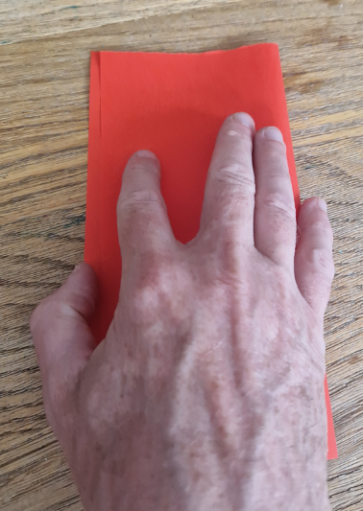
The launcher – Step 1
Cut a piece of A4 paper or card to 20cm x 20cm
Then fold in half
Notes:
Take care when using the pin to make the hole as it will be sharp.
This creates the lens for the front of the camera.

Slide 11
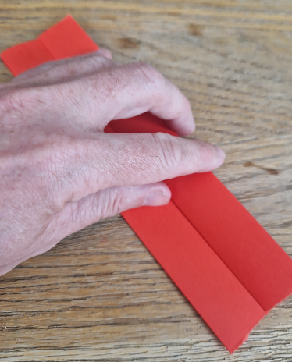
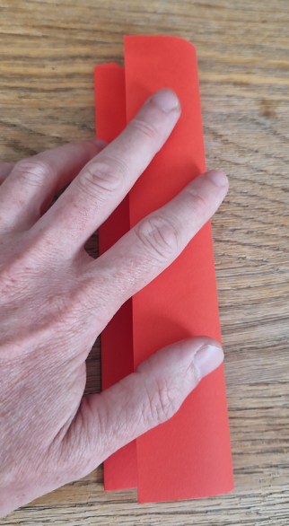
The launcher – Step 2
Now fold one half back on itself
Repeat on other side

Slide 12
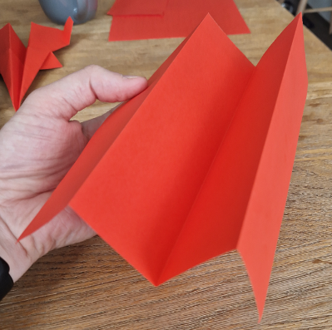
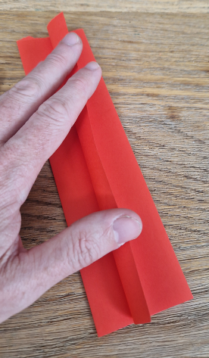
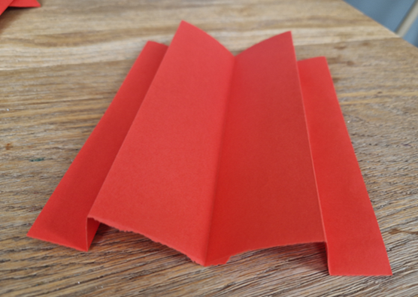
The launcher – Step 3
Open out to ensure you have it right
Then fold edge up on both sides
Notes:
Explain that the pinhole acts as a tiny camera lens. This allows the light to enter the shoebox which is then focussed and projected onto the screen, creating an inverted image.
Do not look directly into a light source.
Demonstrate the camera working to partner or classmate.

Slide 13
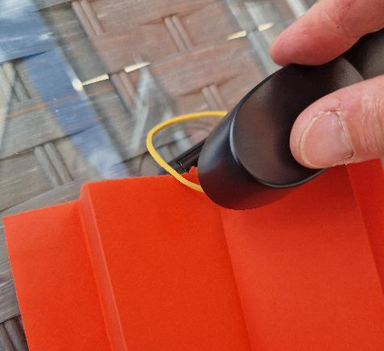
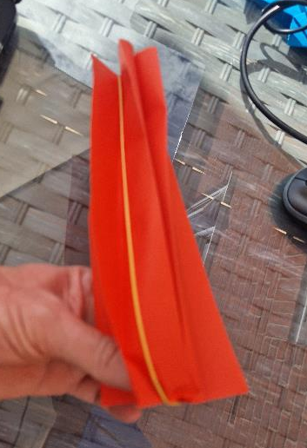
The launcher – Step 4
Staple your elastic band to inside bottom corner as shown here
Loop it over the launcher so it is around the back edge here
Notes:
Explain that the pinhole acts as a tiny camera lens. This allows the light to enter the shoebox which is then focussed and projected onto the screen, creating an inverted image.
Do not look directly into a light source.
Demonstrate the camera working to partner or classmate.

Slide 14
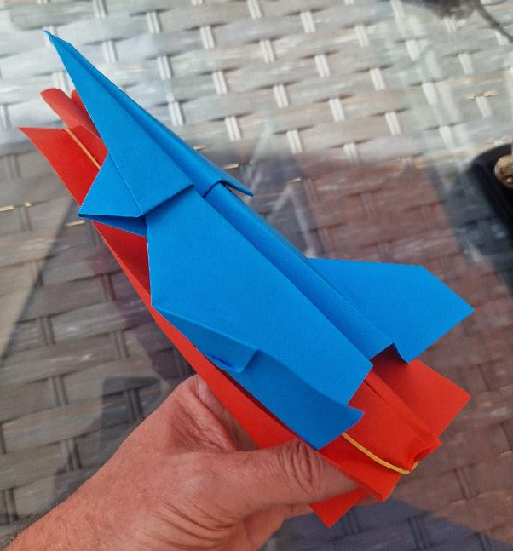
The launcher
Put your plane on the launcher facing the staple end
Pull apart the sides of the launcher to send the plane soaring!
Notes:
Explain that the pinhole acts as a tiny camera lens. This allows the light to enter the shoebox which is then focussed and projected onto the screen, creating an inverted image.
Do not look directly into a light source.
Demonstrate the camera working to partner or classmate.

Slide 15

Extension
Add decoration such as camouflage to your launcher
What happens if you use a shorter or longer elastic band?
Could you improve this launching device using other materials?

