Slide 1
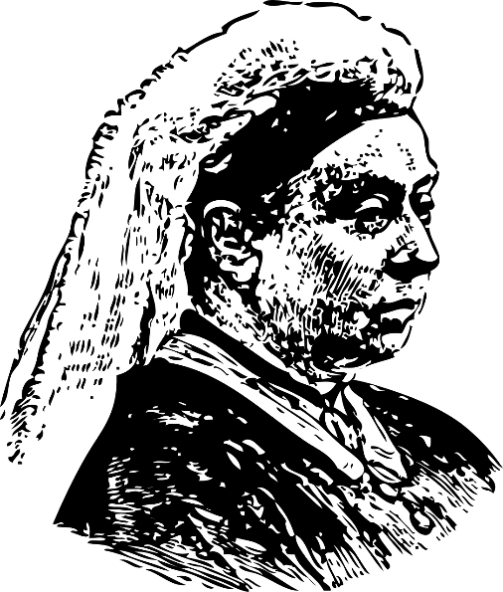
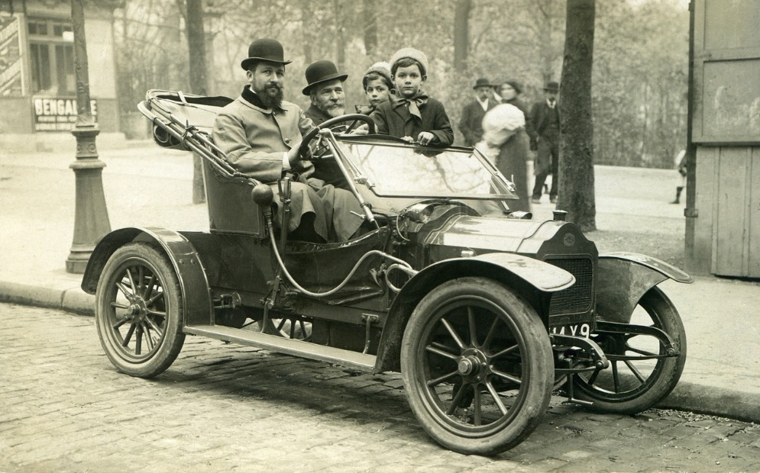
Victorian Engineering Research
Using the internet to research engineering inventions that were made during the Victorian era
Notes:
This activity would work well as a starter or lead in activity to ‘Making a Pinhole Camera’.

Slide 2
Stay safe
Whether you are a scientist researching a new medicine or an engineer solving climate change, safety always comes first. An adult must always be around and supervising when doing this activity. You are responsible for:
ensuring that any equipment used for this activity is in good working condition
behaving sensibly and following any safety instructions so as not to hurt or injure yourself or others
Please note that in the absence of any negligence or other breach of duty by us, this activity is carried out at your own risk. It is important to take extra care at the stages marked with this symbol: ⚠
Notes:
Safety Warning

Slide 3
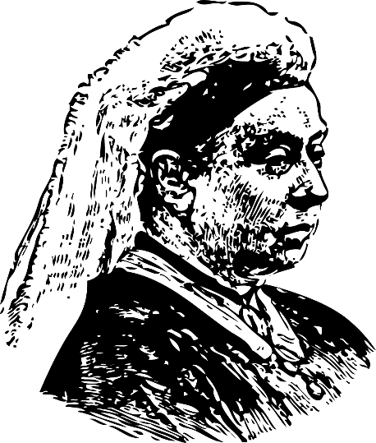
The Victorians
The Victorian age was a period in time in the United Kingdom where Queen Victoria reigned
This was between June 1837 and January 1901
There were huge changes to how people lived and worked during this period
In this activity you will learn about the different technologies used and invented by the Victorians!
Notes:
Explain the theme of the Victorians to learners.
Teacher could ask learners to write down five things that that they already know about the Victorians and/or the Victorian era.
The Victorian era is sometimes also defined as being between around 1820 and 1914, based on the defining characteristics of society at the time, rather than the exact dates of Queen Victoria’s reign as monarch. Either definition, or a mixture of the two, is historically accurate to use.

Slide 4
Victorian Engineering Research
Technology and engineering moved a long way forward during the Victorian era
This included many inventions that we take for granted today:
Motor cars
Light bulbs
Photographs
Telephones
Radio
Research one engineering invention that was made during the Victorian era and present what you find out to the class
Notes:
Learners could use the internet to complete their research.
Learners could consider areas such as who invented the technology, when it was invented and how it affected society.
Learners could select one invention from the list, or this could be assigned by the teacher to ensure good overall class coverage.
Teacher could set a maximum length for the presentation e.g. 10 minutes or 5 slides.
Learners could work in small groups or as individuals. One good way of doing this is where they complete their research independently, then form small groups and combine what they have found and create a group presentation.

Slide 5
To include in the presentation:
The name of the invention
A picture of the invention
Who invented it and when
A summary of what it does/how it works
How it has impacted on engineering or society today
Notes:
Learners could be given additional time to practice their presentation before speaking to the class.

Slide 6
Extension
Produce a class display of different technological inventions that took place during the Victorian era
How have they influenced technology today?

