Slide 1
Simple Circuits

Slide 2
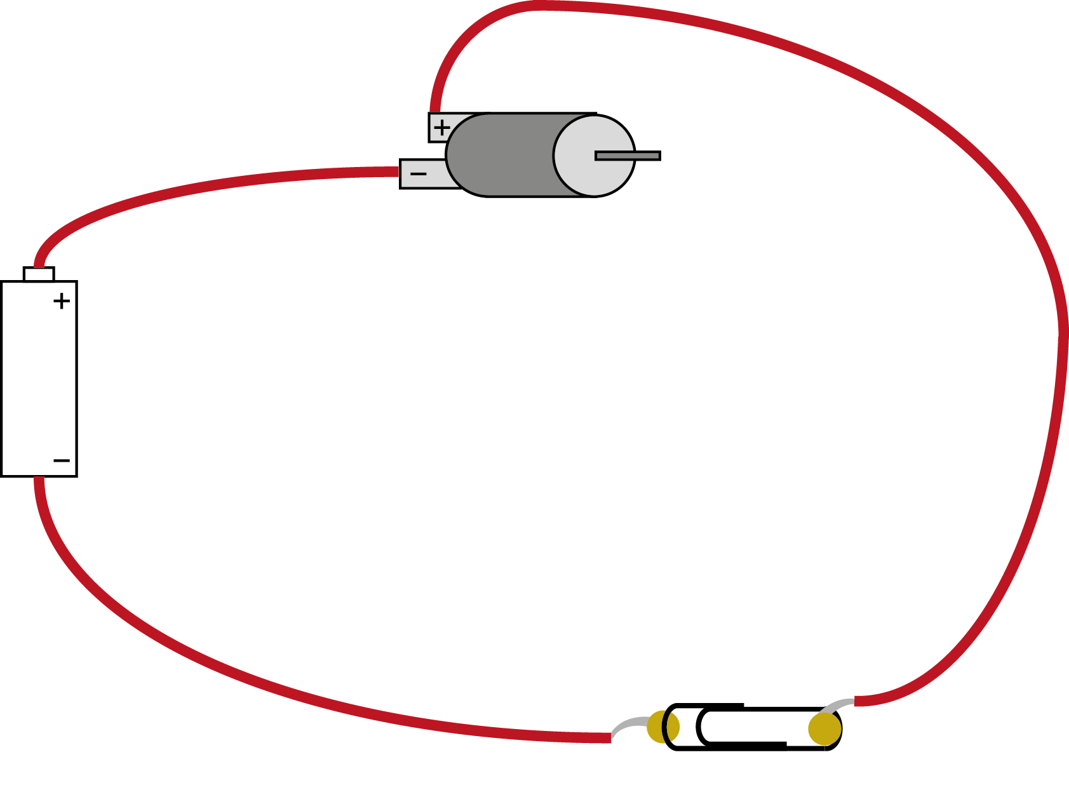
We are going to make this circuit…
motor
wire
battery
(in holder)
switch

Slide 3
You Will Need:
1 motor
1 battery pack
1 switch
3 lengths of wire

Slide 4
Preparing the wires to make the circuit
Stripped end of wire
Cut the wire to the length needed.
Using wire strippers, take off about 10 mm of plastic coating from the end.
Twist the exposed stands of wire to join them together.
Twist wire this way
wire

Slide 5
Joining two wires together
Twist the exposed wires together
wire
wire
Using wire strippers, take off about 10 mm of plastic coating from the end of each wire.
Twist the exposed stands of wire to join them together.
Wrap sticky tape around the joint.

Slide 6
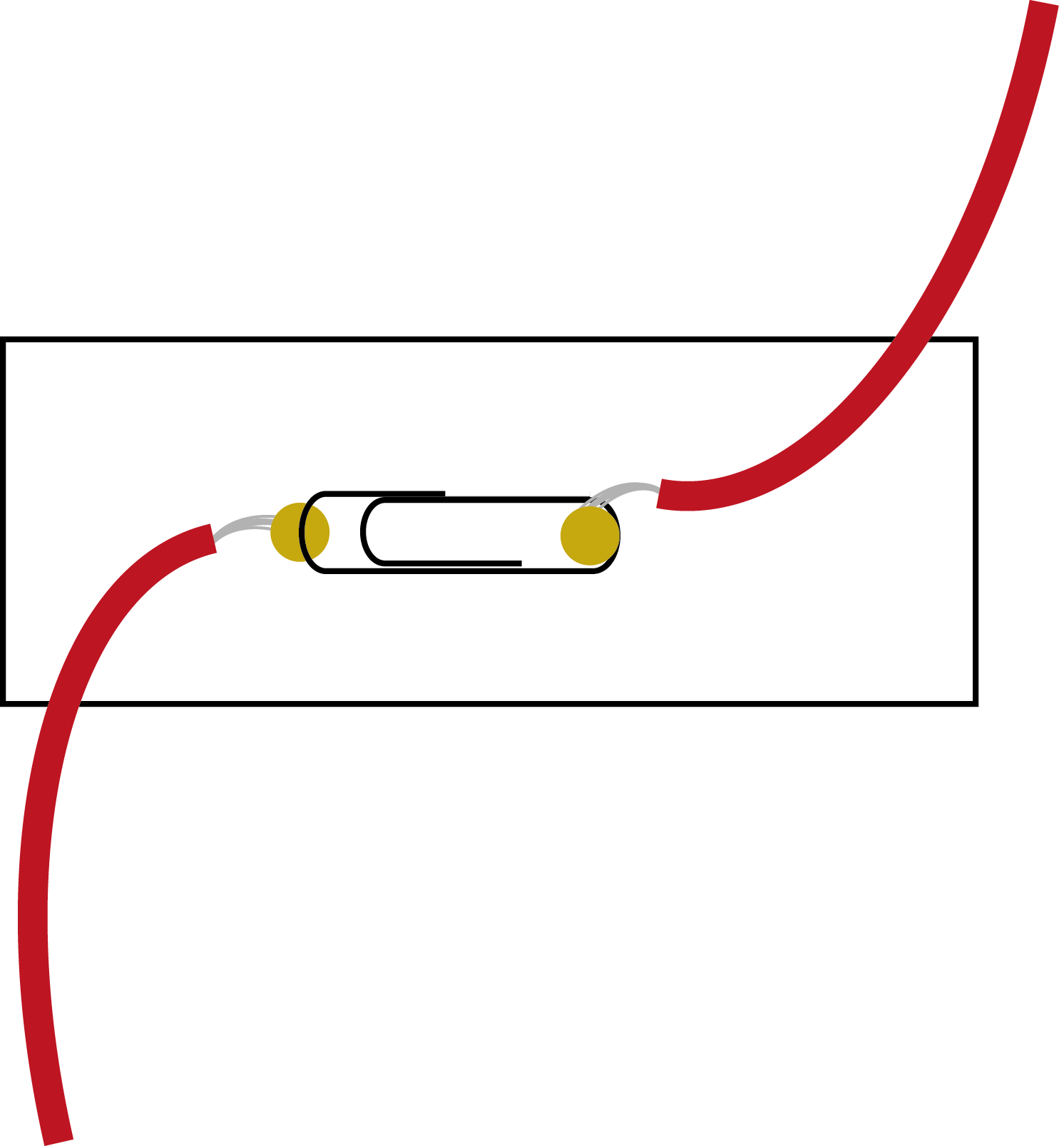
Making a switch from a paper clip
wire
Push two metal fasteners through a piece of card.
Wrap a wire around the back of each metal fastener.
Slide a paper clip under one of the fasteners, on the top side.
If you move the paper clip round so it touches the other fastener, it completes the circuit.
stud
paper clip
stud
wire

Slide 7
The completed circuit…
motor
wire
battery
(in holder)
switch

