Slide 1
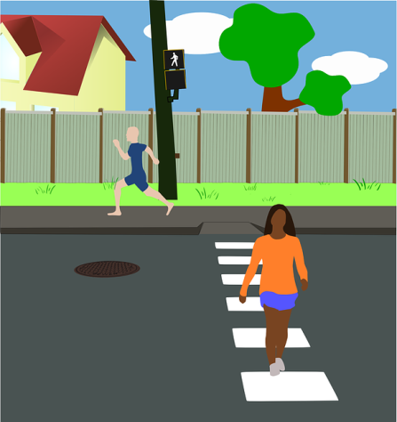
Let’s Cross Safely! micro:bit Pedestrian Control
Product Prototype

Slide 2
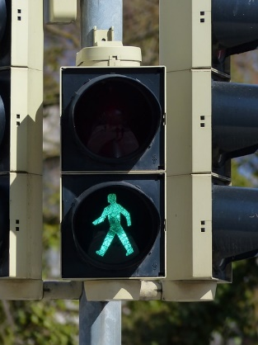
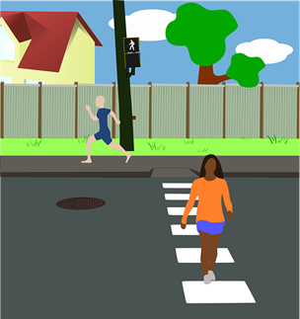
Design Brief
Situation
Hundreds of people are killed in accidents on roads in the United Kingdom every year. When schools are situated close to roads there is particular danger to children crossing them. A good, well programmed pedestrian control system can minimise risk and enable people to cross the road safely.
Brief
Create a scale model and working prototype for a pedestrian crossing system for a school. Your prototype should make use of the micro:bit system. It should clearly show how it would enable pupils to cross the road outside their school safely.
Notes:
Share this brief with the students and discuss as a class.

Slide 3
Design Criteria
The proposed prototype must:
Successfully integrate the micro:bit based programmable system into the product.
Stop traffic when a button is pressed by a pedestrian.
Inform pedestrians when it is safe to cross the road.
Allow pedestrians an appropriate time to cross the road.
Include a scale model of the crossing that shows how the system would allow people to cross the road safely.

Slide 4
Pre-Written Program
Go to www.microbit.org/code and open the JavaScript Blocks Editor.
Drag the file microbit-pedestrian-jsb.hex onto the work area.
Download the program onto your BBC micro:bit.
Notes:
This program can be downloaded onto the BBC micro:bit by the learners or in advance by the teacher or technician.

Slide 5
Pre-Written Program
Go to www.microbit.org/code and open the Python Editor.
Drag the file transport.py onto the work area.
Download the program onto your BBC micro:bit.
Notes:
This program can be downloaded onto the BBC micro:bit by the learners or in advance by the teacher or technician.

