Slide 1
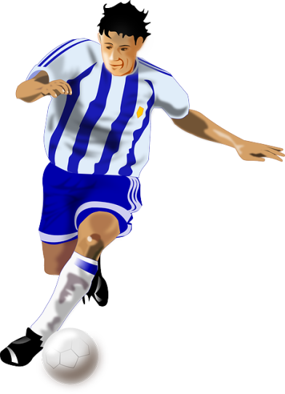
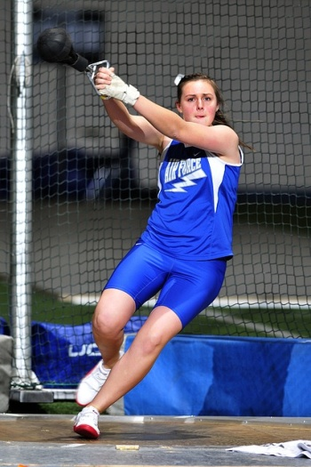
Sports Technology - micro:bit Beep Tester
Manufacturing the Product – Vacuum Forming

Slide 2
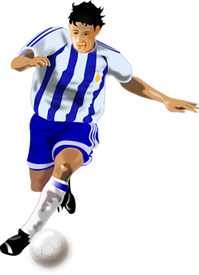
Design Brief
Situation
Technology can be used in sports to enhance performance and help participants to improve their fitness and stamina. For example, automated beep tests can be used to monitor fitness levels during training sessions, and set targets for future improvement.
Brief
Create a portable ‘beep tester’ for sports people to use when they are training. The tester should be suitable for outdoor use and weather resistant. It should integrate the micro:bit programmable system.
Notes:
Share this brief with the students and discuss as a class.

Slide 3
Design Criteria
The proposed product prototype must:
Successfully integrate the micro:bit based programmable system.
Be suitable for use by sports people when they are training.
Be durable and weather resistant (suitable for outdoor use).
Be small, light and portable (easy to carry).
Fit easily inside a pocket or have some way of attaching it to sportswear.
Be aesthetically pleasing to the user.

Slide 4
Pre-Written Program
Go to www.microbit.org/code and open the JavaScript Blocks Editor.
Drag the file microbit-beeptest-jsb.hex onto the work area.
Download the program onto your BBC micro:bit.
Notes:
This program can be downloaded onto the BBC micro:bit by the learners or in advance by the teacher or technician. The program will provide a ‘beep’ that sounds at decreasing time intervals. A beeper or buzzer will need to be connected to pin 0. Button A begins the beep test.

Slide 5
Pre-Written Program
Go to www.microbit.org/code and open the Python Editor.
Drag the file beeptest.py onto the work area.
Download the program onto your BBC micro:bit.
Notes:
This program can be downloaded onto the BBC micro:bit by the learners or in advance by the teacher or technician. The program will provide a ‘beep’ that sounds at decreasing time intervals. A beeper or buzzer will need to be connected to pin 0. Button A begins the beep test.

