Slide 1
'How's the Service, micro:bit?’ Information Device for London Underground Travellers
Programming the System

Slide 2
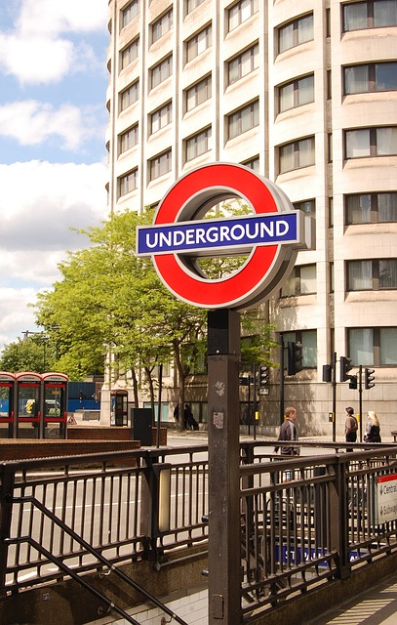
Design Brief
Situation
The London Underground is one of the busiest public transport systems in the world. It is used for over 1.2 billon journeys a year. Passengers need up to date information when using it so that they can plan their journeys well.
Brief
Using the micro:bit, create a prototype for a travel information system that could be used by passengers on the Underground. The system must provide both service (how well the network is running) and timetable information when different buttons are pressed.
Notes:
Share this brief with the students if not already done from the starter activity.

Slide 3
Systems Diagram
INPUT
PROCESS
OUTPUT
Button 1
Processor
LED Display
Press
Information messages
Button 2
A systems or block diagram shows the layout of the system to be created. The blocks represent sub-systems and the arrows represent signals.
Press
Notes:
A block or systems diagram shows a possible basic layout of the system. Teachers could get students to develop their own systems diagram, using this as an example.

Slide 4
Design Criteria
The proposed system must:
Be programmable using the micro:bit.
Give information on how well the service is running when the Button A is pressed.
Give timetable information, such as train times and destinations when Button B is pressed.
Use the micro:bit’s inbuilt LED display to show the required information to the passenger using it.

Slide 5
Time to Develop your Program!
Your device must be programmed.
Your program must meet the needs of the design brief and the design criteria.
You can program your BBC micro:bit using either the JavaScript Blocks Editor or Python Editor.
An example program written in each has been given to help get you started.
Go to www.microbit.org/code to begin!

Slide 6
Example Program – JavaScript Blocks Editor
Go to www.microbit.org/code and open the JavaScript Blocks Editor.
Drag the file microbit-transport-jsb.hex onto the work area.
Test it, download it and experiment with how it works!
Notes:
Share this example program with learners to help them. Lower ability learners or those lacking programming confidence could start by writing or experimenting with this program first. They could then adapt and develop it. A PDF handout showing the program is available and can be handed out to learners.

Slide 7
Example Program – Python Editor
Go to www.microbit.org/code and open the Python Editor.
Drag the file transport.py onto the work area.
Test it, download it and experiment with how it works!
Notes:
Share this example program with learners to help them. Lower ability learners or those lacking programming confidence could start by writing or experimenting with this program first. They could then adapt and develop it. A PDF handout showing the program is available and can be handed out to learners.

