Slide 1
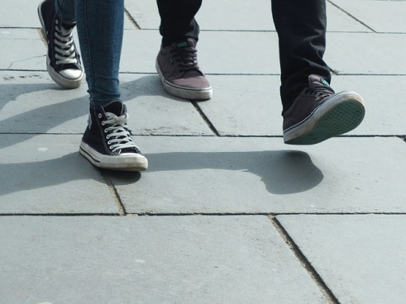
Count Those Steps! micro:bit Based Step Counter
Developing the
Product Prototype

Slide 2
Design Brief
Situation
Walking is an excellent form of exercise that most people can take part in. The average person walks 3000-4000 steps per day. The National Health Service in the UK has set a challenge for each person to walk 10,000 steps per day.
Brief
Using the micro:bit, create a prototype for a step counter or stepometer product. The product must be light and portable. It must also be suitable for use by teenagers.
Notes:
Share this brief with the students and discuss as a class.

Slide 3
Design Criteria
The proposed product prototype must:
Successfully integrate the micro:bit based programmable system.
Be suitable for use by teenagers.
Be small, light and portable (easy to carry).
Fit easily inside a pocket or have some way of attaching it to clothing.
Be aesthetically and ergonomically pleasing.

Slide 4
Pre-Written Program
Go to www.microbit.org/code and open the JavaScript Blocks Editor.
Drag the file microbit-step-jsb.hex onto the work area.
Download the program onto your micro:bit.
Notes:
This program can be downloaded onto the BBC micro:bit by the learners or in advance by the teacher or technician. The program will count the number of steps taken every time the device is ‘shaken’.

Slide 5
Pre-Written Program
Go to www.microbit.org/code and open the Python Editor.
Drag the file step.py onto the work area.
Download the program onto your micro:bit.
Notes:
This program can be downloaded onto the BBC micro:bit by the learners or in advance by the teacher or technician. The program will count the number of steps taken every time the device is ‘shaken’.

