Slide 1
Saving Lighting Energy with the micro:bit
Developing the Programmable System

Slide 2
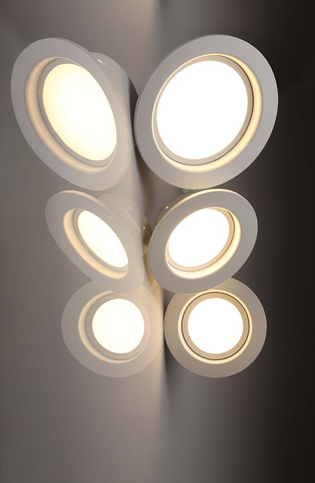
Design Brief
Situation
People are always looking for ways to save energy. It is estimated that the average UK homeowner could save up to £240 a year alone on the cost of lighting their home.
Brief
Using the micro:bit, create a prototype for an automatic lighting system for the home. The system must be able to turn the lighting on when somebody enters a room. It must also turn the lighting off when people leave the room, or after a timed period to save energy.
Notes:
Share this brief with the students if not already done from the starter activity.

Slide 3
Systems Diagram
INPUT
PROCESS
OUTPUT
Motion Sensor
Processor
Hi-bright
LEDs
Movement
Light
A systems or block diagram shows the layout of the system to be created. The blocks represent the physical parts of the system and the arrows represent signals.
Notes:
A block or systems diagram shows a possible basic layout of the system. Can be used as an example of how the students may plan out their own system.

Slide 4
Design Criteria
The proposed system must:
Be programmable using the micro:bit.
Use a suitable sensor to detect when somebody has entered a room.
Use one or more hi-bright LEDs to provide the lighting for the room when someone has entered.
Turn off the lighting when people leave the room or after a timed period.

Slide 5
Input Device Options
Input and output devices can be attached to the micro:bit’s input ports using crocodile clips.
Possible input device options:
Passive infrared (PIR) sensor
Reed switch (attached to room door)
Pressure pad (under floor)
LDR (light dependent resistor)
Any type of motion sensor
Additional Activity:
Using component catalogues or internet sites, research different input devices that would be suitable for use in this system.
Notes:
This slide contains simple input devices that could be used in the system. However it is anticipated that this slide will be edited by the teacher to reflect what is available in their school or what they wish to be available for students. An additional activity could allow learners to research and find their own suitable input devices, or look at alternatives.

Slide 6
Time to Develop your Program!
Your device must be programmed.
Your program must meet the needs of the design brief and the design criteria.
You can program your BBC micro:bit using either the JavaScript Blocks Editor or Python Editor.
An example program written in each has been given to help get you started.
Go to www.microbit.org/code to begin!

Slide 7
Example Program – JavaScript Blocks Editor
Go to www.microbit.org/code and open the JavaScript Blocks Editor.
Drag the file microbit-lighting-jsb.hex onto the work area.
This program will turn on an output attached to pin 1 (such as an LED) when a high input signal is received on pin 0.
Test it, download it and experiment with how it works!
Notes:
Share this example program with learners to help them. Lower ability learners or those lacking programming confidence could start by writing or experimenting with this program first. They could then adapt and develop it. A PDF handout showing the program is available and can be handed out to learners.

Slide 8
Example Program – Python Editor
Go to www.microbit.org/code and open the Python Editor.
Drag the file lighting.py onto the work area.
This program will turn on an output attached to pin 1 (such as an LED) when a high input signal is received on pin 0.
Test it, download it and experiment with how it works!
Notes:
Share this example program with learners to help them. Lower ability learners or those lacking programming confidence could start by writing or experimenting with this program first. They could then adapt and develop it. A PDF handout showing the program is available and can be handed out to learners.

