Slide 1
‘Keep off that bag!’ micro:bit School Bag Alarm
Developing the System - Using the micro:bit Accelerometer

Slide 2
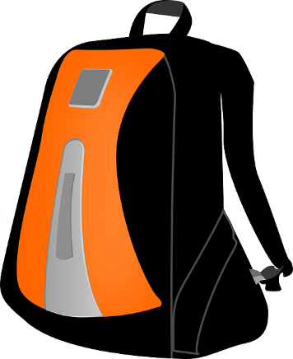
Design Brief
Situation
During a busy day school bags can often be left unattended. For example, when playing sports at break time. This could result in them being taken by mistake or even stolen.
Brief
Using the micro:bit, create a working alarm system for a school bag. The system must detect when the bag has been moved and warn the person responsible that this is not their bag.
Notes:
Share this brief with the students if not already done from the starter activity.

Slide 3
Systems Diagram
INPUT
PROCESS
OUTPUT
Accelerometer
processor
Buzzer
Movement of bag
Warning
sound
A systems or block diagram shows the layout of the system to be created. The blocks represent the physical parts of the system and the arrows represent signals.
LED display
Warning Text
Notes:
A block or systems diagram shows a possible basic layout of the system. Can be used as an example of how the students may plan out their own system.

Slide 4
Design Criteria
The proposed system must:
Be programmable using the micro:bit.
Use the micro:bit’s inbuilt accelerometer to detect when the bag has been moved.
Use a suitable sound output device, such as a buzzer, to warn away anyone who moves the bag.
Use the micro:bit’s LED display to show a visual warning to anyone who moves the bag.

Slide 5
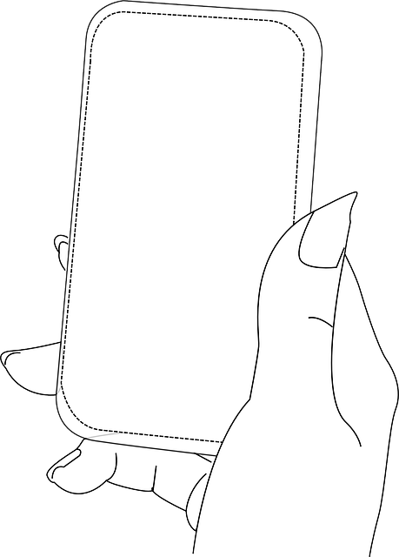
What is an Accelerometer?
Accelerometers measure changes in motion.
They can be used as a sensor to detect movement.
They are used in a range of electronic devices. E.g. in a smart phone so that it knows the difference between up and down.

Slide 6
Time to Develop your Program!
Your device must be programmed.
Your program must meet the needs of the design brief and the design criteria.
You can program your BBC micro:bit using either the JavaScript Blocks Editor or Python Editor.
An example program written in each has been given to help get you started.
Go to www.microbit.org/code to begin!

Slide 7
Example Program – JavaScript Blocks Editor
Go to www.microbit.org/code and open the JavaScript Blocks Editor.
Drag the file microbit-bagalarm-jsb.hex onto the work area.
This program assumes a buzzer has been connected to pin 0.
Test it, download it and experiment with how it works!
Notes:
Share this example program with learners to help them. Lower ability learners or those lacking programming confidence could start by writing or experimenting with this program first. They could then adapt and develop it. A PDF handout showing the example programs is available and can be handed out to learners.

Slide 8
Example Program – Python Editor
Go to www.microbit.org/code and open the Python Editor.
Drag the file bagalarm.py onto the work area.
This program assumes a buzzer has been connected to pin 0.
Test it, download it and experiment with how it works!
Notes:
Share this example program with learners to help them. Lower ability learners or those lacking programming confidence could start by writing or experimenting with this program first. They could then adapt and develop it. A PDF handout showing the example programs is available and can be handed out to learners.

