Slide 1
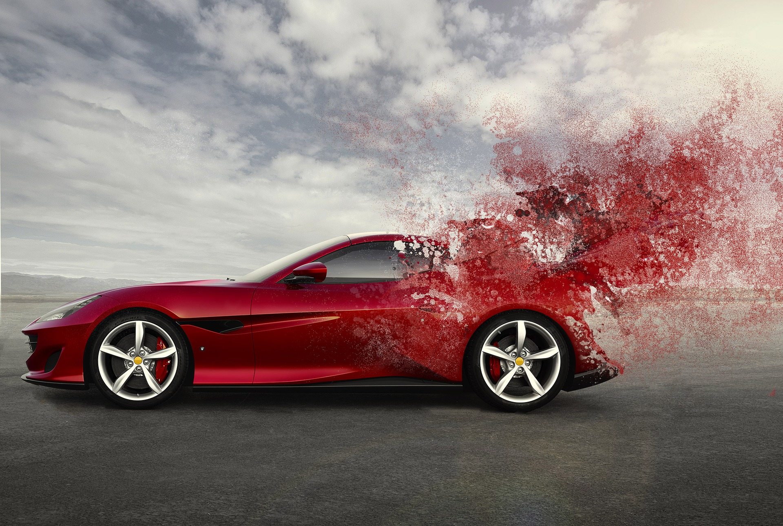
Car body
Making a Net for a Car Body

Slide 2
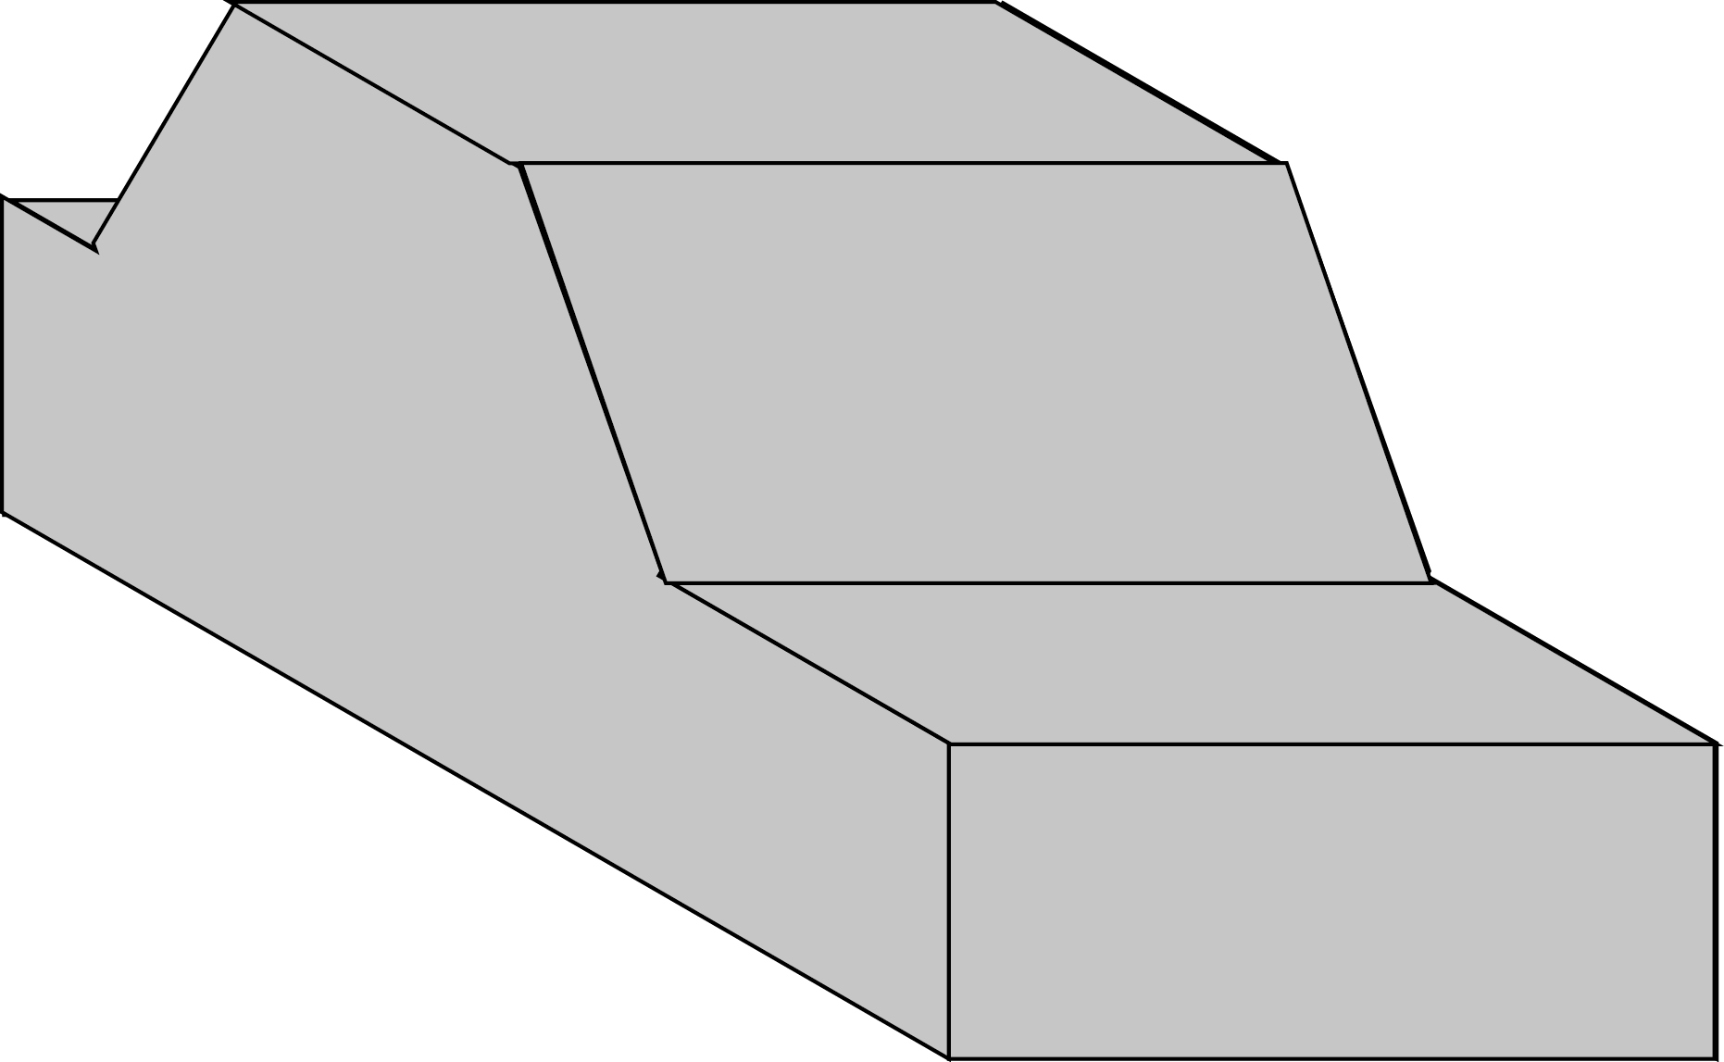
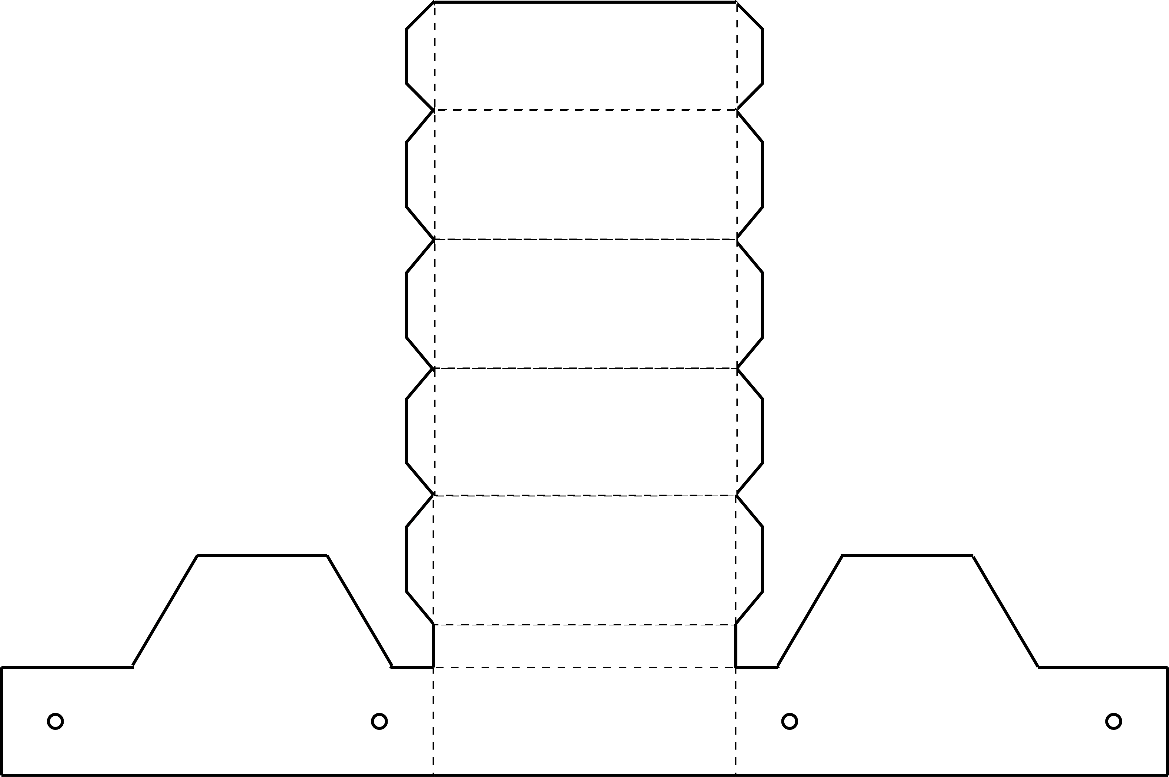
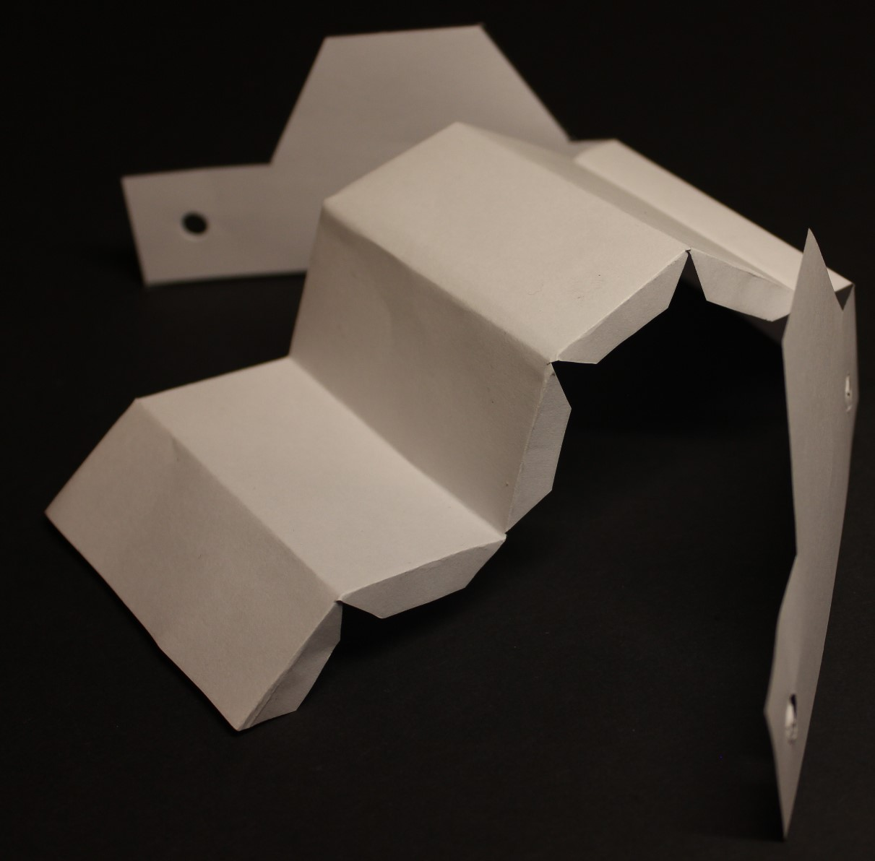
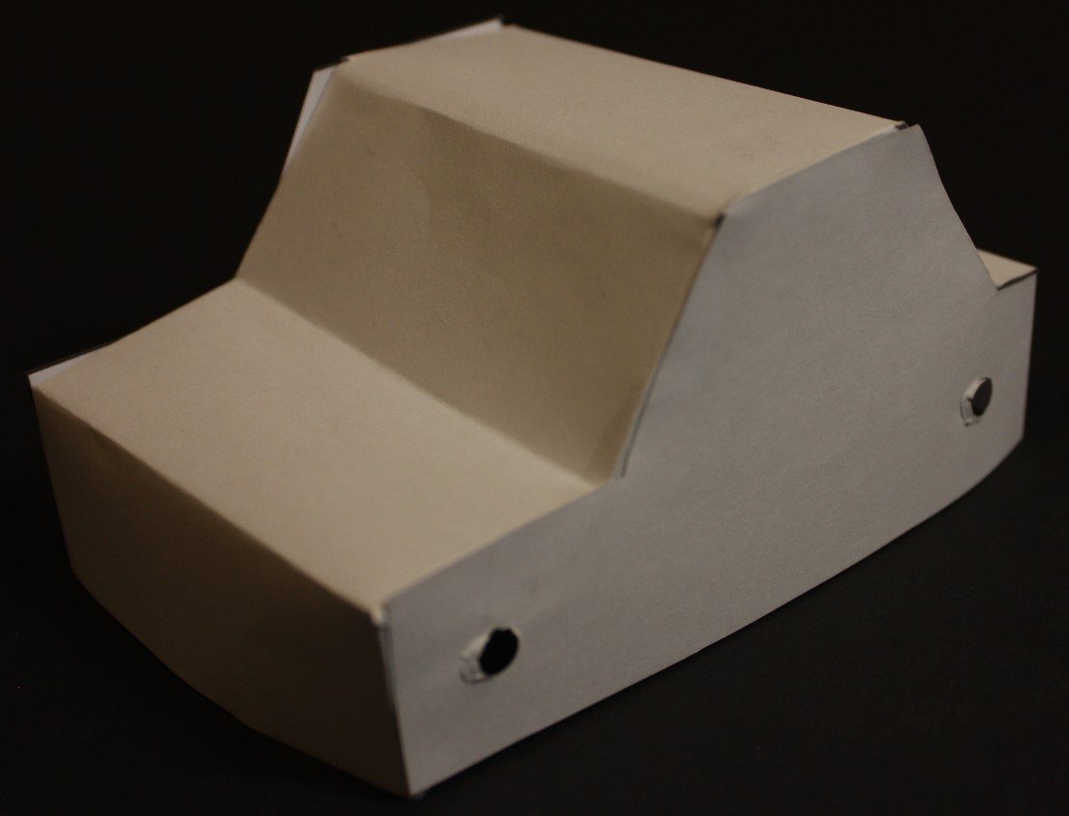
Making a Car Body
fold line
Cut out the outline of the net
Fold the net along the dotted lines (so the dotted lines are on the inside of the fold)
tab
cut line
Put glue on the tabs and assemble the car body

Slide 3
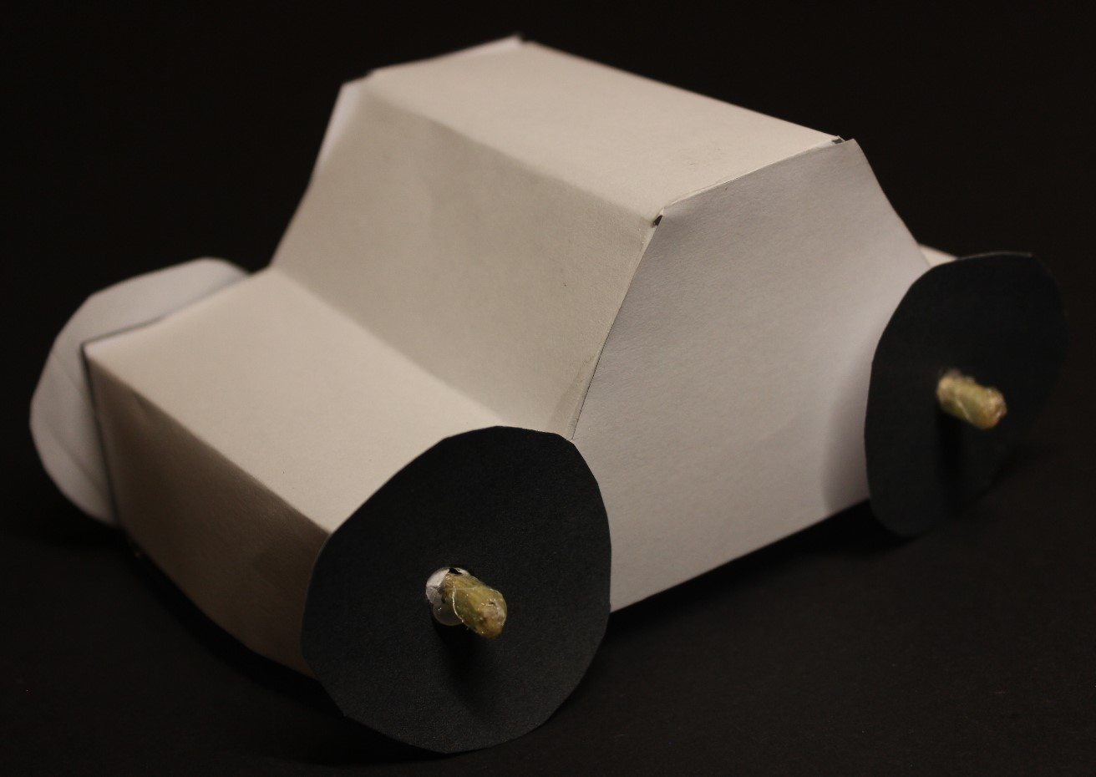
Now Try This…
What graphics and colour need to be added to your car?
How would you change the net to improve the design of your car?

