Slide 1
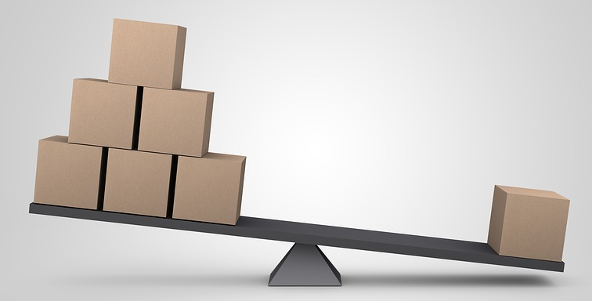
Seesaw Scales
Understanding levers

Slide 2
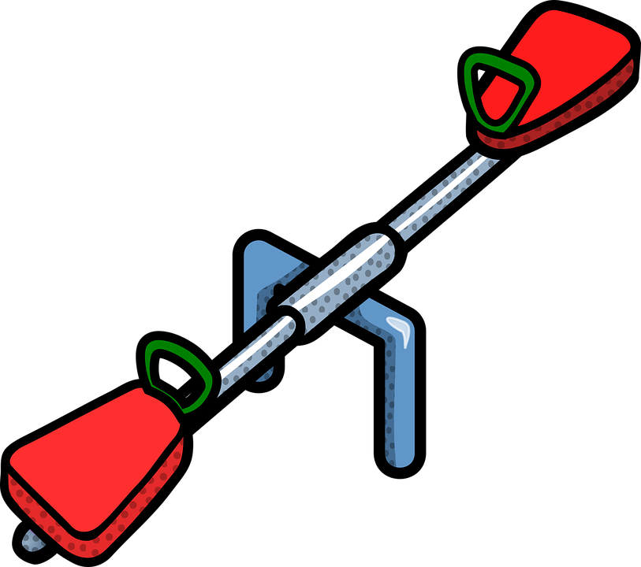
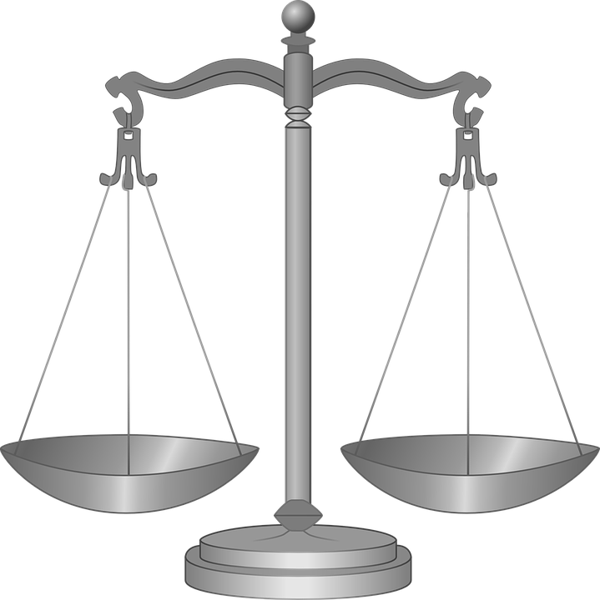
What is a Lever?
A lever is a simple machine
It is used to change the size or direction of a force
Examples of levers include seesaws, old-style kitchen scales, wheelbarrows and nutcrackers
Notes:
A seesaw is a class 1 lever. There are two other classes of lever, depending upon where the load, effort and fulcrum are positioned.

Slide 3
Parts of a Lever
Effort
Load
Beam
Fulcrum
Notes:
The load is the weight (force) that is being moved.
The effort is the force used to move the load.
The fulcrum is the point about which the lever pivots.

Slide 4
So… What happens here?
The load and effort are the same force (weight).
They are each the same distance from the fulcrum.
Effort
Load
Fulcrum
Notes:
The lever will balance.

Slide 5
And… What happens here?
The load and effort are the same force (weight).
The distance from the load to the fulcrum is less than the distance from the load to the effort.
Load
Effort
Load
Effort
Fulcrum
Fulcrum
Notes:
The effort will be lower than the load – the image will change to show this on the first mouse click.

Slide 6
And… What happens this time?
The load is bigger than the effort.
They are each the same distance from the fulcrum.
Effort
Effort
Load
Load
Fulcrum
Fulcrum
Notes:
The load will be lower than the effort – the image will change to show this on the first mouse click.

Slide 7
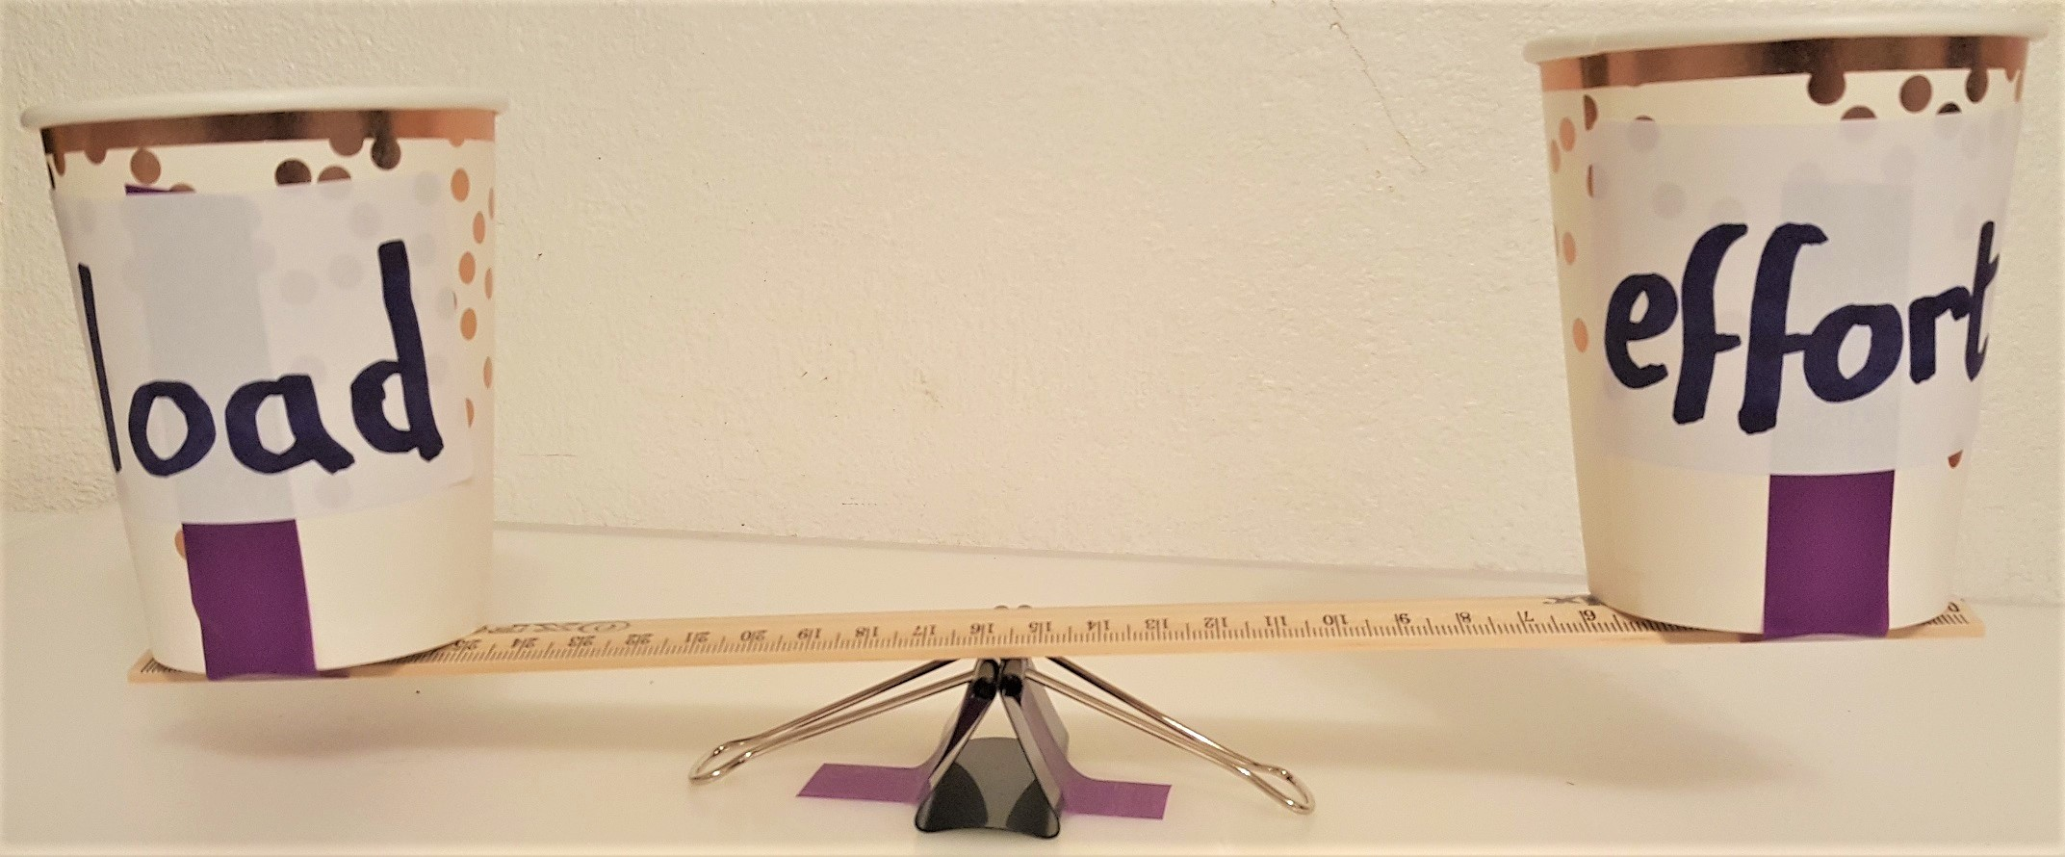
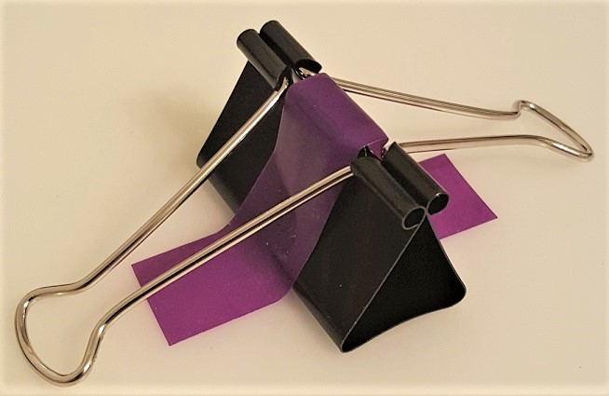
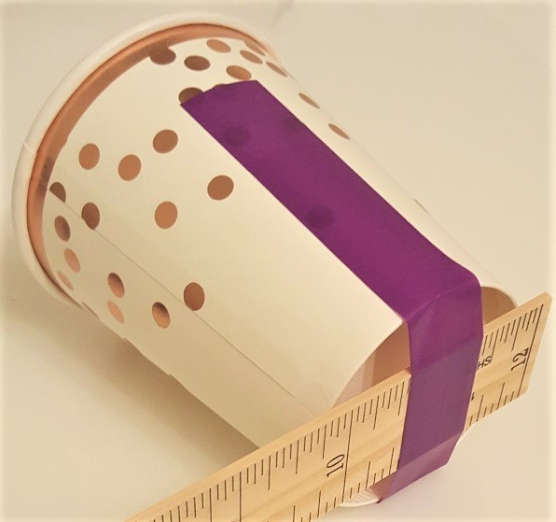
Now do this…
Effort cup
Create the set up shown below:
Ruler
Load cup
Binder clip (fulcrum)
Use sticky tape to hold the binder clip and cups in place
Notes:
Sticky tape assists in stopping the binder clip moving and keeping the cups in place. The binder clip can be used with the wire extenders fully open – they do not need to be removed. The ruler must be rigid (i.e. flexible plastic types will not work) should be able to be moved across the binder clip as needed.

Slide 8
Measuring and Recording Results
Put different weights in the two cups.
Move the ruler along the fulcrum until it balances, then note the distance from the fulcrum to each cup.
Record your results in a table.
Number of weights in load cup | 1 | 2 | 3 | 4 | 5
Number of weights in effort cup | 1 | 1 | 1 | 1 | 1
Distance from load cup to fulcrum, mm
Distance from effort cup to fulcrum, mm
Notes:
The distance measured from the fulcrum should be to the mid-point/centre of the cups. It is easiest to measure the distances using a second ruler.
The table could be extended for different weight combinations or modified as appropriate.

Slide 9
Now do this…
Use different combinations of weights – for example, 2 in the load cup, 3 in the effort cup. What is the distance from the fulcrum that this needs to balance?
Put different (unequal) weights in the two cups – can you work out the distance to the fulcrum to make it balance? Carry out a test to see if your calculation is correct.
Get a friend to put some weights in a cup and cover it with a piece of paper so you can’t see them. Can you work out what the weight is by putting weights in the other cup and measuring the distance from the fulcrum?

