Slide 1
Smart Sensors

Slide 2
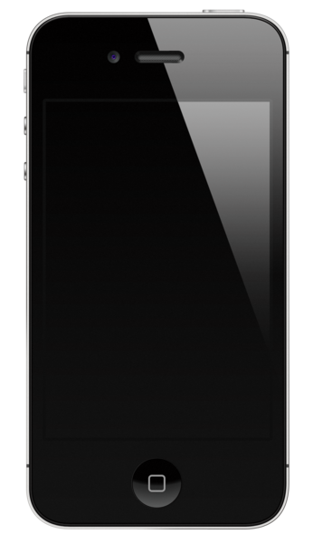
Inside every smart sensor are primitive sensors. The sensor becomes smart due to its built-in electronics.
The sensors really become smart when the sensing and processing results in an ‘adaptive’ sensing system that can react and give useful measurements.
For example, the light on an iphone turns off to conserve energy when the device is placed near to the ear. The built-in smart sensor picks up the distance between ear and phone, and adjusts the lighting needs accordingly.
Image: en.wikipedia.org/wiki/File:IPhone_4S_No_shadow.png

Slide 3
A smart sensor has a transducer and a signal controller/processor that have some intelligence. Smart sensors are those that include some logic functions and/or make some type of decision.
In mobile phones, a proximity sensor says when the person has held the phone to their ear to talk.
During this time, the screen can be turned off, saving power and increasing battery life.
Environment -->Sensing Proximity --> Filter and Amplify Signal -->Compare to threshold to activate or power down microprocessor (and screen)
“Adaptable Measurement”

Slide 4
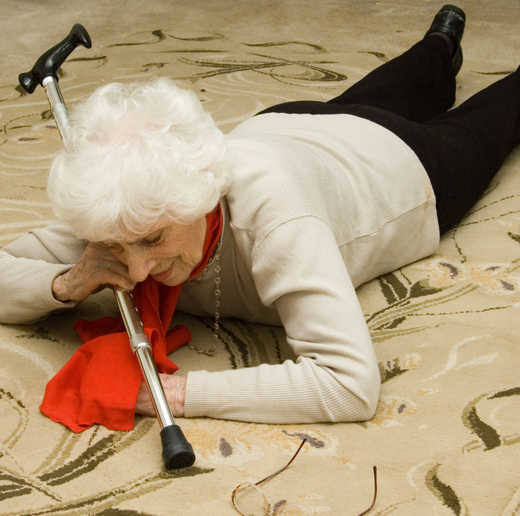
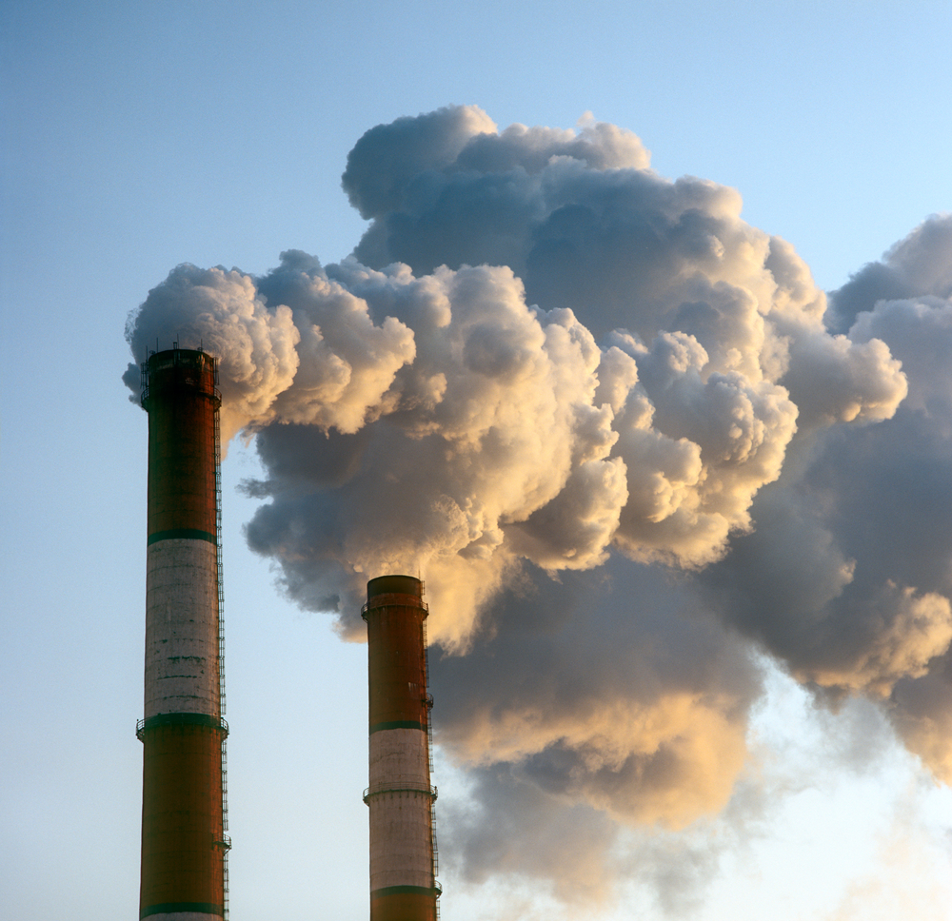
Smart sensors can also do multi-sensing.
Fall detection
Air pollution
Weather warning

Slide 5
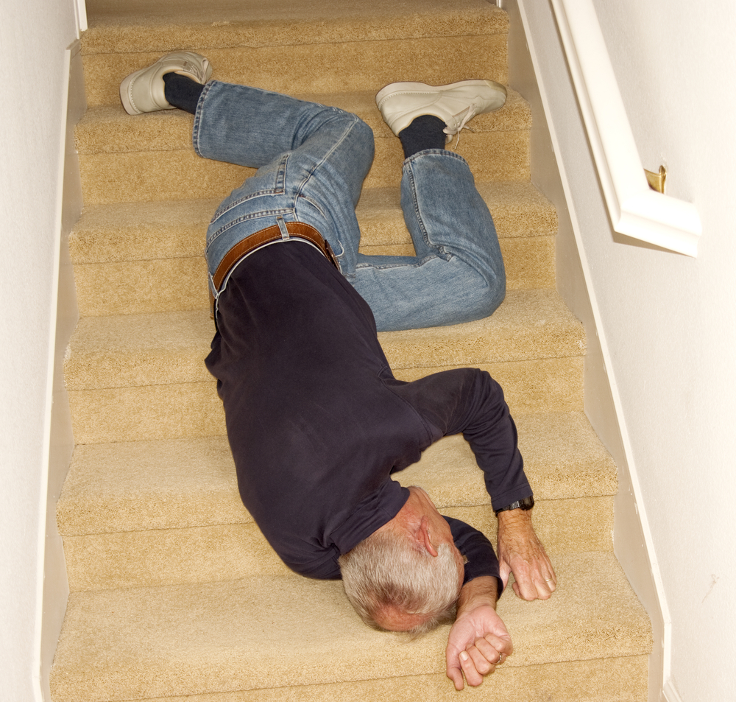
But this has its own design constraints
Fall detection
You get false positives and negatives
Use of sensor in places with other electronic
equipment e.g. pacemakers may not be safe
The smart sensor is a complex device
Its use must fit with the environment

Slide 6
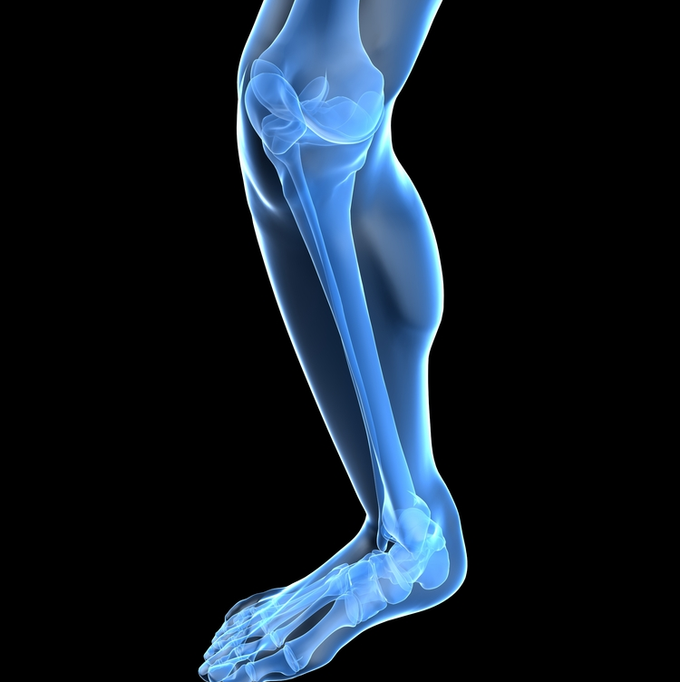
The smarter the sensor the more it costs.
The rest of the electronic system needs to be adapted to a smart sensor.
The use of ‘smart’ or ordinary sensors depends on the complexity of the intended use.
Smart sensors are becoming essential in medical uses.
Robotic surgery will use smart sensors.

Slide 7
Questions
1. What are the differences between an ordinary sensor and a smart sensor?
2.a. What can a smart sensor do to your mobile phone when you hold it to
your ear?
b. Why is this useful?
3.a. In what circumstances to you get a ‘false positive’ from a fall sensor?
b. Would this be a big problem in the care of the elderly?
4. Give two reasons in favour of using smart sensors, and two reasons against.

