Slide 1
Personal Health Check micro:bit Heart Rate Monitor
Using an Accelerometer
and Programming the System

Slide 2
Design Brief
Situation
There are 2.7 million people in the UK currently suffering from heart problems. The quicker these problems can be found and treated the better the chance of a full recovery.
Brief
Using the micro:bit, create a prototype for a personal heart monitoring system. The system must use an accelerometer to detect the movement of the heart. It must also use a suitable sound output and an LED display to give heart rate information to the user.
Notes:
Share this brief with the students and discuss as a class.

Slide 3
Systems Diagram
INPUT
PROCESS
OUTPUT
Accelerometer
Processor
Beeper
Heart pumping
Pulsing sound
A systems or block diagram shows the layout of the system to be created. The blocks represent the physical parts of the system and the arrows represent signals.
LED display
Text information
Notes:
A block or systems diagram shows a possible basic layout of the system. This can be used as an example of how the students may plan out their own system.

Slide 4
Design Criteria
The proposed system must:
Be programmable using the micro:bit.
Use the micro:bit’s inbuilt accelerometer to detect movement of the heart.
Use a suitable sound output device, such as a beeper, to give an audible indication of the person’s heart rate.
Use the micro:bit’s LED display to show visual information about the person’s heart rate.

Slide 5
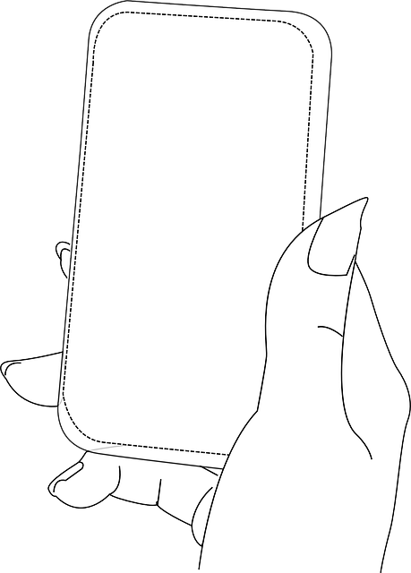
What is an Accelerometer?
Accelerometers measure acceleration (changes in motion).
They can be used as a sensor to detect movement of the heart.
They are used in heart monitoring equipment in hospitals and cardiac care units.
A smartphone has an accelerometer built in that can detect the tiny body movements made by the heart pumping.
Notes:
Give the example of an accelerometer in a smartphone. This can be used to detect the tiny body movements caused by the heart pumping.

Slide 6
Time to Develop your Program!
Your device must be programmed.
Your program must meet the needs of the design brief and the design criteria.
You can program your BBC micro:bit using either the JavaScript Blocks Editor or Python Editor.
An example program written in each has been given to help get you started.
Go to www.microbit.org/code to begin!

Slide 7
Example Program – JavaScript Blocks Editor
Go to www.microbit.org/code and open the JavaScript Blocks Editor.
Drag the file microbit-heartrate-jsb.hex onto the work area.
Button A can also be used to test if it is working.
Test it, download it and experiment with how it works!
Notes:
Share this example program with learners to help them. Lower ability learners or those lacking programming confidence could start by writing or experimenting with this program first. They could then adapt and develop it. A PDF handout is available and can be handed out to learners.

Slide 8
Example Program – Python Editor
Go to www.microbit.org/code and open the Python Editor.
Drag the file heartrate.py onto the work area.
Button A can also be used to test if it is working.
Test it, download it and experiment with how it works!
Notes:
Share this example program with learners to help them. Lower ability learners or those lacking programming confidence could start by writing or experimenting with this program first. They could then adapt and develop it. A PDF handout is available and can be handed out to learners.

