Slide 1
Saving Lighting Energy with the BBC micro:bit
Calculating Protective Resistor Values for LEDs

Slide 2
Stay safe
Whether you are a scientist researching a new medicine or an engineer solving climate change, safety always comes first. An adult must always be around and supervising when doing this activity. You are responsible for:
• ensuring that any equipment used for this activity is in good working condition
• behaving sensibly and following any safety instructions so as not to hurt or injure yourself or others
Please note that in the absence of any negligence or other breach of duty by us, this activity is carried out at your own risk. It is important to take extra care at the stages marked with this symbol: ⚠

Slide 3
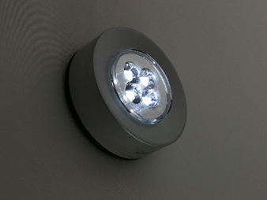
Saving Lighting Energy
In this unit of work you are going to use the BBC micro:bit to produce a prototype lighting system that saves energy in the home.
Your system will turn lighting on only when it is needed.
You will also use LEDs instead of incandescent bulbs to save even more energy!

Slide 4
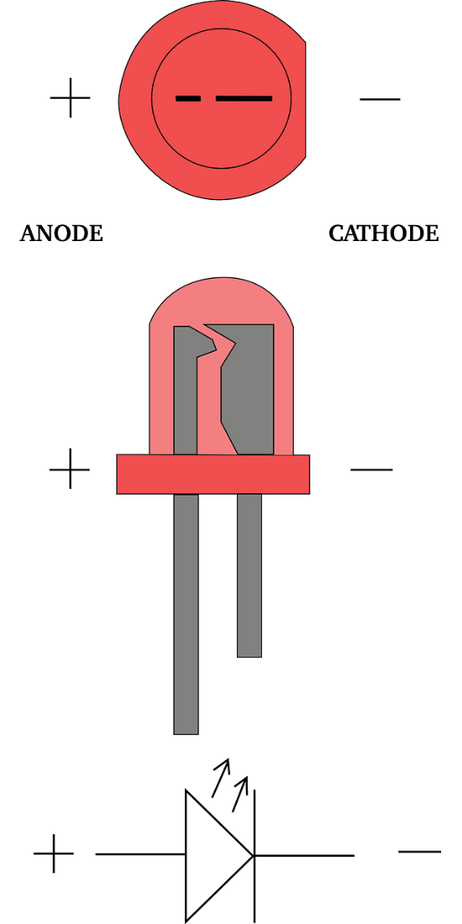
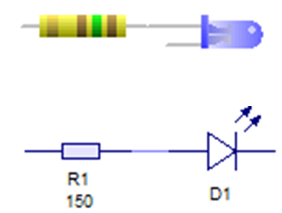
Light Emitting Diodes (LEDs)
Output device
Produces light when current flows from the anode to the cathode lead
Usually needs a protective resistor
Uses much less energy than an incandescent bulb
Ideal for home lighting

Slide 5
Using Ohm’s Law
Calculate the value of the resistor you would need to protect an LED if the power supply is 5V, the LED uses 2V and the LED draws a current of 20mA (0.02A).
V
I
R
V (voltage) = I (current) x R (resistance)

