Slide 1
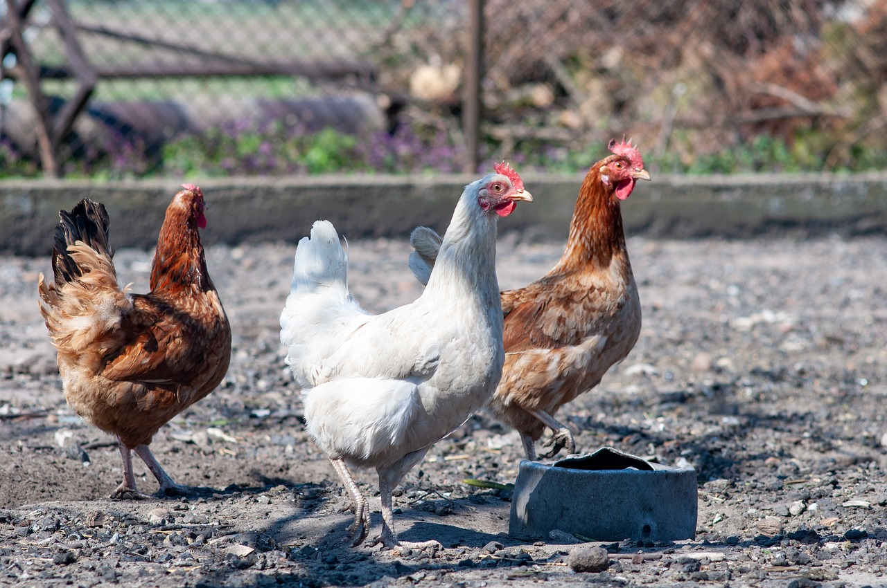
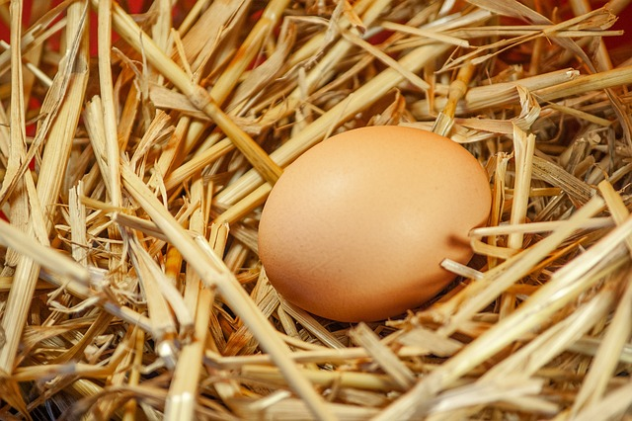
Bugatti - Chicken Coop
Designing a chicken coop inspired by the work of Ettore and Carlo Bugatti

Slide 2
Stay safe
Whether you are a scientist researching a new medicine or an engineer solving climate change, safety always comes first. An adult must always be around and supervising when doing this activity. You are responsible for:
ensuring that any equipment used for this activity is in good working condition
behaving sensibly and following any safety instructions so as not to hurt or injure yourself or others
Please note that in the absence of any negligence or other breach of duty by us, this activity is carried out at your own risk. It is important to take extra care at the stages marked with this symbol: ⚠
Notes:
Safety Warning

Slide 3
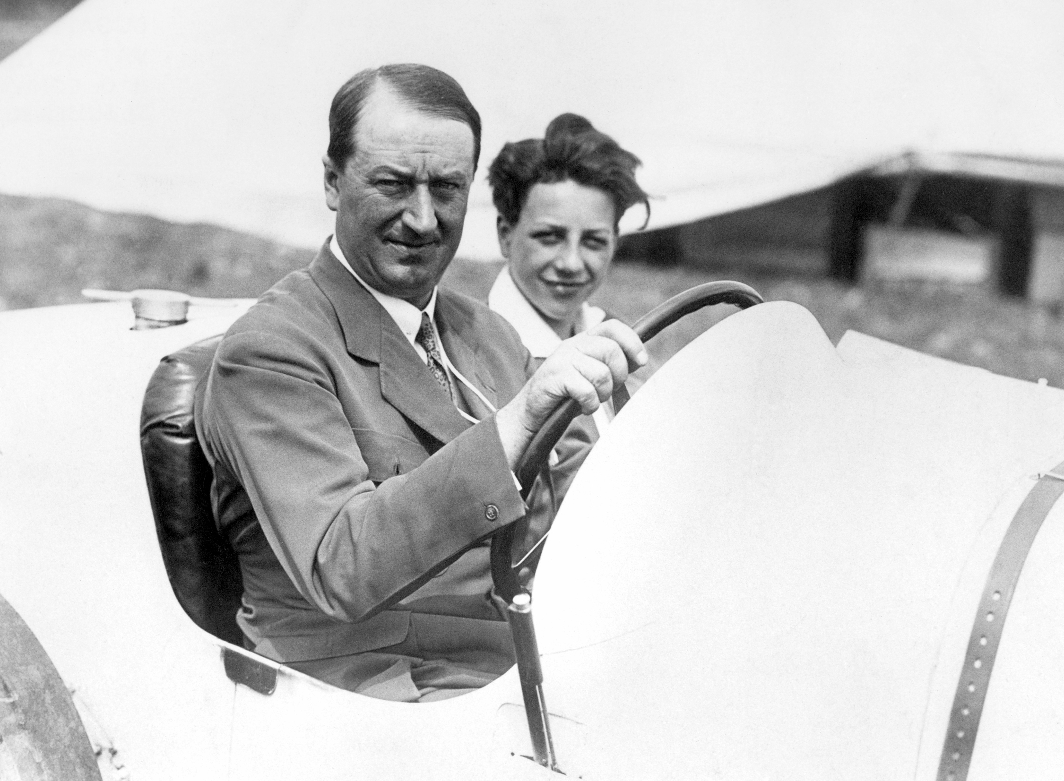
Ettore Bugatti
Ettore Bugatti was a famous designer, manufacturer and engineer
He was born in Italy, but received French citizenship in 1946
He is best known for his racing car designs and for forming Bugatti Automobiles
Notes:
Discuss the designs and achievements of Ettore Bugatti with the class.
As a starter or additional main activity learners could use the internet to research the vehicles that he designed.
They could also produce a mood board of his designs.

Slide 4
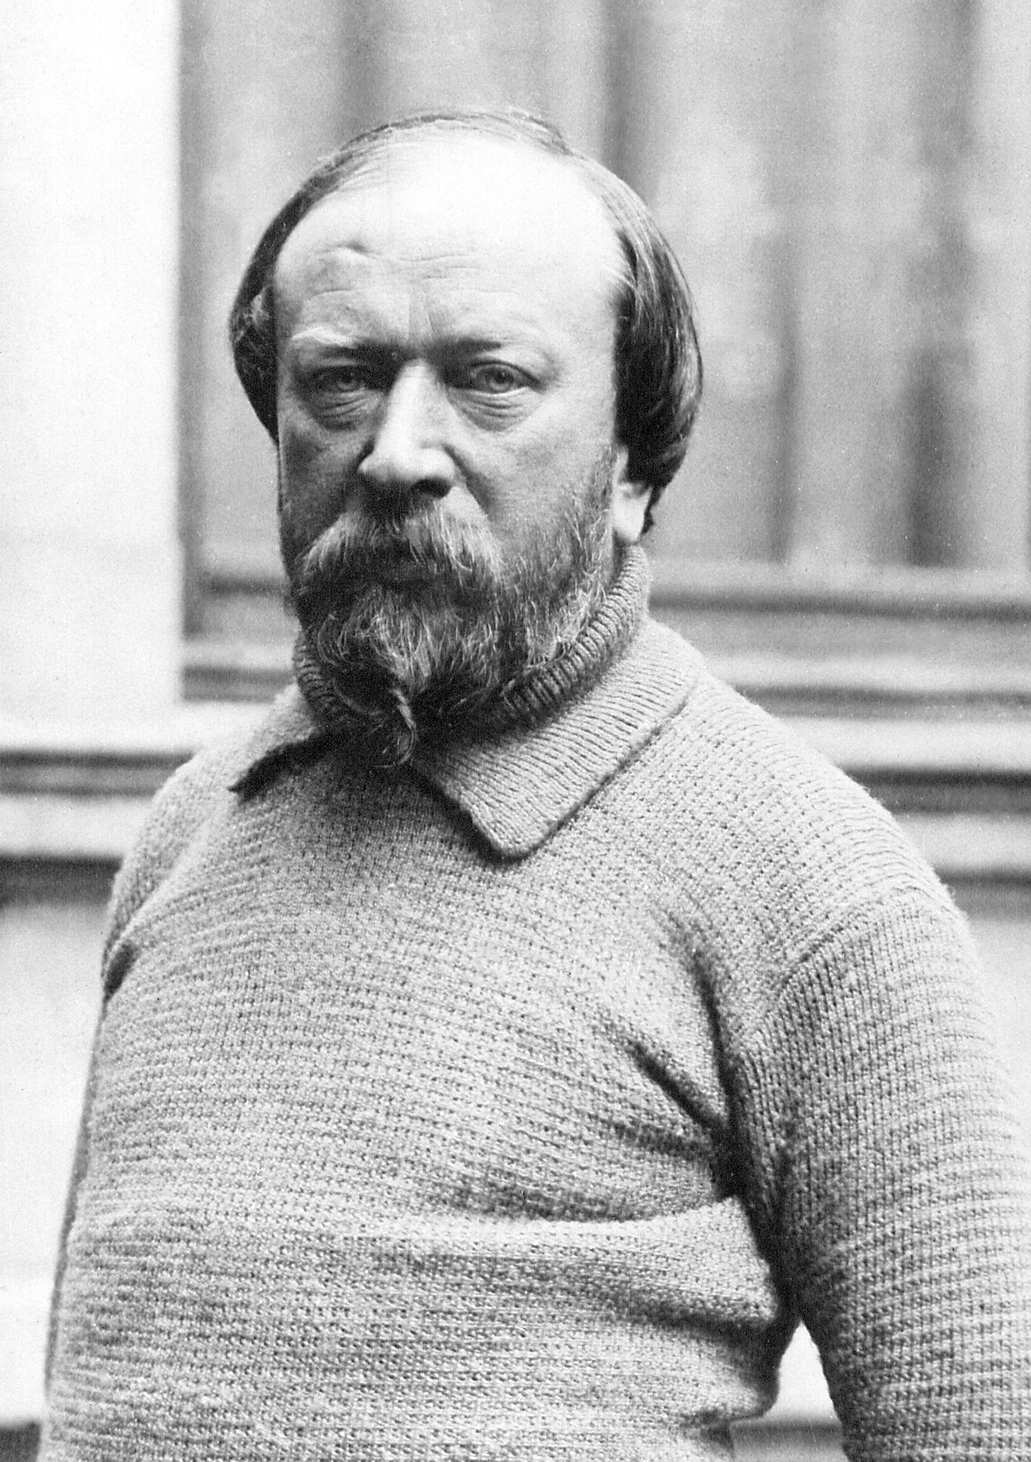
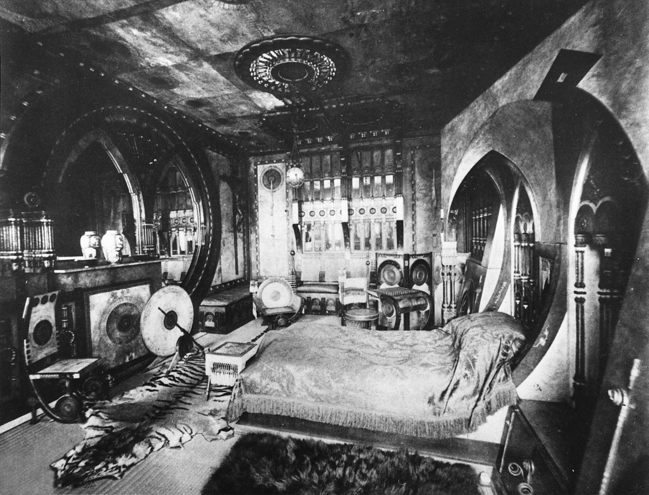
Carlo Bugatti’s use of egg shapes
Ettore’s father Carlo Bugatti was heavily influenced by the shape of eggs
He used egg shapes when producing design ideas for different products
This is because they are both strong and aesthetically pleasing
Notes:
Explain the meaning of the term ‘aesthetics’.
What other benefits are there of using egg shapes in designs?

Slide 5
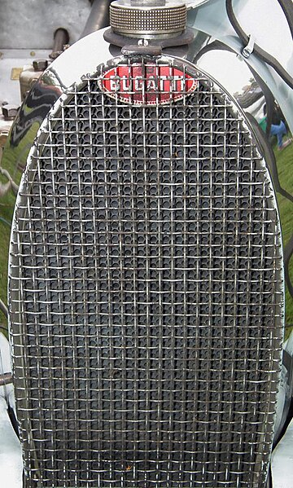
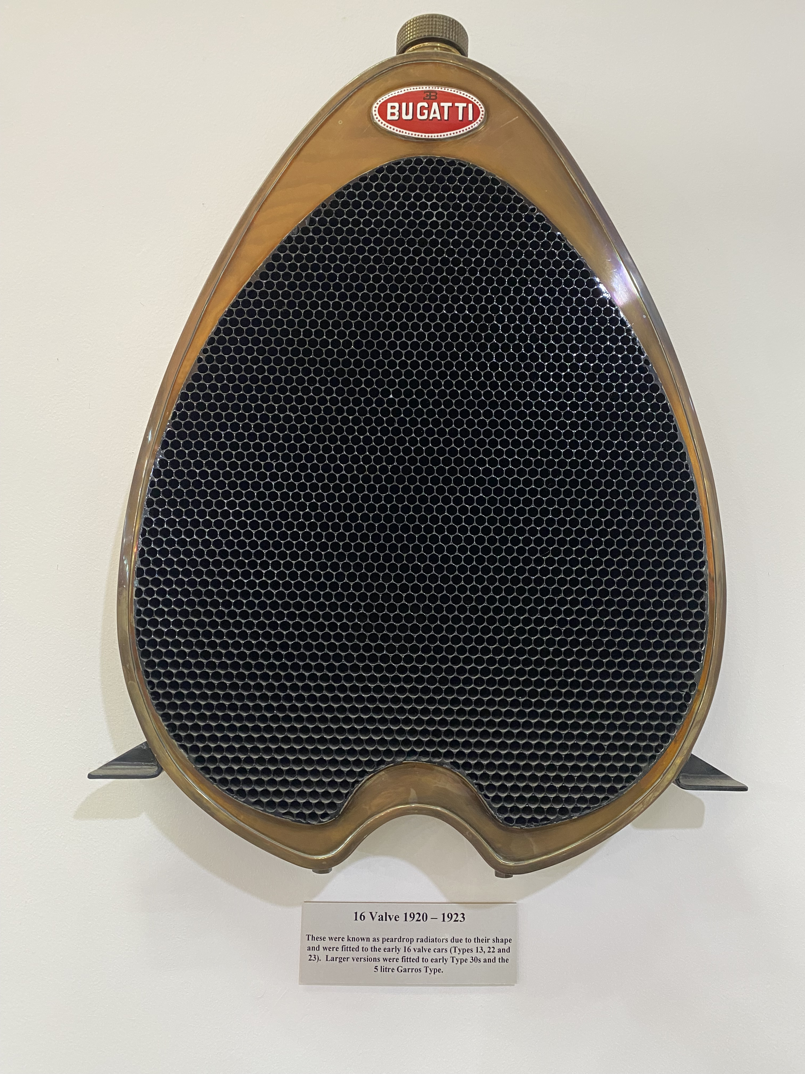
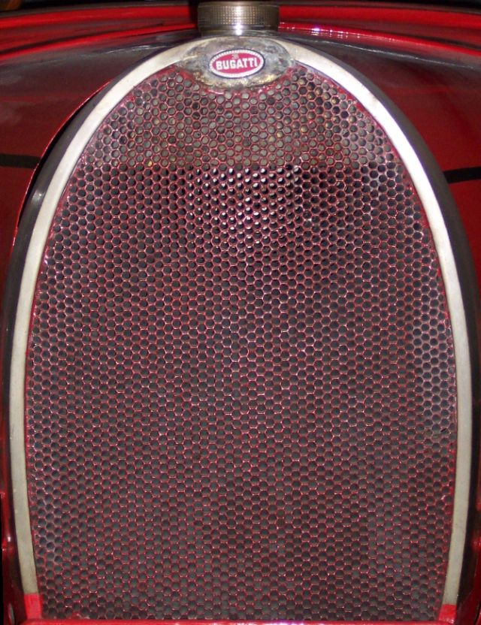
Egg shaped car radiators
Image initially produced by Stahlkocher https://commons.wikimedia.org/wiki/File:Bugatti_Typ_40_K%C3%BChler.jpg used under the following licence https://creativecommons.org/licenses/by-sa/2.0/deed.en , no modifications made.
Image initially produced by PSParrot https://commons.wikimedia.org/wiki/File:Bugatti_radiator_detail_-_Kop_Hill_2013.jpg used under the following licence https://creativecommons.org/licenses/by/2.0/deed.en , no modifications made.
Notes:
Bugatti car radiator designs inspired by the shape of eggs.
Use as inspiration for design work.

Slide 6
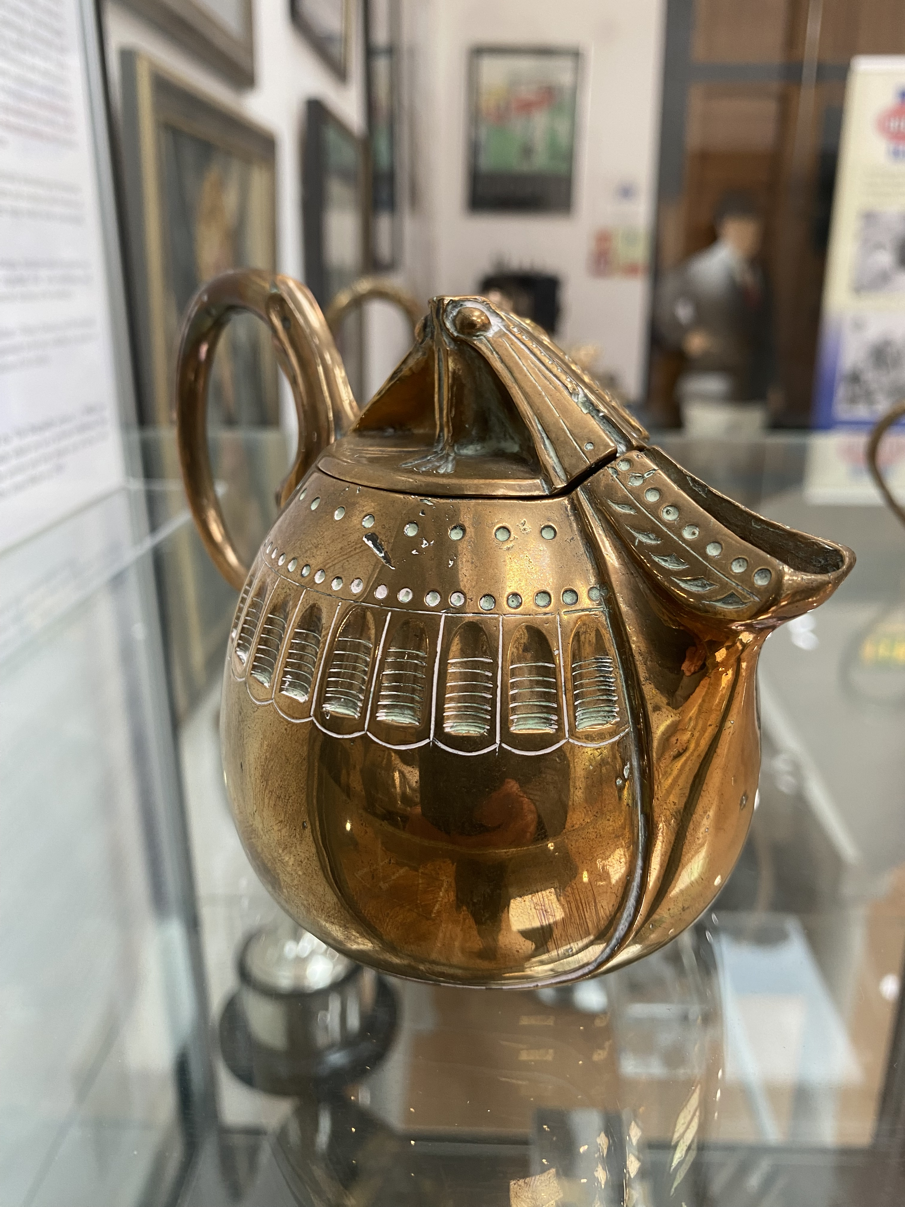
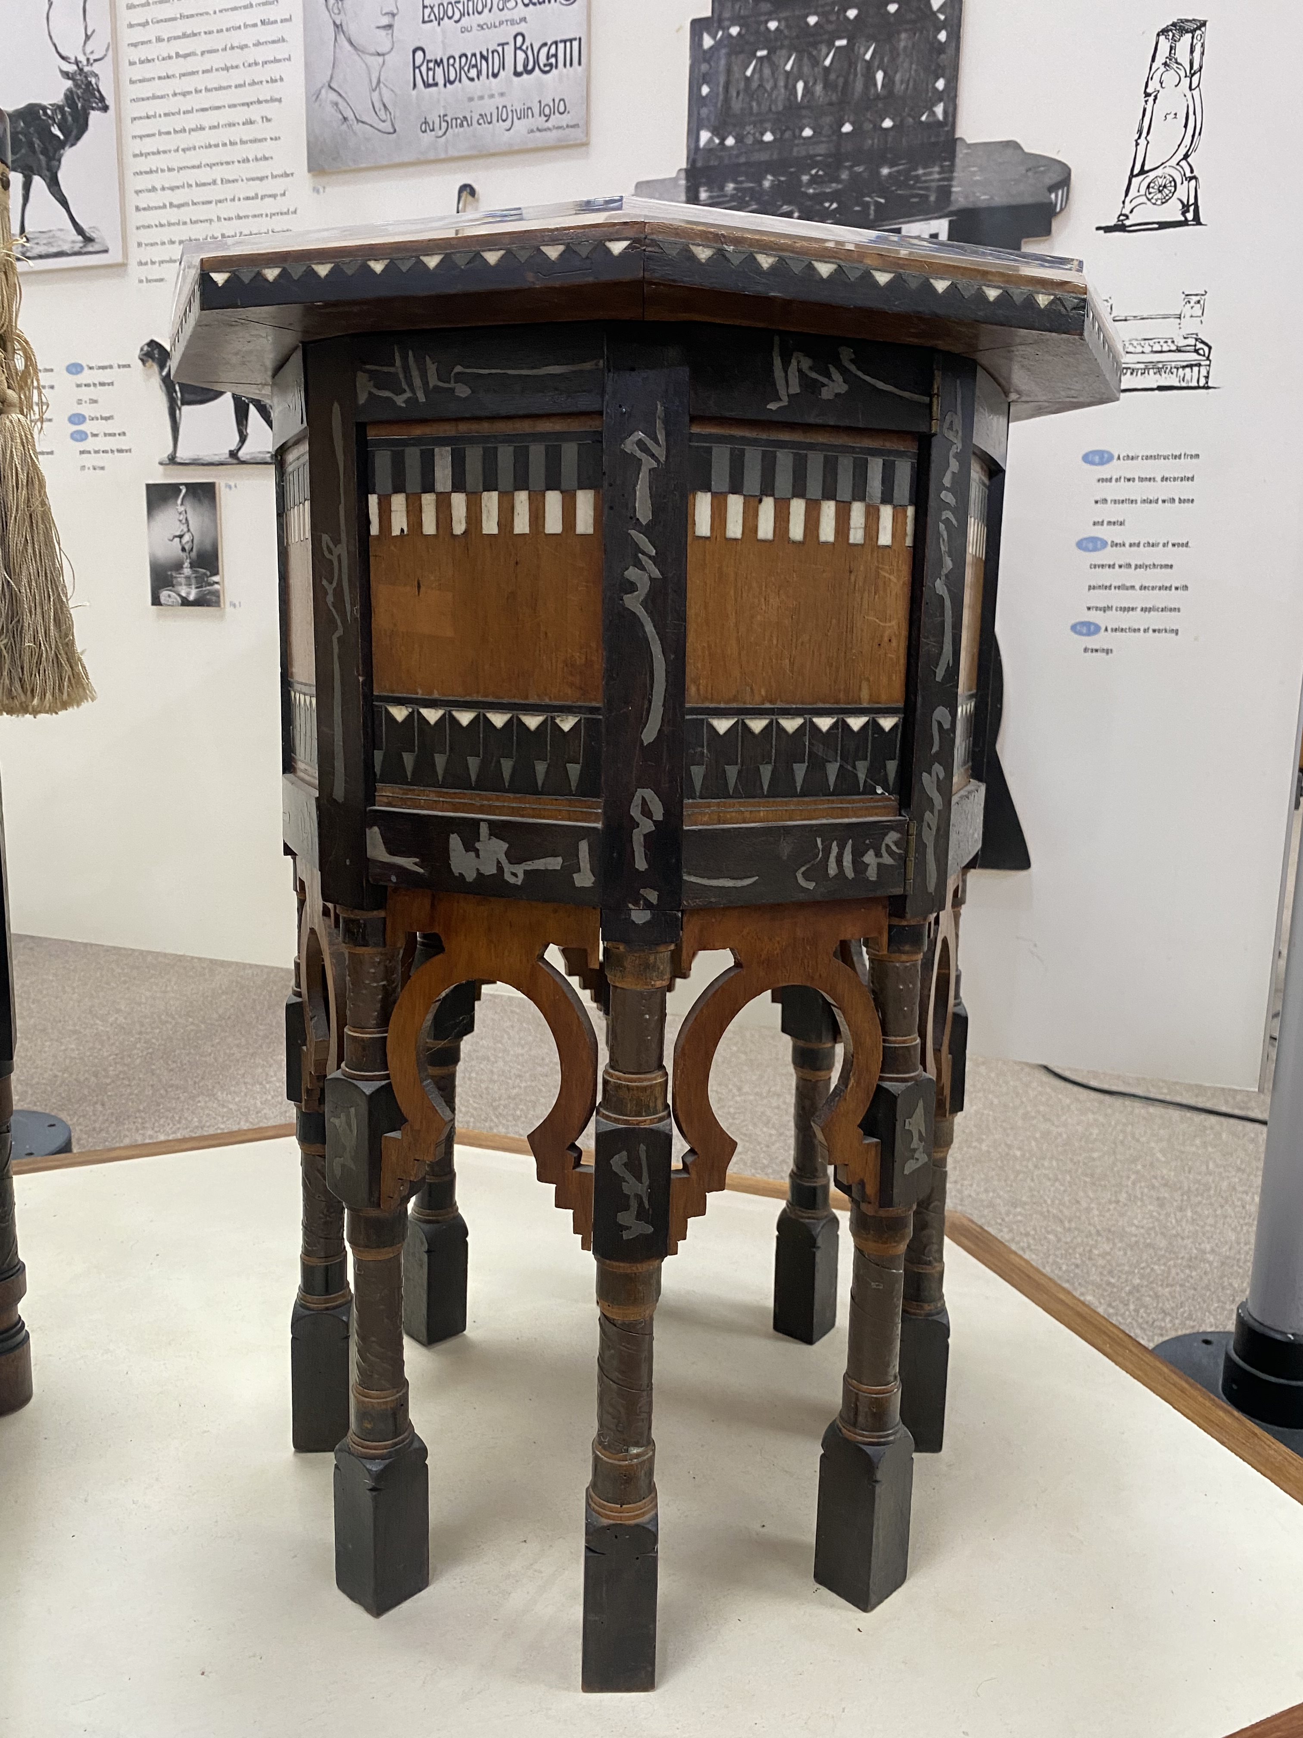
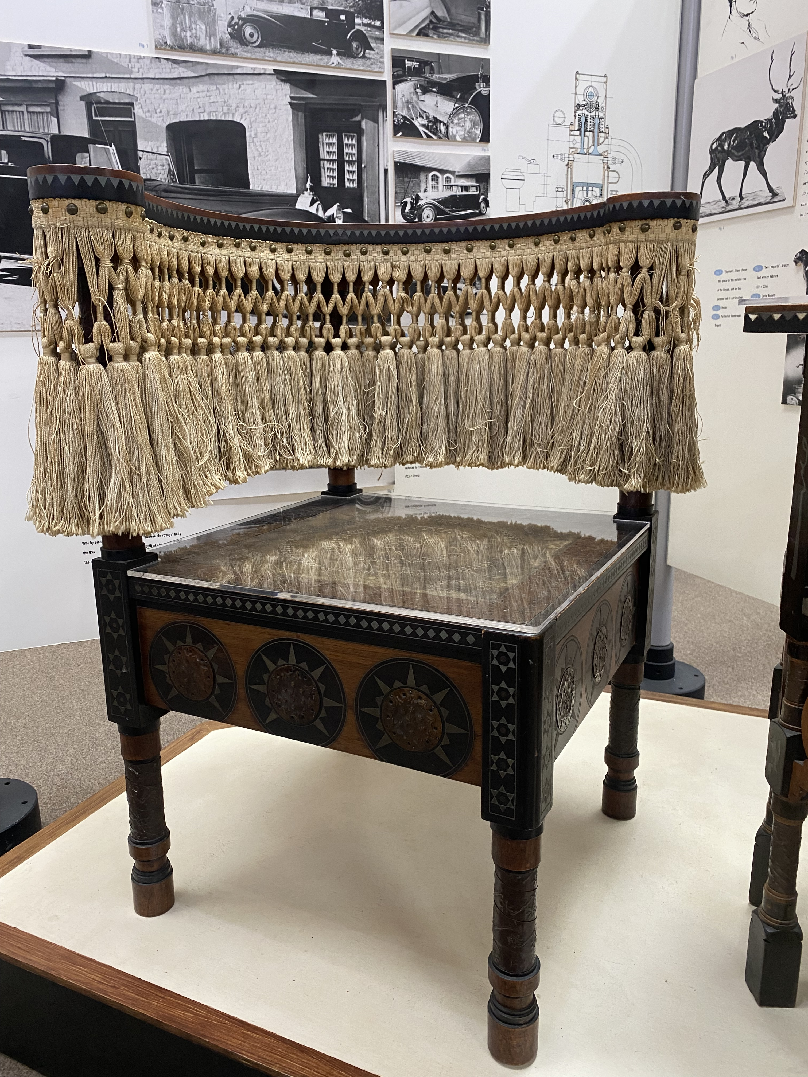
Carlo Bugatti products and structures
Notes:
Part of an egg-shaped tea set, side table and tassled chair, all designed by Carlo Bugatti.
Use as inspiration for design work.

Slide 7

Chicken coop
There is a myth that Ettore Bugatti was so frustrated at the price of eggs that he decided to raise his own chickens
He then possibly designed a chicken coop to house them
This might have been placed on wheels so it could be moved around
Notes:
Discuss the issues surrounding raising and housing chickens.
What are the benefits of raising your own chickens?
What are the benefits of having a chicken coop on wheels?

Slide 8
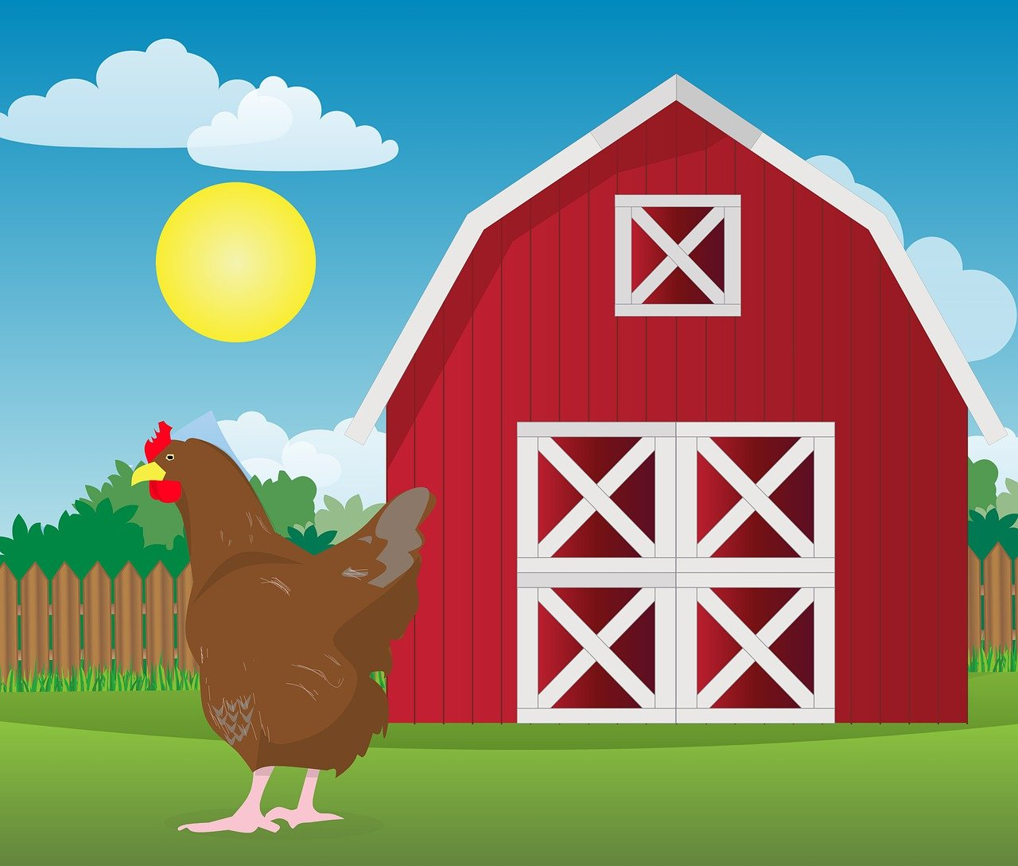
Design brief
Context
Chicken coops are used to safely house chickens, so they can lay eggs
It is claimed Ettore Bugatti might have designed his own chicken coop placed on wheels
Brief
Design a chicken coop to house up to four chickens
Your design must meet the design criteria given on the next slide
Notes:
Discuss the design brief with learners.
The context sets the scene for the design problem, the brief gives the problem itself that is to be solved.

Slide 9
Design criteria
Your chicken coop must have:
Enough space for up to four chickens
Features that provide safety against predators, such as foxes
Access to a food and water supply
A nesting area where the chickens can lay eggs
At least one design feature inspired by the work of Ettore or Carlo Bugatti
For example, Ettore’s chicken coop might have been on wheels like a car, Carlo used egg shapes to provide strength and visual appeal
Notes:
Discuss the design criteria with learners. The design criteria is a list of design points that the finished solution must meet.
This is a minimum set of requirements, but learners could also add their own!
For a design feature inspired by Bugatti, learners could look at some of their other design ideas and features used on their cars, including their shape and looks (e.g. they could make use of egg shapes).
For helping to make the chickens safe, technological aspects could be included, such as alarms, motion sensors or smart systems that alert the owner that there is a problem.

Slide 10
Chicken coop design
Use this space to sketch your chicken coop design idea
How my design meets the design criteria
Notes:
Learners could use this space to produce their design – this could be printed on A4 or A3 paper.
Encourage them to use notes and labels to explain their idea and how it meets the design criteria.

Slide 11
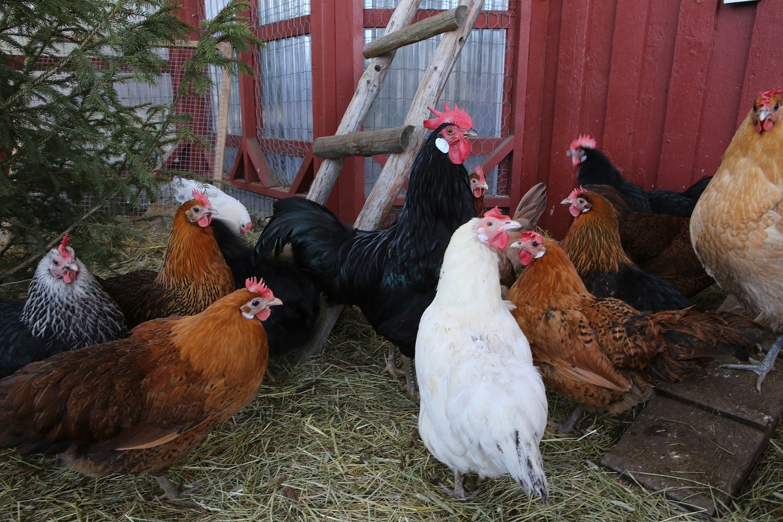
Other images to help you

Slide 12
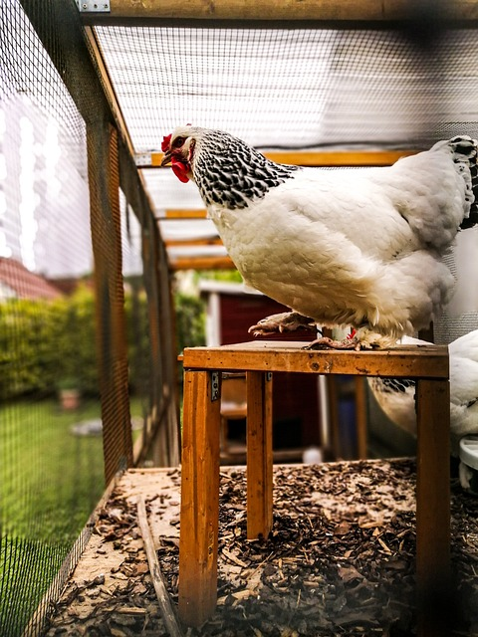
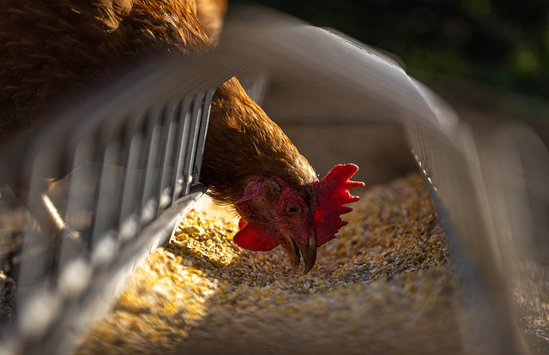

Slide 13
Extension
Make a prototype or scale model of your chicken coop design
Redesign another product using egg shapes as inspiration e.g. a chair or a smartphone
Discuss how other natural forms can influence product designs (e.g. honeycombs, flowers, leaves, animals) and their benefits

