Slide 1
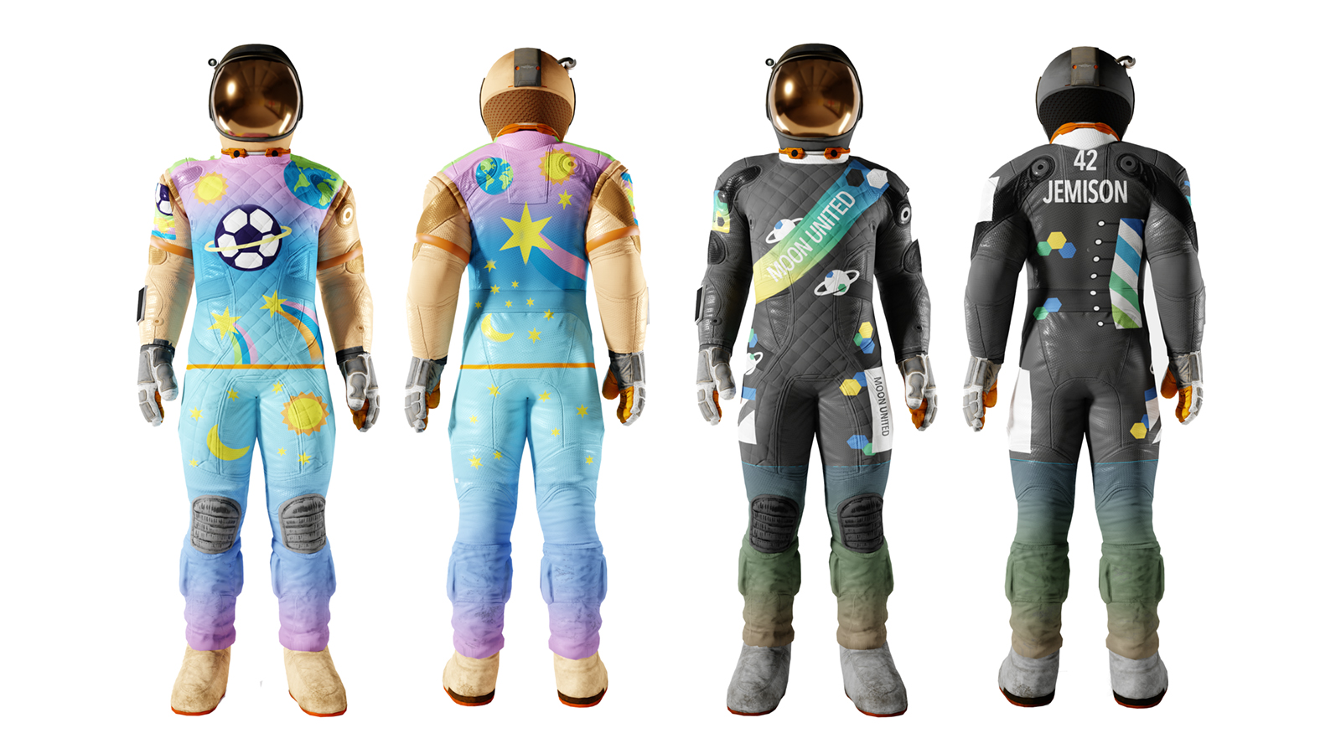
Design a moon football kit
Designing a football kit for the first football team on the Moon

Slide 2
Stay safe
Whether you are a scientist researching a new medicine or an engineer solving climate change, safety always comes first. An adult must always be around and supervising when doing this activity. You are responsible for:
ensuring that any equipment used for this activity is in good working condition
behaving sensibly and following any safety instructions so as not to hurt or injure yourself or others
Please note that in the absence of any negligence or other breach of duty by us, this activity is carried out at your own risk. It is important to take extra care at the stages marked with this symbol: ⚠
Notes:
Safety Warning

Slide 3
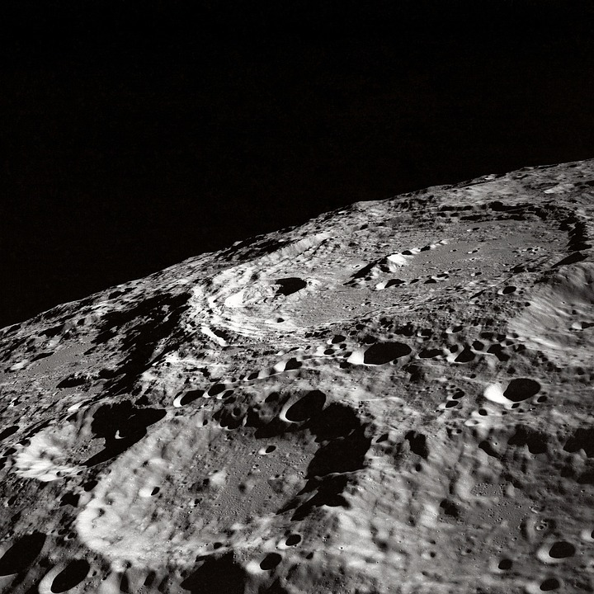

Football on the moon
Thanks to STEM we could be playing football on the Moon in years to come!
This would be very different to here on Earth
What problems do you think you would face?
Notes:
Discuss the problems with playing football on the Moon with learners:
How would you be able to breath?
How would you cope with much lower gravity?
What surface would you play on?
Can learners think of any others?
STEM = Science, Technology, Engineering and Mathematics

Slide 4
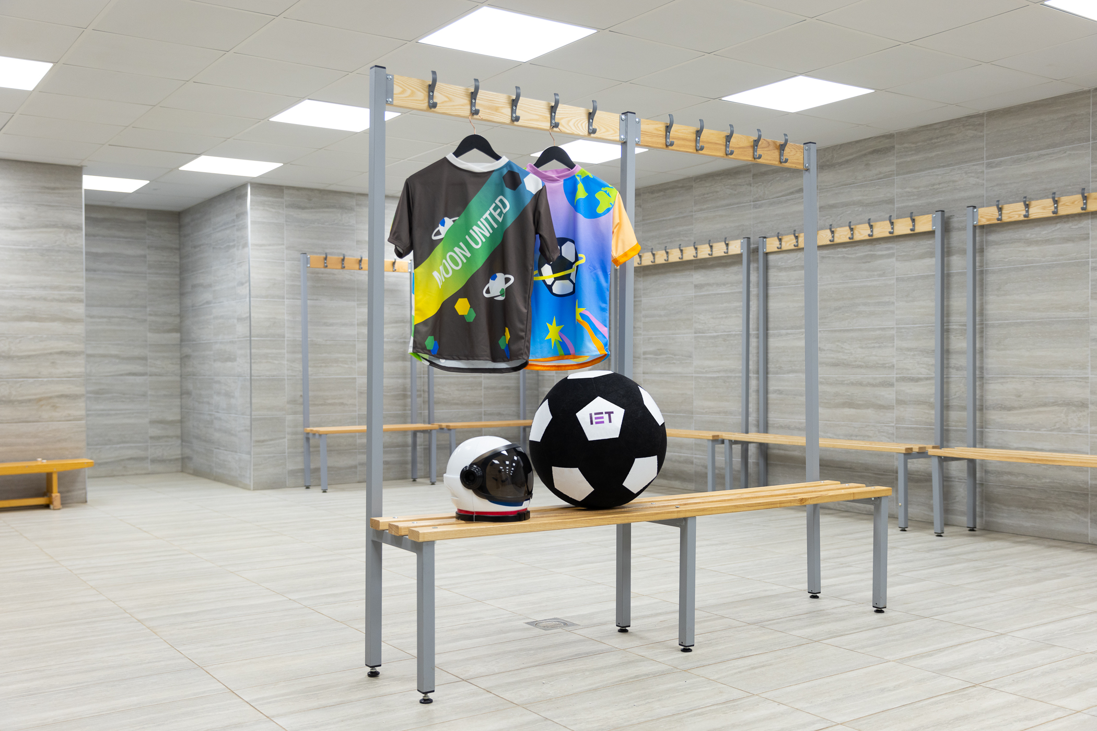
Design brief
Context
Moon United are the first football team to play on the Moon!
They need a kit to play in
Brief
Use your skills, creativity and imagination to design a home football kit for Moon United
Notes:
Discuss the design brief with learners.
The context sets the scene for the design problem, the brief gives the problem itself that is to be solved.

Slide 5
Design criteria
Your design must include:
A badge design for team Moon United
Colours and items that you like or that show your personality
A special element, gadget or tech feature that would make your kit perfect for playing on the Moon
Notes:
Discuss the design criteria with learners.
The design criteria is a list of design points that the finished solution must meet.

Slide 6
Things to think about in your design
Originality: How original is your idea?
Creativity: How creative is your idea?
Engineering: What makes your kit perfect for the Moon and different from an Earth football kit?
Personality: How does the design bring to life the things you love?
Notes:
Teacher may need to explain the terms originality and creativity.

Slide 7
Moon United football kit design
Notes:
Learners could use this space to produce their design – this could be printed on A4 or A3 paper.
Encourage them to use notes and labels to explain their idea and how it meets the design criteria.

Slide 8
Examples
Example 1
Example 2
Images from IET Moon United 2023 competition and campaign.
Notes:
Examples of possible designs.
Further examples can be found here: https://eabw.theiet.org/kids-stem-competition/

Slide 9
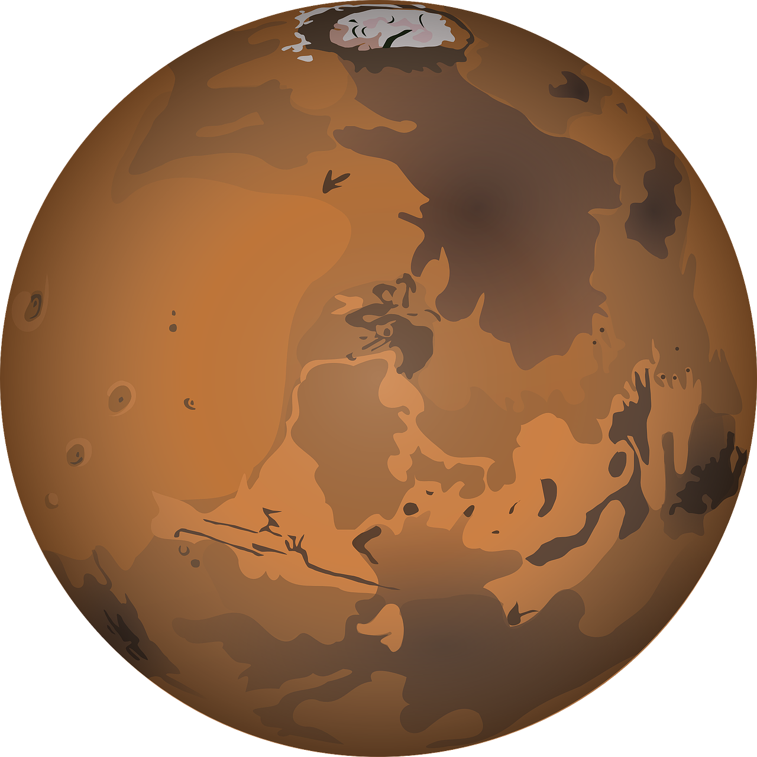
Extension
Design an away kit for Moon United
Design a football pitch for Moon United to play on

