Slide 1
Inputs & Outputs of Design

Slide 2
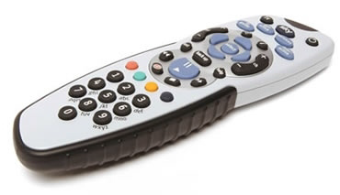
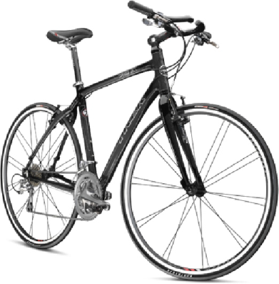
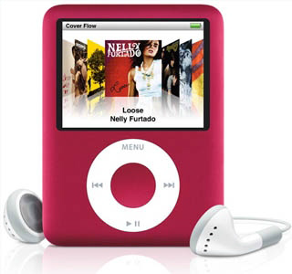
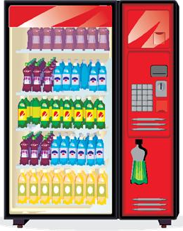
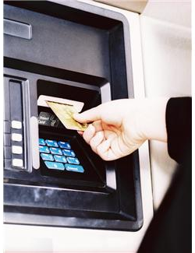
What are the inputs & outputs?
Remote control
Bike
iPod
Cash machine
Vending machine
Electronic alarm clock

Slide 3
What were the input(s), process & output(s) of the lesson?
Input(s)
………………………………………………………………………………………………………………………………………………………………………………………………………………………………
………………………………………………………………………………………………………………………………………………………………………………………………………………………………
………………………………………………………………………………………………………………………………………………………………………………………………………………………………
process
OUTput(s)

