Slide 1
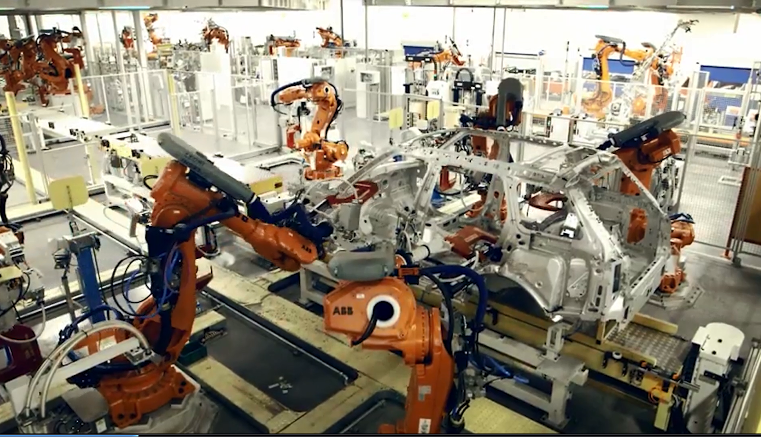
Robot arms

Slide 2
Parts of a Robot Arm
3
2
4
Shoulder
Elbow
Wrist
Hand
1

Slide 3
Produce a 2D Card Model of a Robot Arm
Hints:
Sketch the parts you will need onto the card before you cut them out
Use thumb tacks to make fixed pivots
Use brass fasteners to make moving pivots
Use string or fishing line and elastic bands to make the hand open and close
Once you have made your first design test it works – then see if moving where the control lines attach to makes it better

Slide 4
Example of a 2D Card Model
Moving pivot
Control string
Fixed pivot
Elastic band
Shape cut from card
Support to hold it on to the back board

