Slide 1
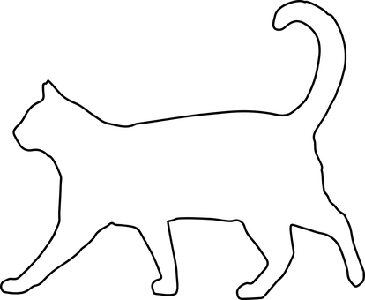
Pouncing Cats
Using static electricity to make tissue paper cats ‘pounce’ onto a balloon

Slide 2
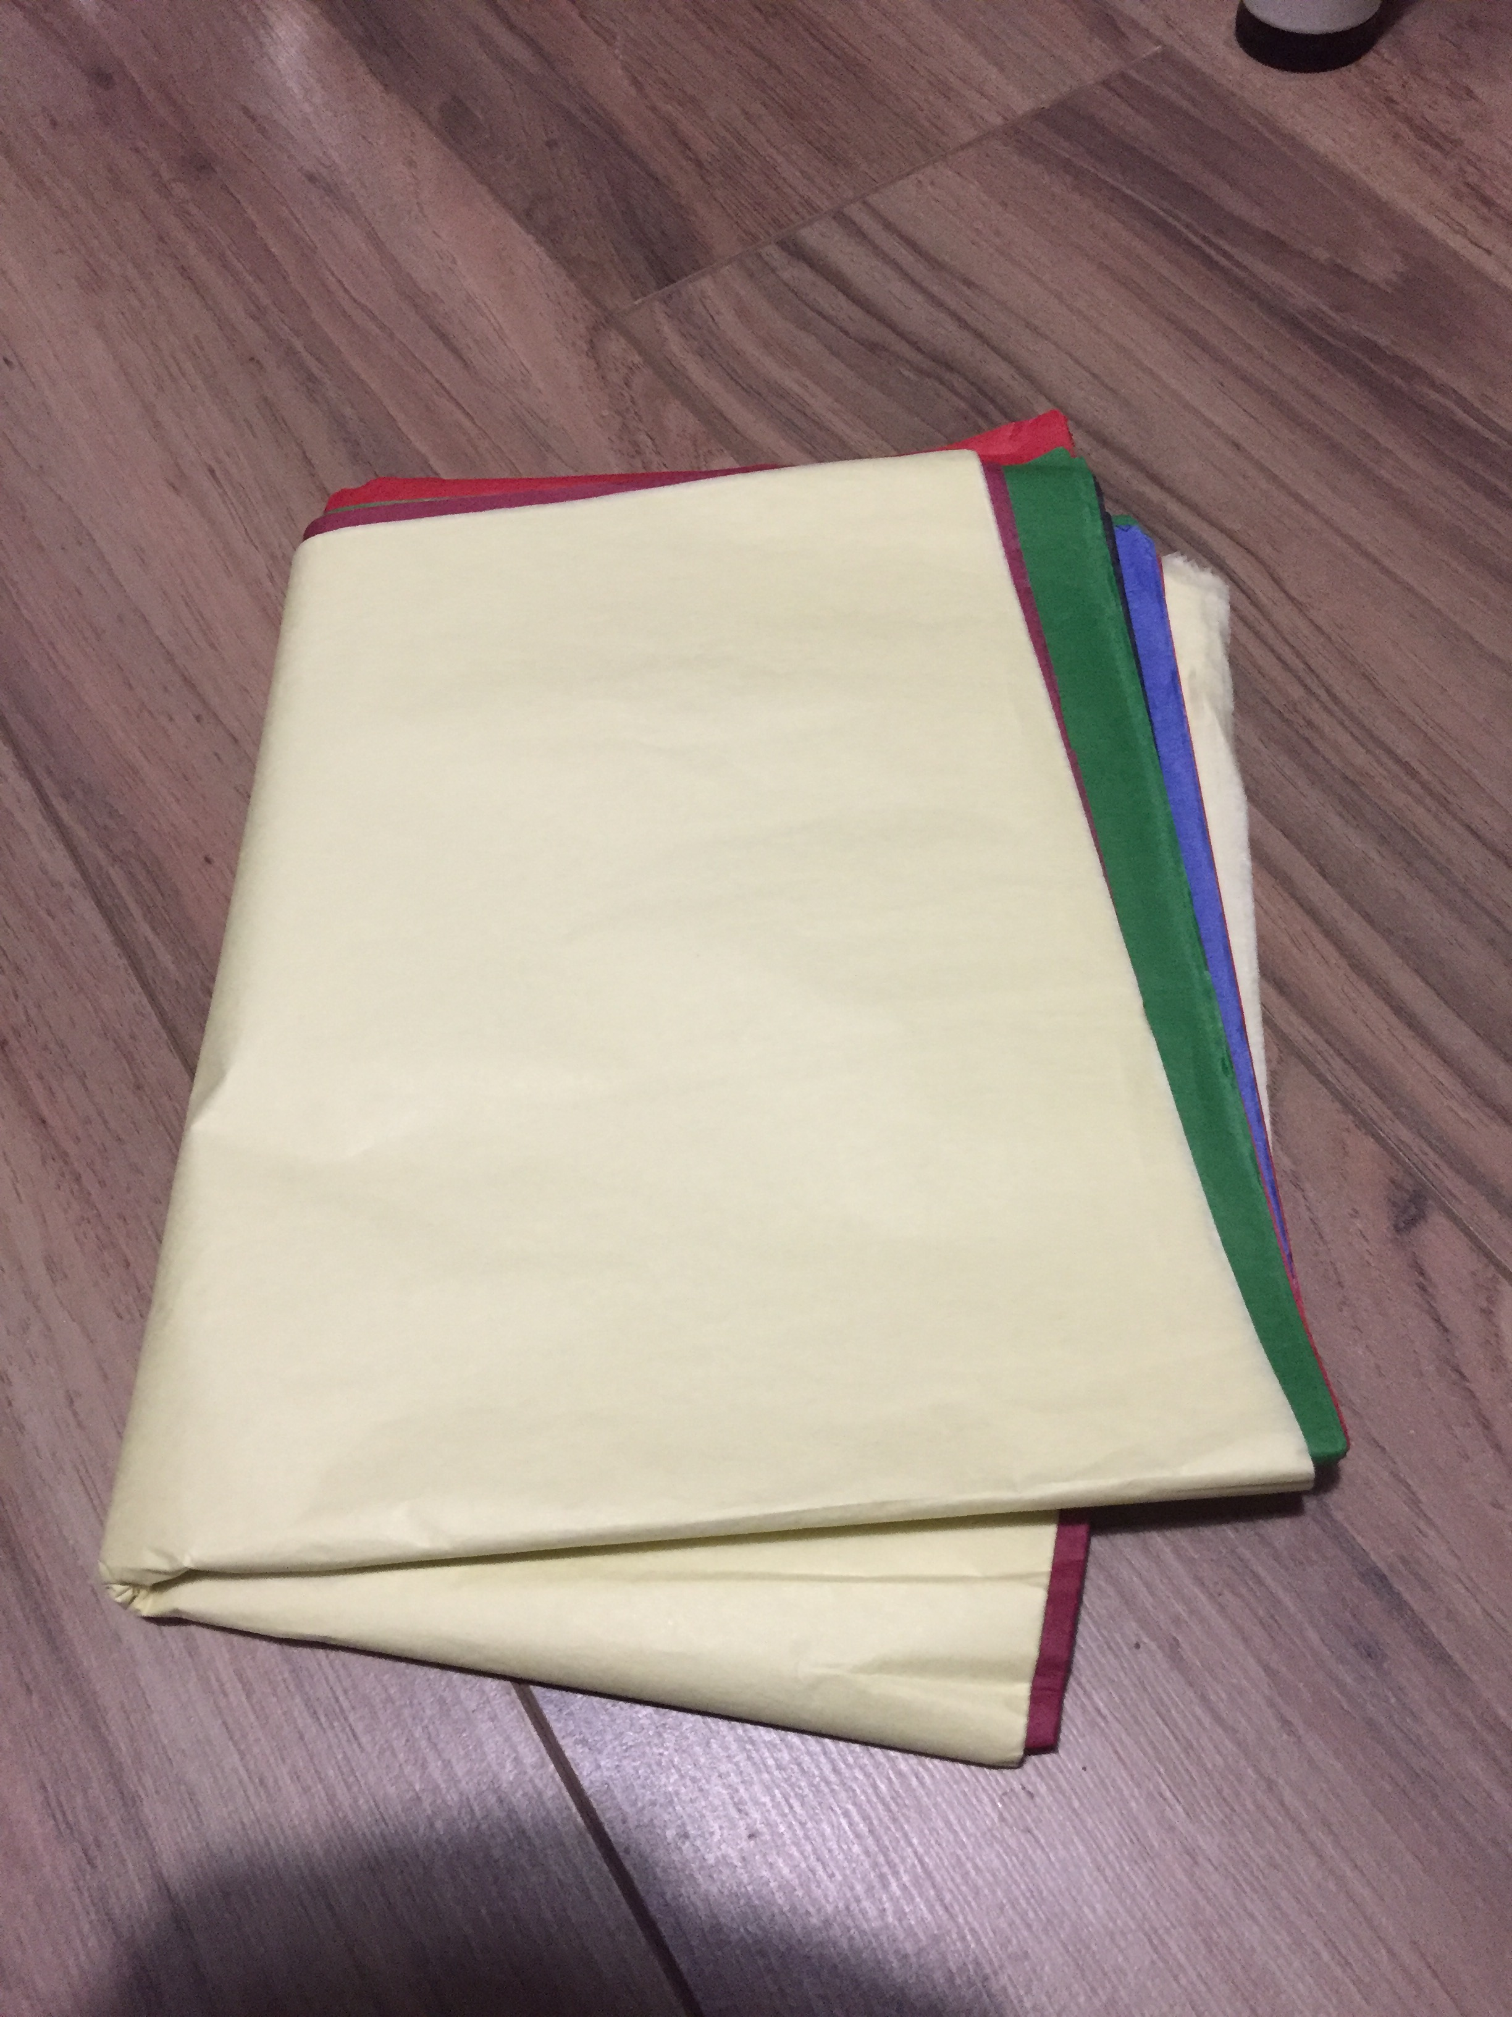
Making your cats
Cut your tissue paper into small cat shapes.
Use different coloured tissue paper to make different coloured cats!
Notes:
Normal paper could be used but tissue paper works particularly well. Learners could also cut out other animal shapes if they wish - they could then be asked to identify each animal. If learners are struggling then animals could be pre-cut, or a template could be provided. Teacher should demonstrate first, including safe use of scissors.

Slide 3
Blowing up the balloon
Blow up your balloon until it is full of air.
Tie the end of the balloon so that the air does not escape.
Notes:
Tying the end of a balloon can be tricky. If learners struggle to do this the teacher could complete this step in advance for the them. The following website shows how to tie a balloon correctly. https://www.wikihow.com/Tie-a-Balloon

Slide 4
Making static electricity
Rub the balloon against your jumper several times.
If you don’t have a jumper on, you could use your hair instead!
Notes:
There is a potential for ‘horseplay’ if using hair to create the static electricity, so a jumper would be preferable!

Slide 5
Making your cats pounce!
Hold your balloon just above your cat shapes.
They should ‘pounce’ onto the balloon and stick to it!

Slide 6
Why does this happen?
Why do the cats ‘pounce’ onto and then stick to the balloon?
What is causing this to happen?
Notes:
Ask learners why they think the cats pounce onto and then stick to the balloon. Explain that the balloon is charged with static electricity when it is rubbed against the jumper or hair. The tissue paper cats are attracted to this so ‘pounce’ up towards the balloon and stick to it. When this static charge wears off, the cats will fall back off the balloon. Learners could repeat the experiment using bigger and smaller cat shapes, different types of paper and different lengths of time when rubbing the balloon, investigating any changes in the outcome. For example does this affect the time that the cats stay stuck to the balloon?

