Slide 1
Blindfold Maze
Using directions to guide pupils through a table maze

Slide 2
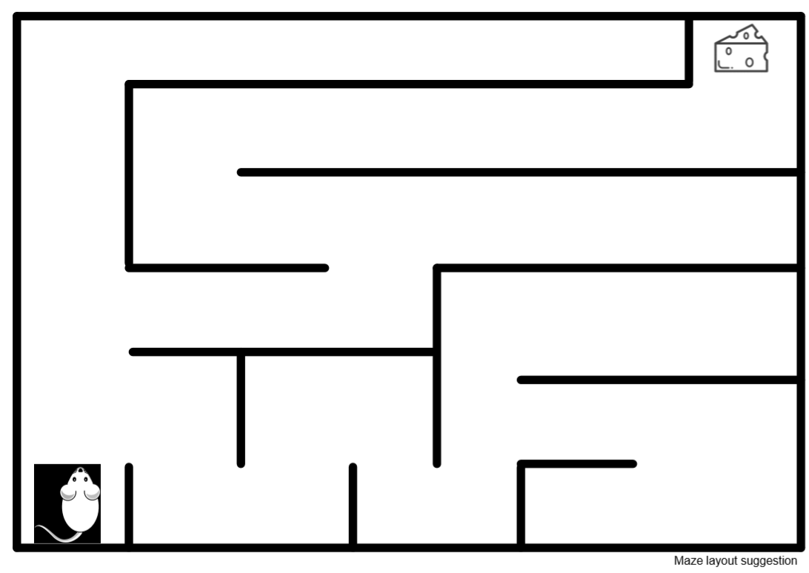
What is a maze?

Slide 3
Blindfold maze?
Working in pairs;
One person will give instructions
One will be blindfolded
The blindfolded person will wait at the start of the maze
The other person will give them instructions
Try to complete the maze.

Slide 4
Instruction Bank
TURN RIGHT
TURN LEFT
WALK FORWARD
TAKE _?_ STEPS
WALK BACKWARDS
STOP

Slide 5
Using Fractions
Use quarter turns, half turns and three-quarter turns.
Use clockwise and anti-clockwise

Slide 6
Use angles for turns as follows:
90 degree turn right, left or clockwise, anti-clockwise
180 degree turn right, left or clockwise, anti-clockwise
360 degree turn right, left or clockwise, anti-clockwise
Using Angles

