Slide 1
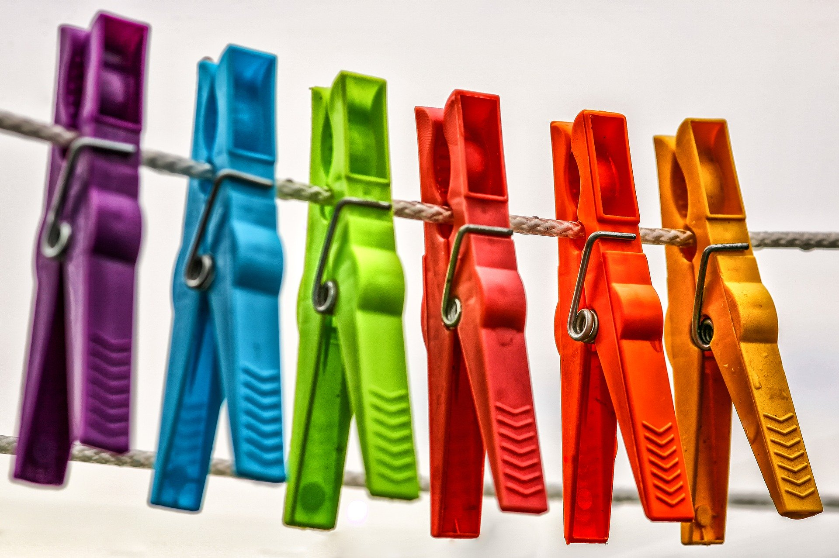
Material World
Matching materials to products

Slide 2
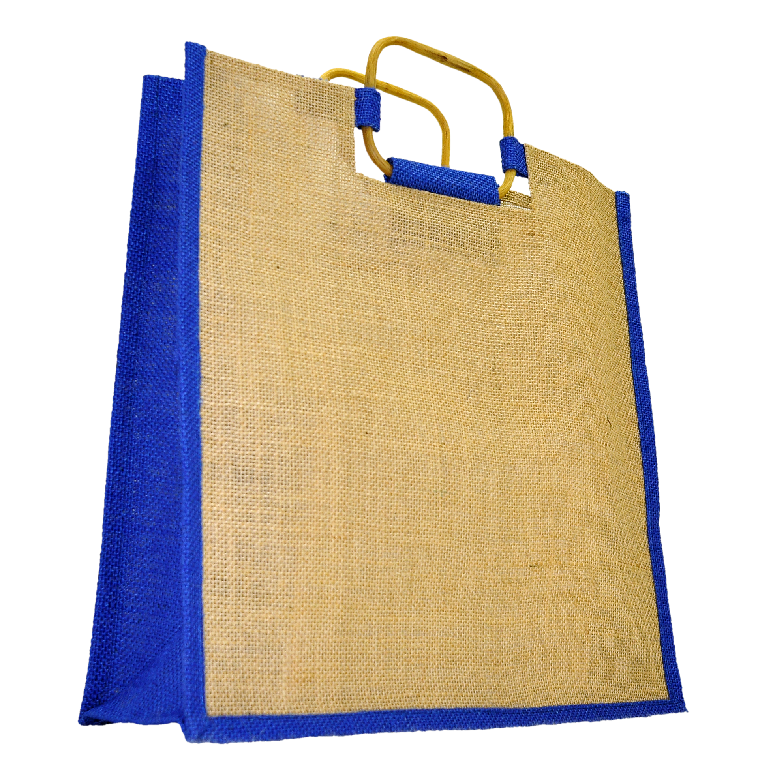
Plastic Bag
Fabric bag
Stretchy
Weak
Not Stretchy
Strong
Not Clear
Light
Light
Clear
Which bag is best for carrying heavy shopping?

Slide 3
Glass bowl
Plastic bowl
Heavy
Light
Strong
Strong
Hard
Hard
Breaks when dropped
Doesn’t break when dropped
Clear
Not Clear
Which bowl would be best for a baby?

Slide 4
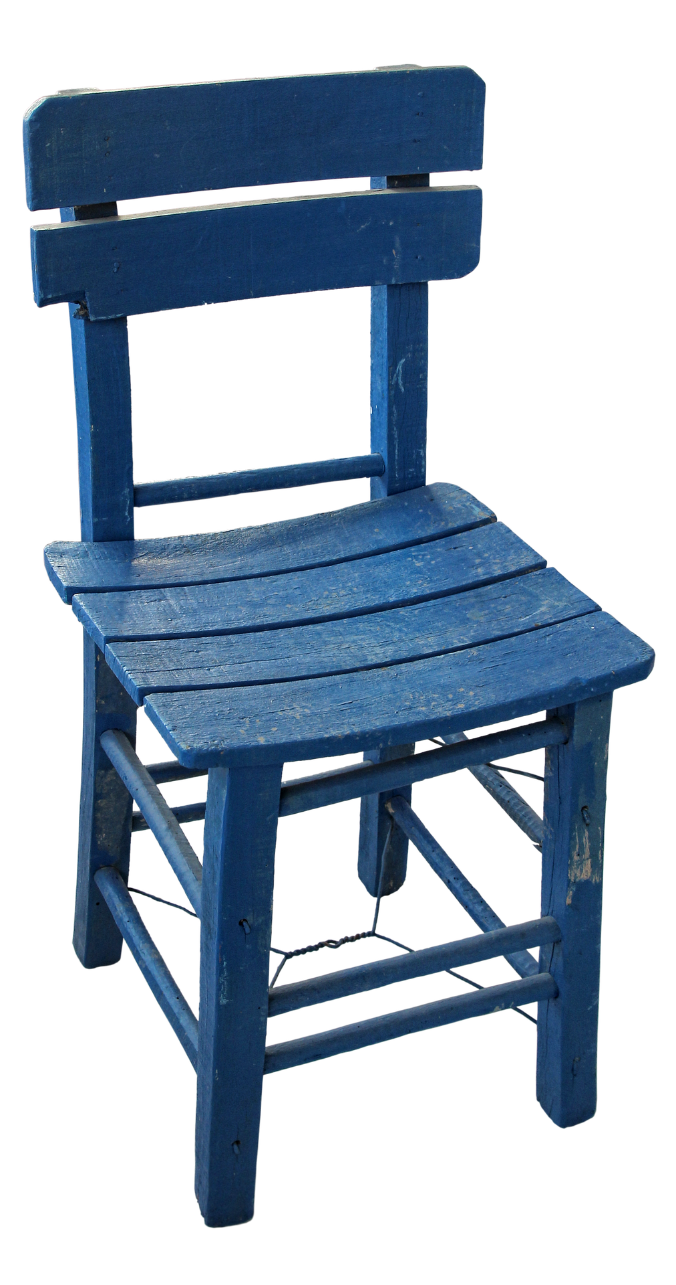
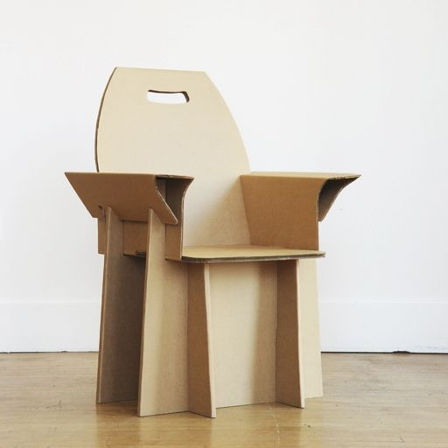
Cardboard chair
Wood chair
Not Waterproof
Heavy
Strong
Hard
Strong
Not Bendy
Light
Bendy
Waterproof
Which chair would be best for outside?

