Slide 1
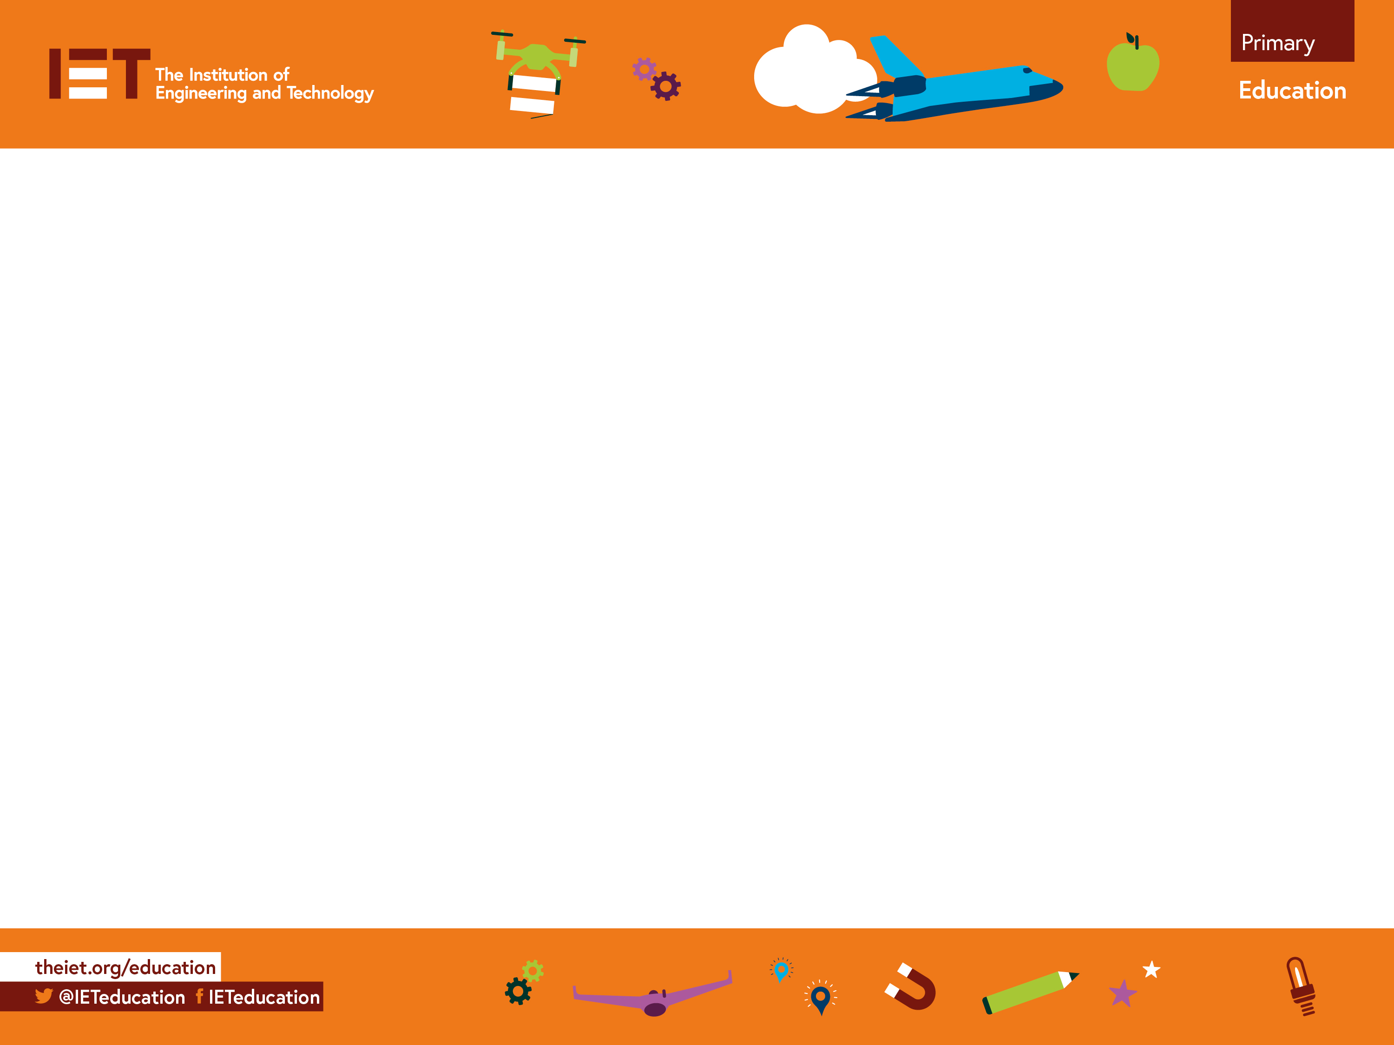
Reverse Writing
Mirror games (Reverse Writing)

Slide 2
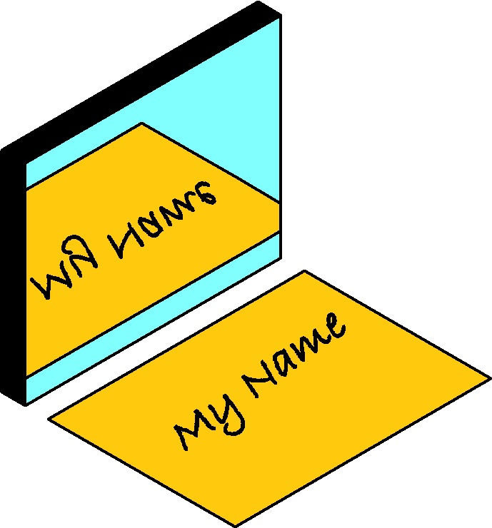
Step 1
Write your name on a piece of paper.
Place the mirror next to the writing.
How does your name now look in the mirror?

Slide 3
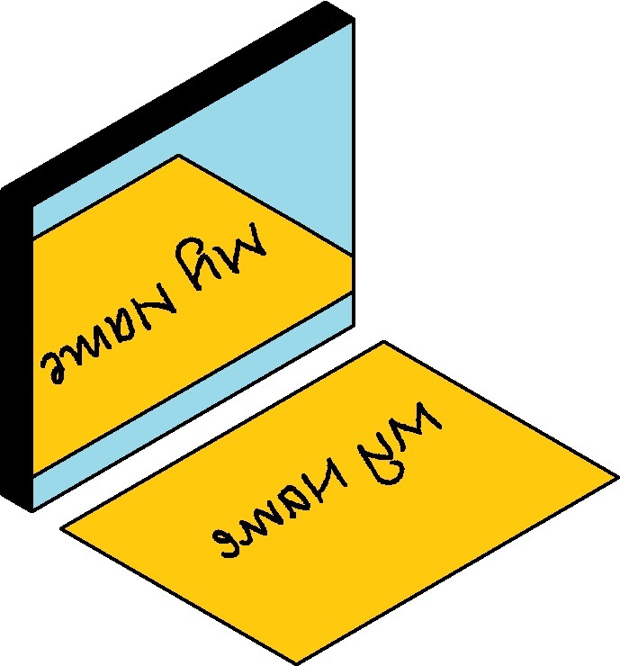
You can now read your name but it is facing away from you.
Step 2
Now write your name backwards from right to left on a piece of paper.
Every letter should be reversed.

Slide 4
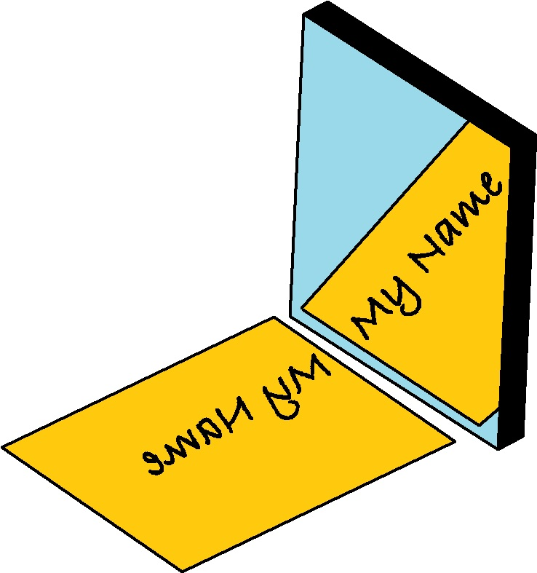
Step 3
Now hold your mirror to the right-hand side of the writing.
You will see your name clearly and not facing away from you.

Slide 5
Reverse Note Writing
Using reverse writing, write a note to a friend.
Ask them a question and see if they can read it.
Take your time as reverse writing takes practice.

