Slide 1
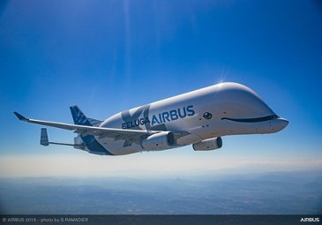
The IET Faraday Challenge Day
Notes:
9.15
As students arrive, get them to fill out Team Registration form and check they have Faradays.
Brief any visiting teachers and ambassadors. Check timings to ensure you can run to schedule. Ask about student needs including nut allergies.
9.30
Host school to do introduction to school and hosting (fire alarm and toilets) if required.
Welcome to the Institution of Engineering and Technology’s Faraday Challenge Day. My name is xxxx and I will be your Challenge Leader today.
The IET Faraday is a STEM Challenge held in many schools and universities for Year 8 students across the UK, England, Northern Ireland, Wales and Scotland.
For this Challenge we are working in partnership with Airbus.
This is a competition and we are looking for the best teams of engineers.
Today all of you will receive a certificate to say you have worked as an engineer for the Airbus team. The team which scores the most points will receive xxxx [whatever prizes school chooses]

Slide 2
Project Flow
Project brief
Planning
Team roles selection
Apprenticeship
Development
Presentation to client
Notes:
3 minutes
SCRIPT:
Today you will be working as real-life engineers.
You will be following an engineering project flow as shown.
We will explain each of these stages when we get to them so you will need to listen carefully to make sure your team completes each section of the project.

Slide 3
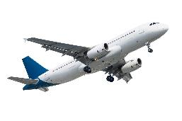
What is engineering?
“The application of knowledge and creativity to the needs of humanity”
Notes:
5 minutes
SCRIPT:
We do the Faraday Challenge Day to encourage you to think of being an engineer in the future. Anyone thinking of being an engineer?
What do you think engineering is? Thy to get response from each group. Stress idea that engineering is difficult to define.
We at the IET use this phrase [click on definition]. Use your own example of engineering to illustrate this idea.
There are many different areas of engineering. All require creativity and innovative problem-solving. Engineering use their knowledge and ideas to come up with new products or adapt existing products. They challenge themselves. We want you to do the same.

Slide 4
Project Flow
Project brief
Planning
Team roles selection
Apprenticeship
Development
Presentation to client
Notes:
1 minute
The first step in our project flow is the brief from our client, in this case the Airbus team.
Watch the video carefully to see what Airbus want you to do today.

Slide 5
Time to watch the video briefing
Notes:
09:50
Video is not embedded, you will either need to insert the video into the PowerPoint presentation or play it from the stand alone video on the website.

Slide 6
The brief
Design and engineer ONE prototype which will either:
help Airbus when transporting aid or,
provide something to help people in times of need.
You MUST Include at least one electronic component.
Complete the planning and events log
Present your idea to the Airbus judge(s).
Notes:
On click: Give overview of brief.
Let’s think about what kinds of disaster you may want to help Airbus support – give examples (earthquakes forest fire, flooding, etc.) or, if time, get students to do it.
Now let’s think about whether your team might want to do to help Airbus transport the aid or the type of aid you want to take to help the people. Remember it could be international transport or local transport. You are not designing an aeroplane or a helicopter but it could be something to help with your mode of transport.
What might people need in these areas – could elicit some ideas such as bridges, shelter, something to help get water, etc. The laminated A3 sheet on your table may give you some ideas but BE CREATIVE.
Your design will be a prototype. Does anyone know what I mean when I say prototype? (Seek responses from students and emphasize that their design may not be the finished product).
On click: Engineering is not just about the end result. The journey to this is just as important. You will need to complete the event log at key points during your development. We will explain this further later.
On click: Finally you will need to present your product to the judge(s) this afternoon. Engineers need to be able to tell people about these so that they can be used in the real world – we don’t want these ideas to be a secret! I will brief you about what should be in your presentation at 12.20 so don’t start writing this until then.

Slide 7
Considerations
Weight
Energy
Flexibility
Sustainability
Notes:
SCRIPT:
On click: You will need to think about the weight of something you design. How will we get it to the area of disaster? Remember heavy things are more difficult to transport both in the air and on land and large things take up more space.
On click: Think about how your prototype will get the energy it needs to power it. Consider the areas you might be going into in times of disaster.
On click: Think about what you will do with your prototype once it is no longer needed. Can we change things back to how they were before or can we use them in other ways?
On click: what will happen once the things you design are no longer needed? Will they just end up as rubbish in the area you were trying to help?
The brief can be found on page 5 of your student booklet so don’t forget to refer to this during your planning and development.

Slide 8
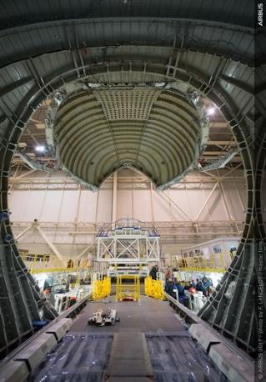
Assessment criteria
Planning
Development
Budget
Product
Presentation
Teamwork
Notes:
SCRIPT:
You will be scored on all of your work today. It isn’t just about your finished product, engineering is a journey and we want to know how you have arrived at your final prototype.
The marking criteria can be found on the back pages of your Airbus Student Booklet (direct students to look at pages 12 and 13) so it is a good idea to have a look at this to see how you can score marks. You will need to do well in all the areas in order to score highly.
You do not get marks for having money left at the end of the challenge but we are looking at how you have spent your budget.

Slide 9
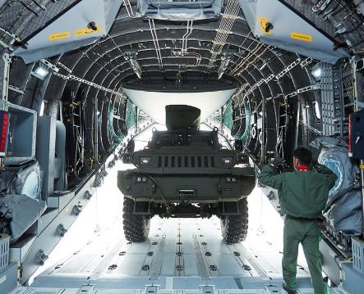
Project tools
Engineering shop
Cutting station
Hire centre trade card
‘How to’ sheets
Airbus Student Booklet
Engineering consultant
Notes:
SCRIPT:
Engineering Shop – This will open later. You have 120 Faradays to spend in the shop but supplies are limited. If you buy something you don’t need/want you can sell some of these back to the shop for half price as long as they unused but we will be looking at how often you do this as it tells us how good your team is at planning. The shop does not negotiate and does not do deals so don’t even try!
Mention Bargain Bin if using
Details of what is available to buy are in your Student Handbook. You MUST read this as it tells you important information and will prevent you buying things you cannot use.
Point out the Cutting Station and Hire centre and explain rules for trade card.
How To sheets – you can take two at a time to your table but please return them to the centre table when you have finished with them. These sheets will help you with some of the aspects of your designs and some of them MUST be read before you try to connect some of the equipment.
Airbus student booklet. This MUST be read if you want to have any chance of winning. There are many things in the book that are essential to score marks that your challenge leader will not tell you and you will only find out by reading. Yhou can write in this booklet if you want as it is yours to keep.
STEM consultant – We will help you but we will not tell you what to do or do it for you.

Slide 10
Project Flow
Project brief
Planning
Team roles selection
Apprenticeship
Development
Presentation to client
Notes:
SCRIPT:
You have now completed the Project Brief.

Slide 11
Project Flow
Project brief
Planning
Team roles selection
Apprenticeship
Development
Presentation to client
Notes:
10:10
Time to move on to Planning.

Slide 12
“Failing to plan is planning to fail”
Be creative!
Planning
Think think think
Notes:
SCRIPT:
Planning is essential to a successful project. We have seen many teams have great ideas and rush into developing them, only to realise that they won’t work, they don’t have enough Faradays or they simply don’t have the time to develop them.
All projects have a large planning aspect. This is an important stage of your project.

Slide 13
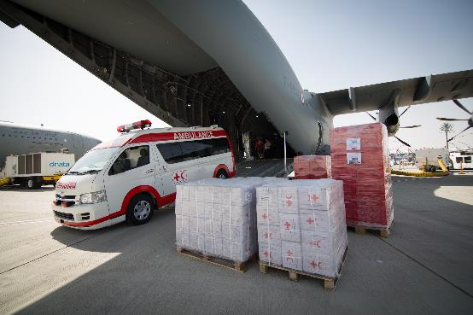
Planning
Explain how your idea will help the Airbus team
(3 marks).
Draw out your idea with labels. Provide as much detail of the construction as possible (5 marks).
Draw the electronic circuit(s) you will use (5 marks).
15
minutes
14
minutes
13
minutes
12
minutes
11
minutes
Time up
4
minutes
3
minutes
2
minutes
1
minute
10
minutes
5
minutes
6
minutes
7
minutes
8
minutes
9
minutes
Notes:
10:10
You have 15 minutes to plan out your prototype idea. Only draw the thing that you will make and make sure you use annotations to note how you are making it and what materials you are using. We should be able to copy your prototype from your final design.
These are the marking criteria from your Student Booklet that we will use to mark you. We do not mark handwriting or spelling so don’t worry about this.
You will not finish the planning in the next 15 minutes but please note that we will be marking this at 12.30. We WILL NOT remind you of this again so make sure you go back to update it during the morning as your design progresses.
Your brief is in your Student Booklet on page 5, use it to remind you what Airbus want from you.
You might want to look at some of the ‘How to ….’ sheets, but please only take two at a time to your table so that all groups get to look at them.
On click: The red box will disappear and the countdown from 15 minutes will begin. Do not freeze the presentation at this point as the countdown will stop.

Slide 14
Project Flow
Project brief
Planning
Team roles selection
Apprenticeship
Development
Presentation to client
Notes:
10.25
SCRIPT:
You have now completed the Planning part of the project. Now it is time to move onto our next task which is team roles selection.

Slide 15
Project Flow
Project brief
Planning
Team roles selection
Apprenticeship
Development
Presentation to client
Notes:
10.25
5 minutes
SCRIPT:
In real life, engineers work in teams and their ability to work well as a team is key to their success. Today, you are going to take on real–life engineering roles to experience what it is like to be part of a problem solving team.

Slide 16
Team Roles
Design engineer
Project manager
Client communication officer
Stress engineer
Safety officer
Accountant
Electronics engineer
Manufacturing engineer
Mechanical engineer
Design engineer
Notes:
SCRIPT
You have 5 minutes to choose a project manager and an accountant for your team. Remember that these people will also be part of the engineering team so they can’t just put their feet up and shout orders!
The Project manager [Red sticker] will manage the project, checking out the marking criteria, keeping the team together and making sure the team meets all the deadlines.
The Accountant [Yellow sticker] will manage the budget. They are the only one who can go to the shop but they may take one other person. They will also need to keep a record of their spending on the accounts sheet.
Your Challenge Leader will give you a red and a yellow sticker so that we can see who has taken on each role. You may decide you want to allocate other roles in your team, it is your team so do you what you feel will work well. But remember everyone is an engineer.
Notes:
Give 1 minute warning.

Slide 17
Project Flow
Project brief
Planning
Team roles selection
Apprenticeship
Development
Presentation to client
Notes:
SCRIPT:
Now onto our last task before you can work as part of the Airbus engineering team.

Slide 18
Project Flow
Project brief
Planning
Team roles selection
Apprenticeship
Development
Presentation to client
Notes:
10:30
SCRIPT:
Find the Engineering Apprenticeship brief on page 7 of your Student Booklet.

Slide 19
Engineering Apprenticeship
All teams MUST complete the Apprenticeship and everyone in your team MUST be involved.
Use the components in the box to connect the circuit shown in your student booklet on page 7.
What happens when you shine a light onto the Light Dependent Resistor?
What happens when you cover it up?
Notes:
10.30
SCRIPT:
All engineers need to complete an apprenticeship. You will also need to discuss the questions on the sheet and be ready to respond when the challenge leader asks for ideas.
You must show me your circuit when you have successfully completed it.
Once all teams have finished discuss the idea of resistance quickly. Remind them these ideas might be important in their development. Explore briefly the difference between LDRs, solar panels and switches. Point them towards ‘How to sheets’ such as making a parallel circuit.
NOTES:
Watch for them splitting in to boys groups and girls groups during apprenticeship – you may want to point out that each gender brings strengths and they should work across the team wherever possible.

Slide 20
Project Flow
Project brief
Planning
Team roles selection
Apprenticeship
Development
Presentation to client
Notes:
Notes:
Collect in apprenticeship packs.
The room may be noisy now and teams will be keen to get going on their development but call for quiet and advise that they have all now completed the Apprenticeship.
Celebrate this by encouraging them to give themselves a round of applause.

Slide 21
Project Flow
Project brief
Planning
Team roles selection
Apprenticeship
Development
Presentation to client
Notes:
SCRIPT:
Now you have completed your apprenticeship, the Airbus team are happy for you to begin work on their project.
You are now my engineers in my engineering workshop. You are not Y8/S1/S2/Y9 [depends on where you are in UK] students so before I open the shop we need to do a quick health and safety briefing.

Slide 22
Health and safety briefing
Keep your work station tidy (including the floor around it).
Take care with craft knives, hacksaw, scissors and staplers.
Three people only at the cutting station at any time.
No blades to be left open and no tools to be removed from the cutting station.
Be careful of short circuits.
Report spillages, accidents or potential hazards to the Challenge Leader or STEM Consultant immediately.
No food or drink near work tables, shop or cutting station.
Notes:
2 mins
Notes:
Remind them that working as a team is important and they need to keep themselves and everyone in the room safe. We will be looking at this when marking their team work.
Go through the tips for safe working!
Re-emphasise the rules of the Cutting Station

Slide 23
Development
Shop open
Hand in your apprenticeship pack to begin using the shop.
Begin to develop your product.
Remember to go back to your Planning sheet to make sure it is completed.
Notes:
10.40
SCRIPT:
Shop open for business!
We will have a break shortly and I will tell you what you need to do for the Events Log after your break.

Slide 24
Morning break
Notes:
11.00-11.10
SCRIPT:
This is a working break so you may continue to work on your prototypes if you wish.
Keep food and drink away from the electrical components and resources please!

Slide 25
Event Log Entry 1
Record your engineering developments during this period. Include how your team has worked and what problems you have faced and how you have solved these.
Be specific.
Be honest and accurate.
Notes:
11:10
Notes:
Remind them to complete the event log for the time period up to this point.
Explain that the journey to their final product is really important. Get them to focus on the engineering progress and to think about how their team is working.
Remind them to look at the assessment criteria for the events logs.

Slide 26
Event Log Entry 2
Record your engineering developments during this period. Include how your team has worked and what problems you have faced and how you have solved these.
Be specific.
Be honest and accurate.
Notes:
11:35
Notes:
Do not interrupt them for this unless the sound is poor and they cannot easily hear the drum roll.

Slide 27
Event Log Entry 3
Record your engineering developments during this period. Include how your team has worked and what problems you have faced and how you have solved these.
Be specific.
Be honest and accurate.
Notes:
12:05
Notes:
Do not interrupt them for this unless the sound is poor and they cannot easily hear the drum roll.

Slide 28
Presentation briefing
5 minutes, maximum, to present.
Look at the assessment criteria and write notes.
Demonstrate and explain how your prototype works.
Make it interesting.
Notes:
12:20
Notes:
Remind them that all the team should present.
Emphasise the need to look at the assessment criteria. If there are 4 marks for something then 1 sentence is not going to be enough to score highly.
Be specific and detailed. For example, if you have used a parallel circuit you might want to explain why. Remember our discussion about resistance in the Engineering Apprenticeship.
Encourage them to make notes for their presentation. Show them the paper and tell them they can have 2 sheets each team. They must take this before lunch as we will be packing it away.
Tell them it is their presentation and they may present in any way they like – make it interesting!

Slide 29
Engineering Priorities
List your engineering priorities for the last half hour of development.
What does the team need to do?
Who will do what?
In what order?
Notes:
12:23
Notes:
Ask teams to spend time before lunch identifying their priorities for the last 30 minutes of workshop time.
Remind them to be specific about what they will do, be realistic about what they can achieve in the time remaining, to look at the marking criteria for the product and to focus on the engineering rather than on aesthetics.
Don’t include writing the presentation in these priorities, stick to engineering priorities only.
Remind them to make sure their planning and events log is ready for marking at lunchtime. They will not get these back after lunch.

Slide 30
Lunch
Tools down – take a 30 minute break
Notes:
12.30 – 1.00 pm
Notes:
Ask students to sit away from their tables if they are remaining in the room for lunch.
Ensure all tools are at the cutting station before the students leave the room
Mark planning and events log.

Slide 31
Final preparations
Can you complete your prototype in the time left?
Have you started preparing your presentation?
Have you filled in your accounts sheet?
Do you need to buy anything else from the shop?
How can you best use the time remaining?
Notes:
13.00
Notes:
Focus the students on reflecting on what is achievable.
SCRIPT:
The shop will close at 1.30 pm so make sure you have bought or sold back any items. You must be ready to submit your accounts sheets to the shop when it closes.
You must be ready to present your pitch at 13.50 so spend time rehearsing it.

Slide 32
Preparing to present
The shop is now closed
Submit your accounts sheets and any remaining Faradays to the shopkeeper.
Return any items you are not using.
Practise your presentation – remember to check the assessment criteria!
Shop closed
Notes:
13.30 pm
Notes:
Accountants to submit sheets and remaining Faradays to shop. Ask shopkeeper to note any discrepancies between what they say have remaining and what they hand back and then to return accountancy sheets to you and sort out Faradays in the box.
Remind teams of importance of doing an interesting, rehearsed presentation and that this is part of the marking criteria.

Slide 33
Project Flow
Project brief
Planning
Team roles selection
Apprenticeship
Development
Presentation to client
Notes:
SCRIPT:
You have now completed your development section.

Slide 34
Project Flow
Project brief
Planning
Team roles selection
Apprenticeship
Development
Presentation to client
Notes:
SCRIPT:
This is the time that the engineers would present their ideas to their client; in this case, the Airbus team.

Slide 35
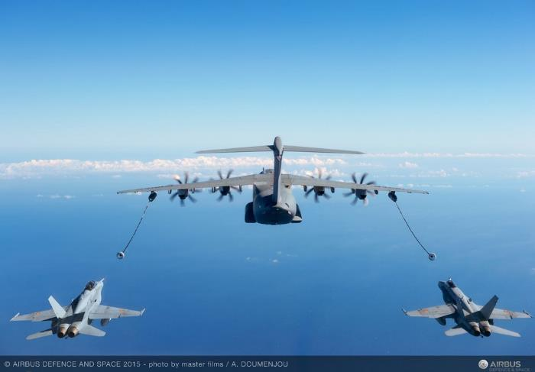
Presentation
Notes:
13.50
SCRIPT:
Telling others about your ideas is fun. There may be problems or issues with prototypes but it is important to be relaxed! Remember I am marking on a number of different things and the competition is not won or lost on the performance of the prototypes. I am using all of the sections of the marking criteria to award marks.
Notes:
Ask students to come and sit in a semi-circle around the presentation area. Leave products on tables until ready to present. Run through how the presentations will work e.g. numerical order, once the previous team has finished – round of applause and then the next team can stand up and get ready.
There may be questions if you have time or if anything needs clarifying. Do not allow questions from students or other teachers.
Emphasise that any questions are intended to get them extra marks and not to trip them up. Keep questions as positive as possible.
Remind them we will cut them off if they go over time.

Slide 36
Project Flow
Project brief
Planning
Team roles selection
Apprenticeship
Development
Presentation to client
Notes:
14.45
SCRIPT:
You have now completed the whole project and worked in the way engineers work in real-life. Well done to all of you. You should be very proud of your achievements today.
Give brief feedback to each team about their strengths if there is time.

Slide 37
And the winner is...
Notes:
14.50
Notes:
Make sure you are finished on time to allow visiting schools to get back in time.
Present trophy/vouchers.

Slide 38
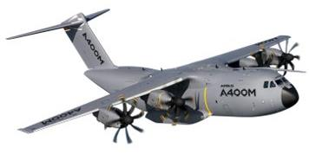
Thank you and goodbye!
Notes:
Slide to be shown as students/teachers leave

