Slide 1
Product design: create an ergonomic shopping bag for older adults

Slide 2
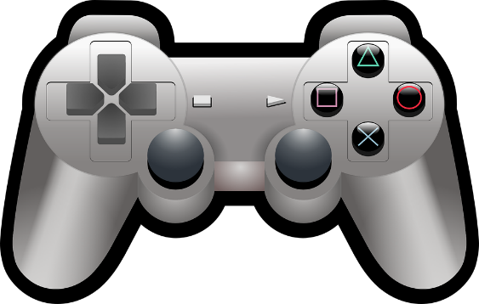
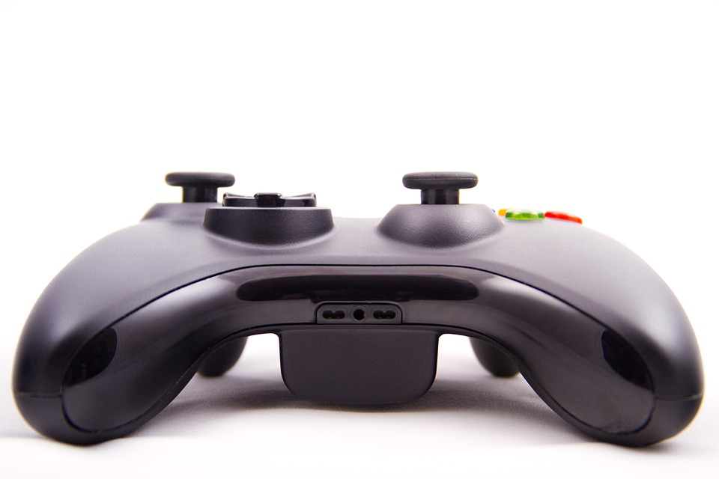
What is ergonomics?
Ergonomics is the study of how efficiently and comfortably people can interact with products and systems.
It is often referred to as ‘human factors’ or the relationship between people and products.
For example, a computer games controller is designed to fit comfortably in the hand.
Notes:
Teacher could show a games controller or other example of ergonomic design and pass round the class. A discussion could then be held about what features are included to make it ergonomic.

Slide 3
What is anthropometric data?
Anthropometrics is the consideration of the sizes of people, so that products can be effectively designed.
Anthropometric data is a collection of measurements of people that is presented in tables and available for designers to use.
For example, hand, feet and head sizes.
When designing a firefighters’ helmet, average adult head sizes would need to be considered.

Slide 4
Design Brief
Situation
Older adults can develop pains in their joints that make carrying their shopping difficult.
Brief
Design a product that will assist older adults in carrying their shopping bags. The product must be ergonomically designed so that it is comfortable to use.
Notes:
Discuss the brief and design criteria with learners.

Slide 5
Design Criteria
The product must:
Enable an older adult to carry three or more shopping bags with one hand.
Have an ergonomically designed handle so it is comfortable to hold.
Make use appropriate anthropometric data.
Be aesthetically appealing to the target audience.
Notes:
Discuss the brief and design criteria with learners. If learners have completed the activity ‘Understanding ergonomics and anthropometrics’ then they should use the data gathered to aid them in this activity. If being completed as standalone activity then the teacher may wish to provide suitable data, or learners can source their own from appropriate tables.

Slide 6
Shopping Bag Carrier Design
Use this space to sketch your idea for your product.
Don’t forget to annotate your design to show how it meets the design criteria!
Notes about design:
Notes:
Learners can use this sheet to present their ideas, annotations and supporting notes.

Slide 7
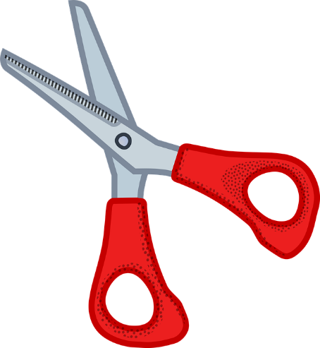
Extension
Make a full scale card model of your design to demonstrate how it would work.

