Slide 1
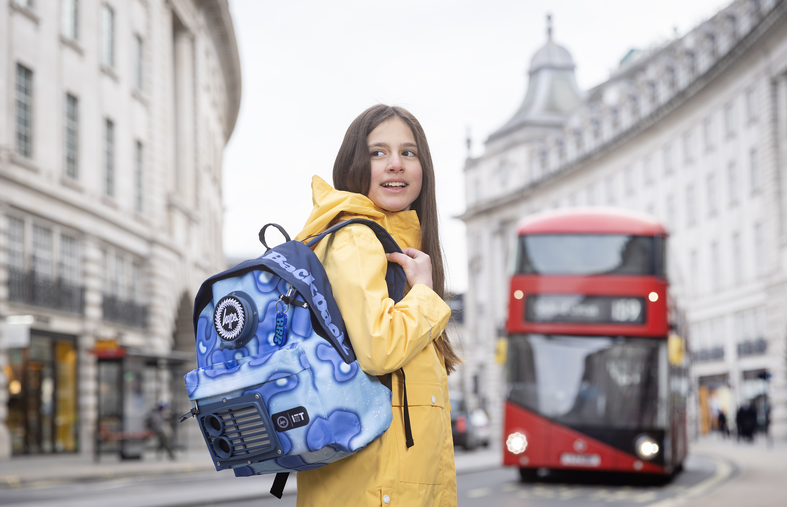
Design a futuristic backpack
Designing the dream backpack of the future

Slide 2
Stay safe
Whether you are a scientist researching a new medicine or an engineer solving climate change, safety always comes first. An adult must always be around and supervising when doing this activity. You are responsible for:
ensuring that any equipment used for this activity is in good working condition
behaving sensibly and following any safety instructions so as not to hurt or injure yourself or others
Please note that in the absence of any negligence or other breach of duty by us, this activity is carried out at your own risk. It is important to take extra care at the stages marked with this symbol: ⚠
Notes:
Safety Warning

Slide 3
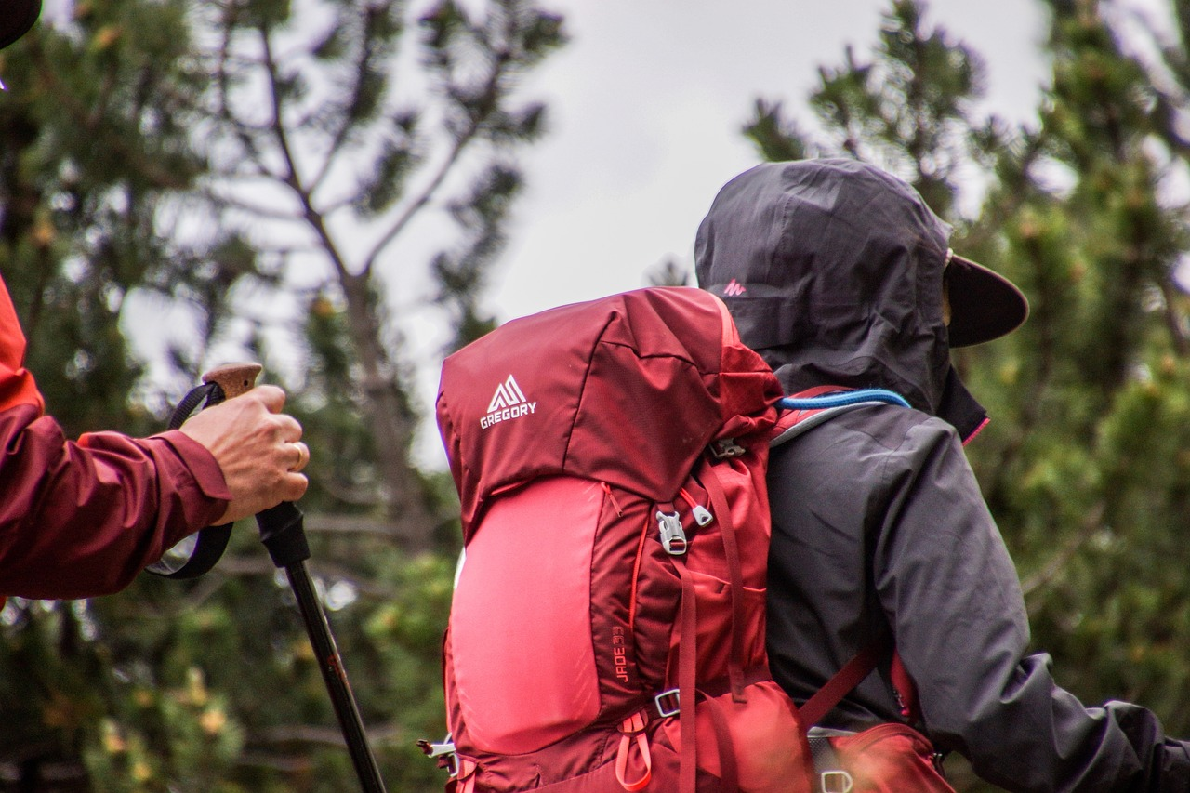
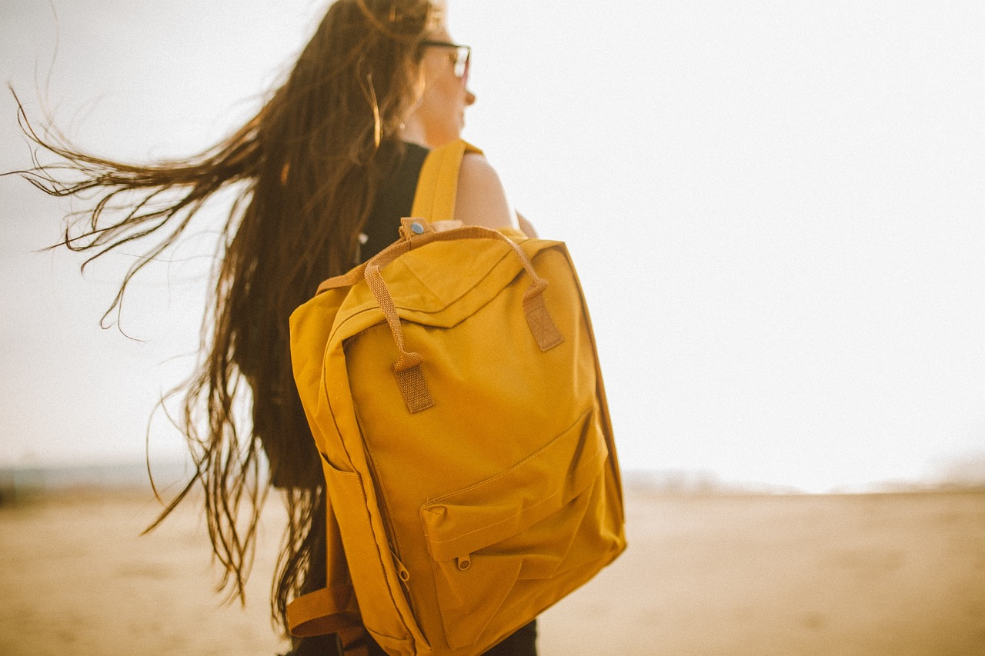
Backpacks
Backpacks are used to carry all sorts of items. For example:
  Books when going to and from school
  Food and water when out walking
  Clothes when going on holiday
Notes:
Discuss different uses of backpacks and why they are used.
Can learners think of any others?
How can STEM be used when designing backpacks?

Slide 4
Design brief
Context
Backpacks are used to carry items for lots of different activities
They are often very colourful and stylish
Brief
Design your dream backpack of the future
Notes:
Discuss the design brief with learners.
The context sets the scene for the design problem, the brief gives the problem itself that is to be solved.

Slide 5
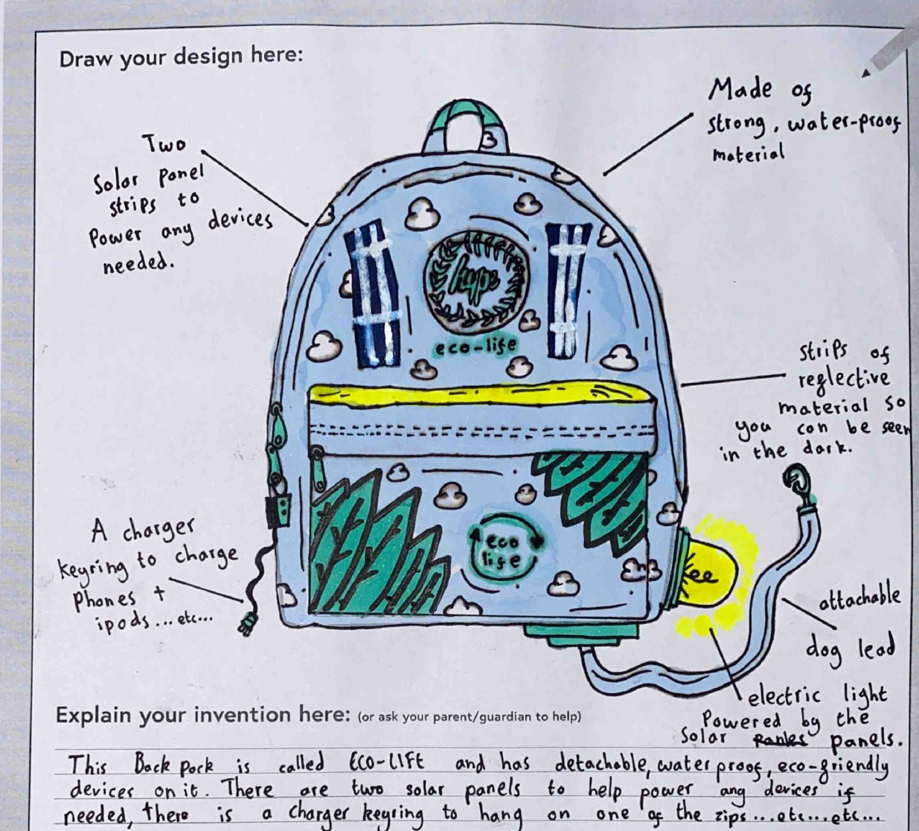
Design criteria
Your design must include:
A way of comfortably wearing on the back
Spaces to carry different items
Colours that show your personality
Clever gadgets and special tech that allow you to do incredible things
Notes:
Discuss the design criteria with learners.
The design criteria is a list of design points that the finished solution must meet.
Examples of clever gadgets etc could include:
A solar power system to help cycle extra fast on the way home from school
A special hive to help protect bees
A way of healing cuts if the wearer fell over
A way to instantly turn plastic rubbish into cool toys to play with at breaktime
Explain these examples to learners and ask them if they can think of any others.

Slide 6
Things to think about in your design
Originality: How original is your idea?
Feasibility: How feasible is it that your design can be turned into a real-life prototype?
Creativity: How creative is your idea?
Engineering: What engineering processes have you used in your design?
Notes:
Teacher may need to explain the terms originality, creativity and feasibility.

Slide 7
Future backpack design
Notes:
Learners could use this space to produce their design – this could be printed on A4 or A3 paper.
Encourage them to use notes and labels to explain their idea and how it meets the design criteria.

Slide 8
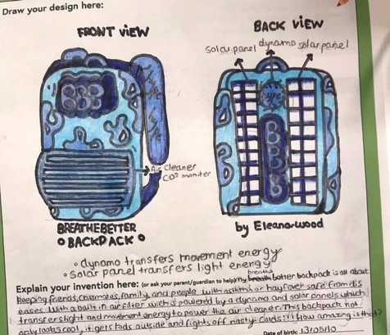
Example 1
Notes:
An example of a possible design.
Winners of IET Backpack to the future competition:
https://www.dailymail.co.uk/sciencetech/article-11691551/Girl-12-creates-backpack-filters-air-pollution-seeing-mother-suffer-asthma.html
https://kindredagency.com/our-work/backpack-to-the-future/
https://eabw.theiet.org/past-campaigns-and-activities/backpack-to-the-future/

Slide 9
Example 2
Notes:
An example of a possible design.
Winners of IET Backpack to the future competition:
https://www.dailymail.co.uk/sciencetech/article-11691551/Girl-12-creates-backpack-filters-air-pollution-seeing-mother-suffer-asthma.html
https://kindredagency.com/our-work/backpack-to-the-future/
https://eabw.theiet.org/past-campaigns-and-activities/backpack-to-the-future/

Slide 10
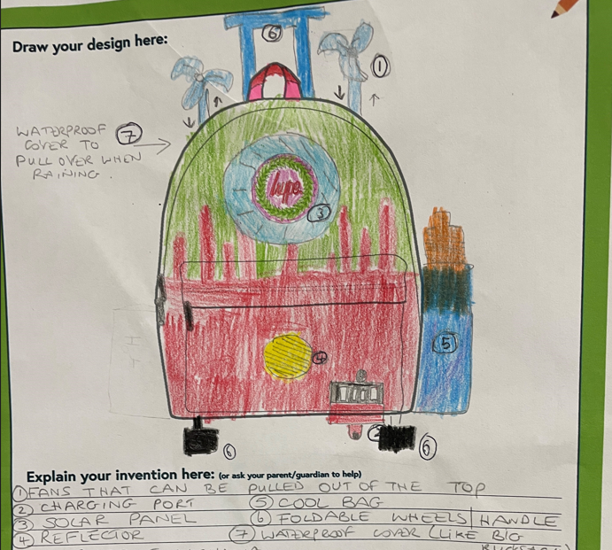
Example 3
Notes:
An example of a possible design.
Winners of IET Backpack to the future competition:
https://www.dailymail.co.uk/sciencetech/article-11691551/Girl-12-creates-backpack-filters-air-pollution-seeing-mother-suffer-asthma.html
https://kindredagency.com/our-work/backpack-to-the-future/
https://eabw.theiet.org/past-campaigns-and-activities/backpack-to-the-future/

Slide 11
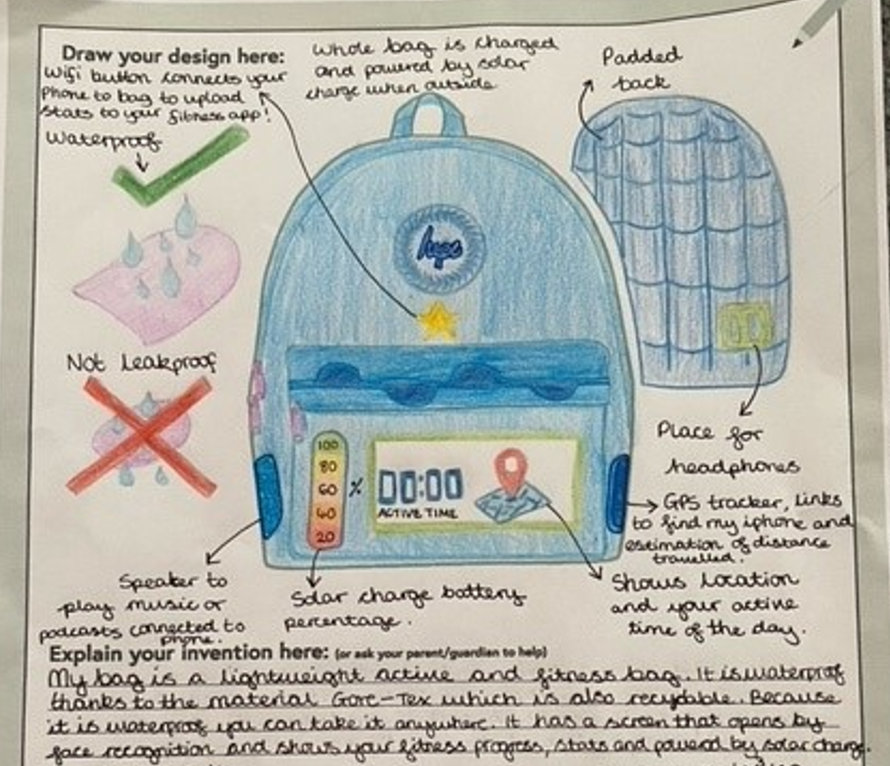
Example 4
Notes:
An example of a possible design.
Winners of IET Backpack to the future competition:
https://www.dailymail.co.uk/sciencetech/article-11691551/Girl-12-creates-backpack-filters-air-pollution-seeing-mother-suffer-asthma.html
https://kindredagency.com/our-work/backpack-to-the-future/
https://eabw.theiet.org/past-campaigns-and-activities/backpack-to-the-future/

Slide 12
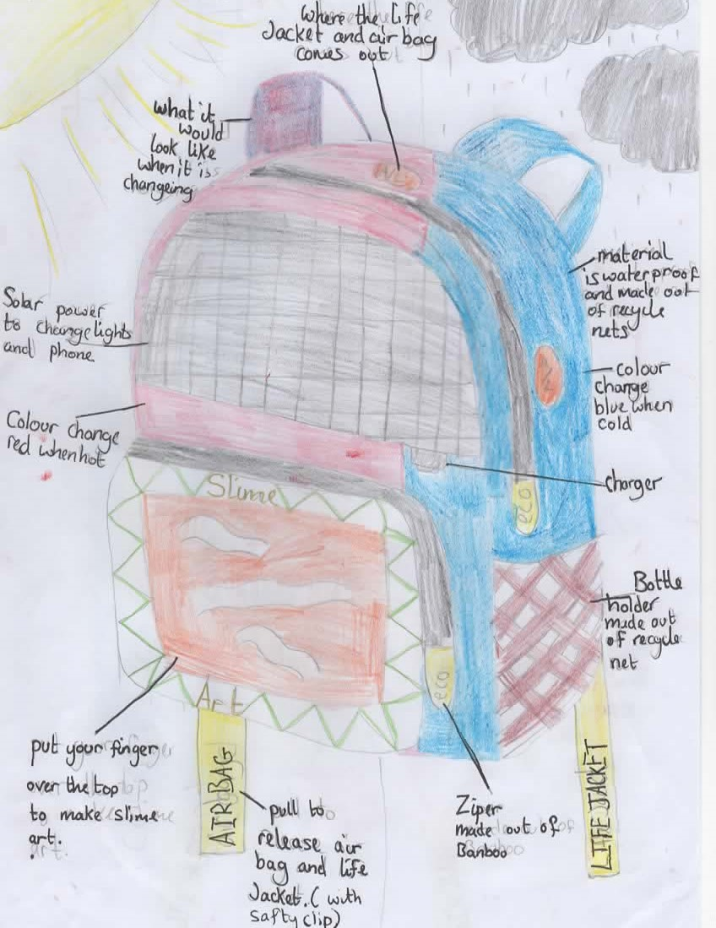
Example 5
Notes:
An example of a possible design.
Winners of IET Backpack to the future competition:
https://www.dailymail.co.uk/sciencetech/article-11691551/Girl-12-creates-backpack-filters-air-pollution-seeing-mother-suffer-asthma.html
https://kindredagency.com/our-work/backpack-to-the-future/
https://eabw.theiet.org/past-campaigns-and-activities/backpack-to-the-future/

Slide 13
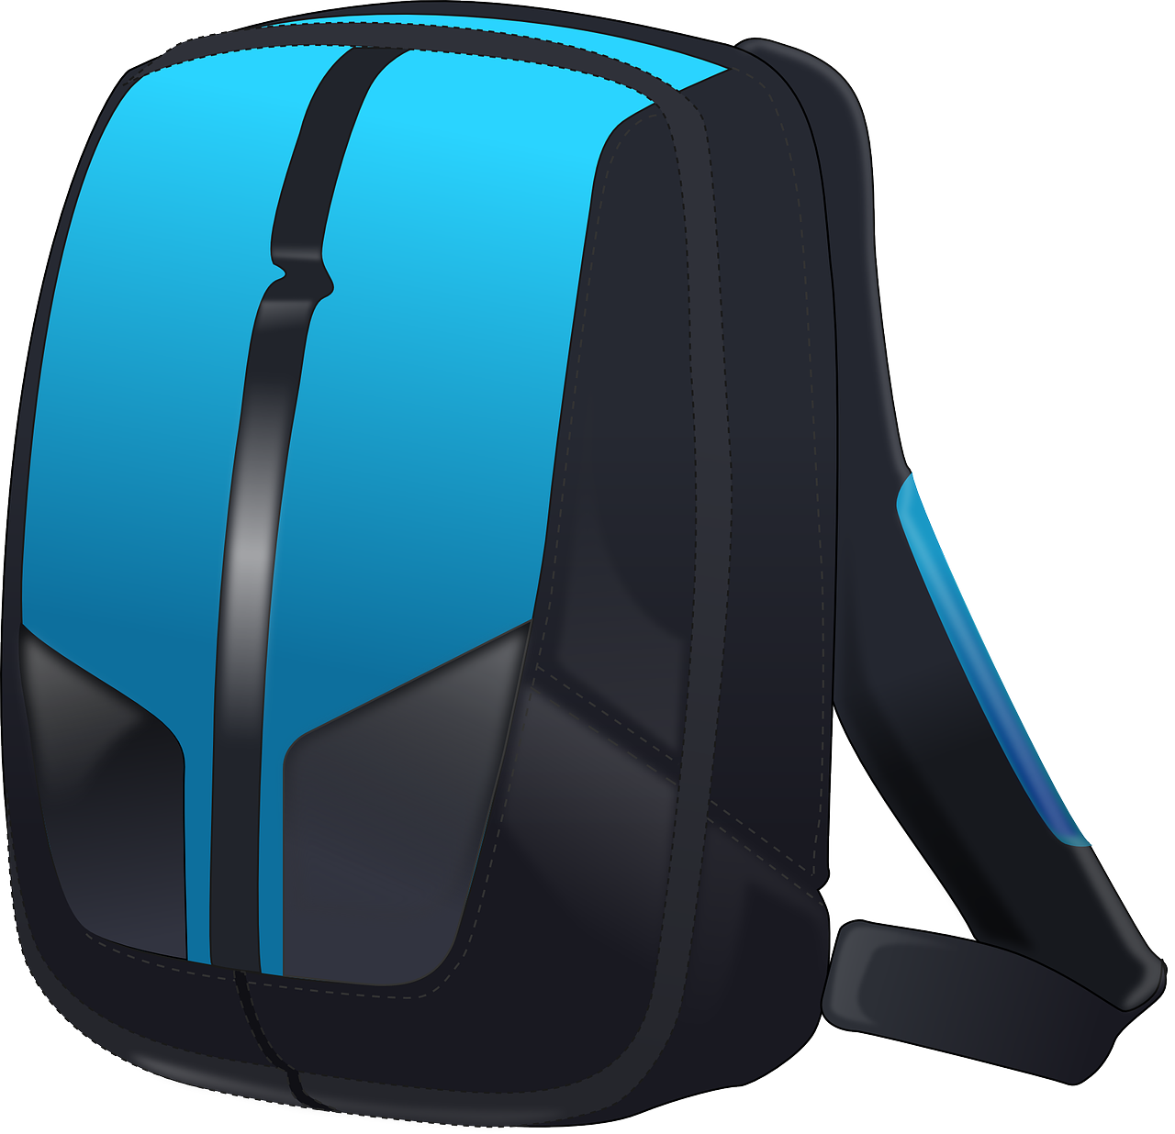
Extension
Make a prototype or model of your backpack design
Design a backpack for doctors or paramedics to carry their medical equipment
Design a backpack for your favourite sports star

