Slide 1
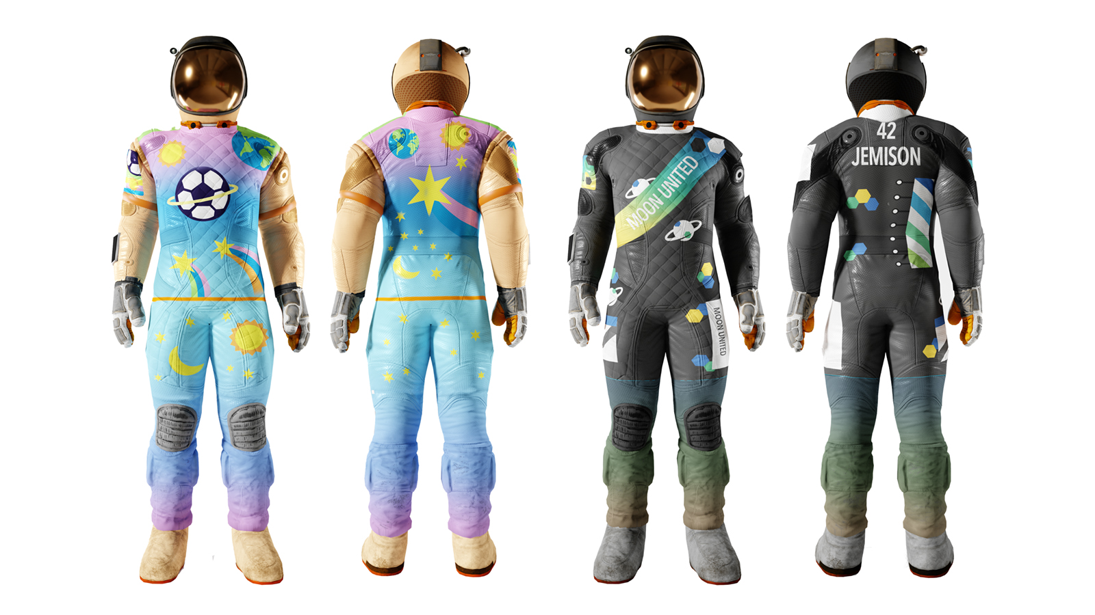
Design a football kit to use on the Moon
Designing and evaluating a football kit for the
first football team on the Moon

Slide 2
Stay safe
Whether you are a scientist researching a new medicine or an engineer solving climate change, safety always comes first. An adult must always be around and supervising when doing this activity. You are responsible for:
ensuring that any equipment used for this activity is in good working condition
behaving sensibly and following any safety instructions so as not to hurt or injure yourself or others
Please note that in the absence of any negligence or other breach of duty by us, this activity is carried out at your own risk. It is important to take extra care at the stages marked with this symbol: ⚠

Slide 3
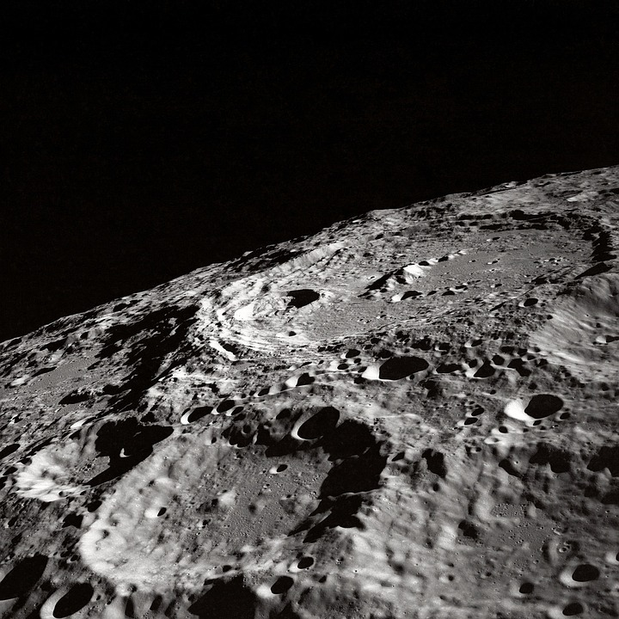
Football on the moon
Thanks to STEM we could be playing football on the Moon in years to come!
This would be very different to here on Earth
What problems do you think you would face?
Notes:
Discuss the problems with playing football on the Moon with learners:
How would you be able to breath?
How would you cope with much lower gravity?
What surface would you play on?
Can learners think of any others?
STEM = Science, Technology, Engineering and Mathematics

Slide 4
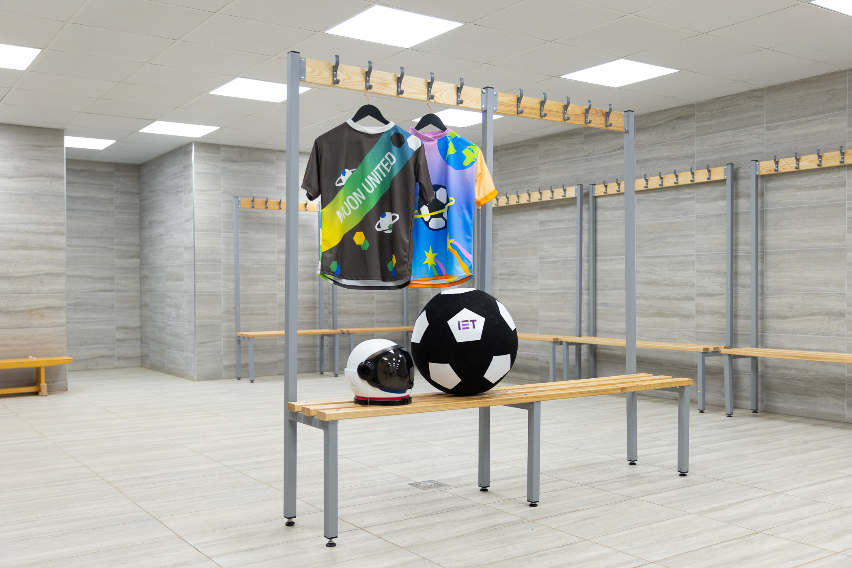
Design brief
Context
Moon United are the first football team to play on the Moon!
They need a kit to play in
Brief
Use your skills, creativity and imagination to design a home football kit for Moon United
Notes:
Discuss the design brief with learners.
The context sets the scene for the design problem, the brief gives the problem itself that is to be solved.

Slide 5
Design criteria
Your design must include:
A badge design for team Moon United
Colours and items that you like or that show your personality
A special element, gadget or tech feature that would make your kit perfect for playing on the Moon
Notes:
Discuss the design criteria with learners.
The design criteria is a list of design points that the finished solution must meet.

Slide 6
Extra design considerations
Originality: How original is your idea?
Creativity: How creative is your idea?
Engineering: What makes your kit perfect for the Moon and different from an Earth football kit?
Personality: How does the design bring to life the things you love?
Notes:
Teacher may need to explain the terms originality and creativity.

Slide 7
Design specification
Use the design criteria and extra considerations to write a six point design specification for your football kit
Point 1
Point 2
Point 3
Point 4
Point 5
Point 6
Notes:
A design specification gives specific and measurable criteria that must be met by the design. It should therefore expand on the design criteria.
For example, what exact materials, colours and technologies will be used.
Extra points could also be added e.g. how the design could be sustainable, make use of solar energy etc.

Slide 8
Moon United football kit design
Notes:
Learners could use this space to produce their design – this could be printed on A4 or A3 paper.
Encourage them to use notes and labels to explain their idea and how it meets the design criteria.

Slide 9
Evaluation
Evaluate how well your design meets the design criteria:
Which points does it meet? How?
Which points does it not meet? Why?
How could you improve your design?
Notes:
Evaluation involves checking the design produced against the design criteria and identifying where improvements could be made.

Slide 10
Examples
Example 1
Example 2
Images from IET Moon United 2023 competition and campaign.
Notes:
Examples of possible designs.
Further examples can be found here: https://eabw.theiet.org/kids-stem-competition/

Slide 11
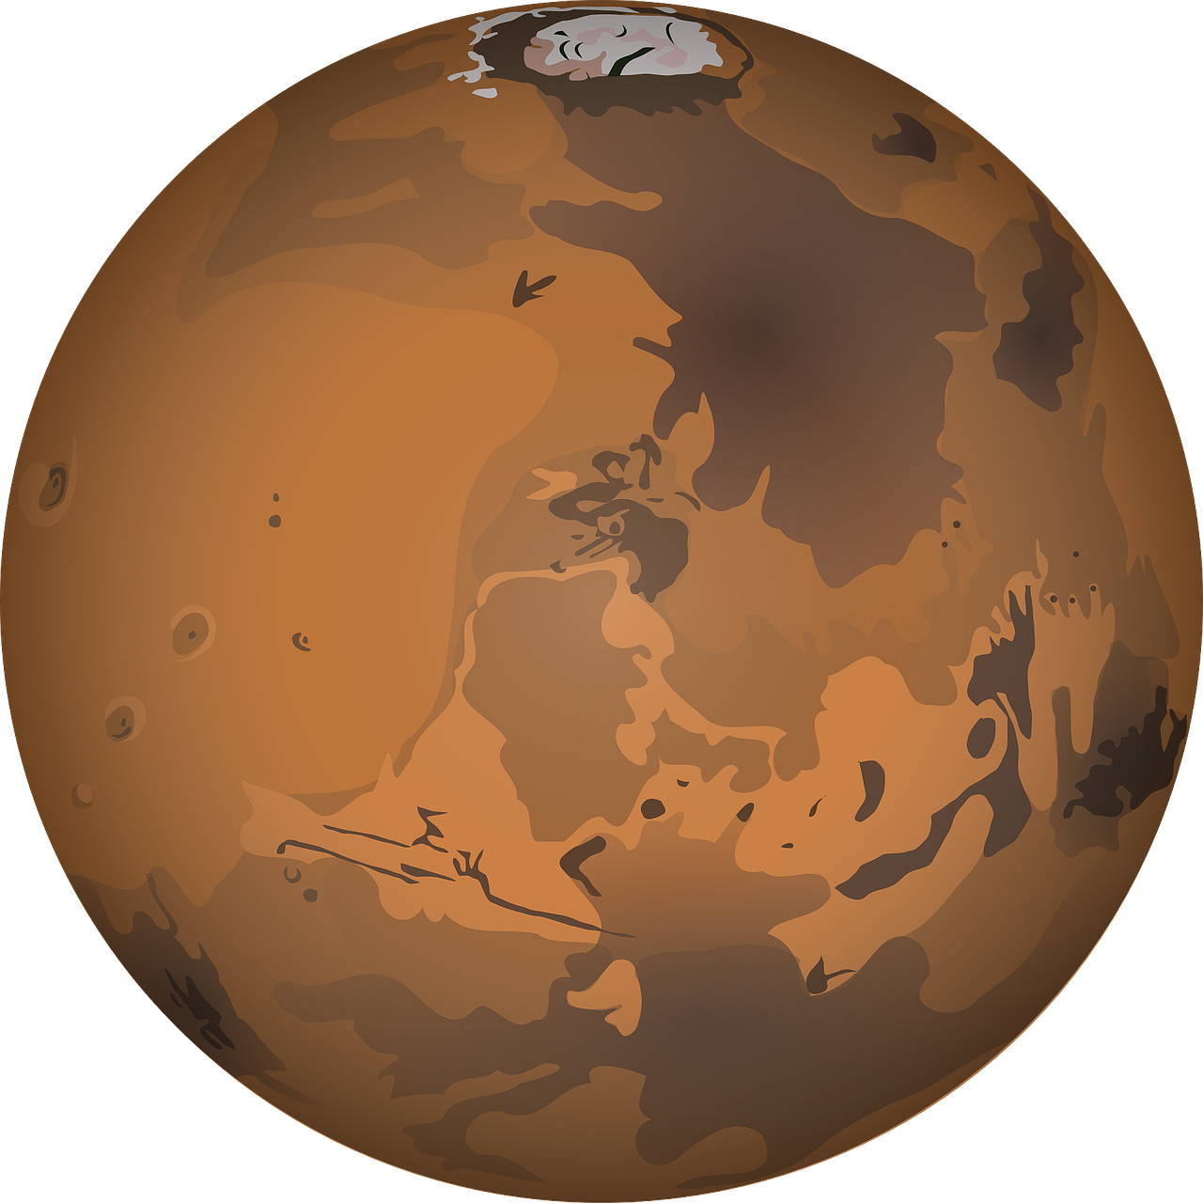
Extension
Design an away kit for Moon United
Design a football pitch for Moon United to play on
Design a home kit for a new football team based on Mars – Mars Rovers

