Slide 1
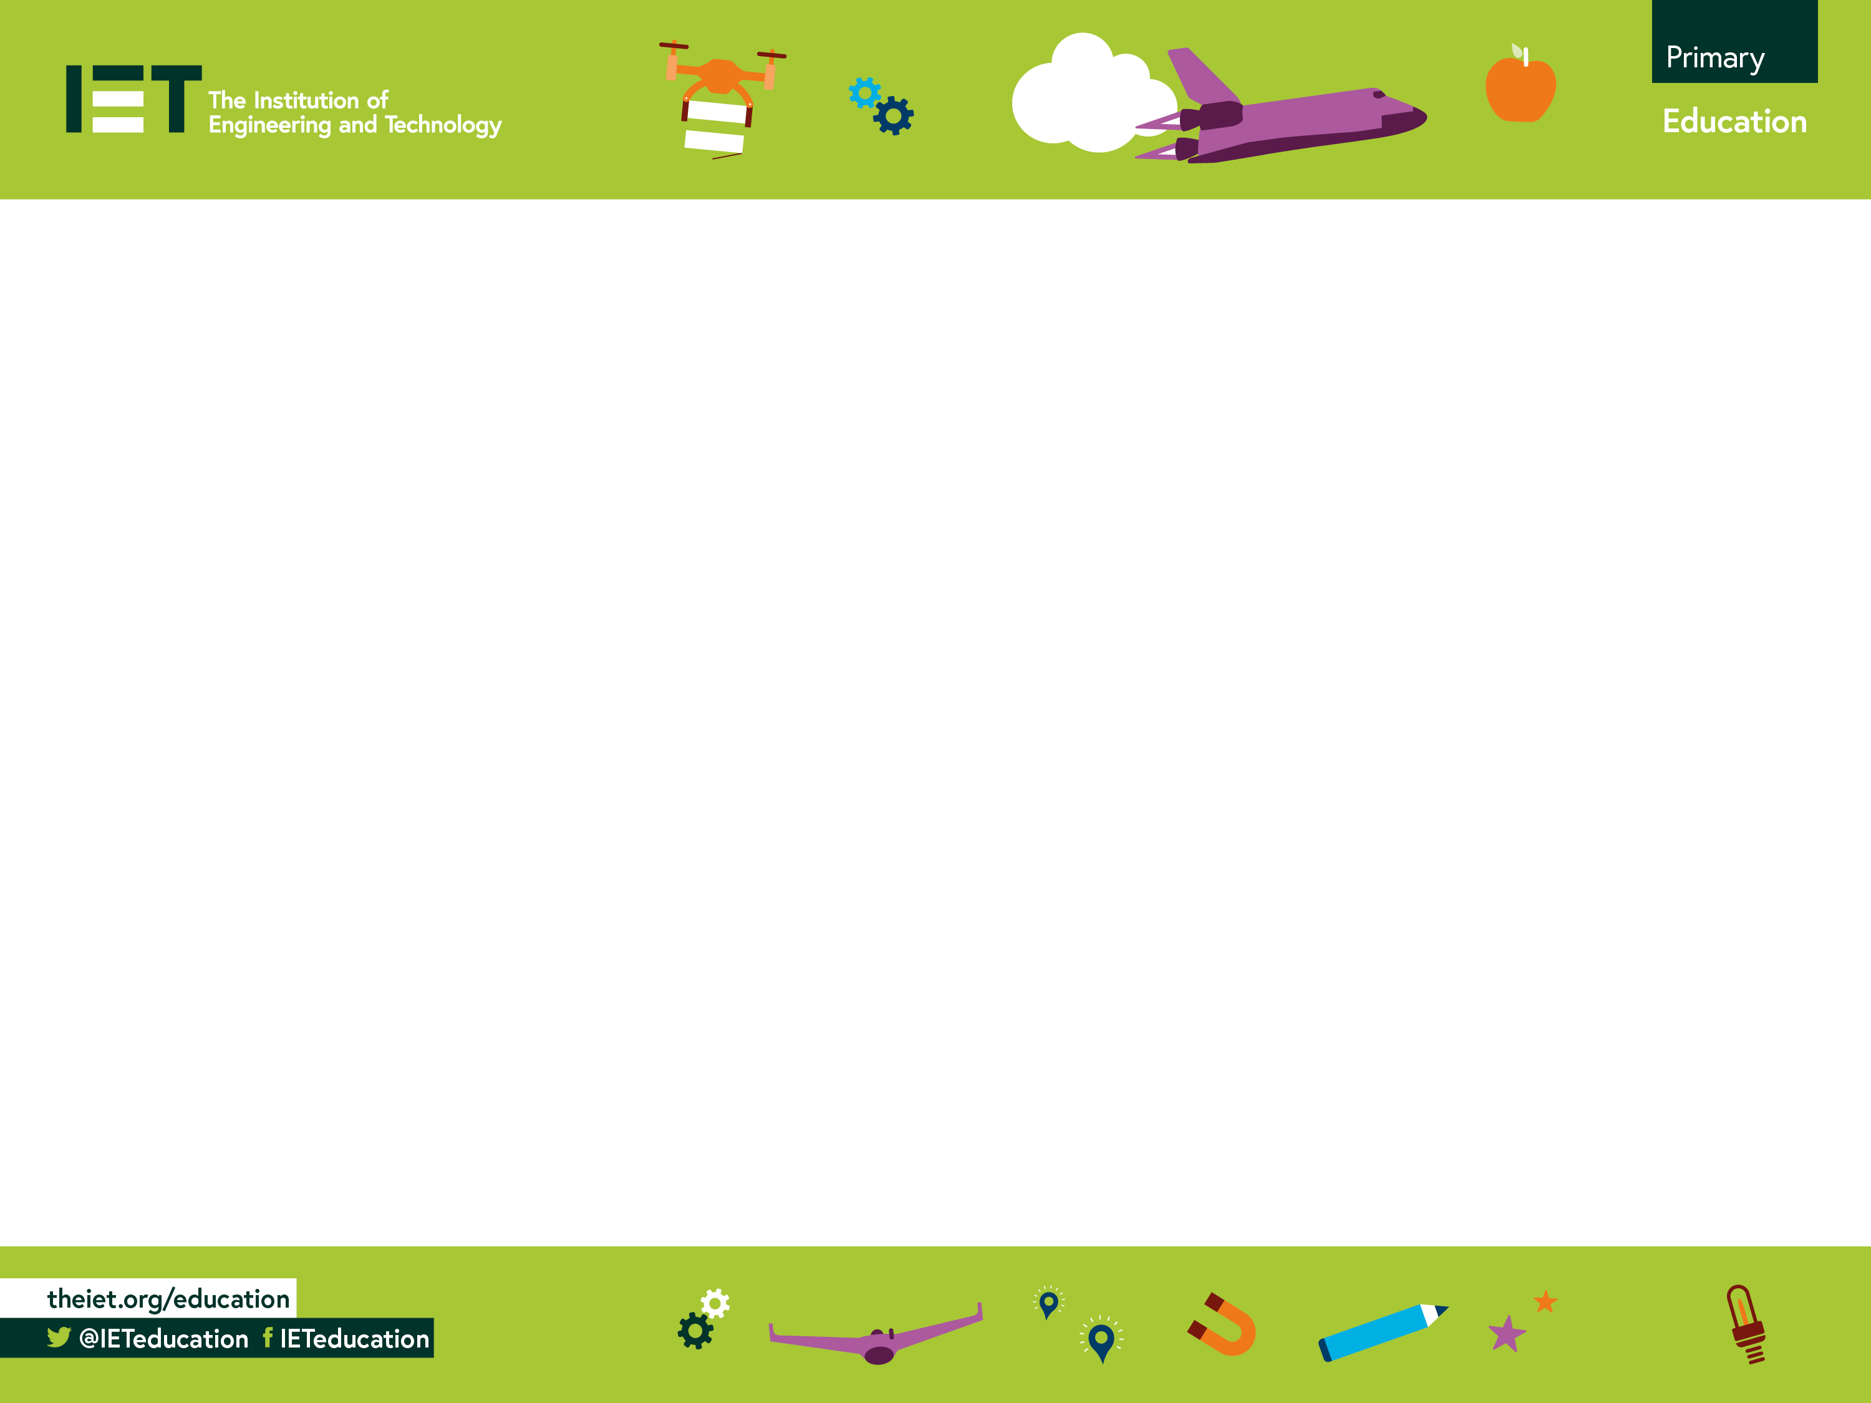
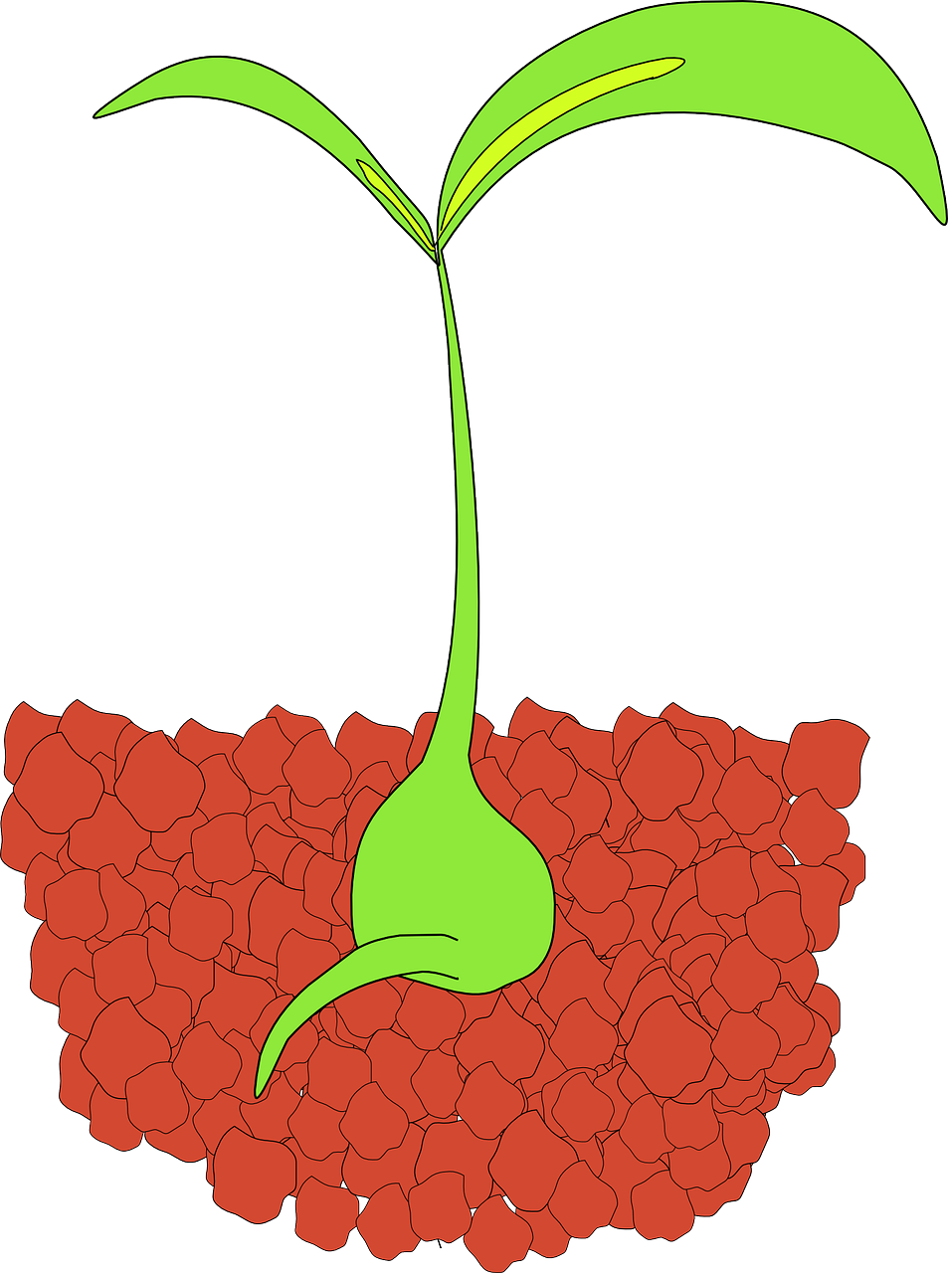
Home Grown
Growing seedlings in a compostable home-made paper container.

Slide 2
Step 1 – Plant box template
Cut out the template
Fold and crease all the fold lines
Cut the corner lines.

Slide 3
Step 2 – Fold and glue the box
Fold up the sides
Fold the tabs onto the sides
Use a glue stick to glue all the tabs.

Slide 4
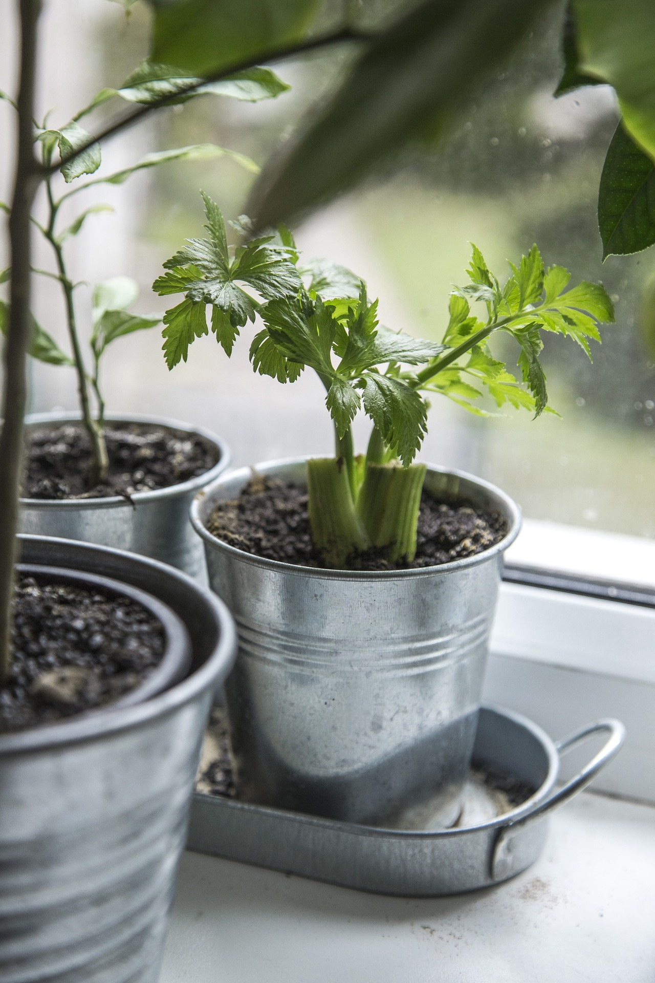
Step 3 – Growing your Plant
Put some damp soil or compost in the plant box
Push one seed about 2 cm below the surface
Cover the plant box with cling film
Stand it on a plate or tray in a warm, sunny place e.g. a windowsill.

Slide 5
Step 4 – And finally…
When the plant is about 1 cm tall, take off the clingfilm.
Now put the plant in the garden!

