Slide 1
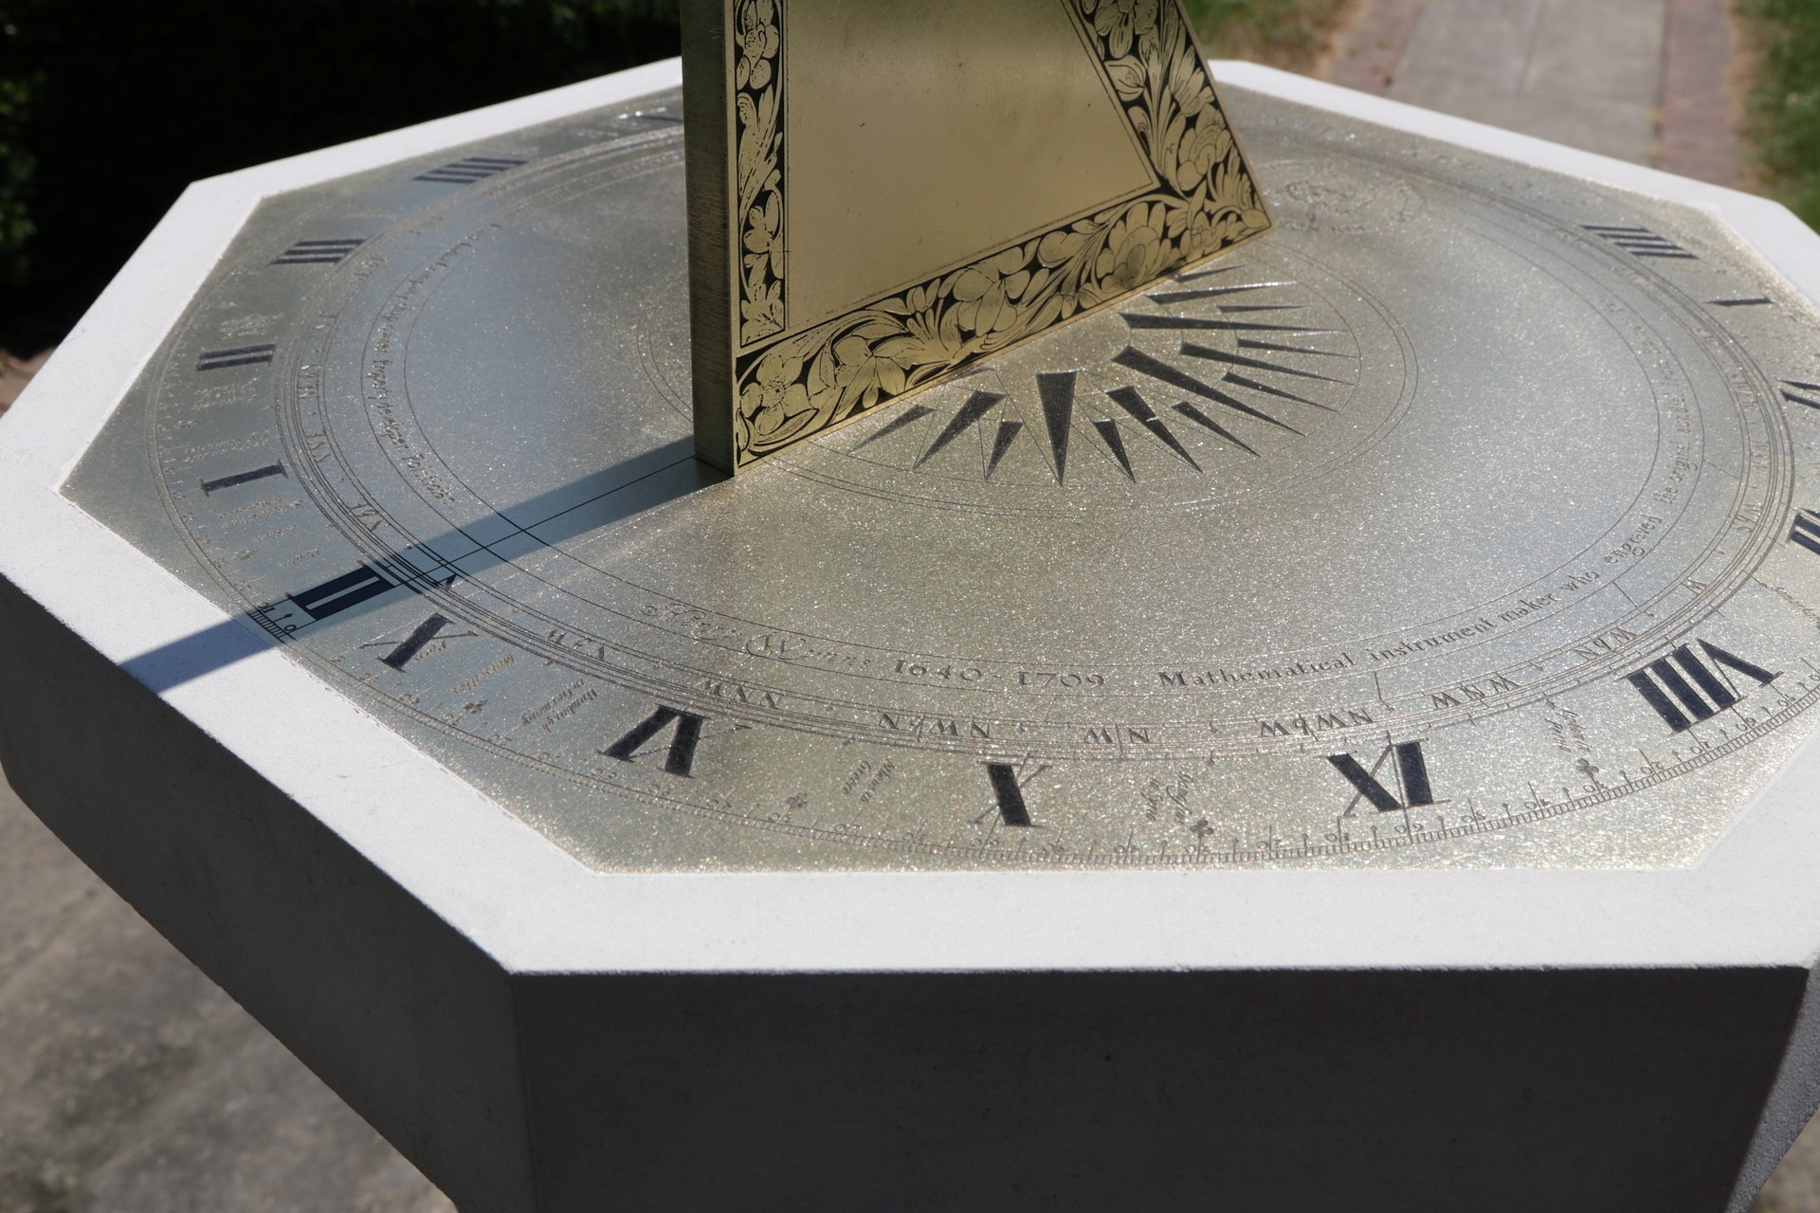
Time for sunshine
Making a sundial

Slide 2
Sundials
A sundial is designed to read time by the sun
Before the 19th Century sundials were used to reset clocks

Slide 3
Making a Sundial
You will need:
A large straight stick
Clock
Chalk
Some stones

Slide 4
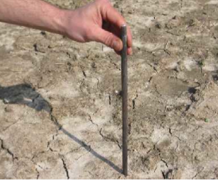
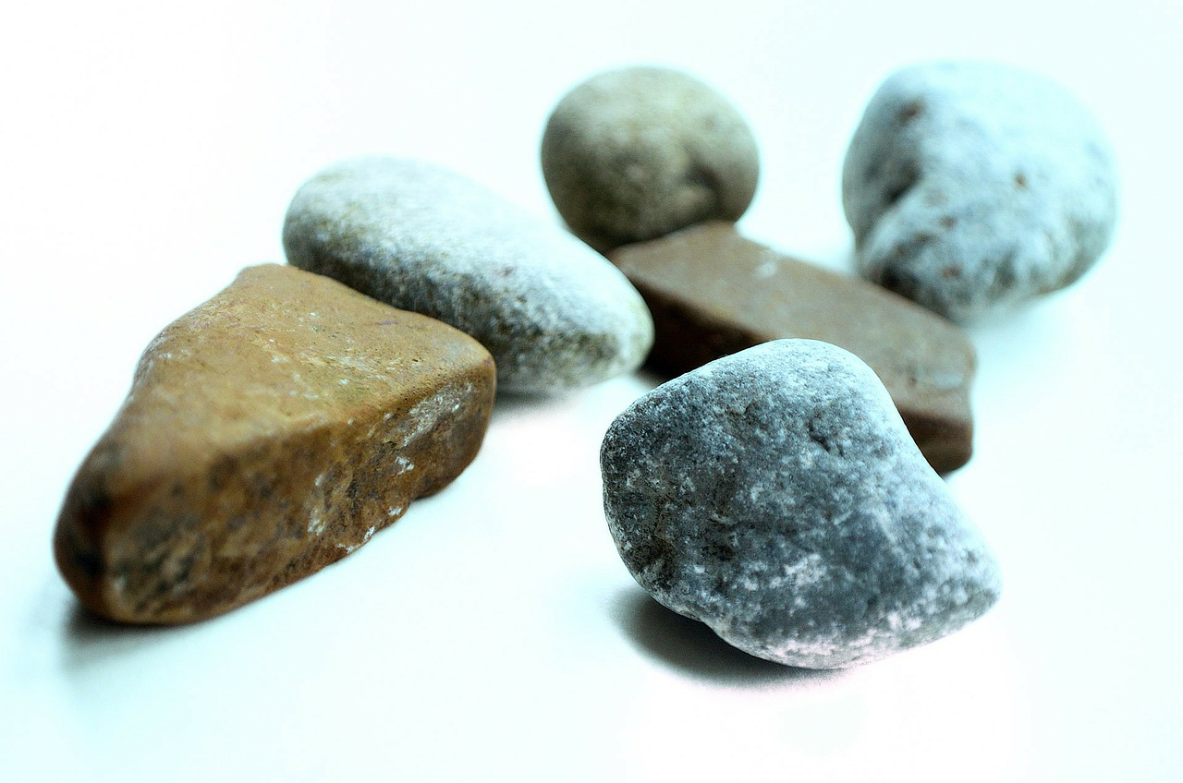
Step 1 - Making a Sundial
Find a spot outdoors that is not sheltered from the sun
Place the stick on the ground so it is straight.
You could use some stones or dirt to keep the stick upright.

Slide 5
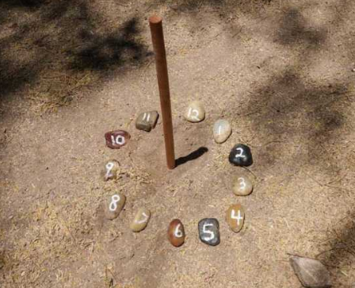
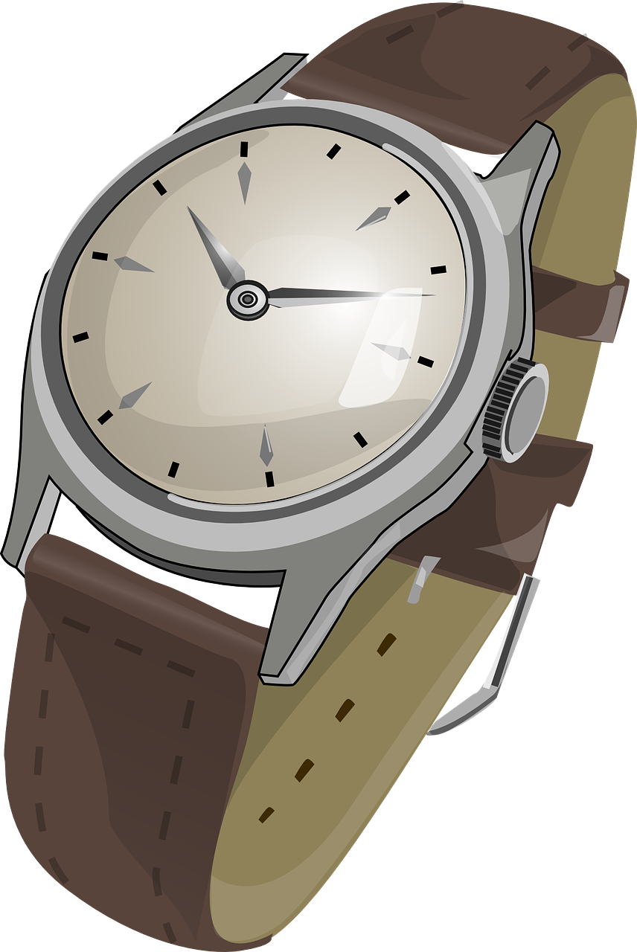
Step 2 - Making a Sundial
Check the time on a clock and on each hour place a stone at the end of the shadow.
Use the chalk to write the hour on or next to the stone.

Slide 6
Step 3 - Making a Sundial
Test your sundial the next day by checking that the shadow falls onto the correct stone at the correct time.

