Slide 1
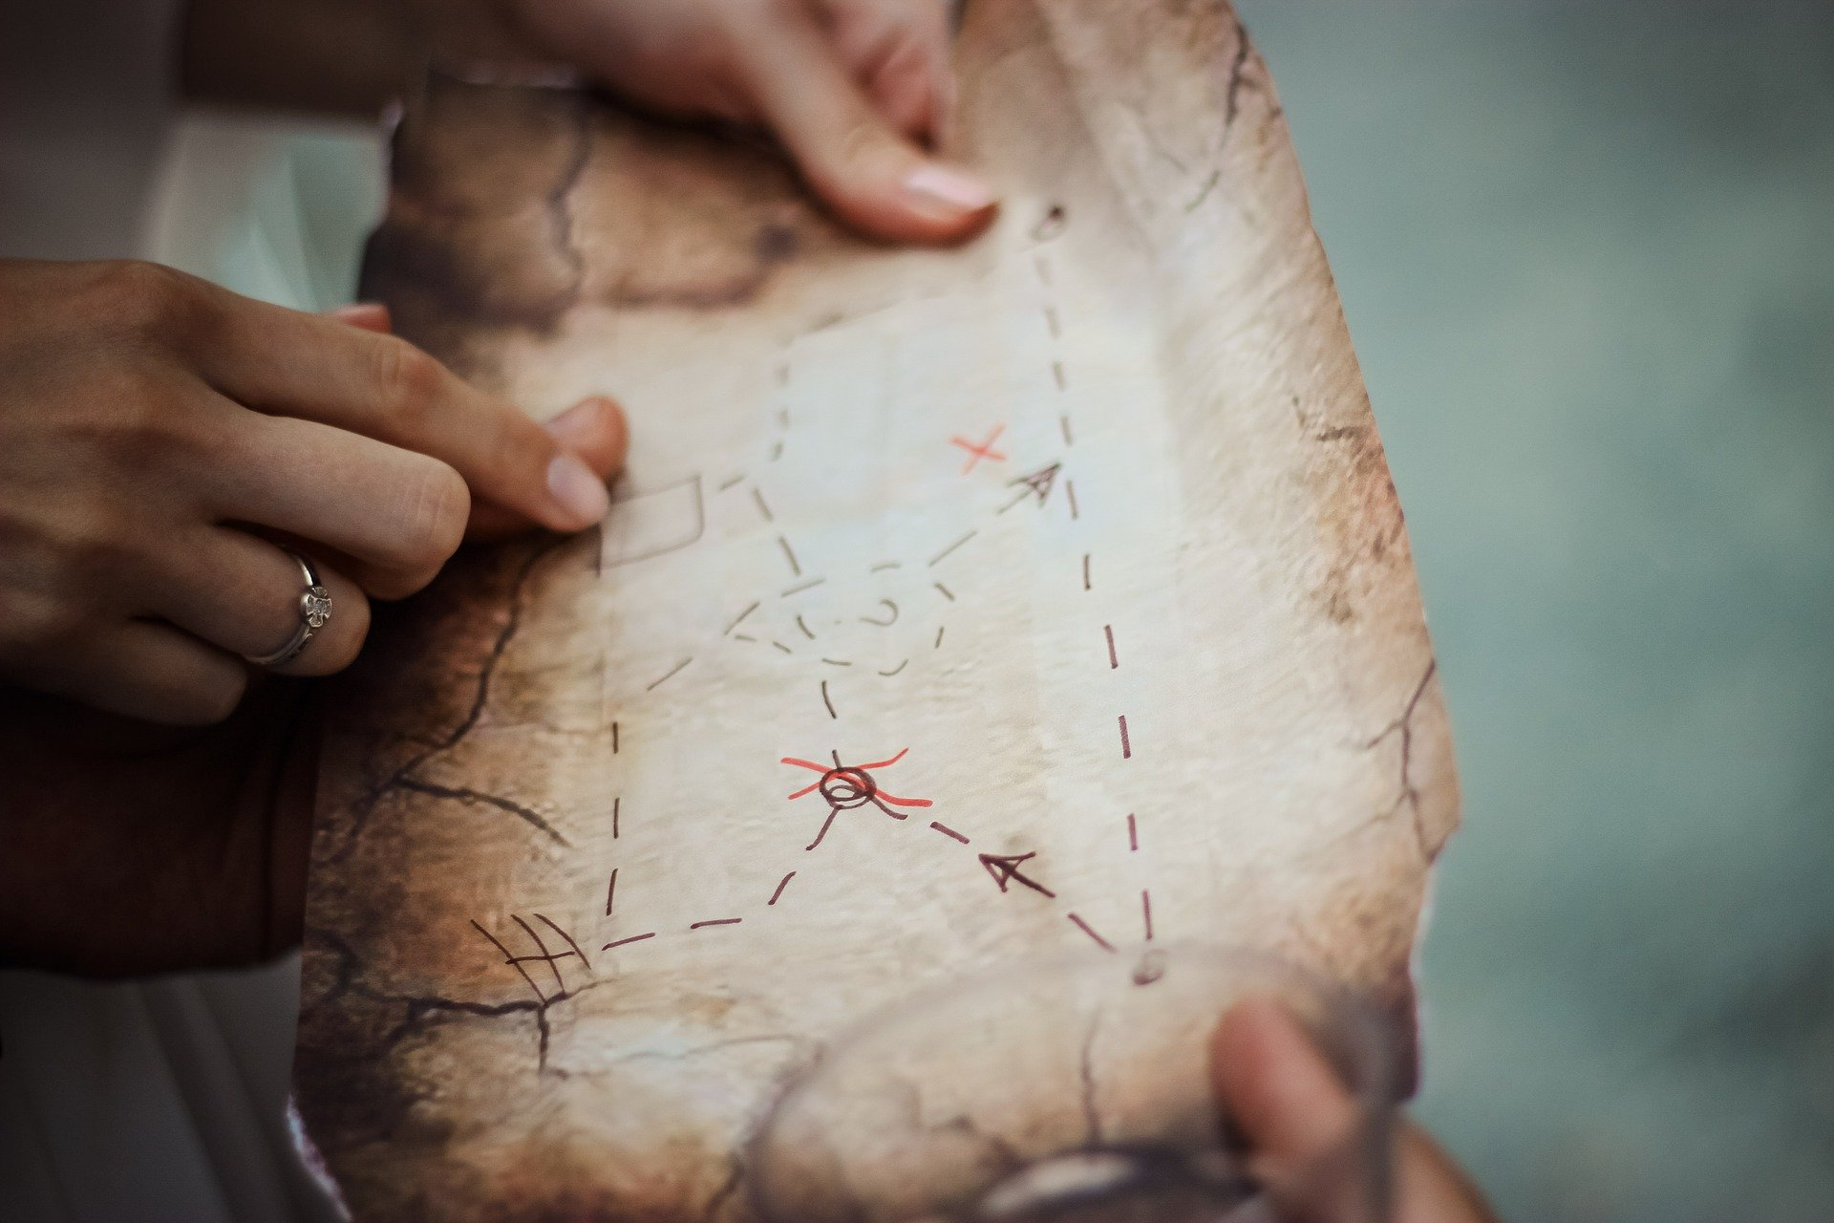
Halloween treasure hunt
Using coordinates, angles and directions to locate pirate treasure on a map

Slide 2




Map Position – Where am I?
Coordinates.
To find a position, always read the x-axis before the y-axis. The x and y position is then written in brackets with a comma.
= (1,3)
= (3,5)
= (5,1)

Slide 3
Map Direction – Where do I go?
Vector Coordinates.
Starting from (0,0):
Move (3,0)
2. Move (0,2)
3. Move (-2,0)
4. Move (0,2)
4
3
2
1

Slide 4
Map Direction – Where do I go?
Polar Coordinates (Bearings)
Using Angle and Distance:
Move 45 degrees, 40mm
Move 315 degrees, 25mm
Move 90 degrees, 20mm
3
2
1

Slide 5
Treasure Hunt Activity
Can you find the treasure?
Worksheet 1 – Using Coordinates
Worksheet 2 – Using Vector Coordinates
Worksheet 3 – Using Polar Coordinates

