Slide 1
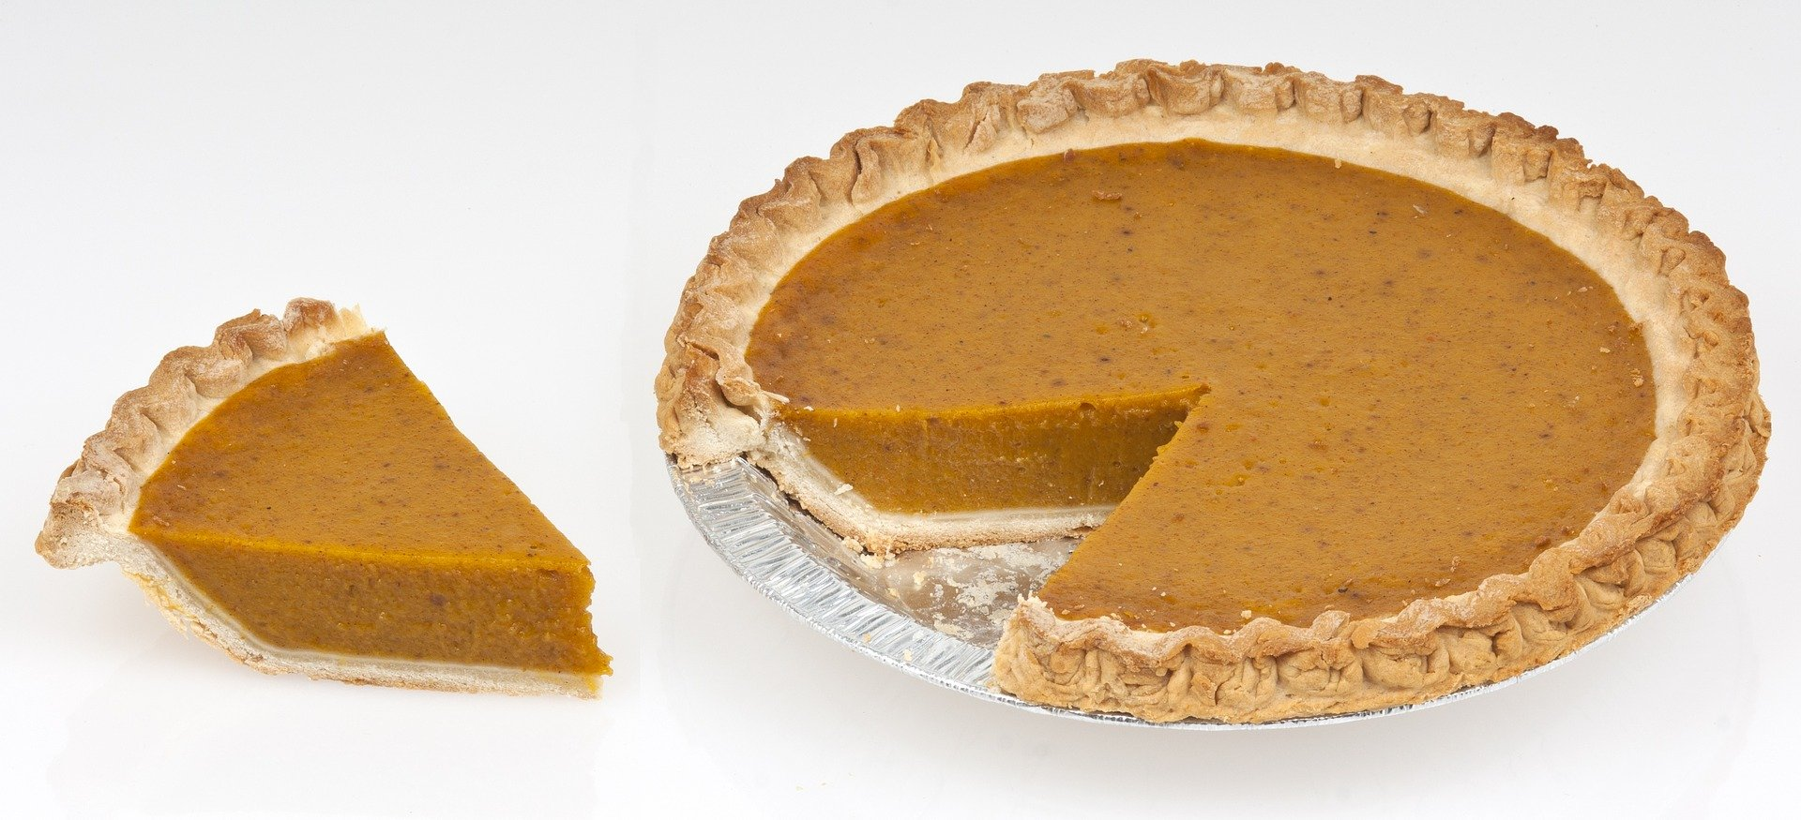
Pumpkin pie fractions
Understanding fractions through a pumpkin pie cutting approach

Slide 2
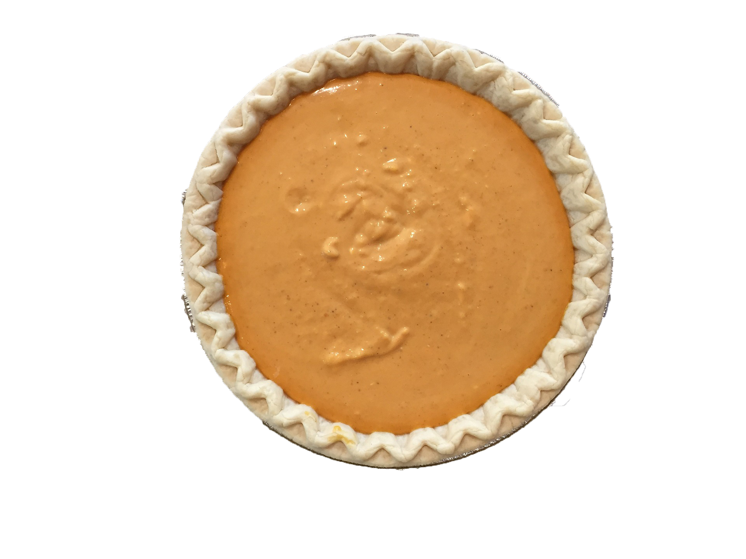
Pumpkin pie fractions
1 Whole Pumpkin pie
We have a delicious pumpkin pie.
To share it with our friends we can use fractions.
Each piece of pumpkin pie we cut is a fraction of the whole pie.

Slide 3
To share your pumpkin pie with 2 friends
you would cut the pie into 2 halves.
2 Halves

Slide 4
To share your pumpkin pie with 4 friends
you would cut the pie into 4 quarters.
4 Quarters

Slide 5
Colour the pumpkin pie fractions
3 Quarters
1 Quarter
1 Half
Whole

