Slide 1
Adorable Advent
A project to make an Advent calendar

Slide 2
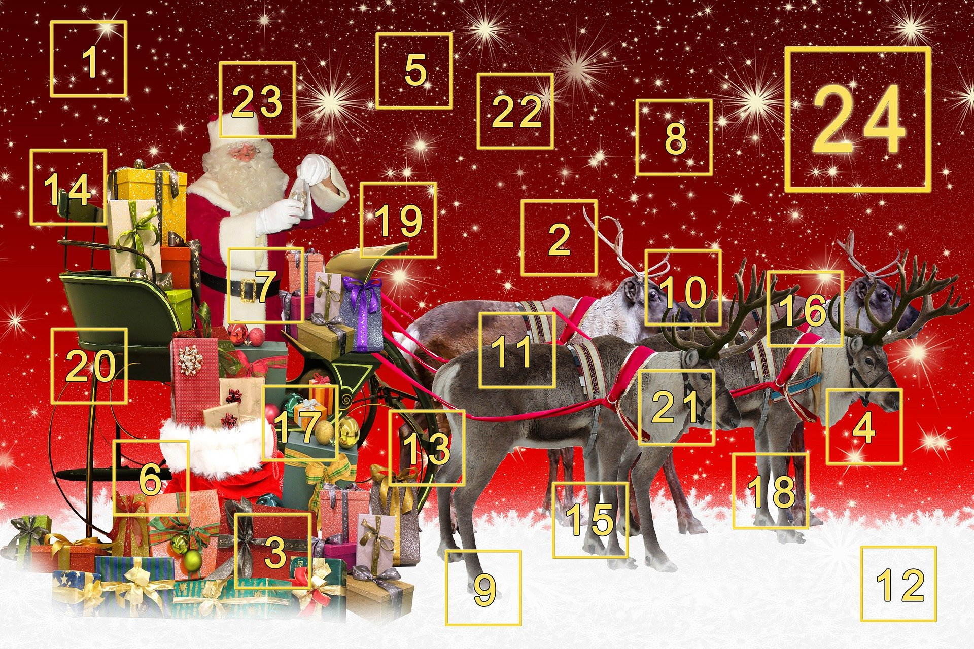
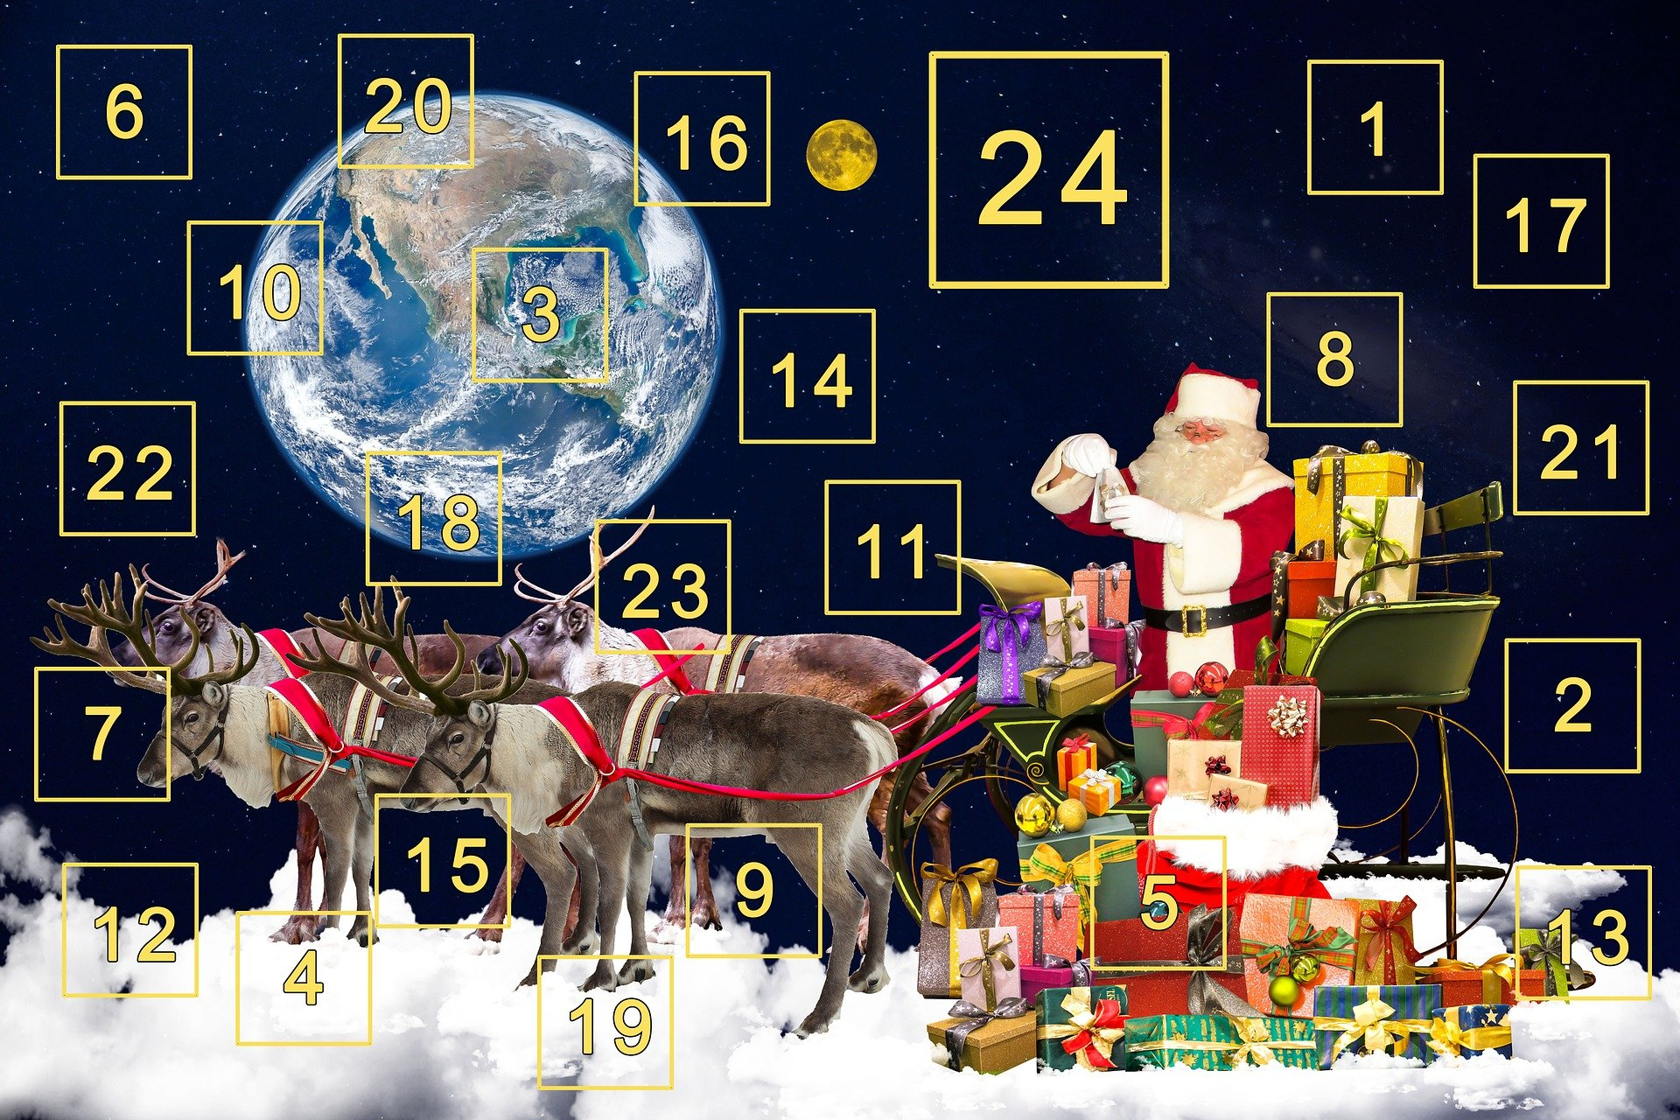
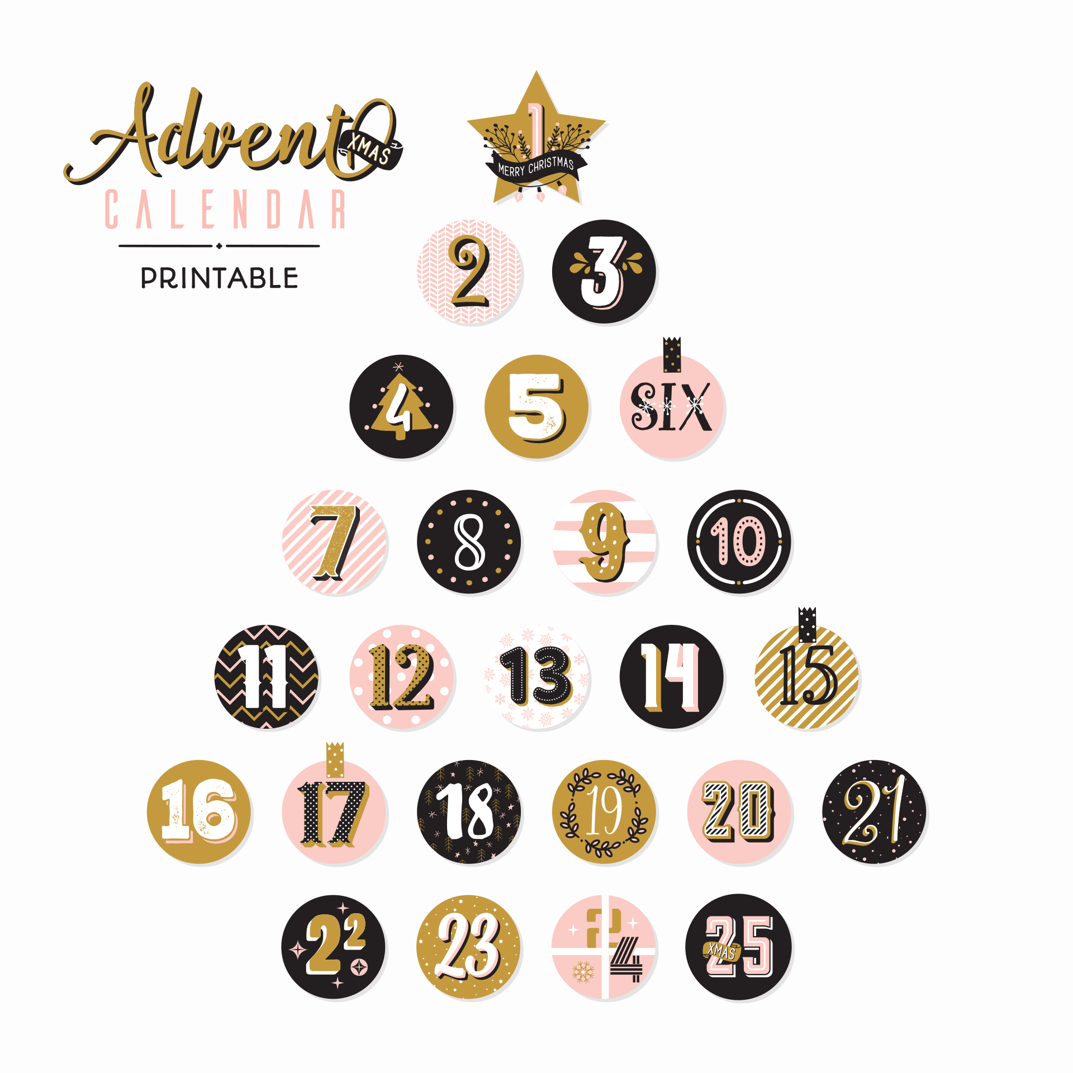
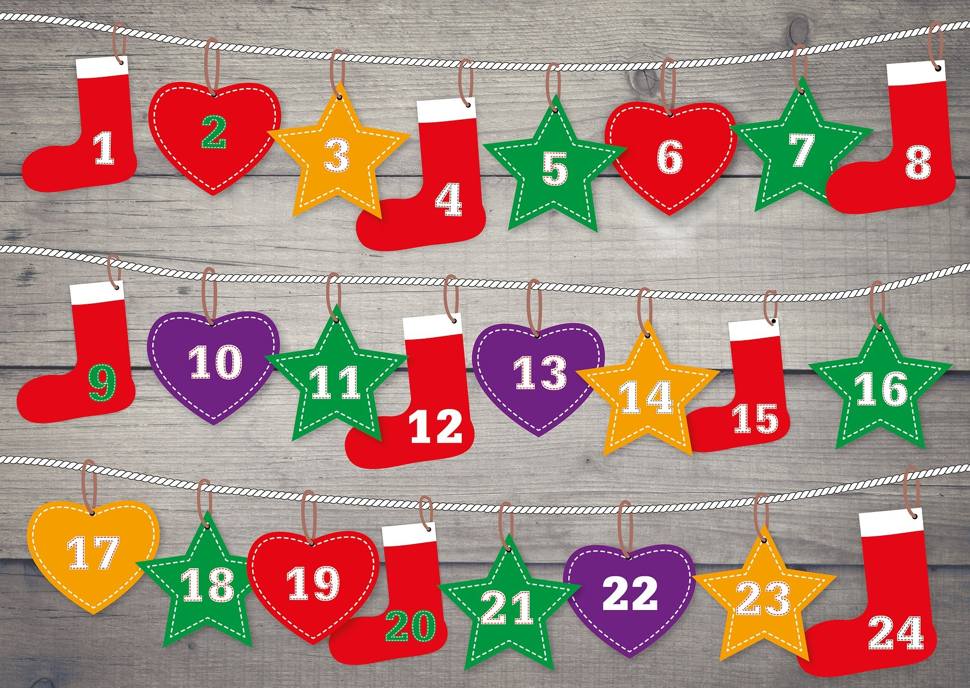
Advent Calendars
These count down from 1st December till 25th December
Each day has a door to open
Behind every day is a picture or surprise
The calendar has two parts:
The front page, with the doors
The back page, with the icons

Slide 3
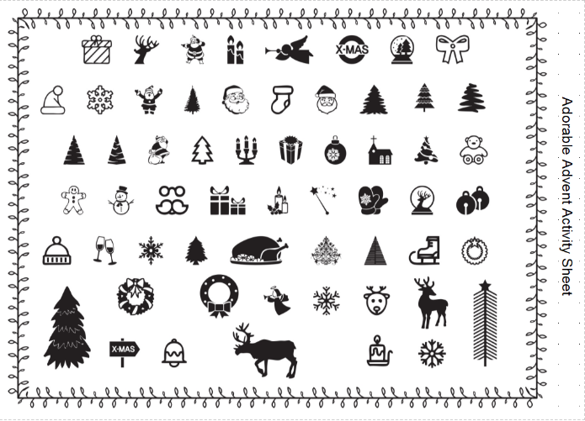
Icons
The icons are pictures of festive things
What other icons can you think of?

Slide 4
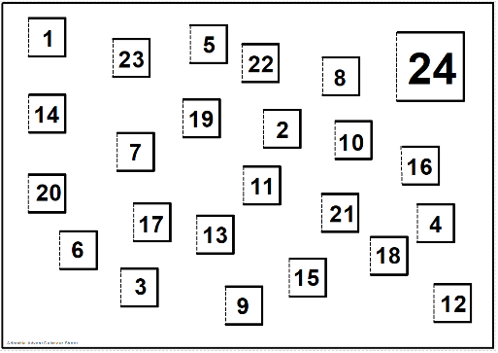
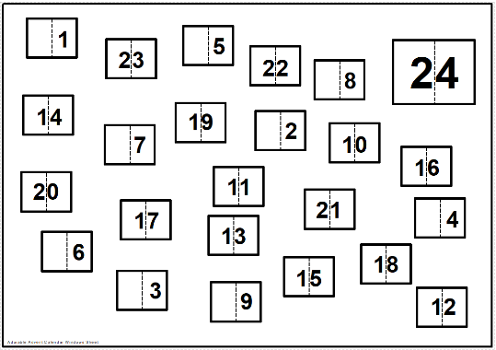
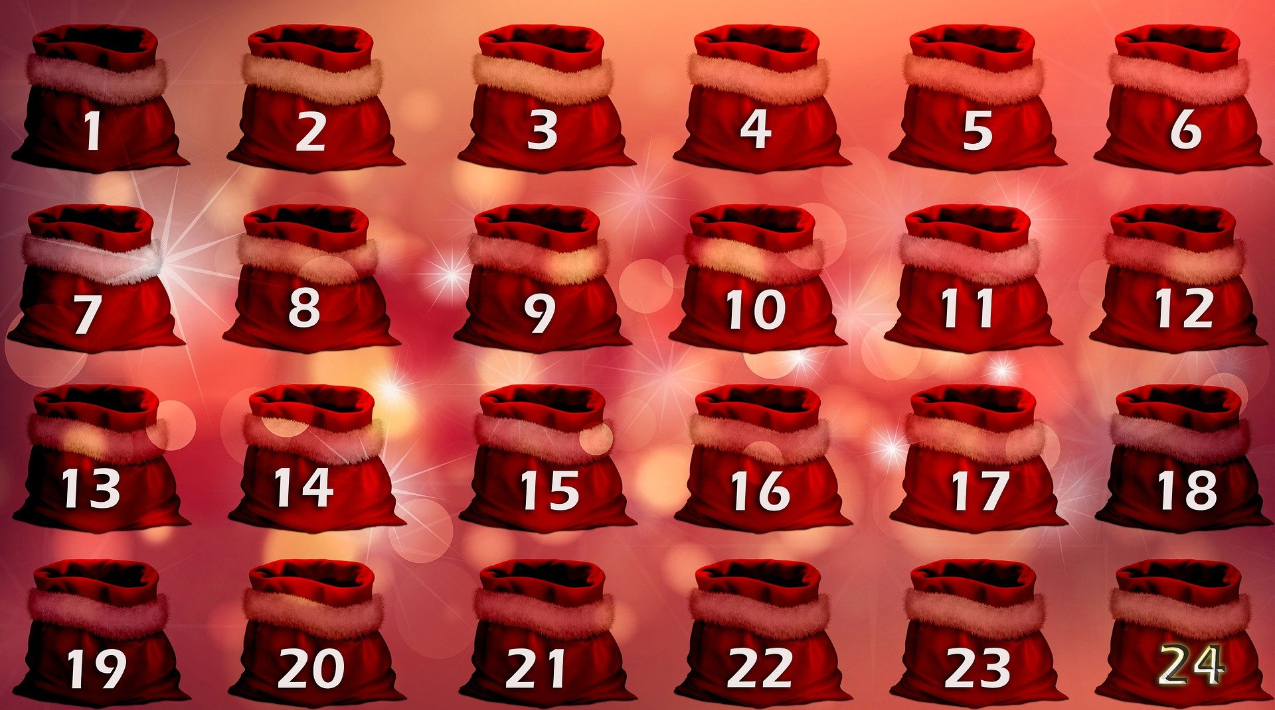
Step 1 – Front page
Choose a door style for the front of your advent calendar
Add your designs and colour to the calendar
Or you could design your own doors…
Single doors
Double doors

Slide 5
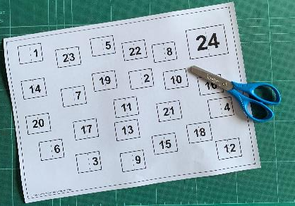
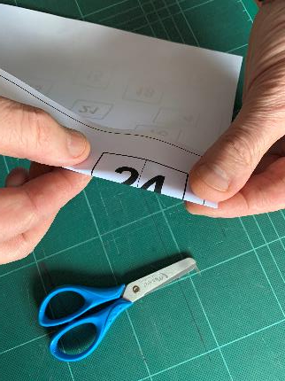
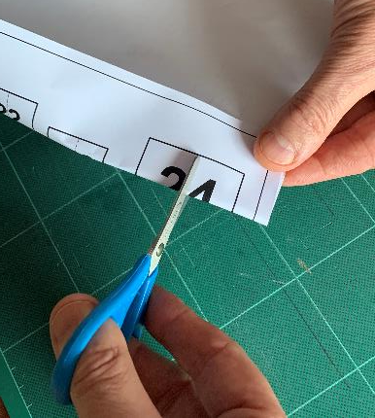
Step 2a – Cutting out the doors
(double doors version)
Pinch the door
Carefully cut the dotted line between the two doors
Pinch
Cut

Slide 6
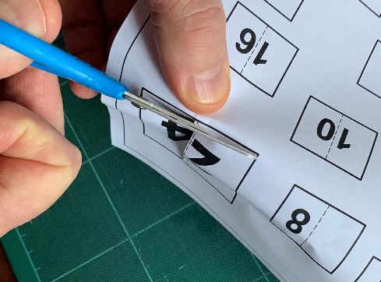
Step 2b - Cutting out the Doors
(double doors version)
Carefully cut the solid line to each corner
DO NOT CUT ALL THE WAY ROUND!
Fold the door open
Cut out

Slide 7
Step 3 – Back page
Glue the calendar to a back page made from card
Choose icons for each day
Cut them out carefully with scissors
Glue icons to the back page, behind a door
You could draw your own icons instead!

Slide 8
Step 5 – Fold the doors closed
Put an icon in every door
Once the glue has dried, fold the doors closed
Use your calendar – or give it to someone as a present!

