Slide 1
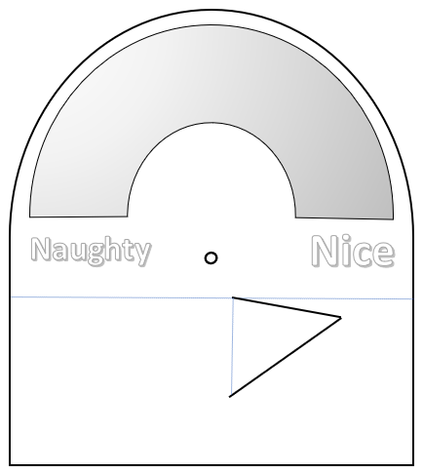
Niceometer

Slide 2
Add graphics and colour to both pieces!
Cut around the gauge using scissors.
Get an adult to cut out the ‘V’ for the stand using a craft knife.
Put a piece of sticky tack behind the hole in the middle of the gauge. Push the sharp point of a pencil through to make the hole.
Cut out the arrow using scissors.
Put a piece of sticky tack behind the hole at the bottom of the arrow. Push the sharp point of a pencil through to make the hole.
Attach the arrow to the gauge by putting a split pin through the two holes.
Fold the gauge along the dotted line so it forms an L- or V- shape when you look at it from the side.
Fold up the V stand. Using some sticky tape attach the V to the back of the gauge to help it stay up.

