Slide 1
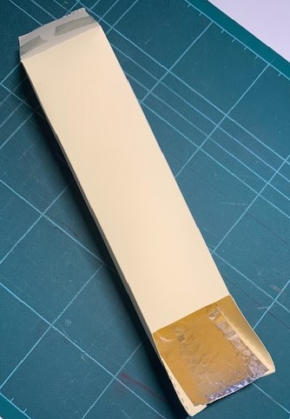
Pixie Periscope
Pixie Periscope
Make a periscope!
Pixies and elves use this to look over walls, to spy on who is naughty and who is nice

Slide 2
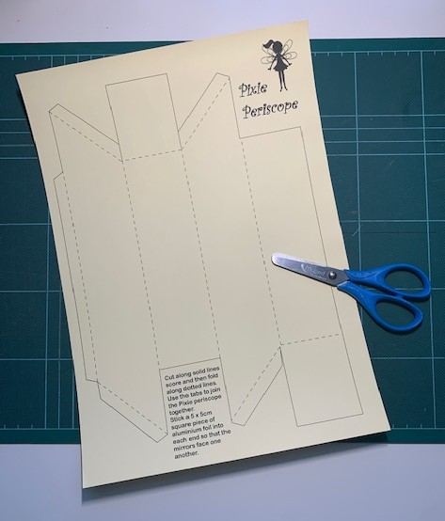
Step 1 – Periscope template
You will need the periscope template and scissors

Slide 3
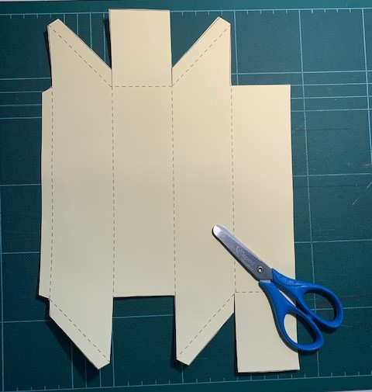
Step 2 – Cut out the template
Carefully cut along the solid lines with scissors
Don’t cut the tabs off!

Slide 4
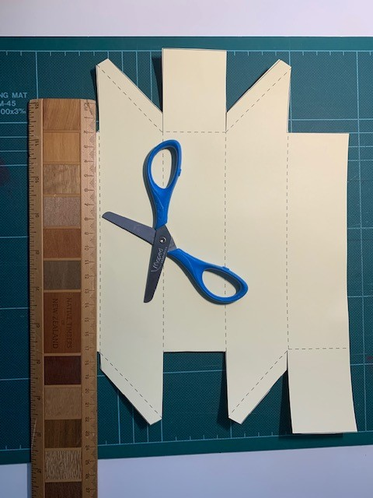
Step 3 – Score the dotted lines
Score along the dotted lines with scissors
Use a ruler to score straight lines
DON’T PRESS TOO HARD AND CUT THE PAPER

Slide 5
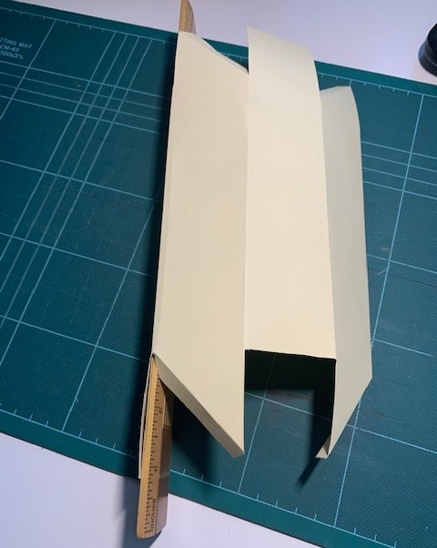
Step 4 – Folding
Fold carefully on the dotted lines
You can use the ruler to keep folds straight

Slide 6
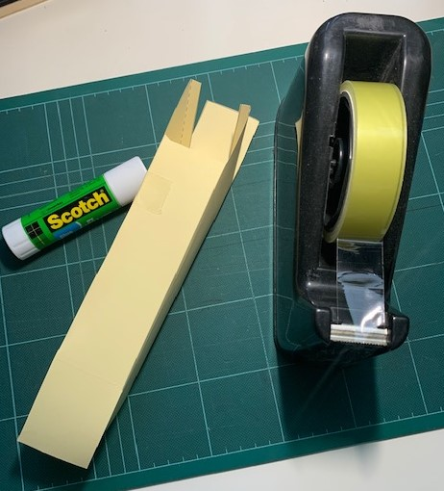
Step 5 – Sticking
Use sticky tape or glue to stick the periscope together using the tabs

Slide 7
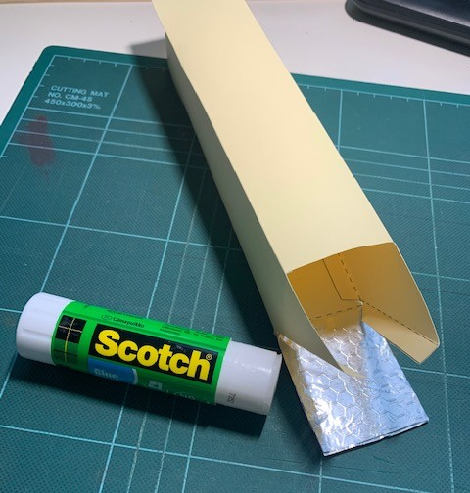
Step 6 – Mirrors
Stick one mirror into each end
If you use aluminium foil instead, keep it shiny side up and very flat
Use glue or double-sided sticky tape
If you look at one mirror, you can see the reflection in the other mirror!

