Slide 1
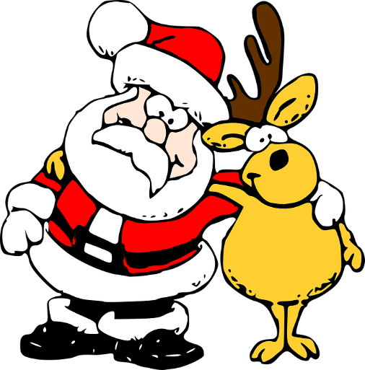
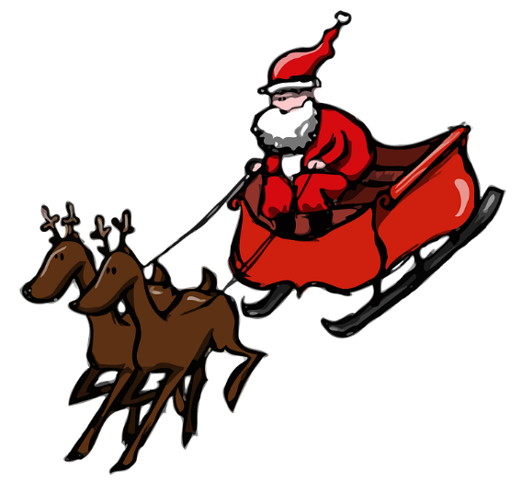
Super Sleigh
Designing a high-tech replacement for Santa’s sleigh

Slide 2
Design Brief
Situation
Santa is concerned that his current sleigh is not environmentally friendly, as the reindeer produce a lot of emissions. With more presents to deliver than ever, he is also worried that it is no longer fast enough to get the job done on time.
Brief
Design a high-tech replacement for Santa’s sleigh. Your design should use an environmentally-friendly method that enables the sleigh to fly through the air, such as a super-sized hoverboard powered by renewable energy.
Notes:
Discuss the brief and design criteria with learners.

Slide 3
Design Criteria
The sleigh must:
Be suitable for Santa to use to carry his presents on Christmas Eve.
Use an environmentally friendly method to achieve and maintain flight.
Be aerodynamically designed and lightweight to increase its speed.
Be aesthetically appealing.
Notes:
Discuss the brief and design criteria with learners.

Slide 4
Santa’s Sleigh Replacement Design
Use this space to sketch your idea for your sleigh.
Don’t forget to annotate your design to show how it meets the design criteria!
Notes about design:
Notes:
Learners can use this sheet to present their ideas, annotations and supporting notes.

Slide 5
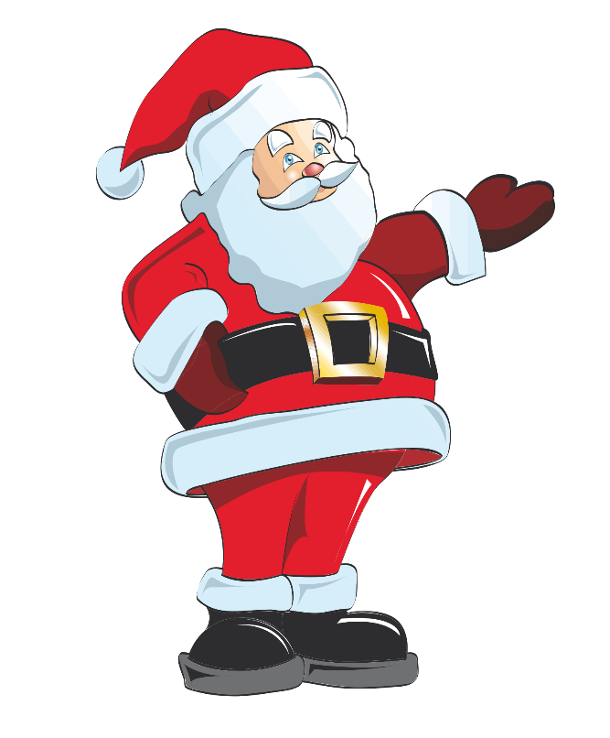
Peer Review
Ask three people to suggest one improvement each to your design.
Select one of these suggested improvements and use it to update your design.

Slide 6
Extension
Consider other potential uses of the sleigh you have designed.
How could this technology be used or modified to meet other social and environmental needs?

