Slide 1

Vanishing Card Deck
A project that makes a magic trick.
Make a pack of cards disappear!

Slide 2
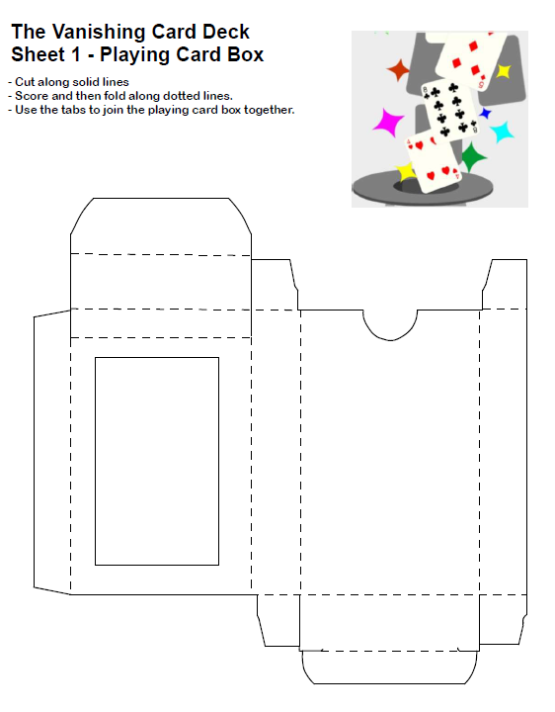
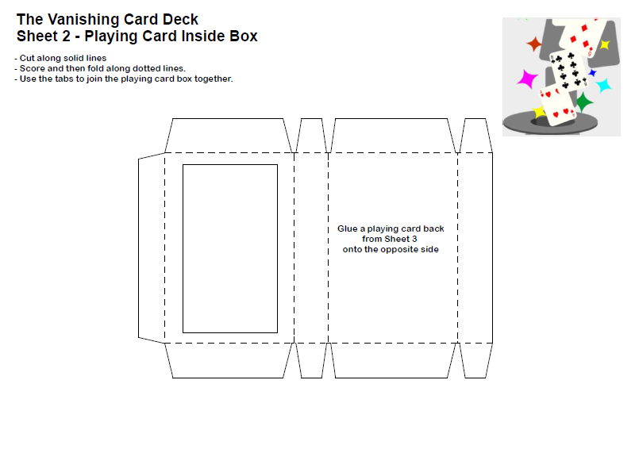
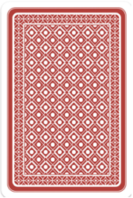
Templates

Slide 3
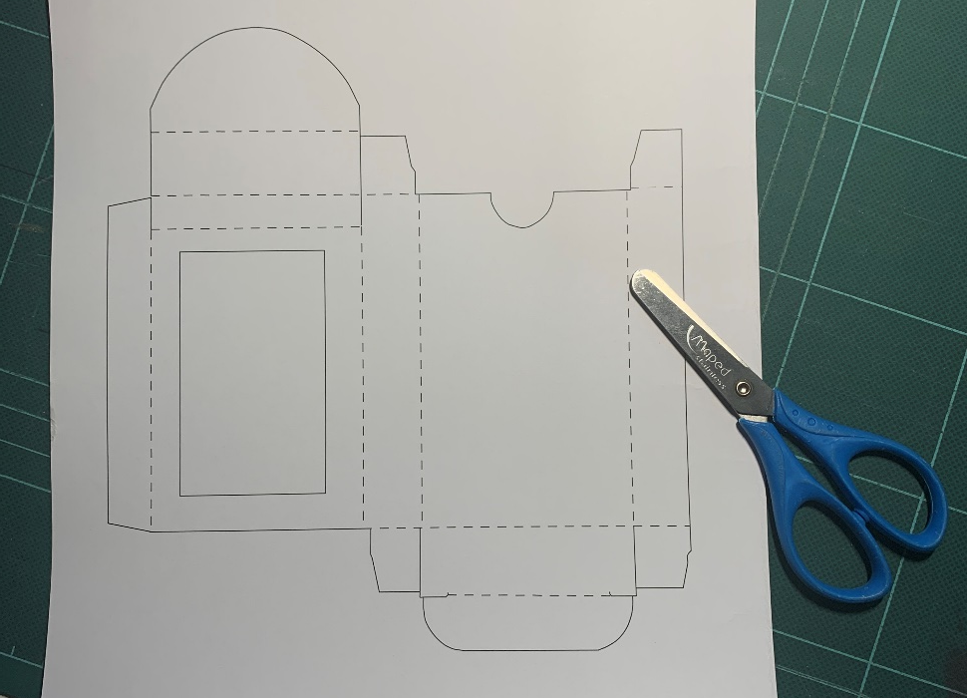
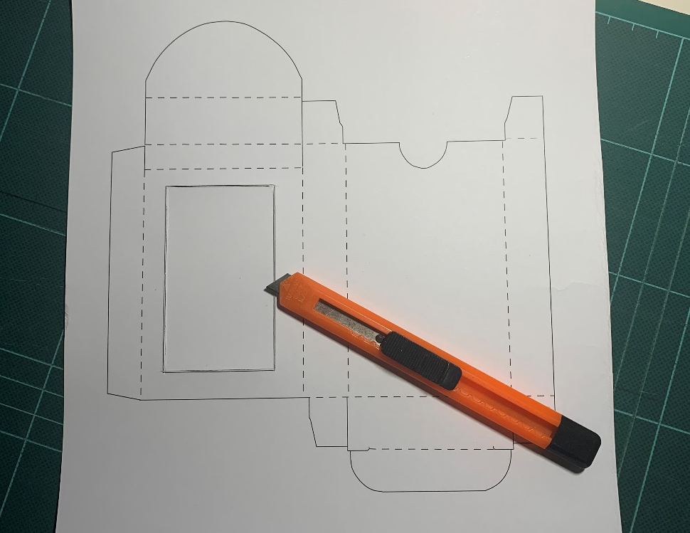
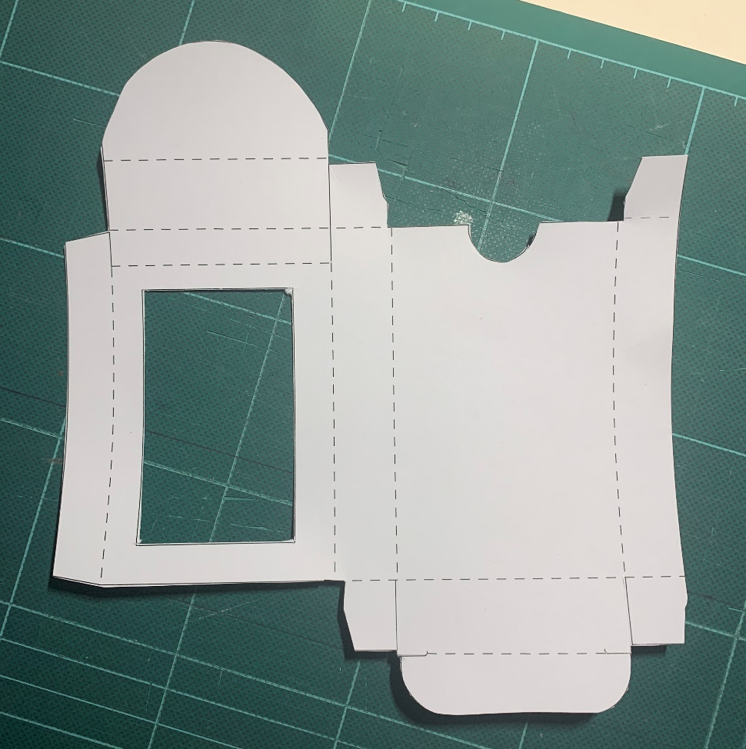
Step 1 – Template sheet 1
Get Sheet 1
Cut out the window
Cut out the template

Slide 4
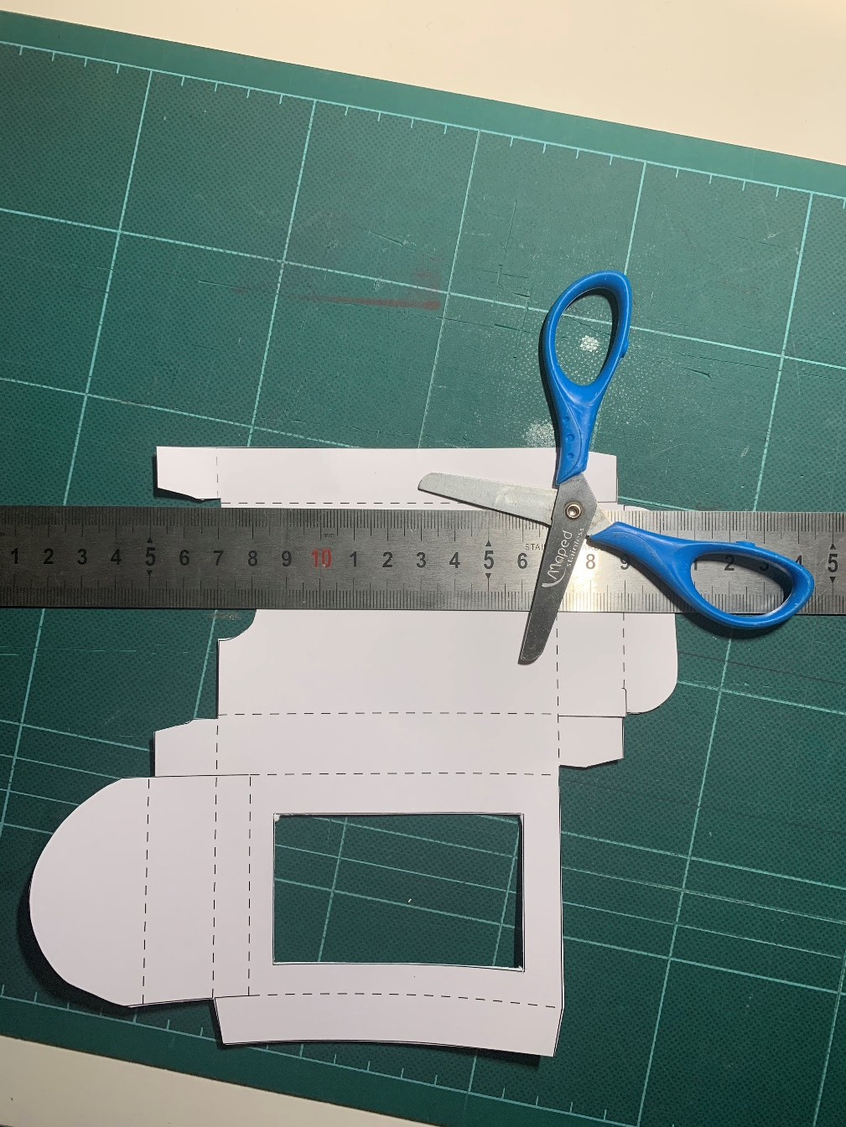
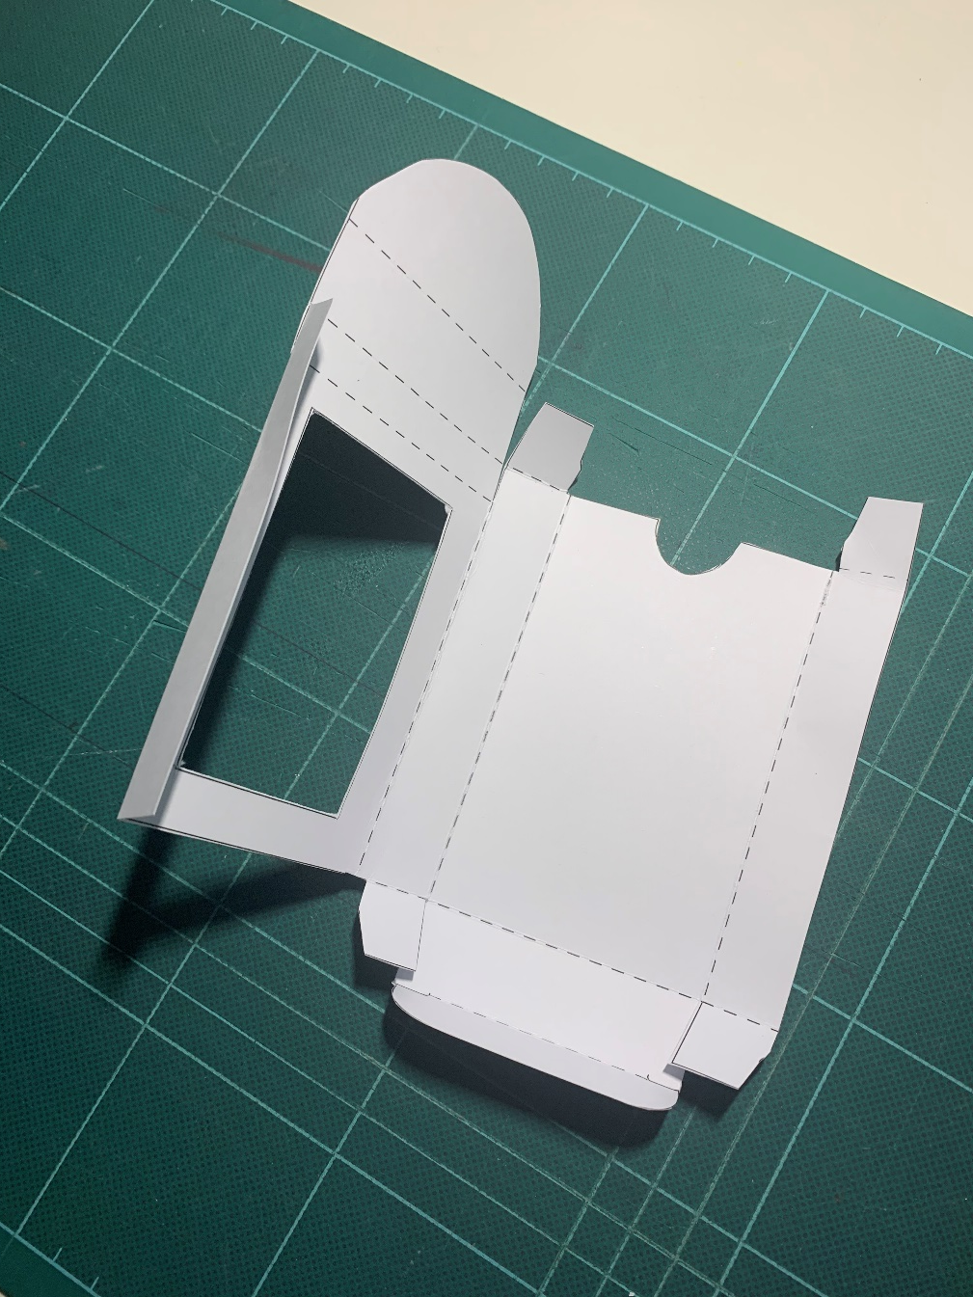
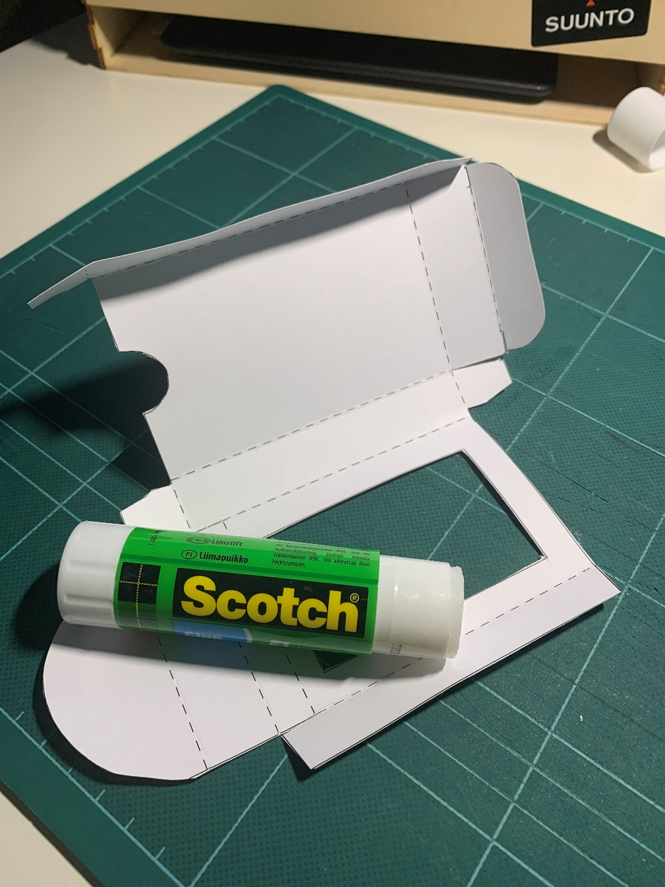
Step 2 – Template sheet 1
Playing Card Box
Score the dotted lines
Fold the dotted lines
Fold and glue the side tab

Slide 5
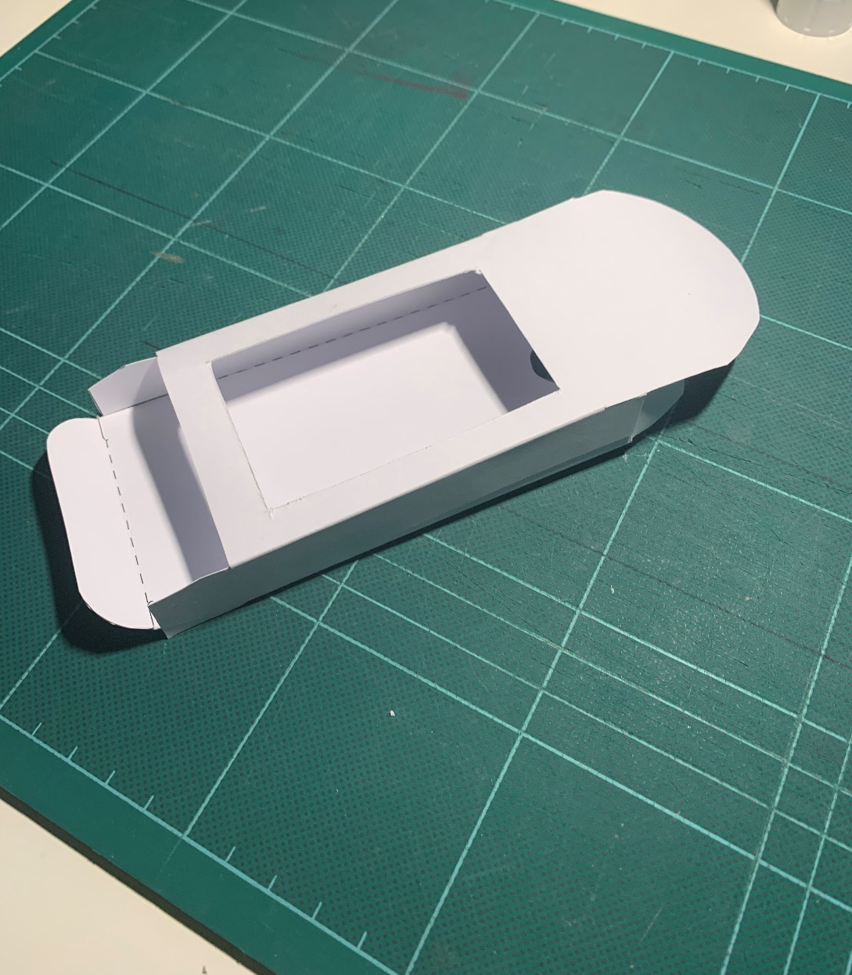
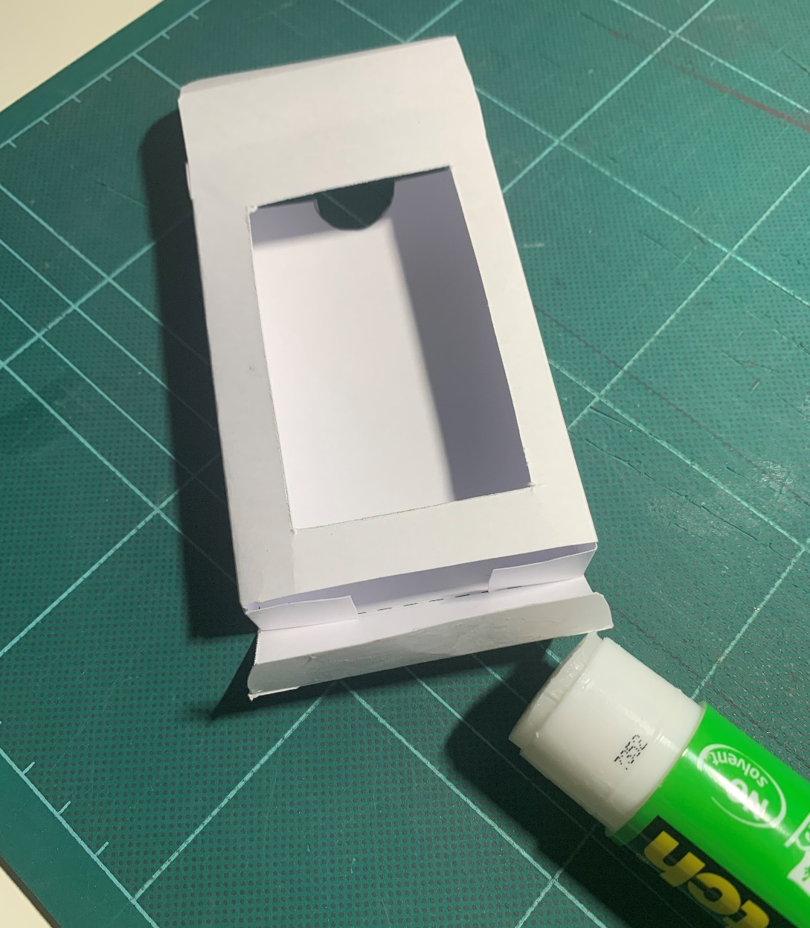
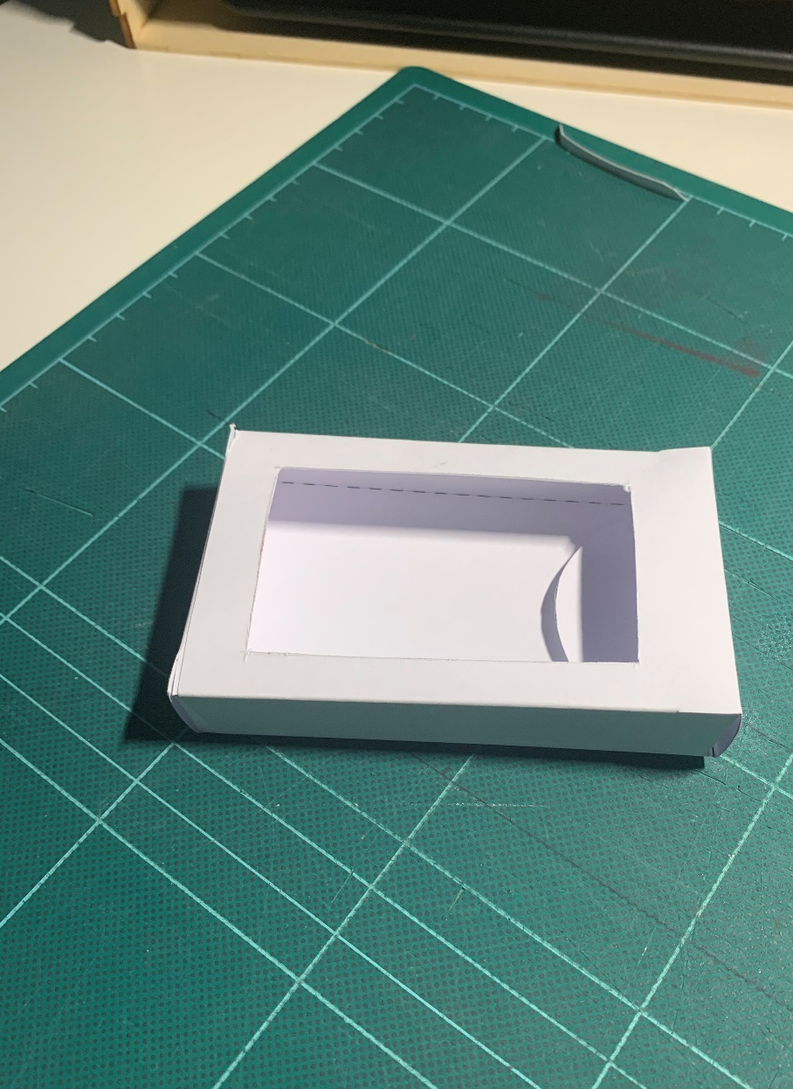
Step 3 – Template sheet 1
Playing Card Box
Fold the top tab in to complete the box
Side tab glued in place
Glue the base tab

Slide 6
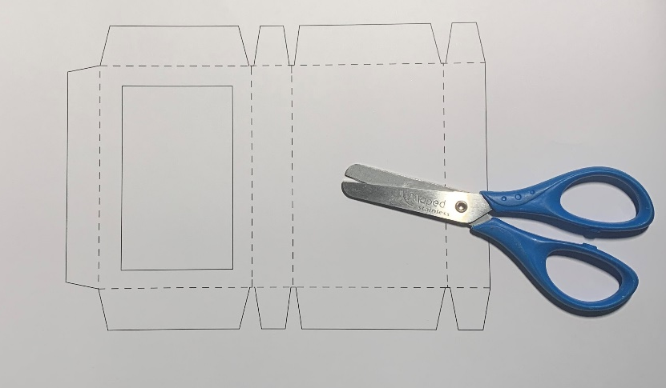
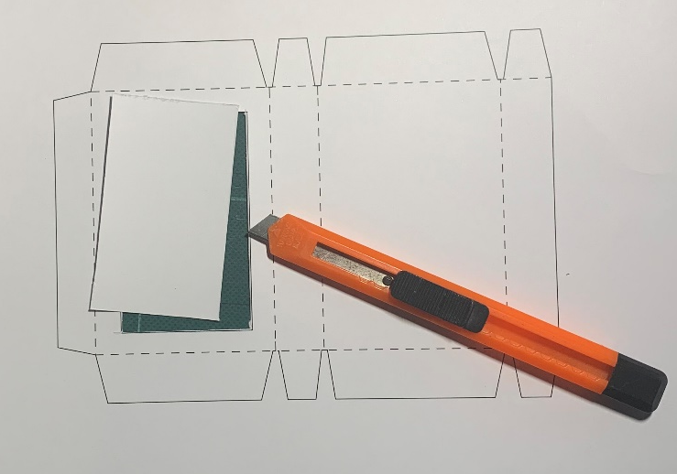
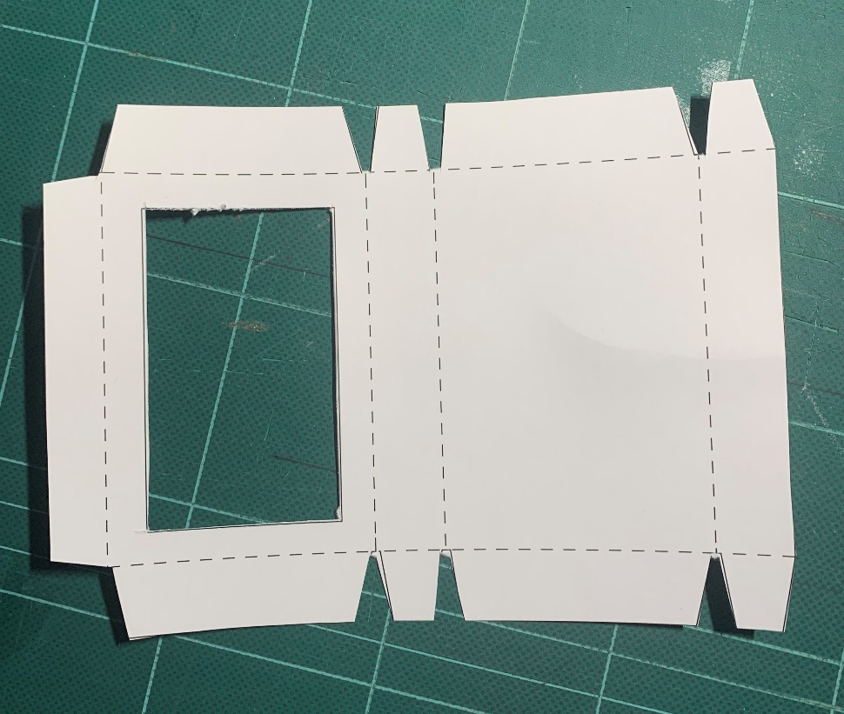
Step 4 – Template sheet 2
Playing Card inside Box
Get Sheet 2
Cut out the window
Cut out the template

Slide 7
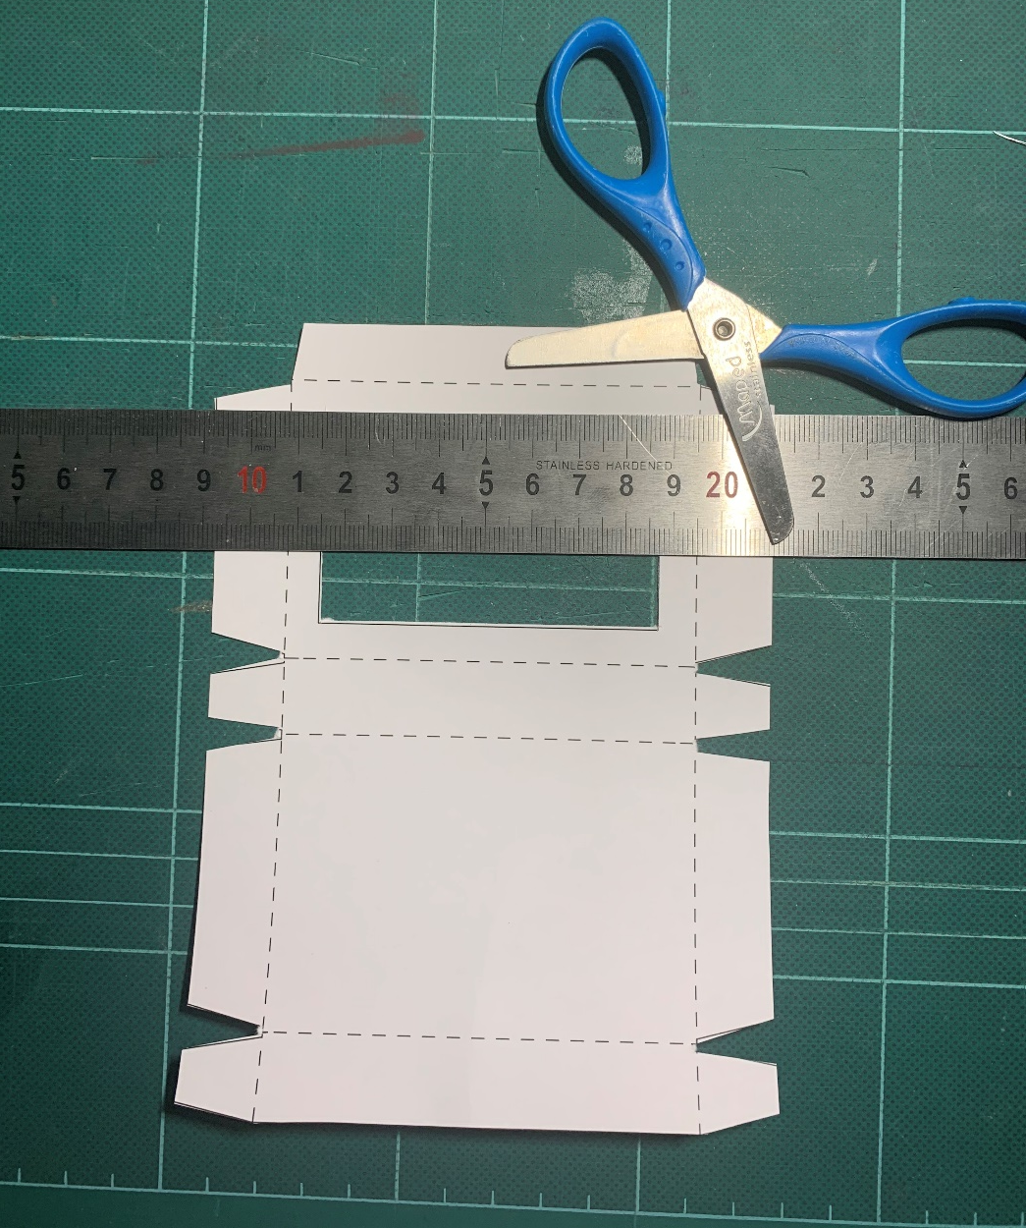
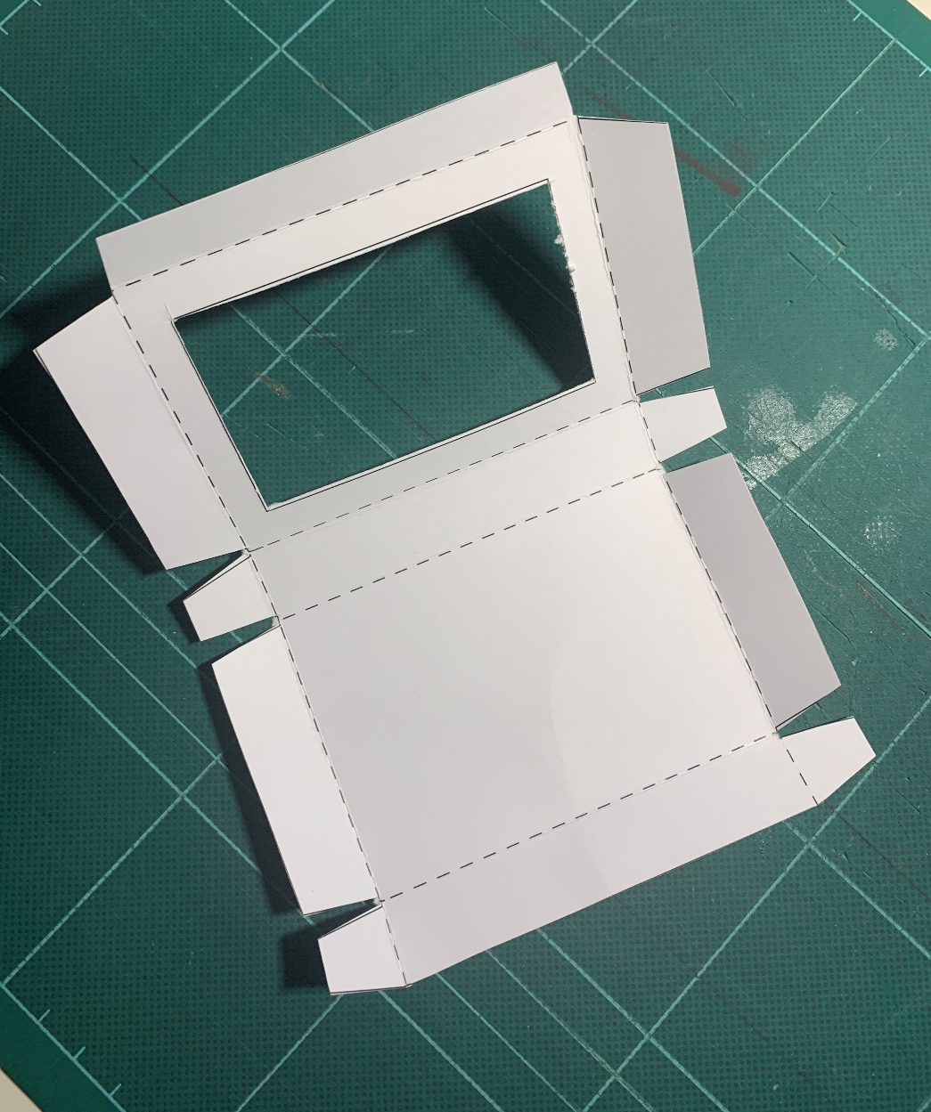
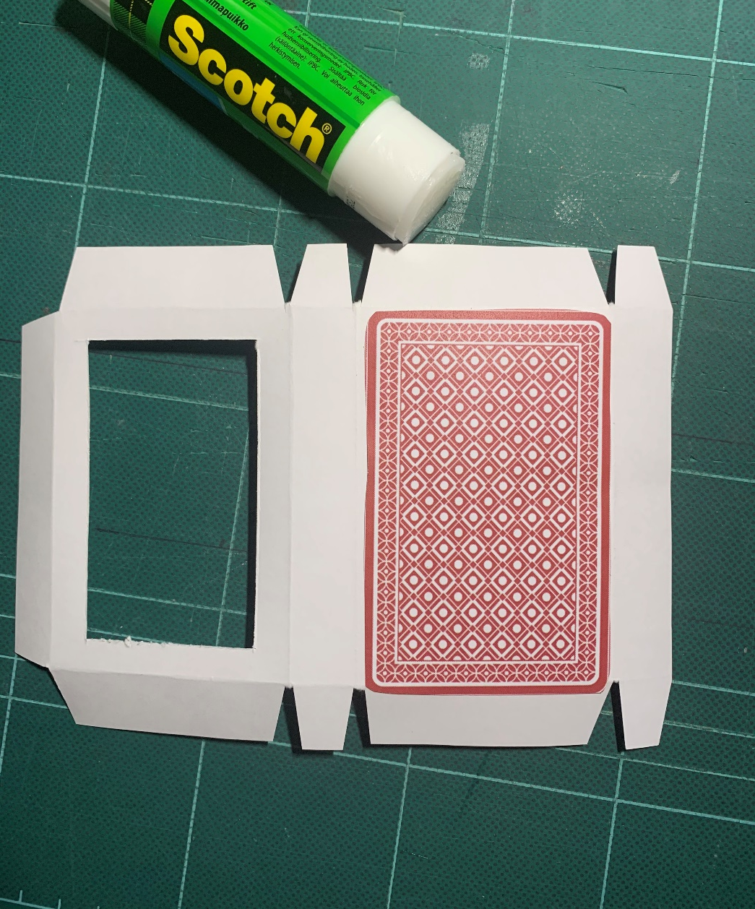
Step 5 – Template sheet 2
Playing Card inside Box
Glue the colour card back to the back of the template
Score the dotted lines
Fold the dotted lines

Slide 8
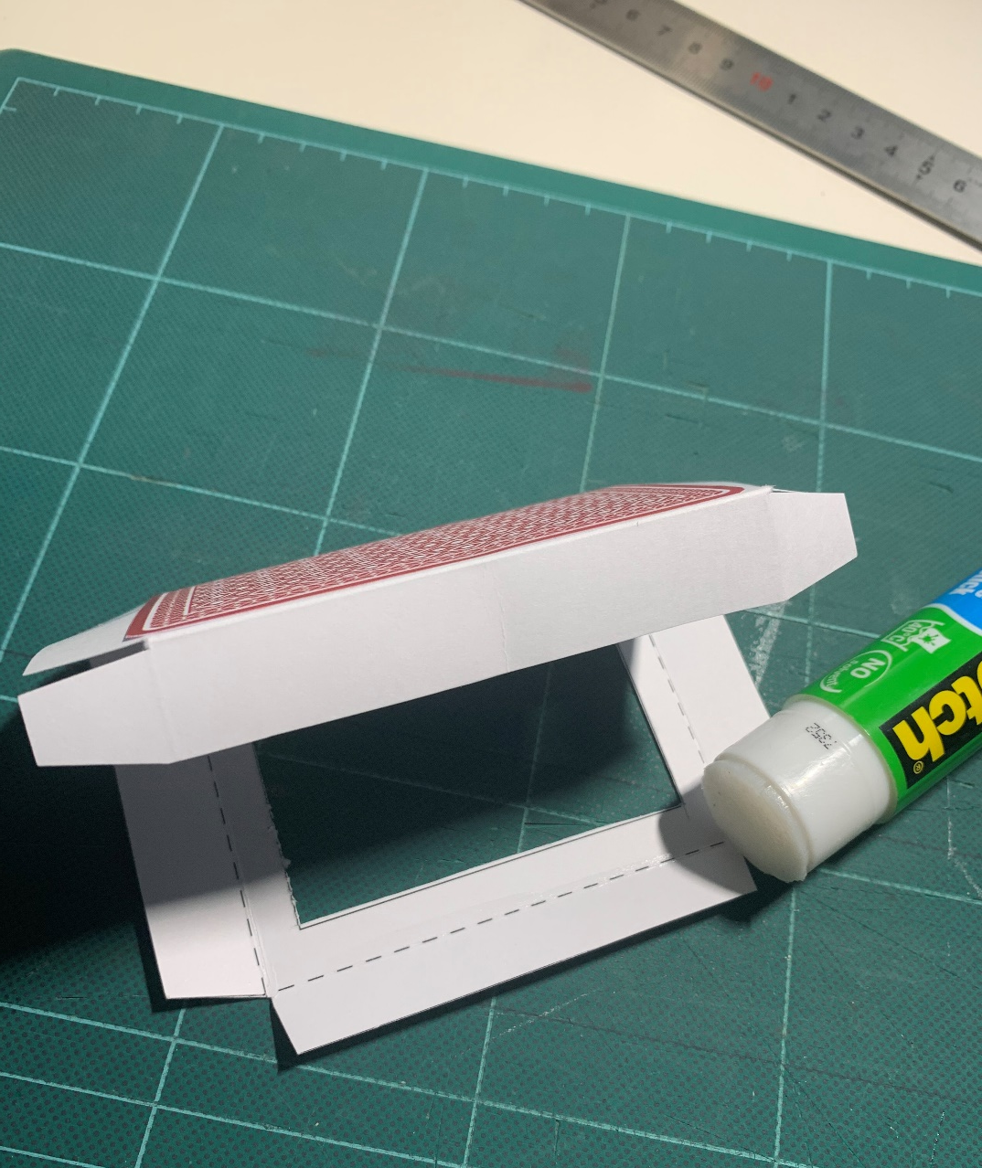
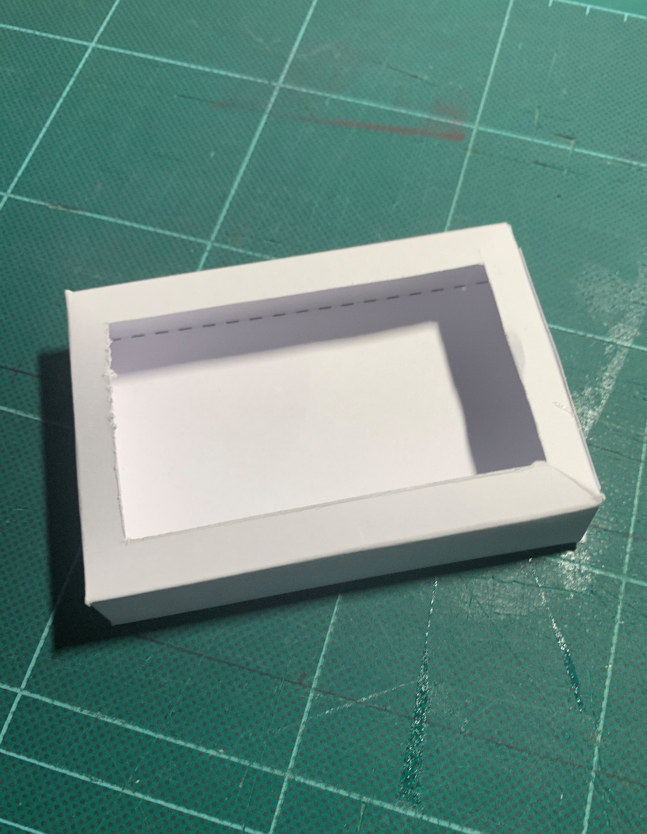
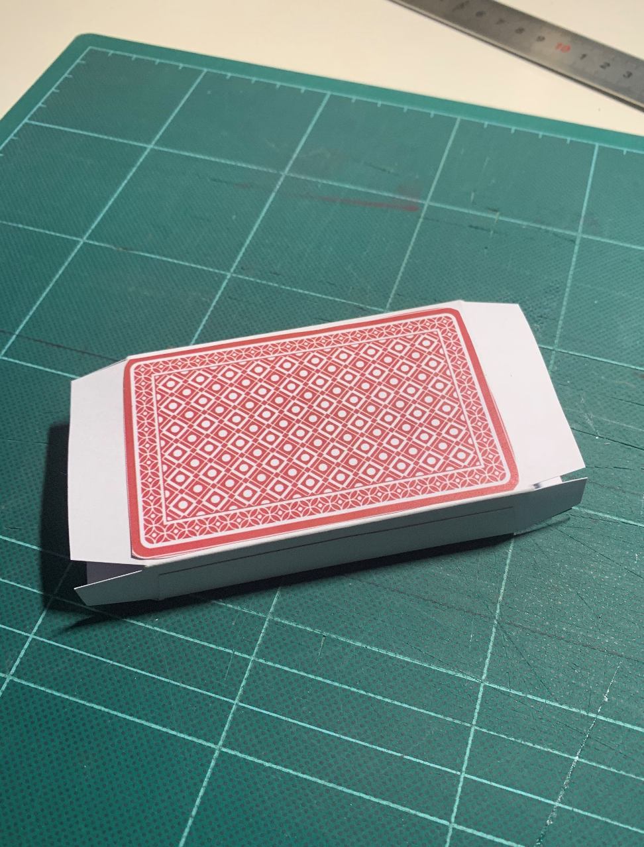
Step 6– Template sheet 2
Playing Card inside Box
Fold and glue the side tab
Fold and glue the end tabs
Completed inside box

Slide 9
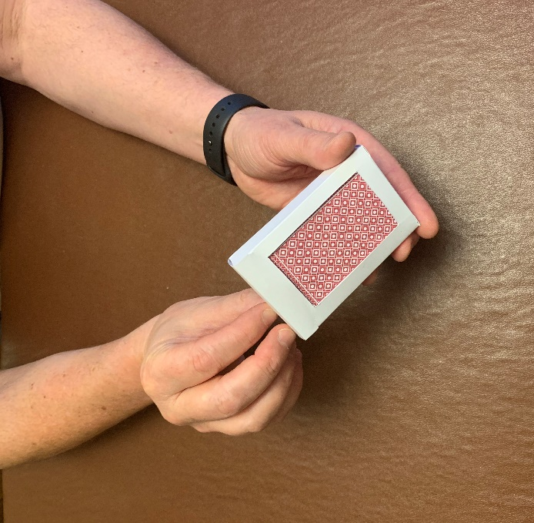
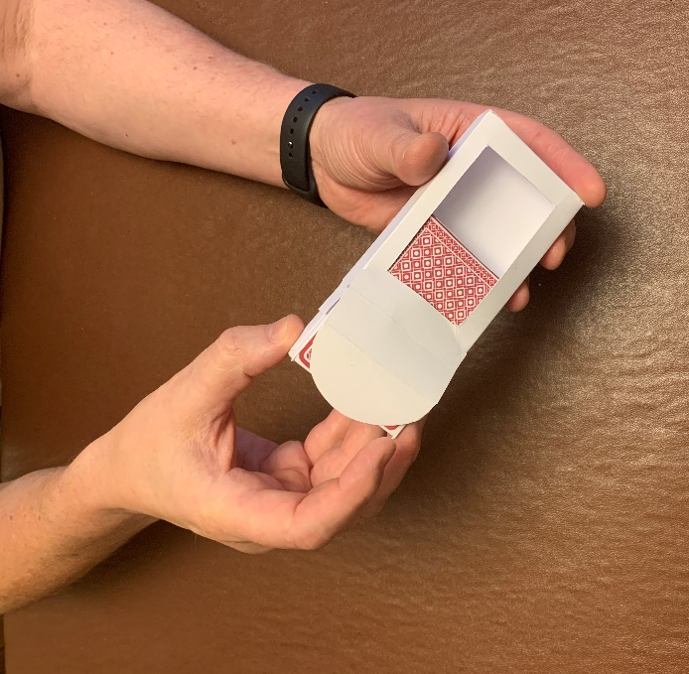
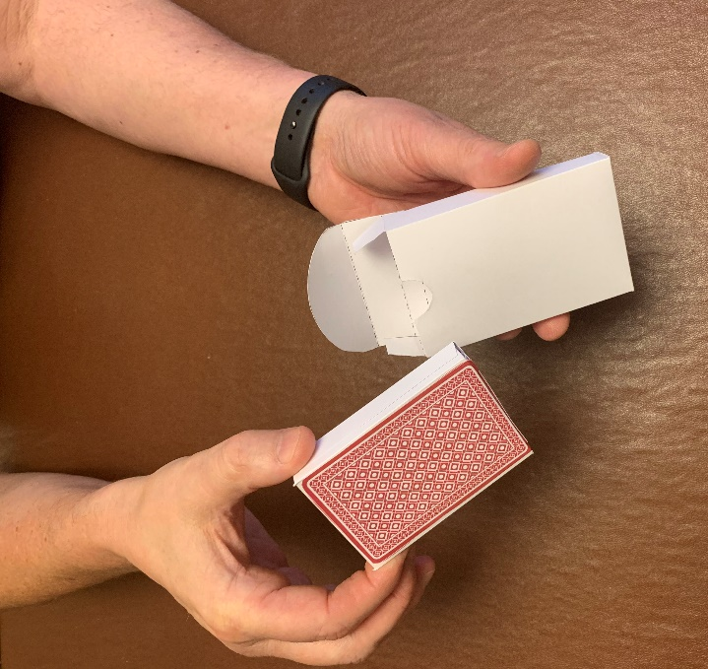
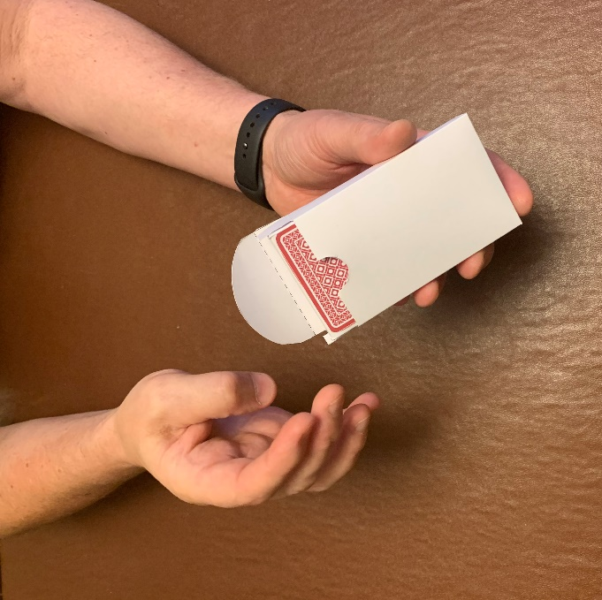
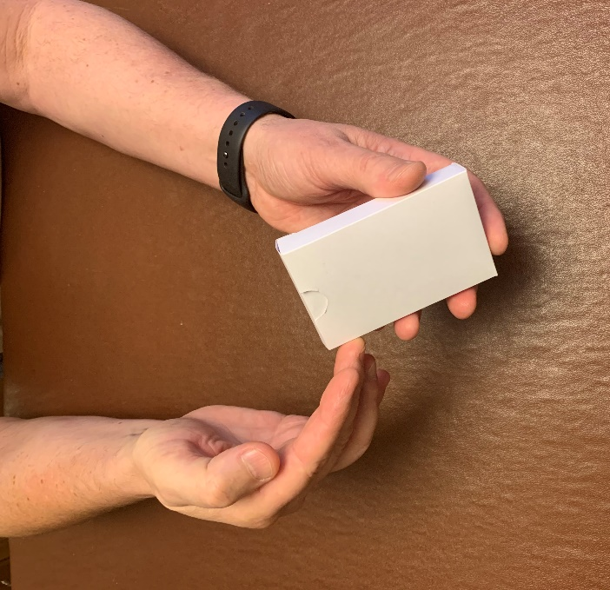
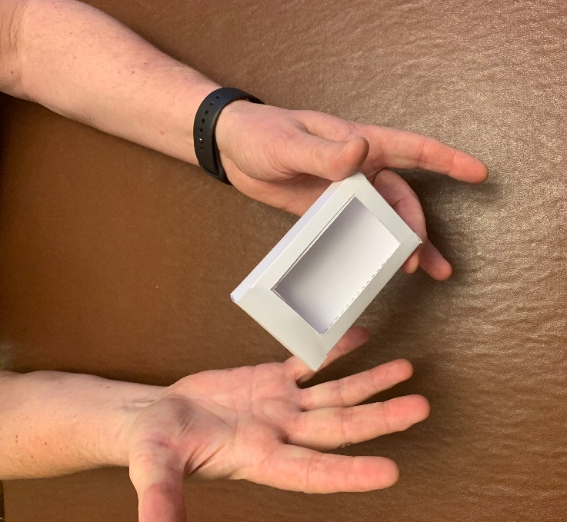
How to do the magic trick
1. Tell your audience you have a pack of cards – show them the coloured back through the open window on the card box
2. Carefully take out the inside box and say “you will now make the cards disappear”
3. Turn the card box around so the window is at the rear
4. Re-insert the ‘pack’ into the box
5. Close the card box and say a magic word
6. Turn the card box around to amaze your audience

