Slide 1
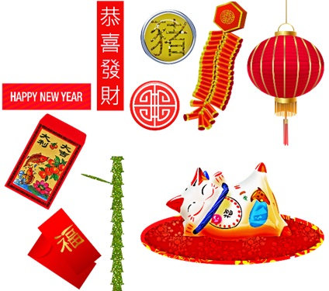
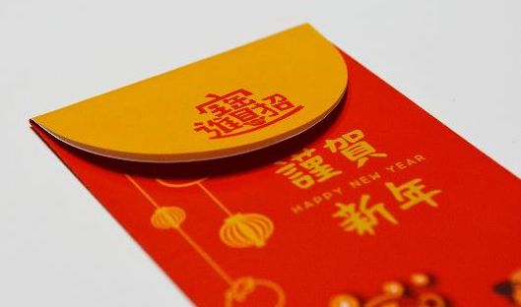
A Red Letter Day
A project to make a red gift envelope
for the Chinese New Year

Slide 2
Red Envelope
February 12th is the Chinese new year, beginning the year of the Ox
In China, it is traditional to give the gift of a bright, beautiful red envelope to your friends and family at new year
In Chinese the red envelope is known as 紅包, hóngbāo).
The red colour symbolizes good luck and prosperity
The envelopes are often decorated with good luck symbols like happy children, beautiful clothing and a peach

Slide 3
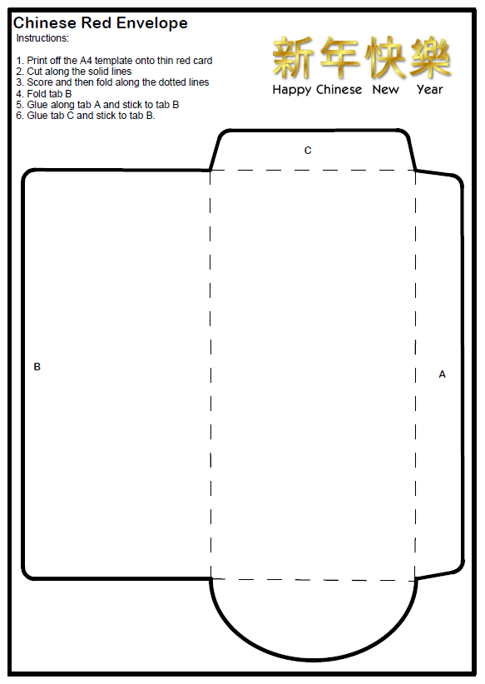
Resources
You will need
Red envelope net
Scissors
Red card
Glue

Slide 4
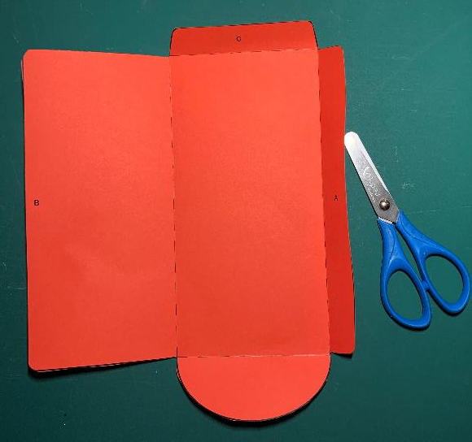
Step 1 – Cut out the envelope
Carefully cut along all the solid outlines
Score and fold the dotted lines

Slide 5
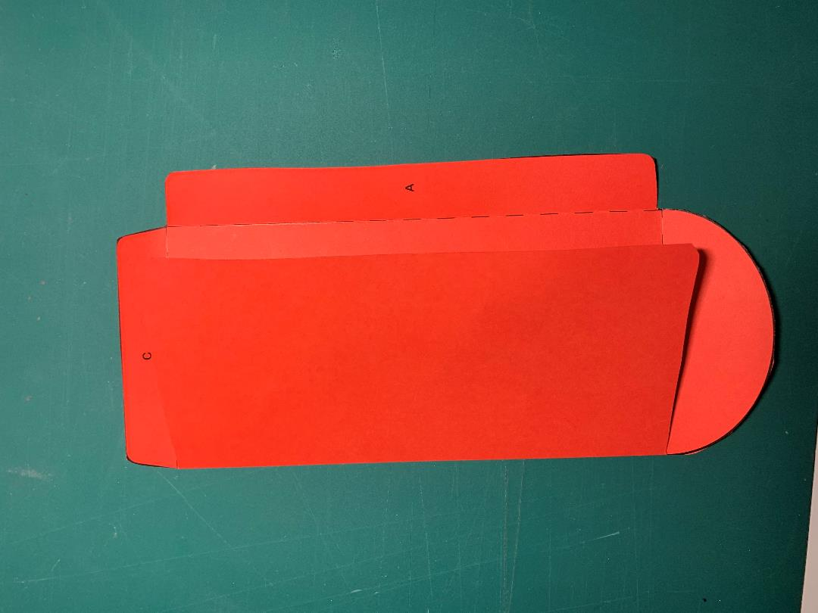
Step 2 – Fold and Glue Tabs A-B
Fold tab B
Glue tab A and stick to tab B
GLUE

Slide 6
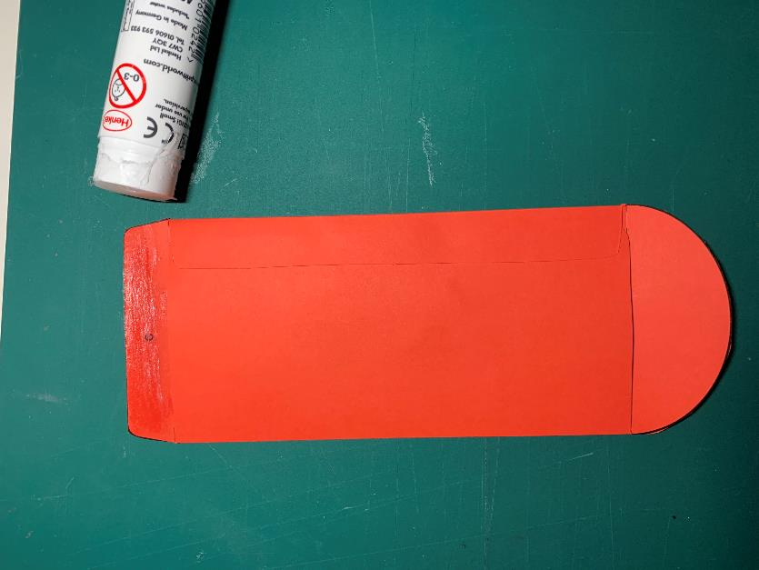
Step 3 – Fold and Glue Tab C
Glue tab C and stick to tab B
Once the glue is dry, you can insert a gift into the envelope and give it to your family and friends on Chinese New Year!
GLUE

Slide 7
Extension – Add a Decoration
Add text or a picture to your envelope
Make a gift or message to go in your envelope

