Slide 1
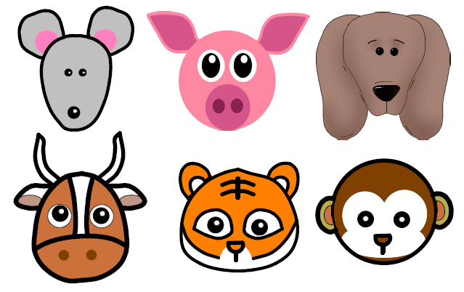
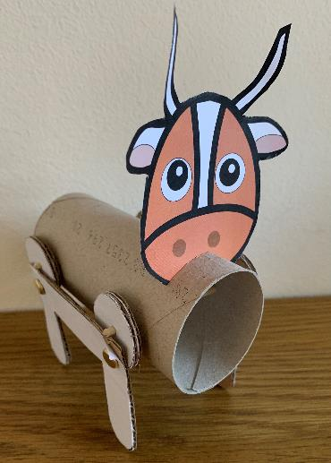
Chinese Zodiac Animals
A graphics project making Chinese zodiac animals that move!

Slide 2
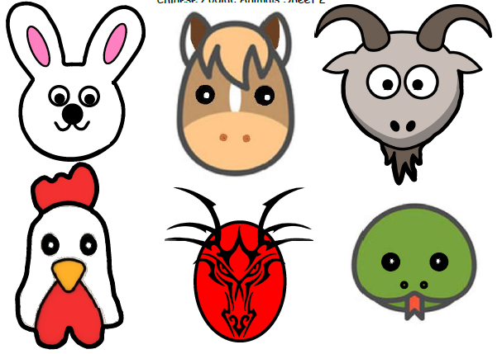
Step 1 – Choose your animal
Choose an animal face
Cut it out carefully with scissors
2021 is the Chinese year of the ox; you could research and use the animal from your own year of birth instead!

Slide 3
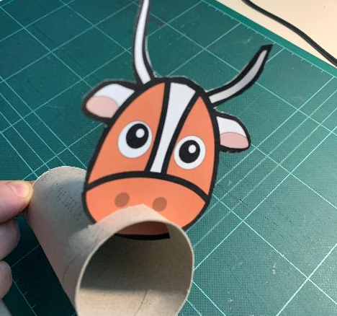
Step 2 – Attach the face
Gently squeeze the card tube
Make one cut near the end, carefully with scissors
Insert your animal face into the cut

Slide 4
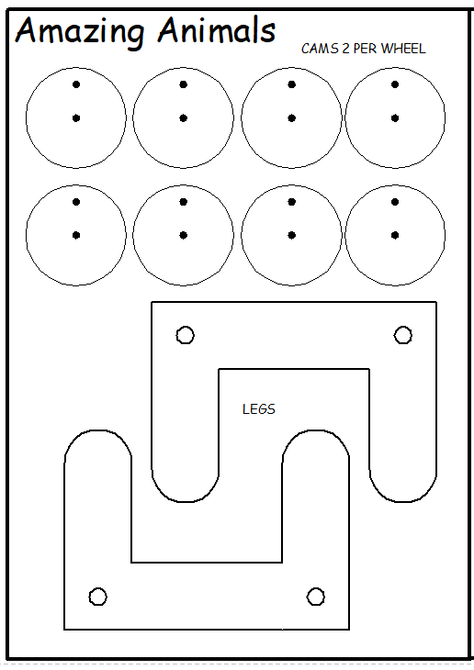
Step 3 – Animal legs template
Carefully cut the cams and legs with scissors

Slide 5
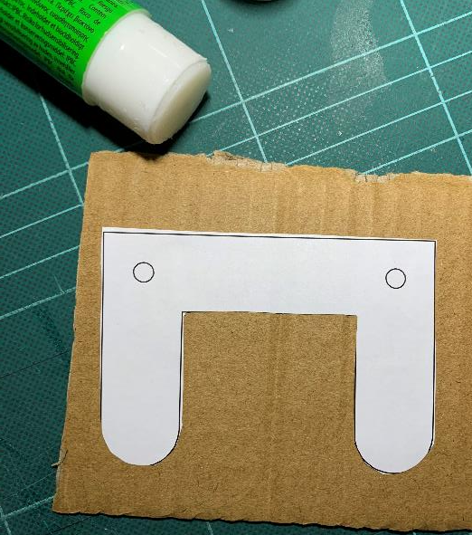
Step 4 – Animal legs
Glue template to cardboard
Carefully cut out with scissors
Put an eraser or sticky tack behind the hole, then push a sharp pencil in to make a small hole

Slide 6
Step 5 – Leg holes
Mark 2 points on each side of the card tube
Use the holes from the legs as a template - push a pencil through each hole in the legs to mark the points
Try to get the holes on each side in line with each other
Put an eraser or sticky tack behind the hole, then push a sharp pencil in to make a small hole. Repeat this for all 4 holes.

Slide 7
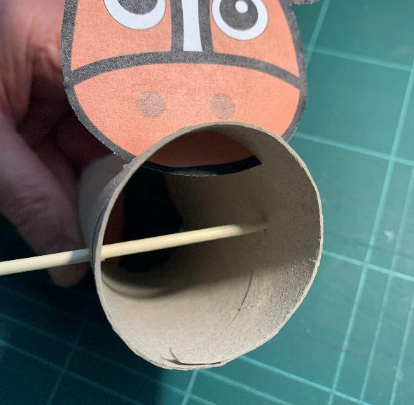
Step 6 – Leg holes
Carefully push a skewer or stick through the holes to make sure they line up
Keep your fingers out of the way of the skewer!

Slide 8
Step 7 – Leg Cams
Glue cam templates to cardboard
Carefully cut out with scissors
Glue 2 cams together

Slide 9
Step 8 – Leg Cams
Split pin goes here
Put an eraser or sticky tack behind the hole, then push a sharp pencil in to make a small hole
Repeat this to make two holes in each cam
Connect the cams to the legs using split pins (through the hole nearest the edge)
Skewer goes here
Linkage

Slide 10
Step 9 – Leg 1
Cut the skewers to 7cm
Get an adult to help
Use glue to attach the skewers to the cams
LET THE GLUE DRY!
Push through the holes in the card tube

Slide 11
Step 10 – Leg 2
Use glue to attach the legs on the other side of the body to the skewers
LET THE GLUE DRY!
To see the legs work, roll the front skewer between 2 fingers

