Slide 1
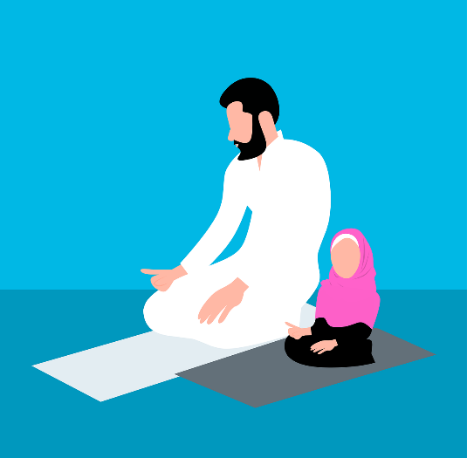
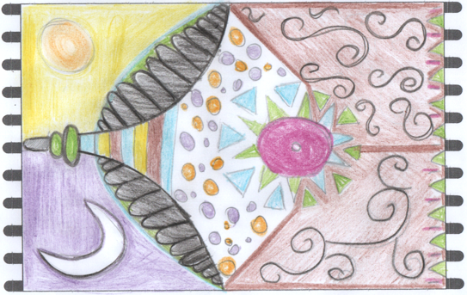
Design a Prayer Mat
Designing a prayer mat for Ramadan

Slide 2
Stay safe
Whether you are a scientist researching a new medicine or an engineer solving climate change, safety always comes first. An adult must always be around and supervising when doing this activity. You are responsible for:
ensuring that any equipment used for this activity is in good working condition
behaving sensibly and following any safety instructions so as not to hurt or injure yourself or others
Please note that in the absence of any negligence or other breach of duty by us, this activity is carried out at your own risk. It is important to take extra care at the stages marked with this symbol: ⚠

Slide 3
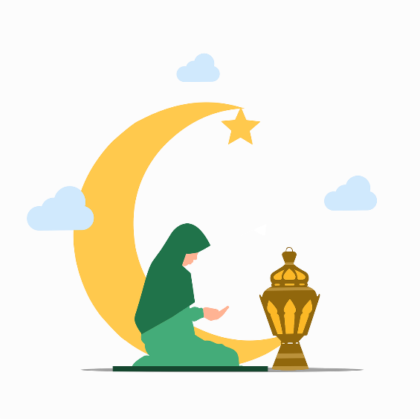
Design Brief
Your task is to design a prayer mat for Ramadan
Notes:
Discuss keywords such as Ramadan, prayer, prayer mat, shape, colour, celebrate.

Slide 4
Things to think about when creating your design…
What is Ramadan?
Who celebrates Ramadan?
What is a prayer mat?
Who uses a prayer mat and why?
What does a prayer mat look like?
Notes:
Discuss keywords such as Ramadan, prayer, prayer mat, shape, colour, celebrate.

Slide 5
Facts About Ramadan
What is Ramadan?
Ramadan lasts for a month - it is when Muslims all over the world fast between dawn and sunset
What does fasting mean?
Someone who is fasting chooses not to eat or drink
When is Ramadan?
It is in the ninth month of the Islamic calendar. It changes each year as it is based on a calendar that uses cycles of the moon
Notes:
Discuss with learners what fasting is. Use the next slide to support discussions.

Slide 6
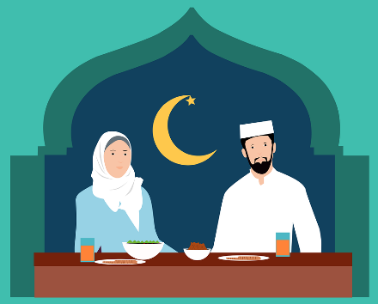
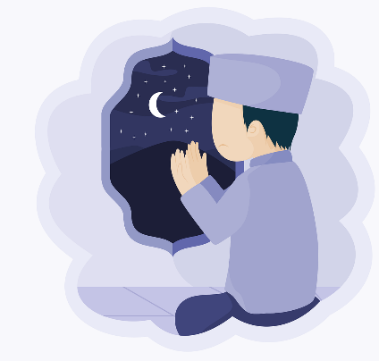
Meals During Ramadan
During Ramadan, many Muslims have just two meals each day:
suhoor - a meal before sunrise
iftar - a meal after sunset
This allows them to:
focus time on prayer and good deeds
spend time with friends and family

Slide 7
When is Ramadan in 2024?
Ramadan starts on Sunday 10th March 2024 and ends on Monday 8th April 2024

Slide 8
Where do Muslims Pray?
Notes:
Ask the class where they think people can pray and specifically Muslims. Ask learners if they have ever been to a Mosque, what did they do, what was it like? Get learners to discuss their experience. Discuss if there is Mosque near the school, what is it like?

Slide 9
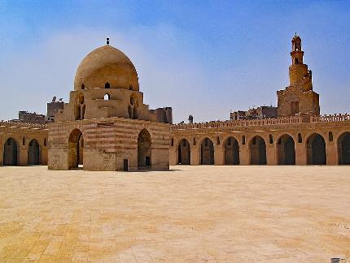
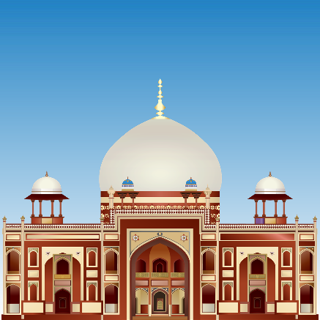
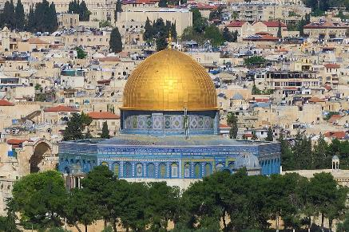
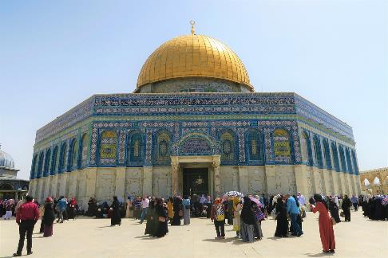
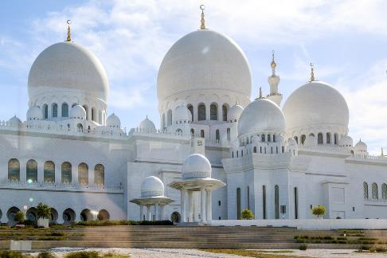
Where do Muslims Pray?
Muslims pray in a Mosque
or at home

Slide 10
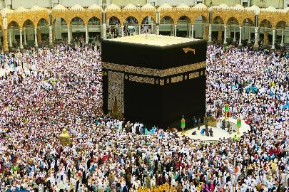
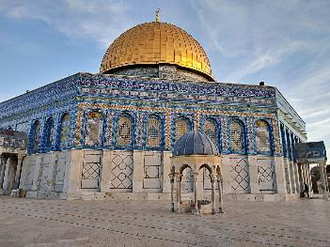
Prayer Mats
Muslims use prayer mats when praying
These prayer mats are often made from fabric or carpet
Prayer mats often have patterns on them, such as flowers, shapes or buildings that are important to them
Ka'aba in Mecca
Al-Aqsa Mosque
Hassan II Mosque
Notes:
Discuss the images, these are important landmarks in Islam and for Muslims.

Slide 11
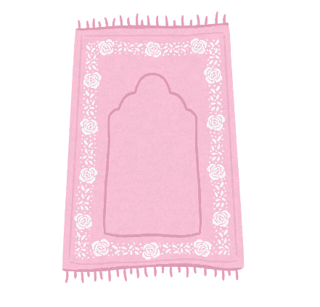
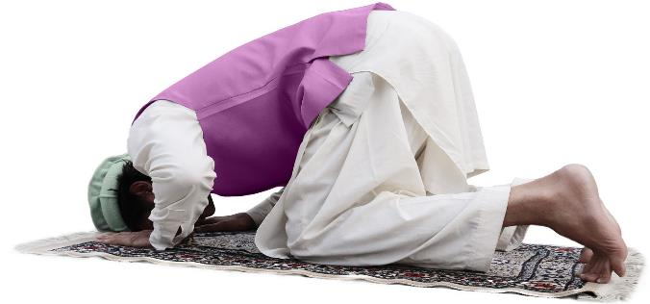
Prayer Mats
Front - the direction the person would face to pray
Muslims pray in the direction of Mecca (Mecca is a holy city in Islam)
A prayer mat will often have a clear top and bottom to the design
Front
Rear
Rear - where the person praying would stand

Slide 12
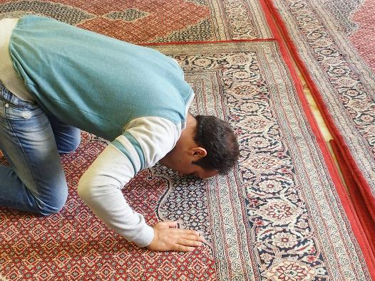
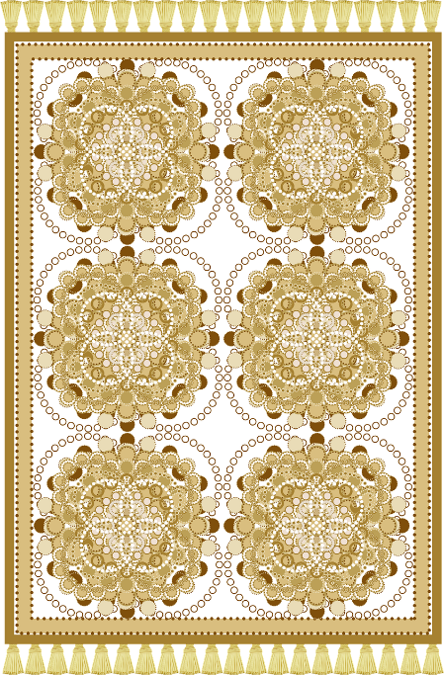
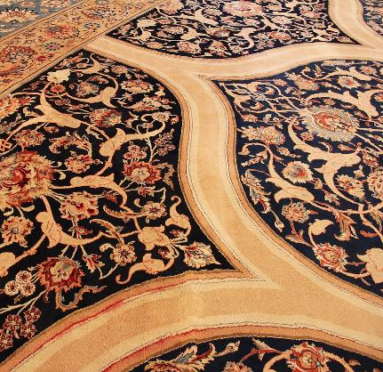
Examples of Prayer Mats
What patterns are on the prayer mats?
What colours have been used?
Notes:
Discuss the patterns, colours, shapes and landmarks used. Discuss how they could be used in the design of the learner’s prayer mat.

Slide 13
Things to think about:
Who will use your prayer mat? Adults or children?
What colours will you use on your design?
What shapes or patterns will you use on your prayer mat?
How will you make it really clear which is the front and rear of the mat?

Slide 14
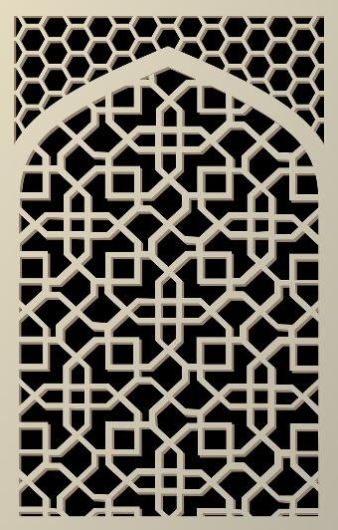
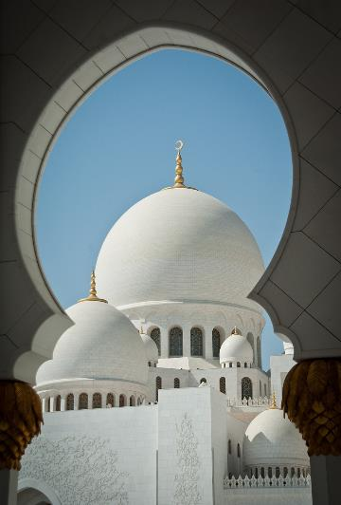
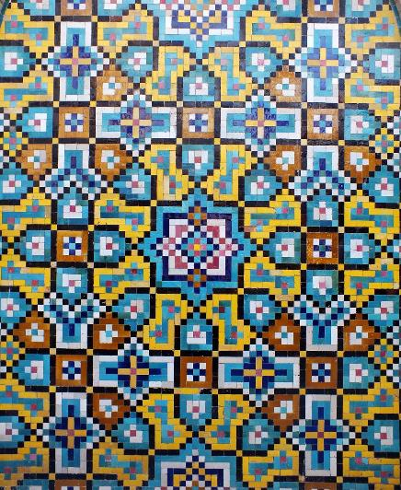
Some Inspiration
Notes:
Patterns and shapes in Islam.

Slide 15
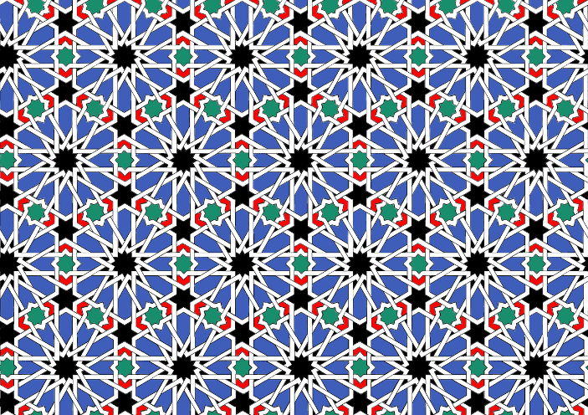
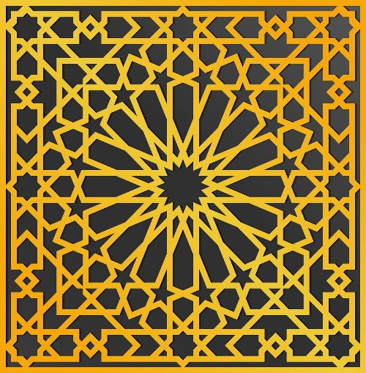
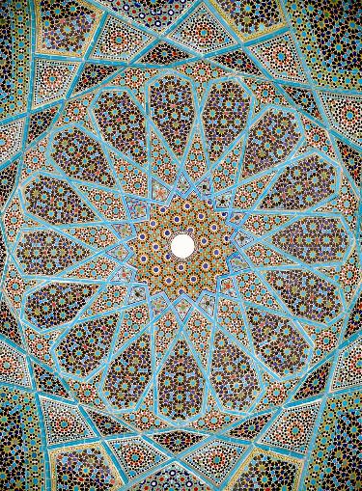
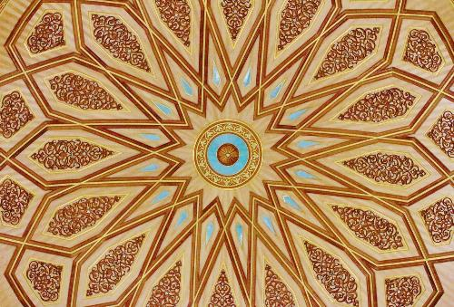
Notes:
Patterns and shapes in Islam.

Slide 16
⚠
Get Designing - What you will need:
Pencil crayons or paint
Prayer mat template or paper
Ruler, rubber, pencil
Felt tip pens
Stencils
Scissors
⚠ Be careful when using the scissors

Slide 17
Prayer Mat Worksheet
Front
Rear
Notes:
Learners can use this template to sketch their design on or use their own prayer mat design. They could cut out a prayer mat shape out of card or paper.

Slide 18
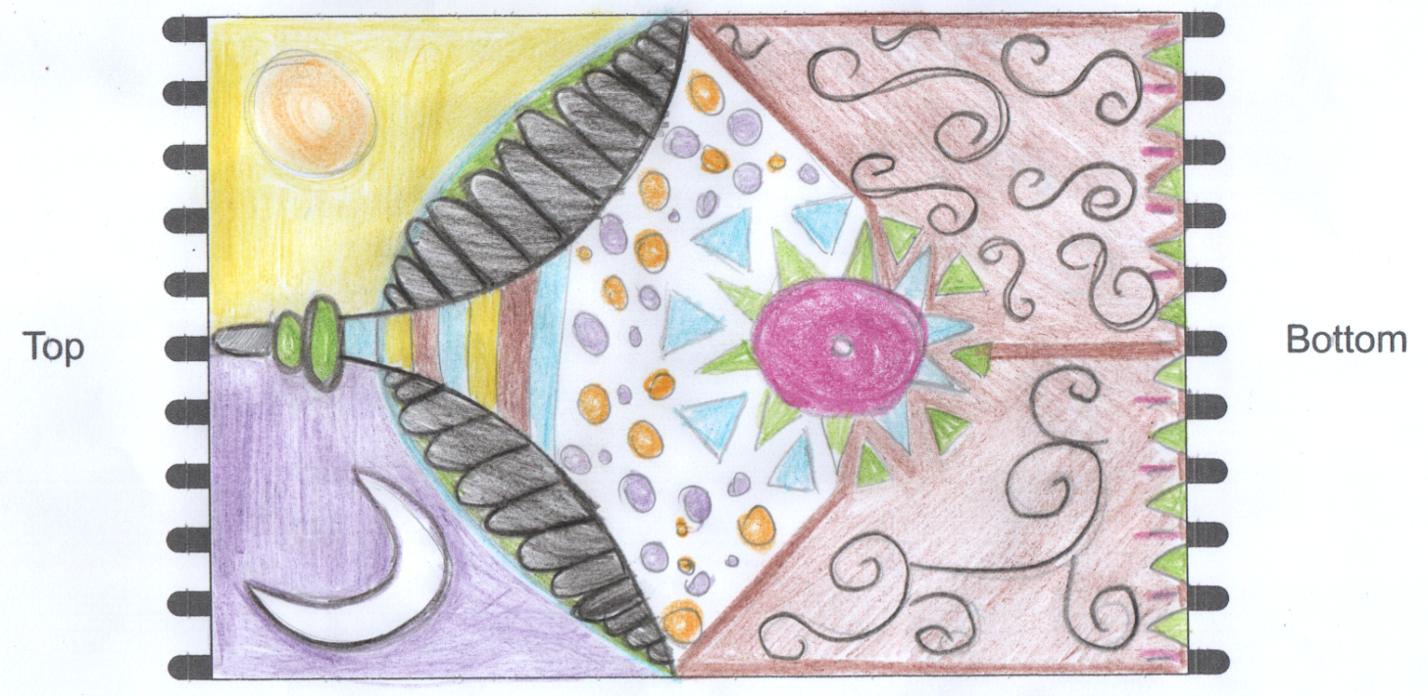
Prayer Mat Example
Add an example
Front
Rear
Top
Bottom

Slide 19
Extension: Making a Prayer Mat
⚠
What you might need:
Pencil crayons or paint
Prayer mat template or paper
Ruler, rubber, pencil
Coloured paper or card
Fabrics such as felt, wool or string
Glue sticks
Scissors
Hole punch
⚠ Be careful when using the scissors

Slide 20
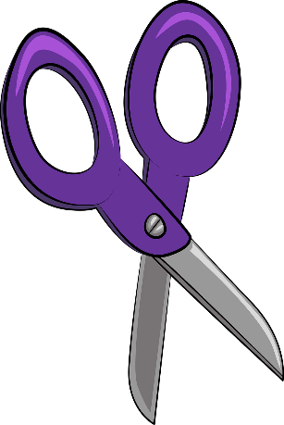
Make your Prayer Mat
⚠
Draw out your prayer mat design - use the template provided.
Cut out your prayer mat
Cut out different materials such as card, paper, felt and stick them on to your design
Using a hole punch and wool, you could add tassels to your prayer mat. Think about plaiting or weaving the wool
⚠ Be careful when using the scissors

Slide 21
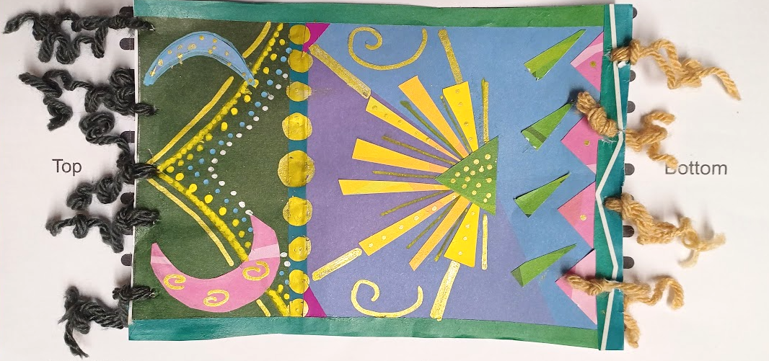
Example Prayer Mat
Front
Rear
Notes:
With thanks to Kirsty M. for making the example.

Slide 22
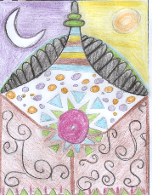
Extension - Making a Class Prayer Mat
Cut out your paper prayer mat (cutting off any tassels)
Lay out all the prayer mats as a class and determine the top and bottom of the prayer mat
Staple or glue the prayer mats together
Lay the class mat on the floor and talk about which way is Mecca

