Slide 1
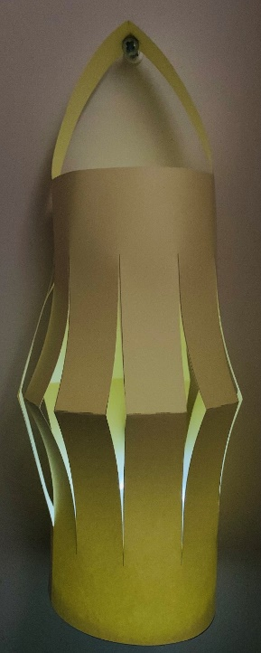
Ramadan Lantern
Making a card lantern for Ramadan

Slide 2
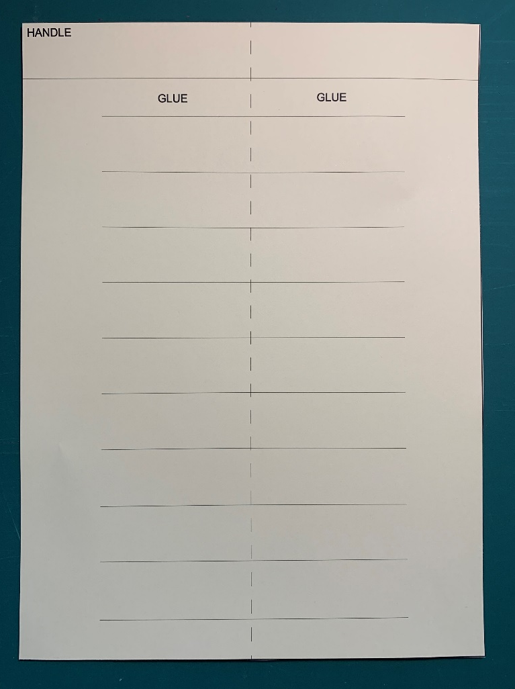
Step 1 – Cut out the Lantern template

Slide 3
Step 2 – Fold and cut the template
Fold on the fold line
Cut off the handle
FOLD

Slide 4
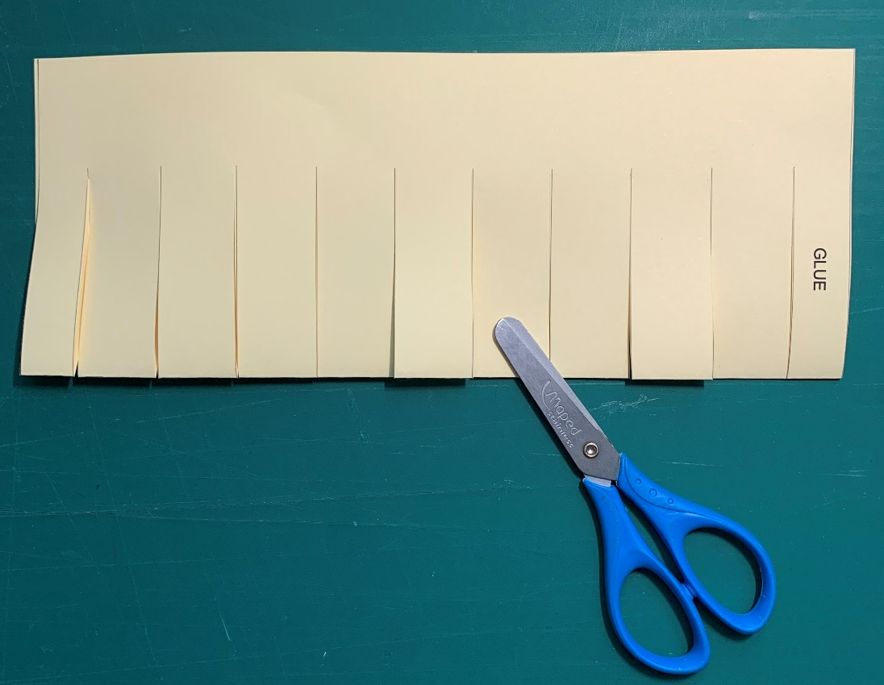
Step 3 - Cut out the strips
Cut along the solid lines
Don’t cut too far

Slide 5
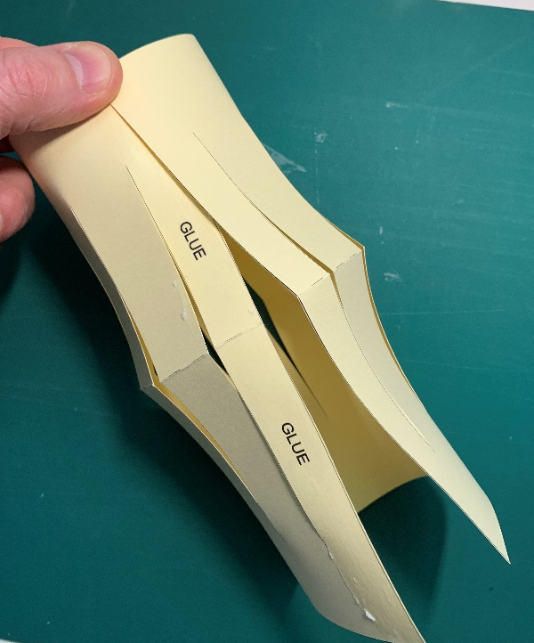
Step 4 – Unfold and glue the lantern
Glue the edge
Join the long edges together

Slide 6
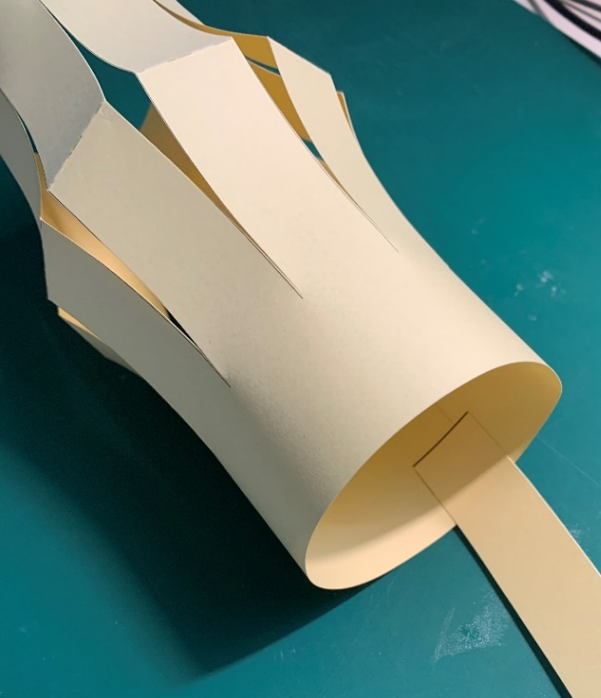
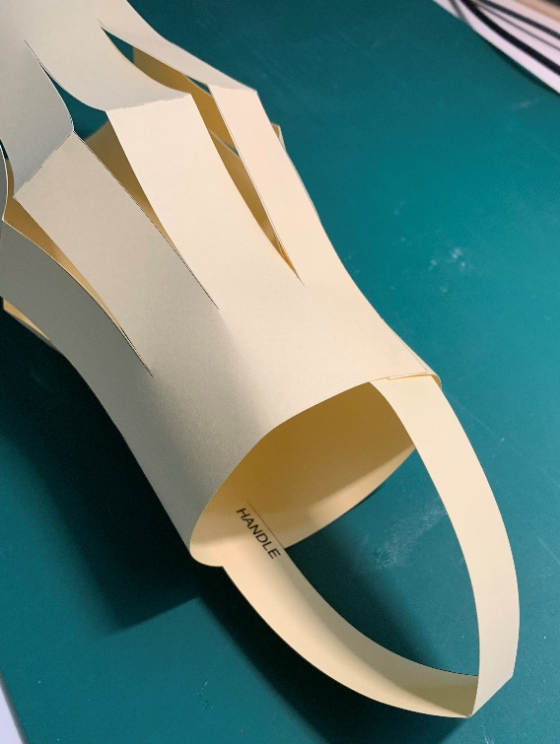
Step 5 – Glue on the handle
Glue the ends of the handle to the inside of the lantern
GLUE
GLUE

Slide 7
Step 6 – Insert a light
Use a small torch or a 9V PP3 battery and a LED, held with string and sticky tape
String and Sticky Tape

Slide 8
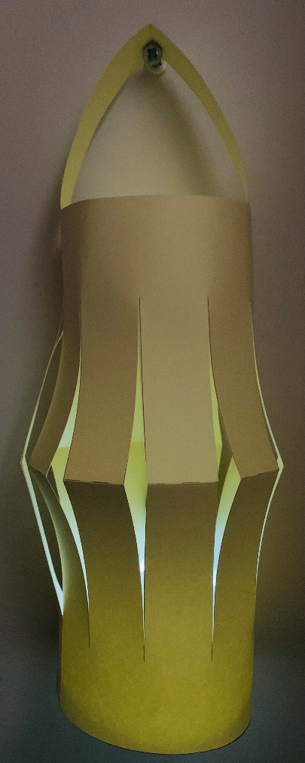
Step 7 – Hang up your lantern

