Slide 1
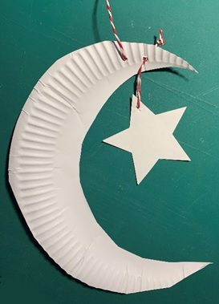
Ramadan Moon and Star
Making a paper plate moon and star decoration for Ramadan

Slide 2
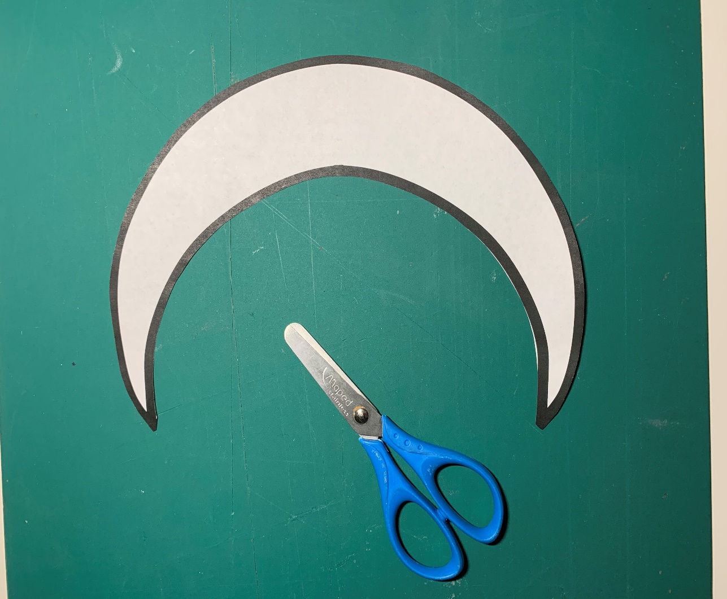
Step 1 – Cut out the moon template
Carefully cut out the moon
template

Slide 3
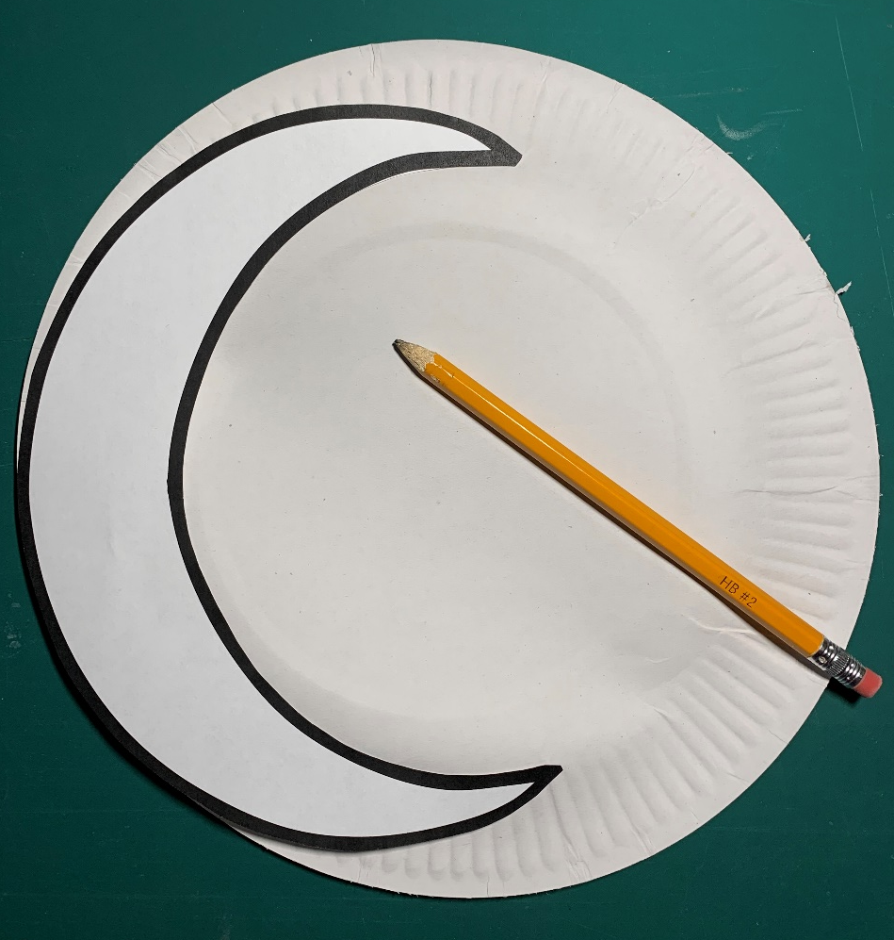
Step 2 – Draw around the moon template
Place the moon template
on the plate edge
Draw around with a pencil

Slide 4
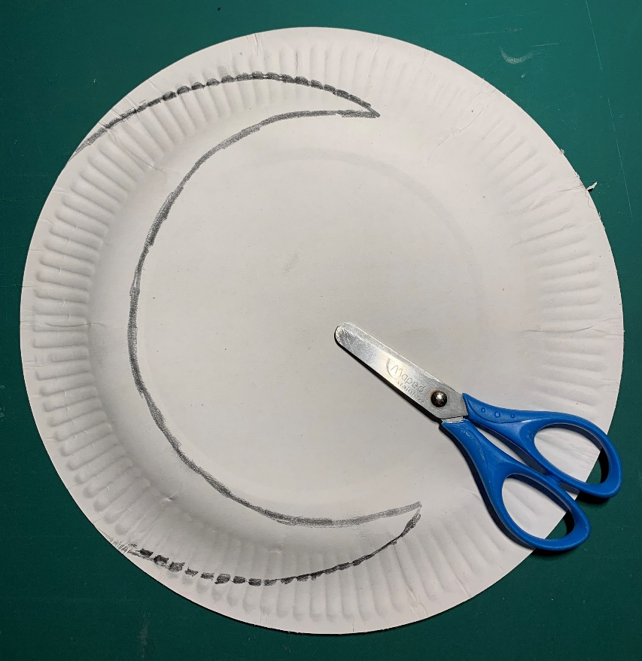
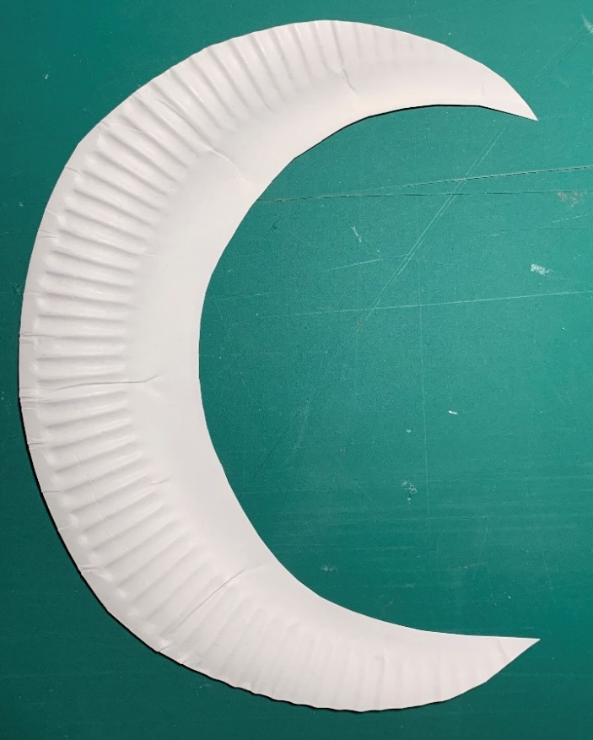
Step 3 - Cut out the moon shape
Carefully cut along the pencil line

Slide 5
Step 4 – Cut out the star template
Carefully cut out the star template

Slide 6
Step 5 – Draw around the star template
Place the star template on
the leftover paper plate
Draw around with a pencil

Slide 7
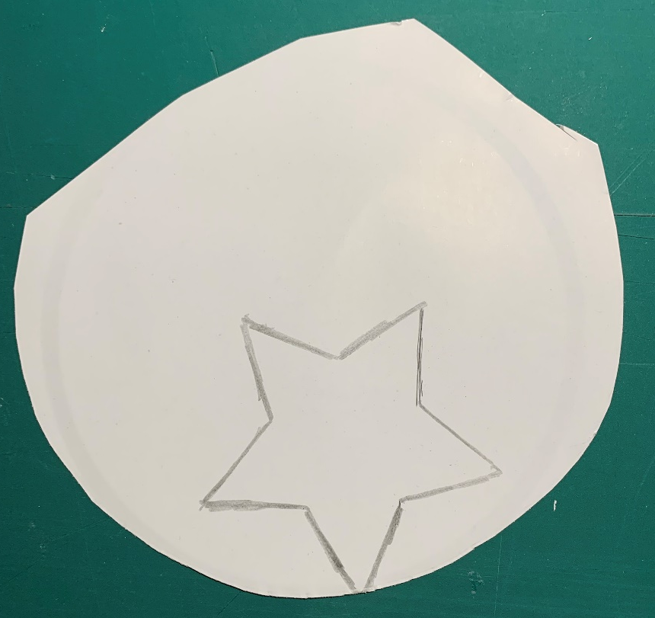
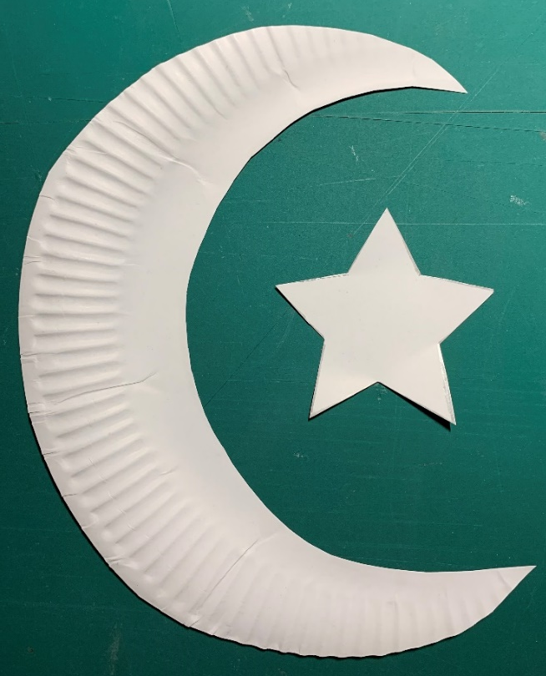
Step 6 - Cut out the star shape
Carefully cut along the pencil line

Slide 8
Step 7 – Make a hole on top of the moon
Put an eraser or sticky tack behind the hole
Push a sharp pencil through the moon into the eraser, to make a small hole

Slide 9
Step 8 – Make a hole on top of the star
Put an eraser or sticky tack behind the hole
Push a sharp pencil through the star into the eraser, to make a small hole

Slide 10
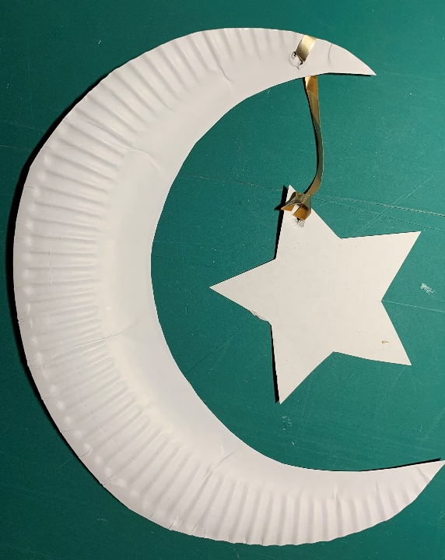
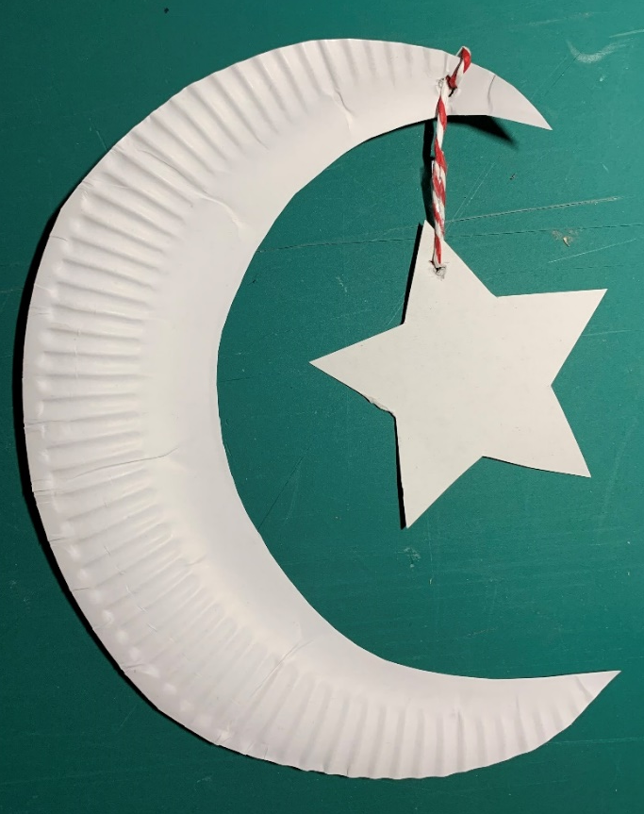
Step 9 – Tie the moon and star together
Use ribbon or string to tie together
Notes:
The string could be either knotted at each end or attached to the back with sticky tape.

Slide 11
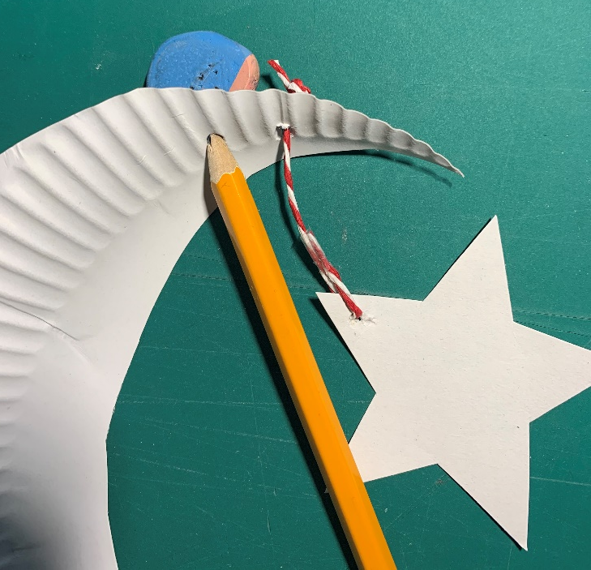
Step 10 – Hang up the moon and star
Repeat Step 8 to make another hole
Use ribbon or string to hang up the decoration

