Slide 1
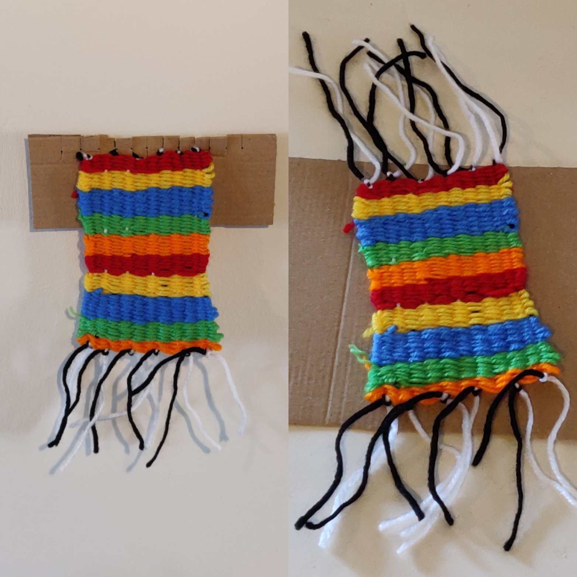
Wonderful Weaving
Using wool to make a woven product

Slide 2
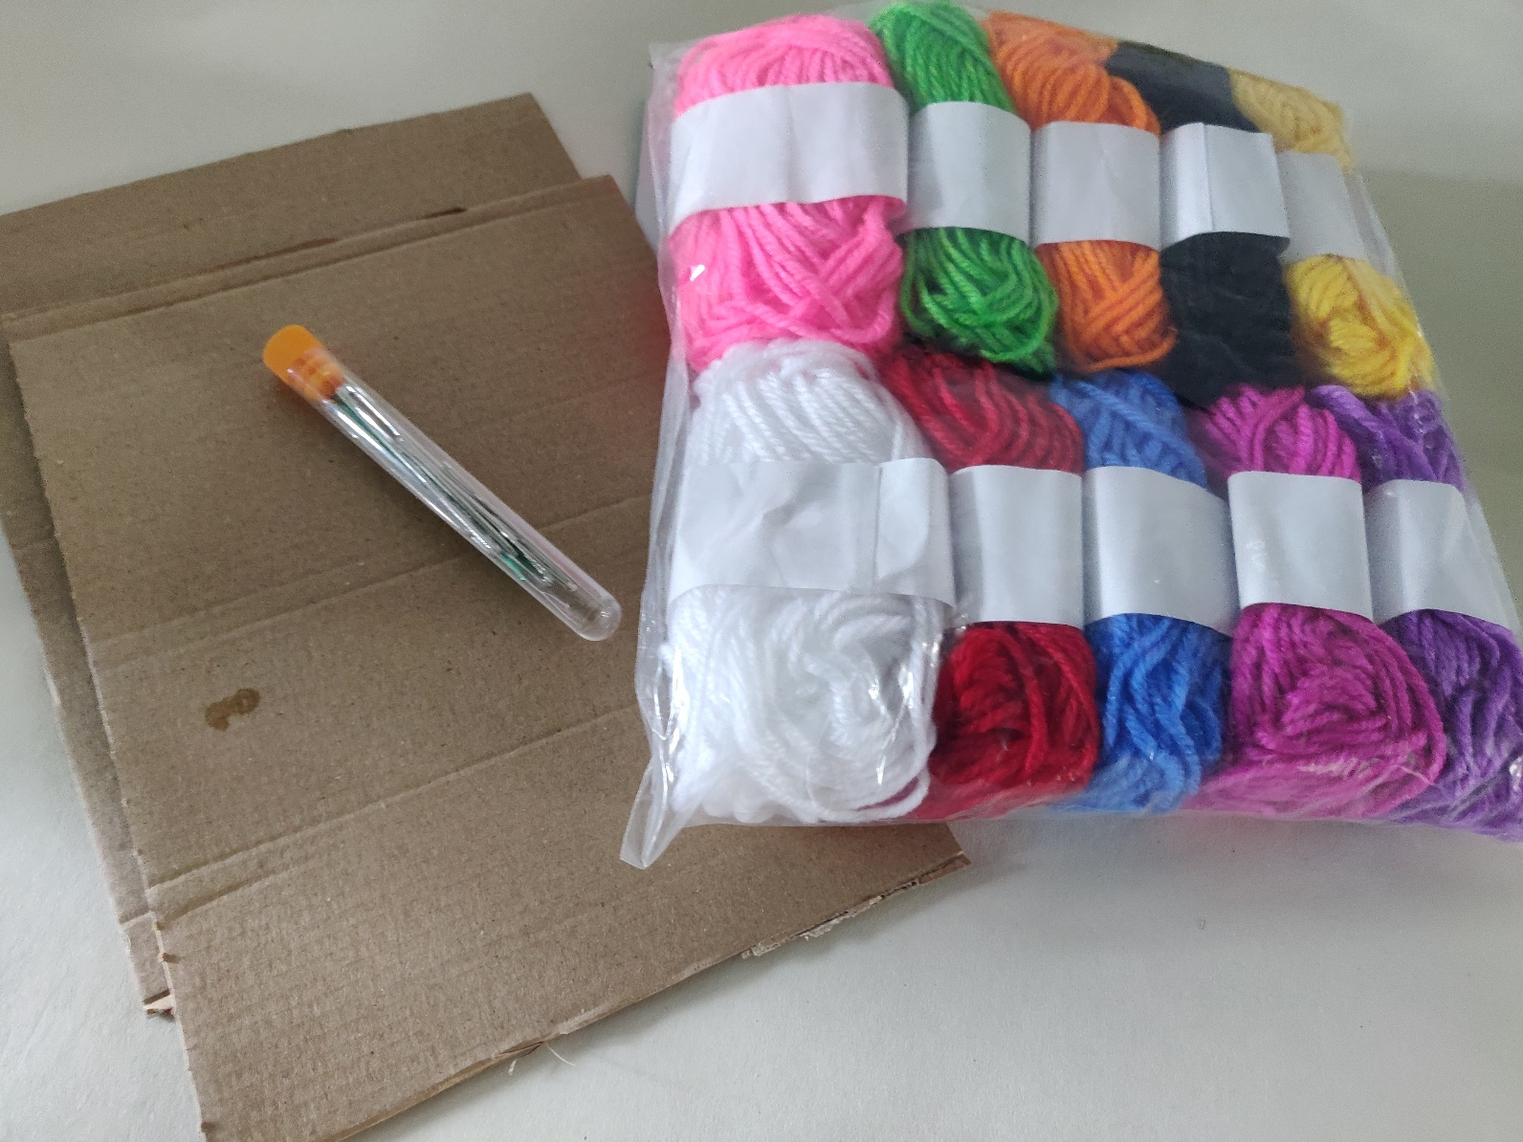
Equipment
Cardboard
Wool
Large eye blunt needle
Masking tape
Notes:
Recycling – using cardboard from postal packaging, paper boxes etc
A5 sized piece approx. 15 x 21cm – larger sizes can be used for complexity or ease of use.
*also need masking tape to secure Warp threads*
Instead of using new wool, can use fabric strips, ribbons or other suitable materials.

Slide 3
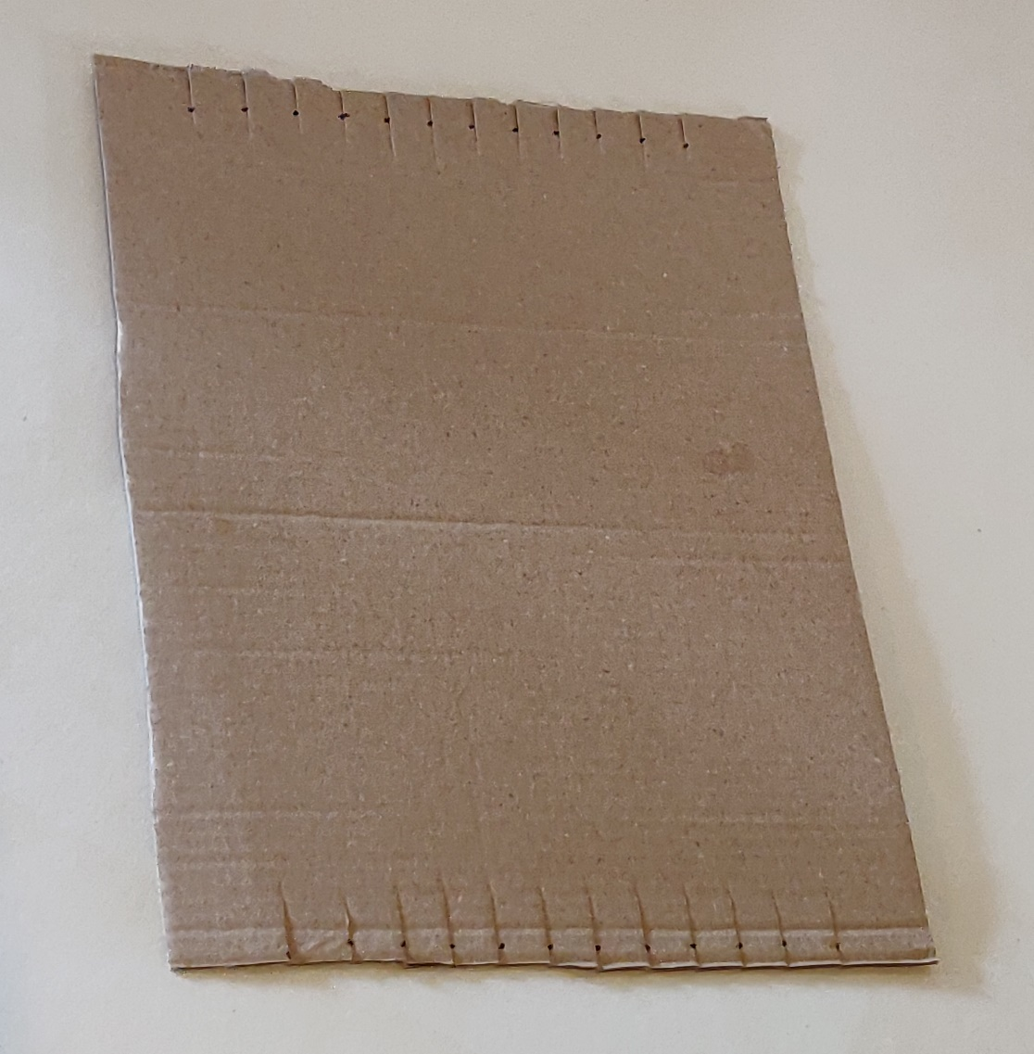
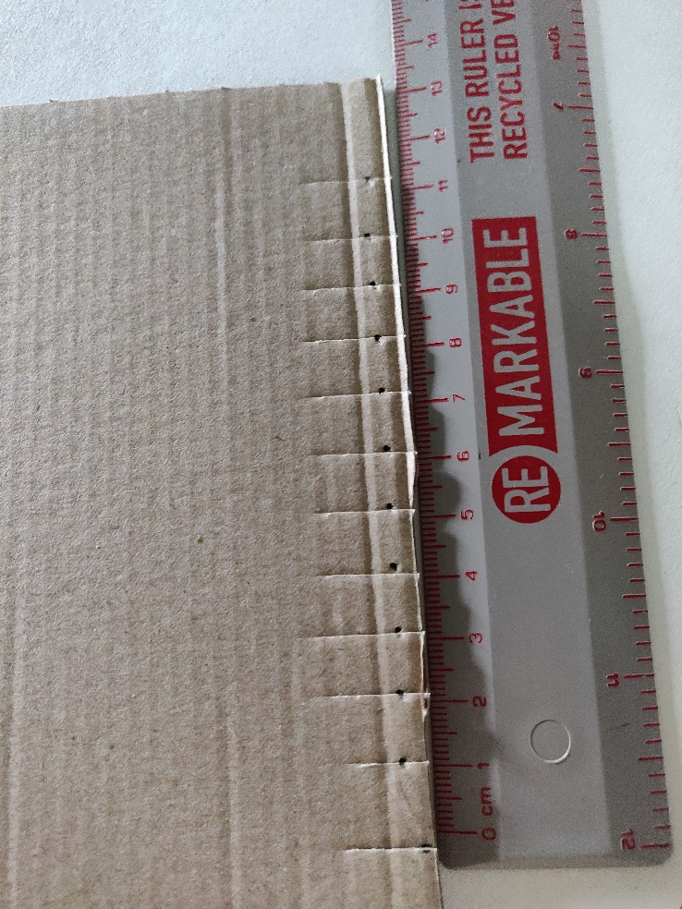
Step 1
Measure and mark out slits for warp threads on the shortest edges of cardboard, 1 cm apart
Cut slits 1 cm deep
Notes:
Ensure there are an EVEN number of warp strings.
Warp threads can be spaced up to 1.5 cm to help with dexterity of required.

Slide 4
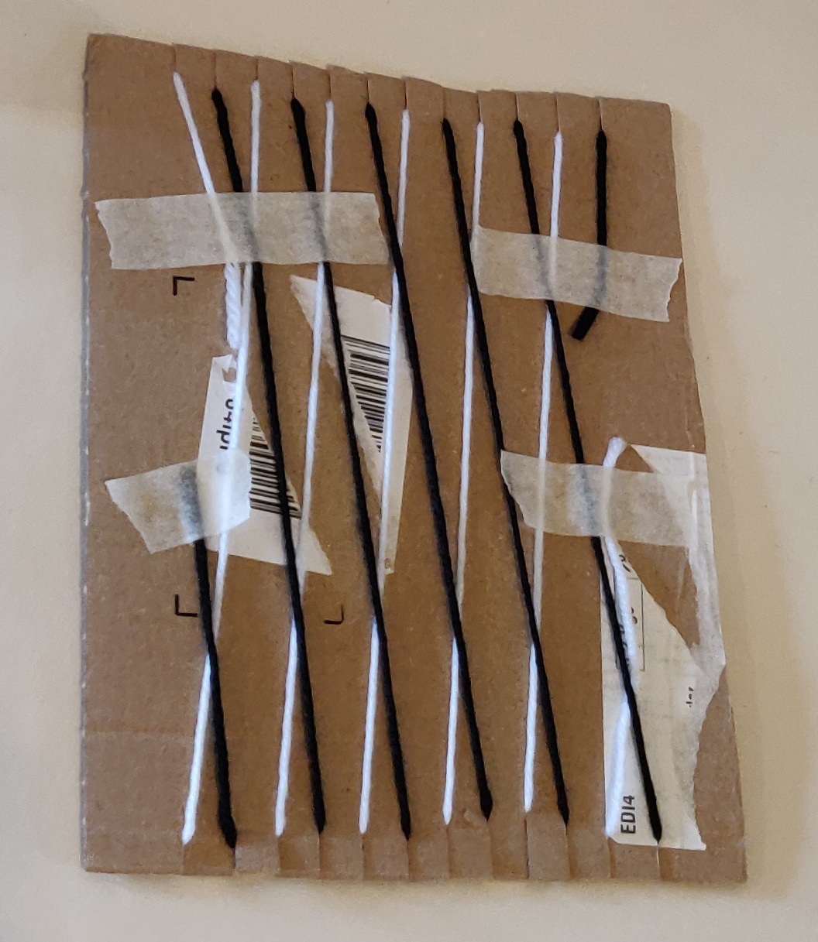
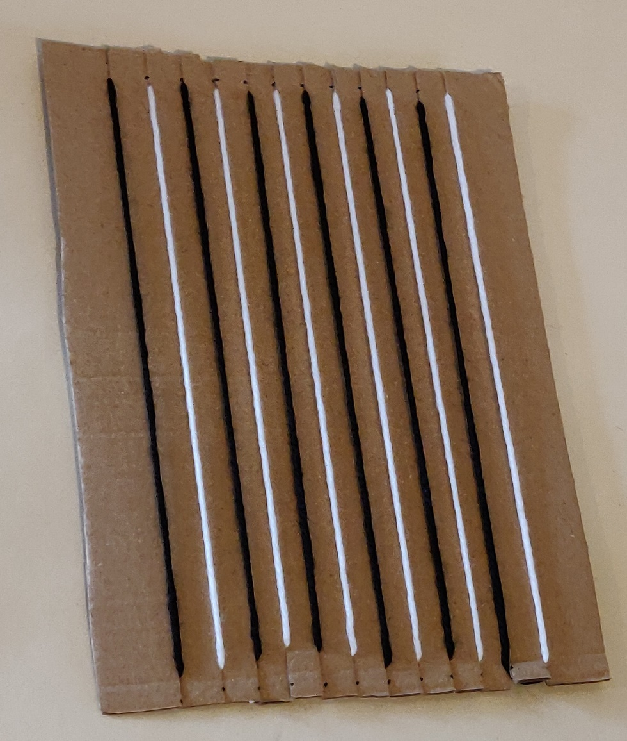
Step 2
Wrap the wool around alternate slits
Stick the ends with masking tape
Notes:
Use alternating colours for the Warp threads – aids with under and over.
Numbering the warp strings can help, 1212

Slide 5
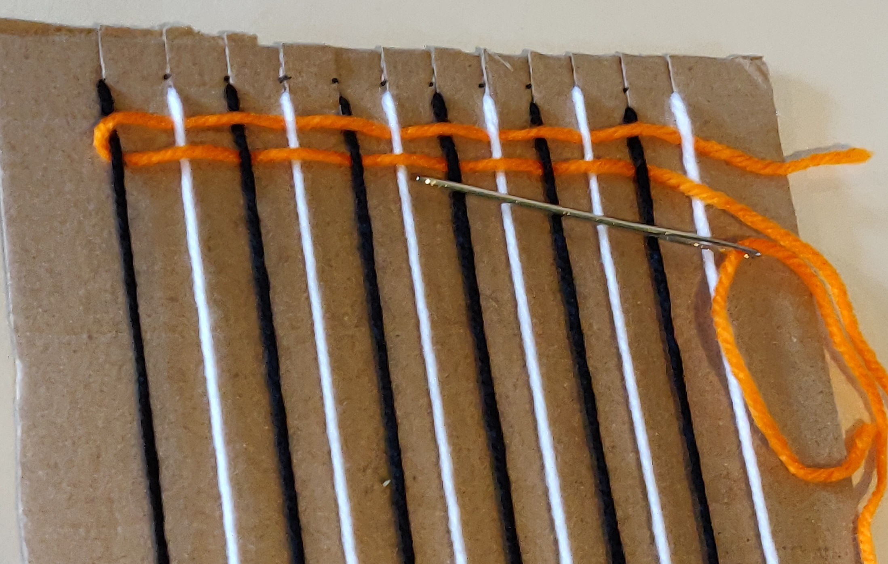
Step 3
Thread blunt needle with wool
Leave tail when begin weaving
‘Under and Over’
Notes:
If using numbered warp threads, remind them ‘12121212’
Extension: design a pattern that can be woven in, for example equal sized stripes or a shape.

Slide 6
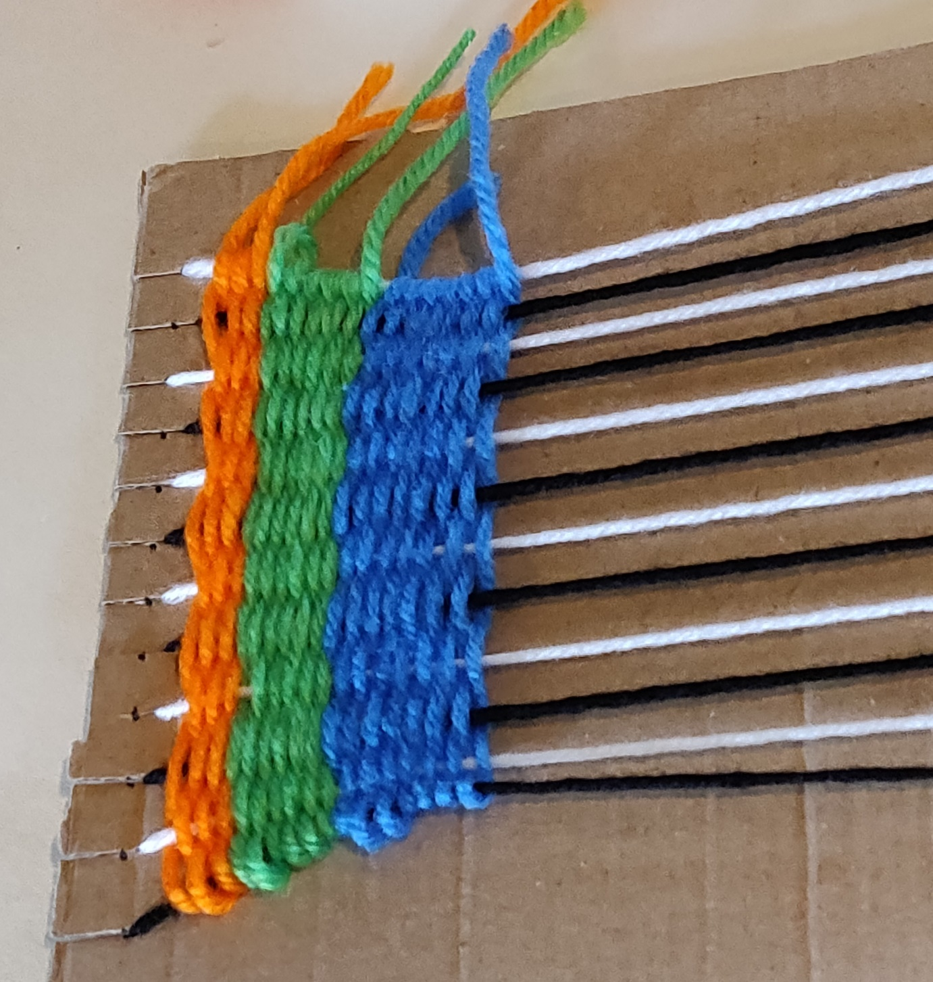
Step 4
Change colour when wool runs out
Leave tail when changing colour
Notes:
Try and get all tails on the same side, makes the neatening process easier at the end.

Slide 7
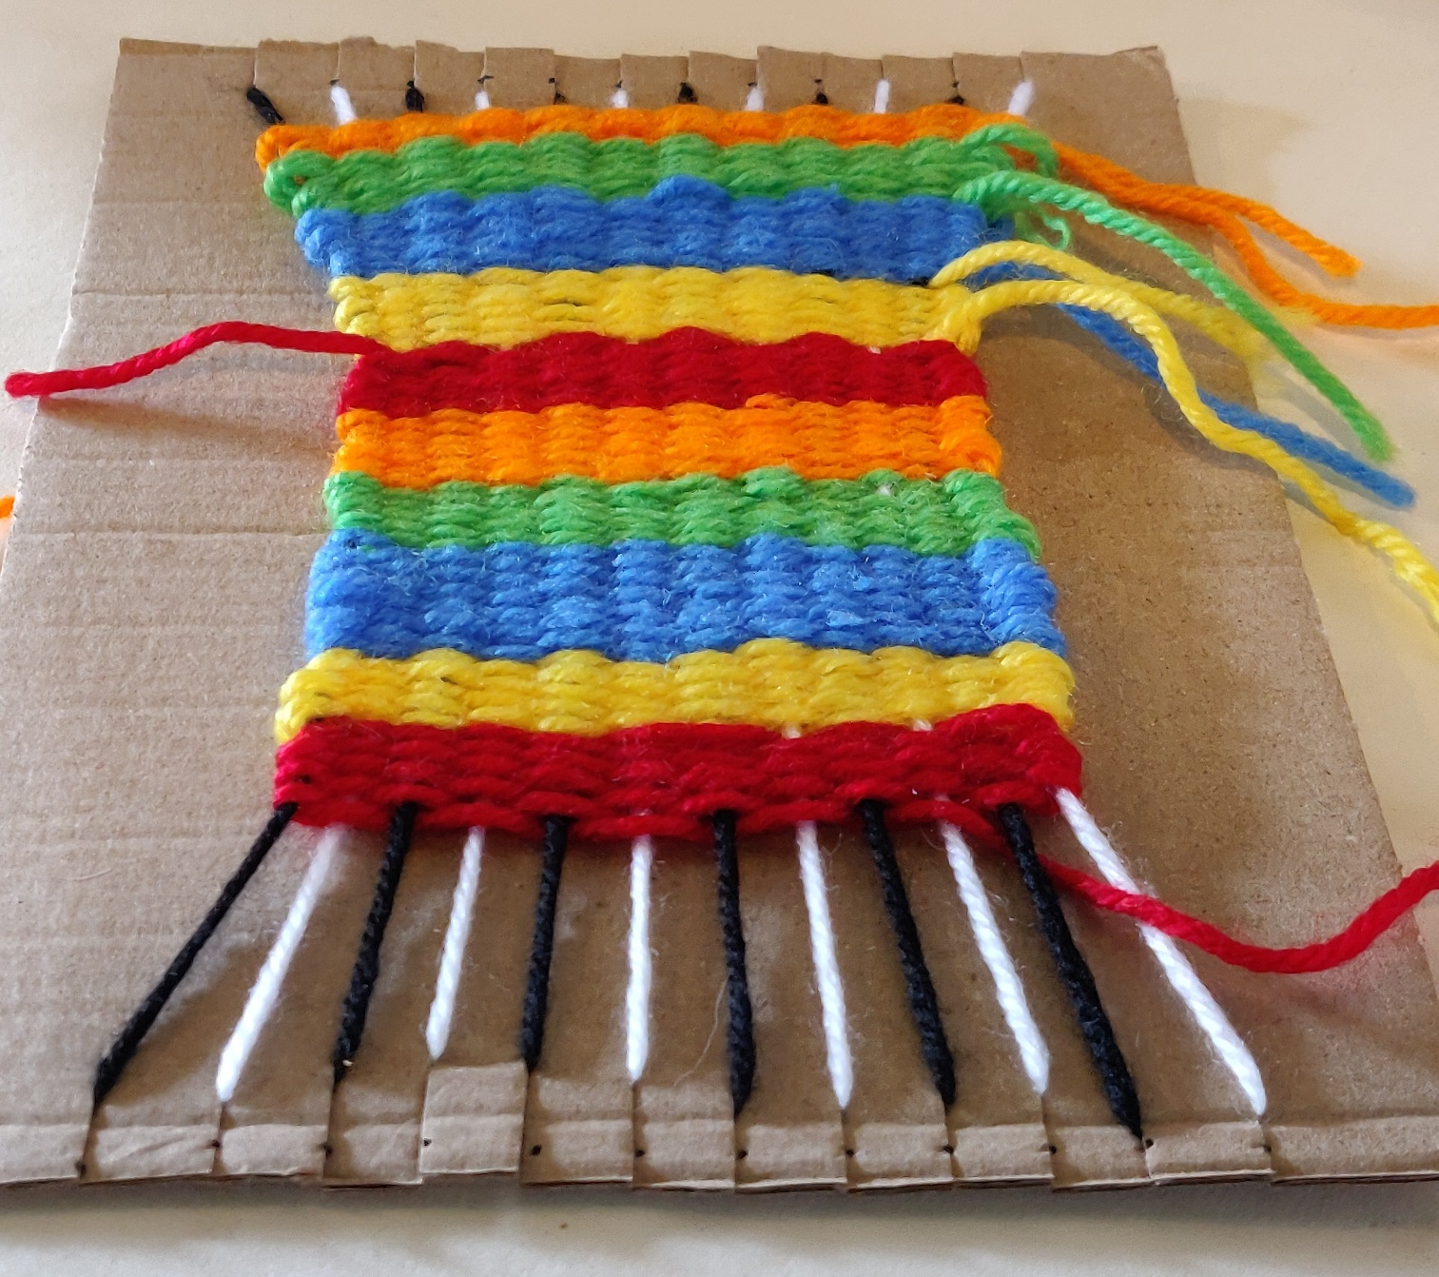
Step 5
Continue weaving until approximately 3 cm from the bottom
Notes:
Check the tension of the weaving, otherwise the material with narrow as in the above example.

Slide 8
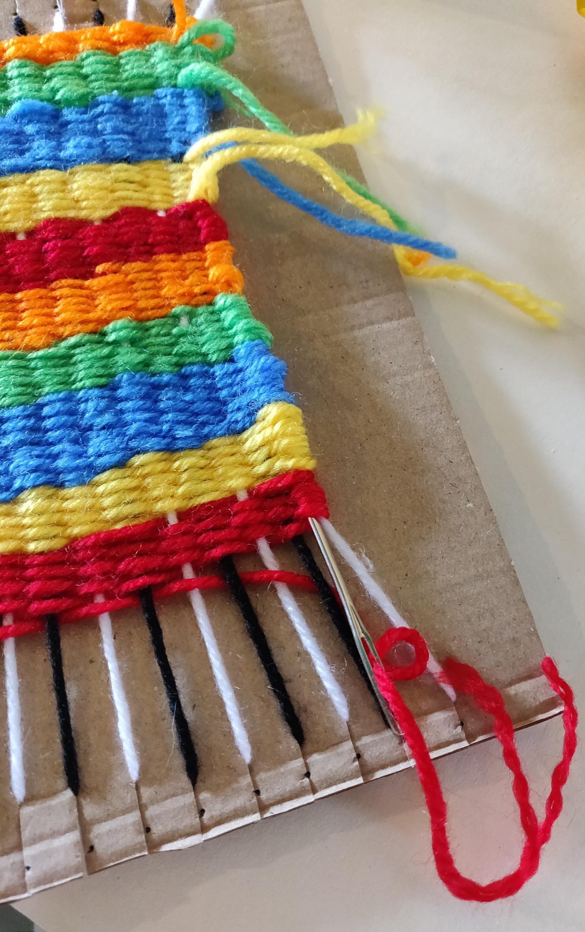
Step 6
Thread the tails into the looped ends of the weft

Slide 9
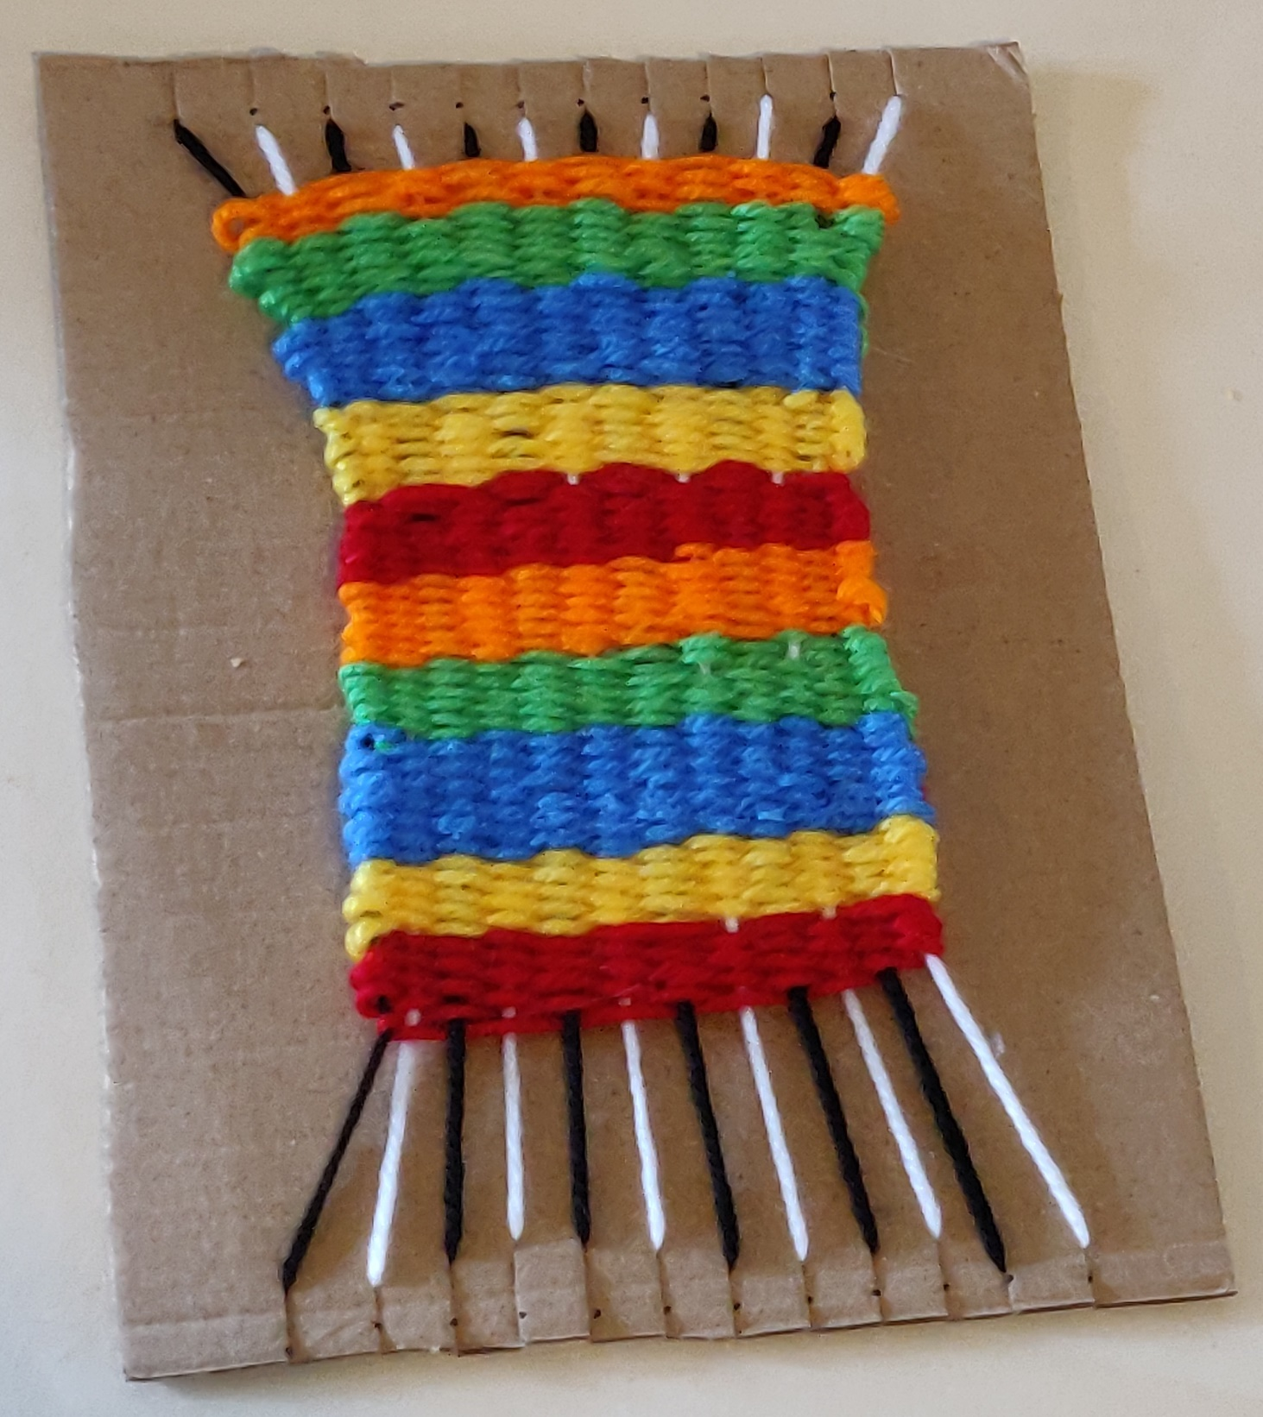
Step 7
The weaving is complete!
Notes:
The weaving is now complete.
This can be displayed on the loom or be cut from the loom and used as a wall hanging.
Continue with Step 8 if removing from the loom.

Slide 10
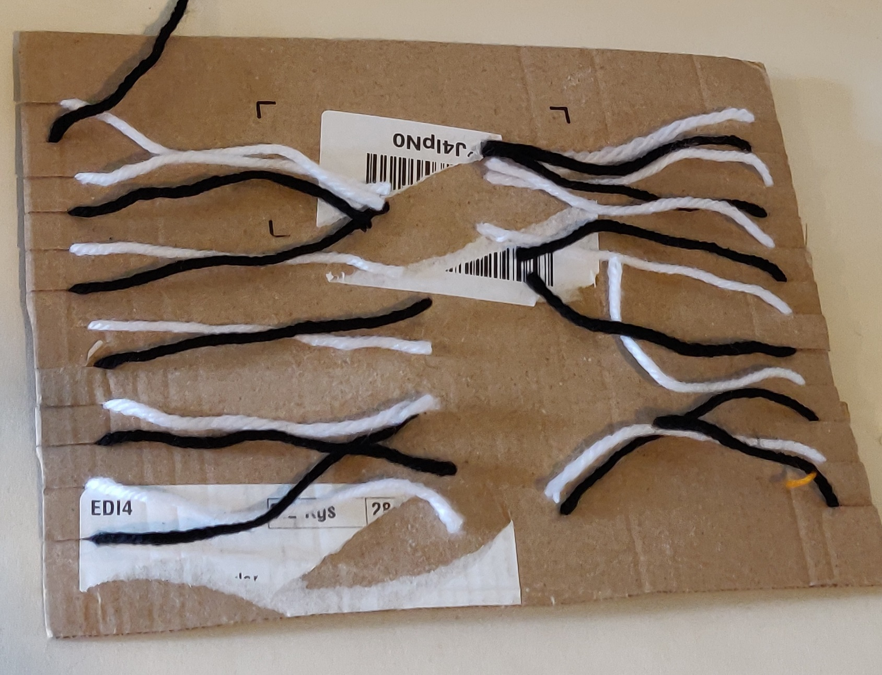
Step 8
Turn the card over and remove tape
Cut warp across the middle
Notes:
The weaving is now complete.
This can be displayed on the loom or be cut from the loom and used as a wall hanging.

Slide 11
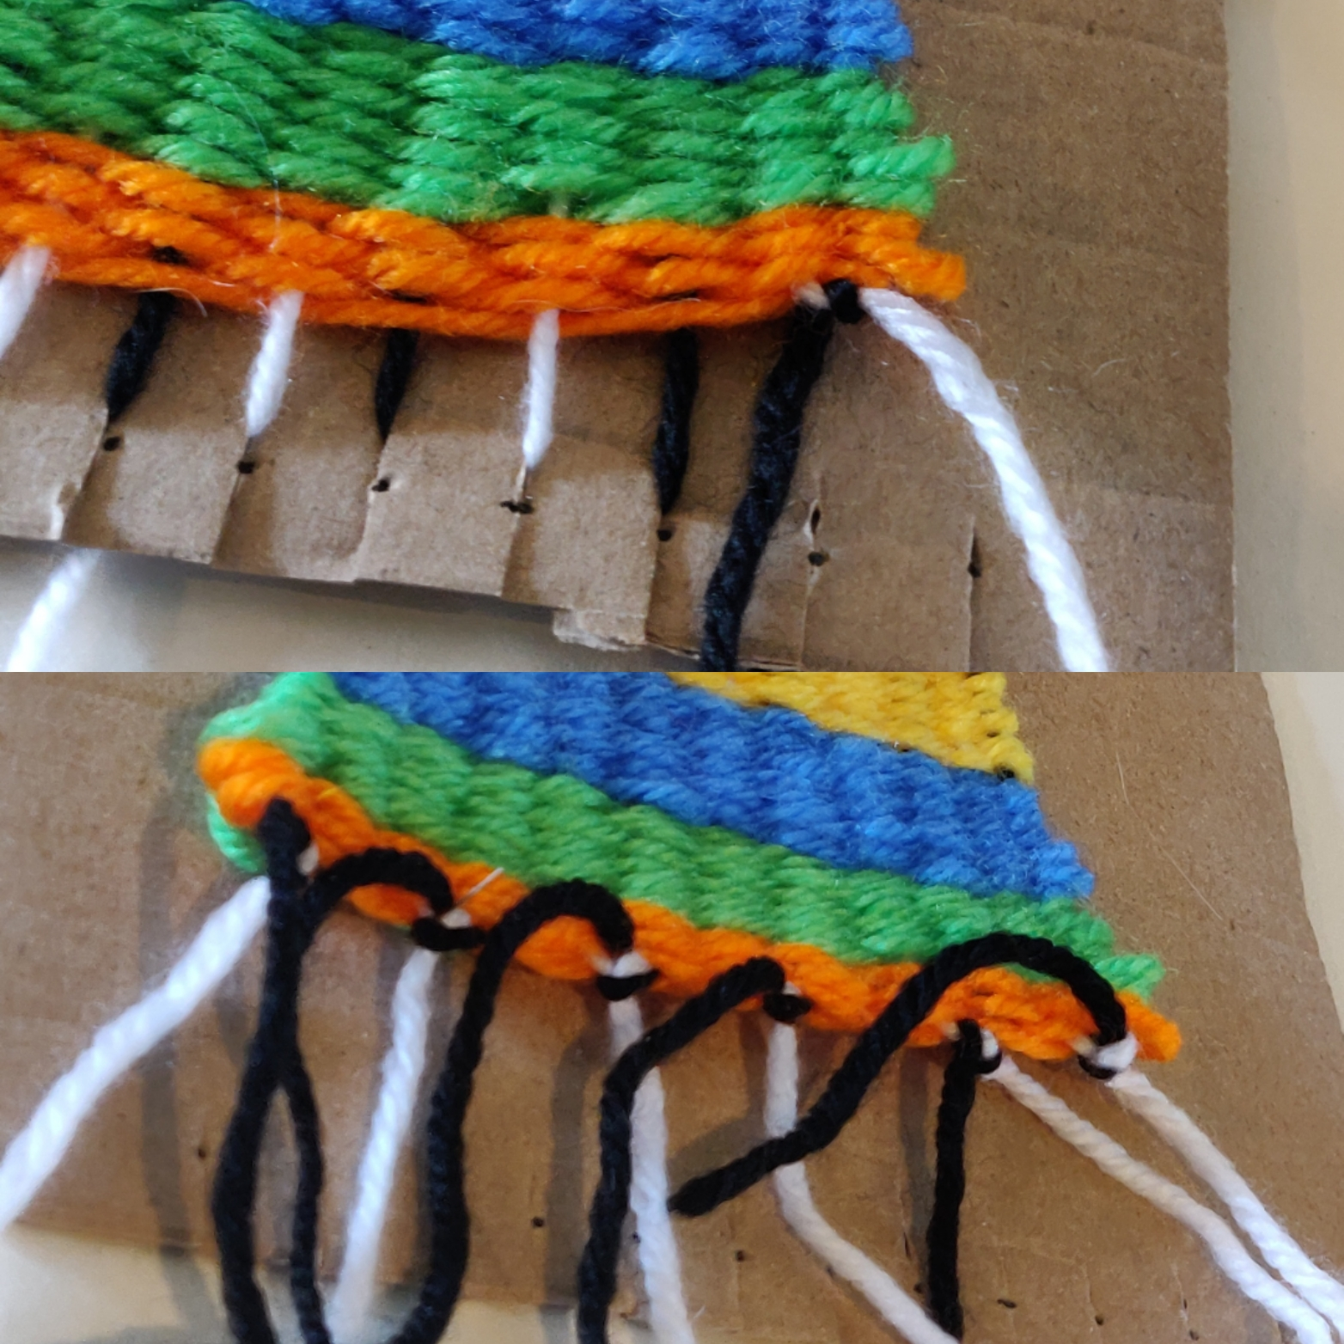
Step 9
Turn the loom over to the front
Pull 2 adjacent warp threads from the slits and knot together
Repeat with each pair of warp yarns
Notes:
The weaving is now complete.
This can be displayed on the loom or be cut from the loom and used as a wall hanging.

Slide 12
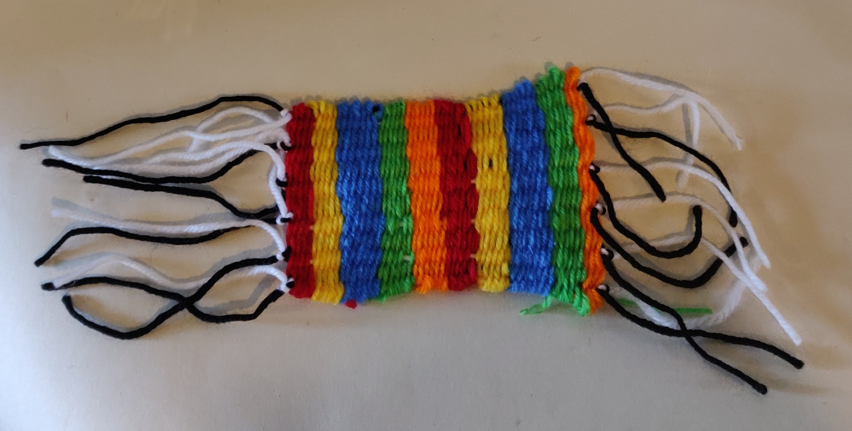
Step 10
Remove the weave from the loom
Notes:
The weaving is now complete.
This can be displayed on the loom or be cut from the loom and used as a wall hanging.

Slide 13
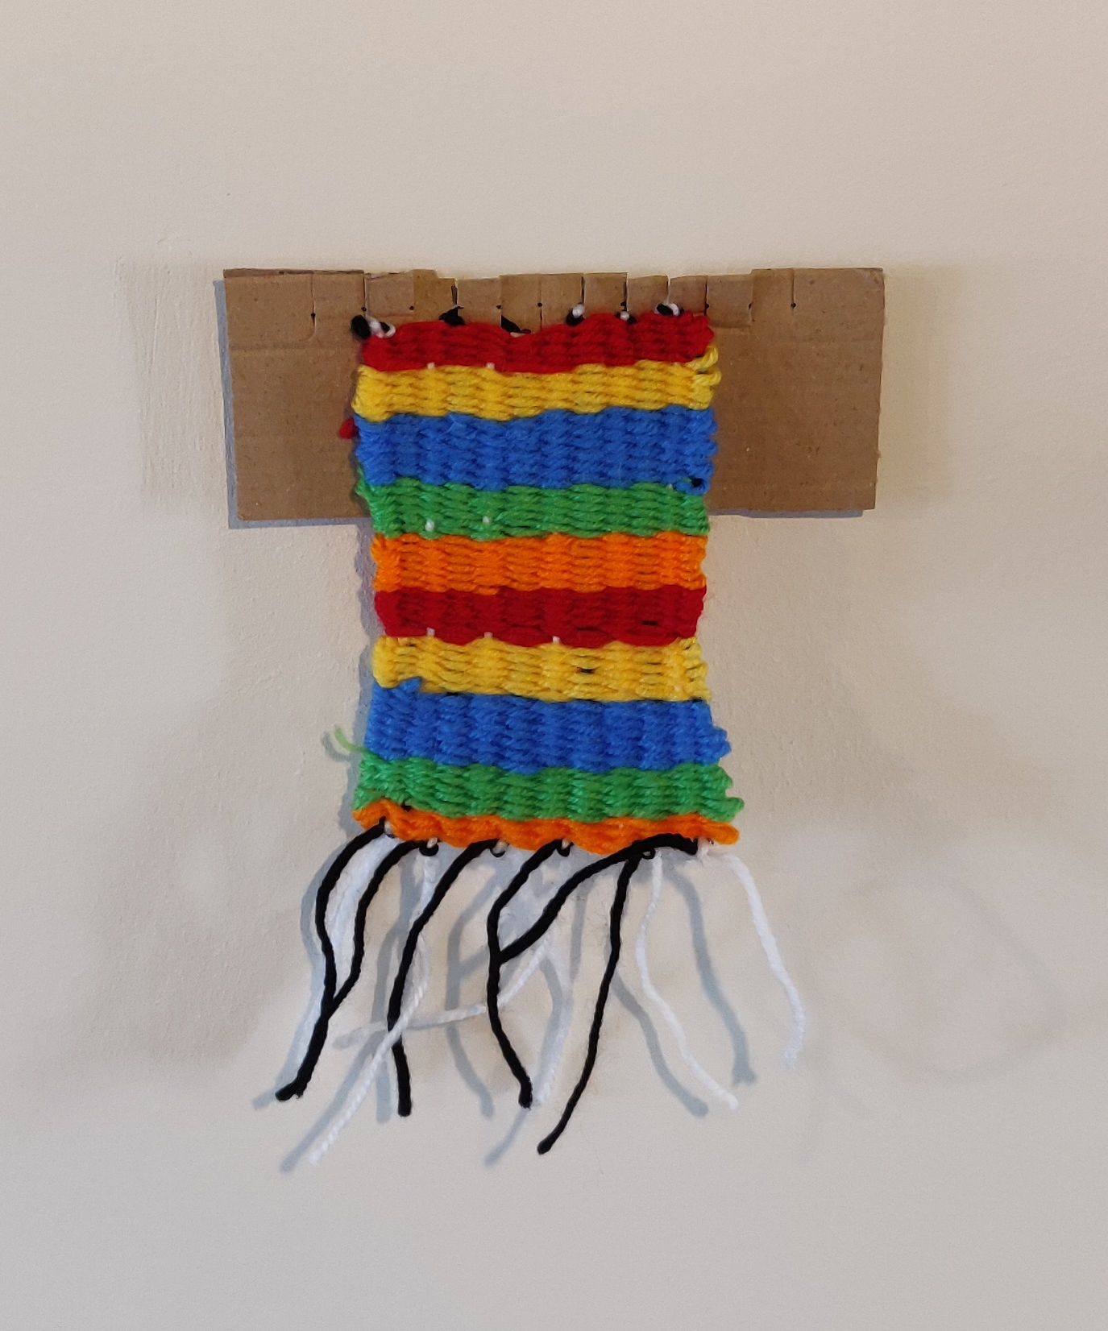
Step 11
Weaving can be displayed as a wall hanging
Use loom to create display point
Notes:
The weaving is now complete.
This can be displayed on the loom or be cut from the loom and used as a wall hanging.

Slide 14
Notes:
The weaving is now complete.
This can be displayed on the loom or be cut from the loom and used as a wall hanging.

