Slide 1
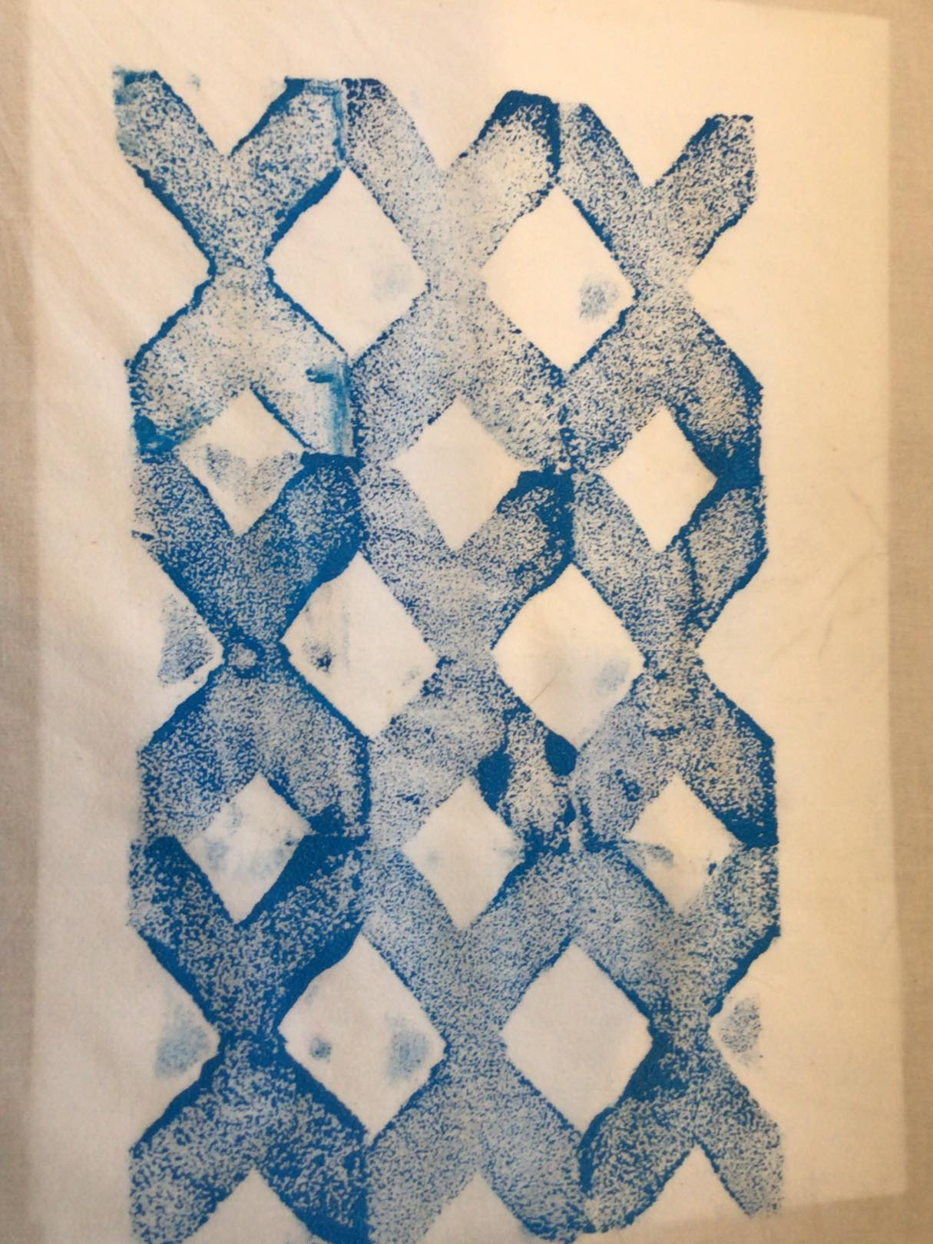
Tessellated Fabric Printing
Creating a pattern that can be tessellated as a fabric print

Slide 2
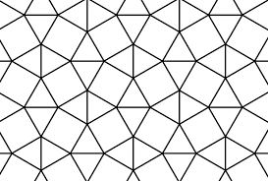
What is Tessellation?
Definition
An arrangement of shapes closely fitted together, especially of polygons in a repeated pattern without gaps or overlapping

Slide 3
Which Shapes Tessellate?
Yes!
No!
Notes:
Identify the shapes.
You will need assorted squares/triangles/pentagons/hexagons for the designing stage.

Slide 4
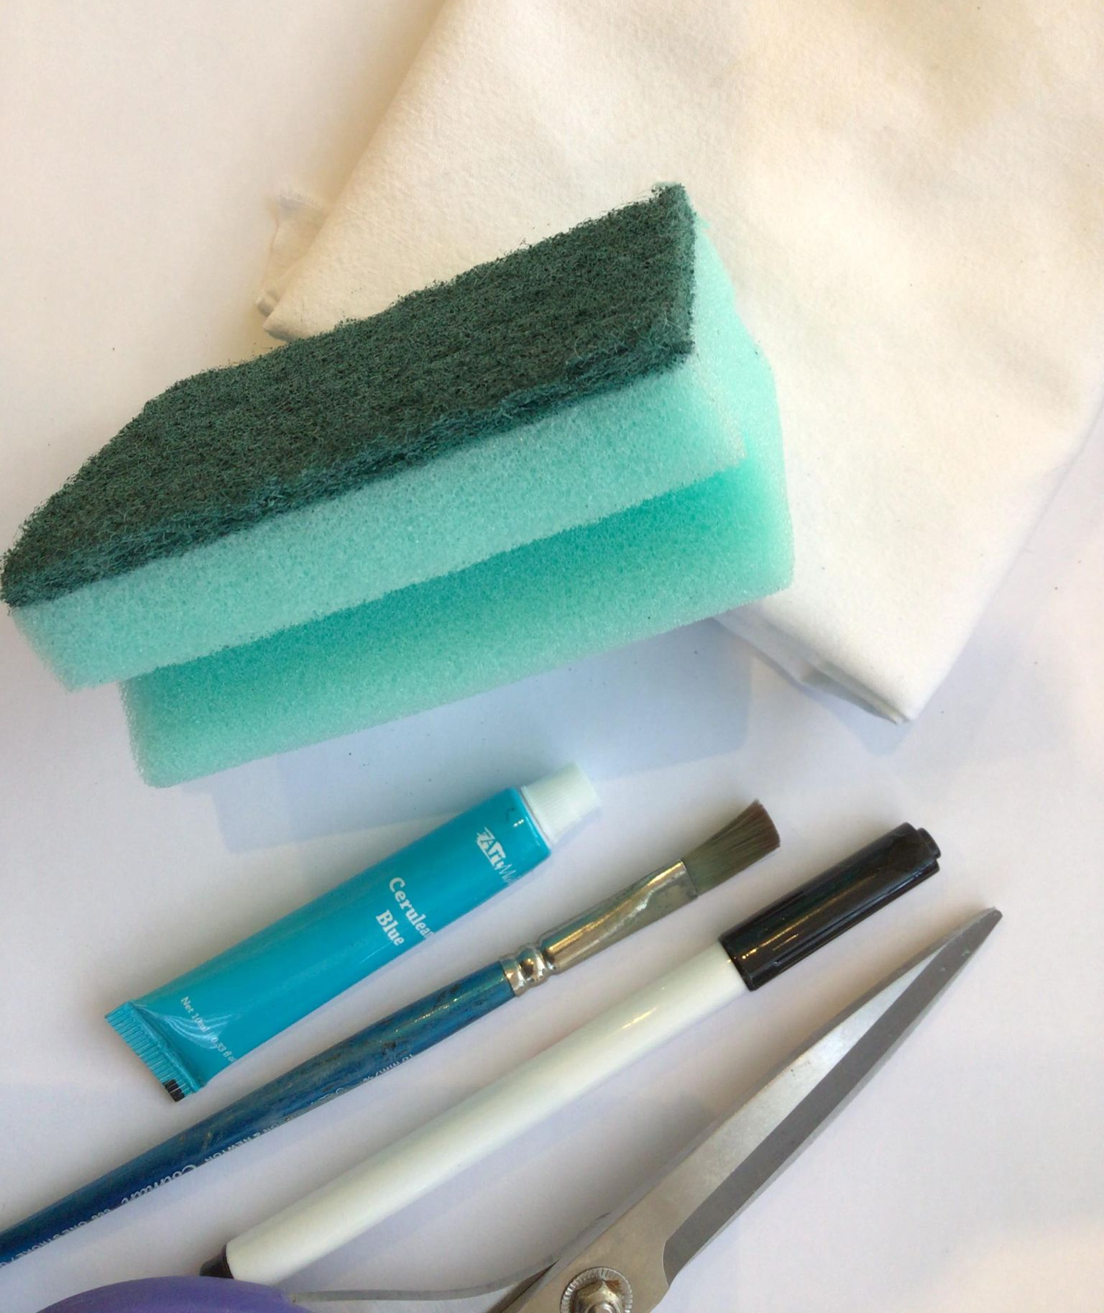
Making a Tessellated Fabric Print
You will need:
An idea for your tessellated shape
Kitchen Sponge
Felt tip pen
Fabric
Paint
Scissors
Notes:
Instead of using fabric paint, you can use ink and rollers or any other suitable medium.
Sponges, potatoes or lino can be used to make the shape.

Slide 5
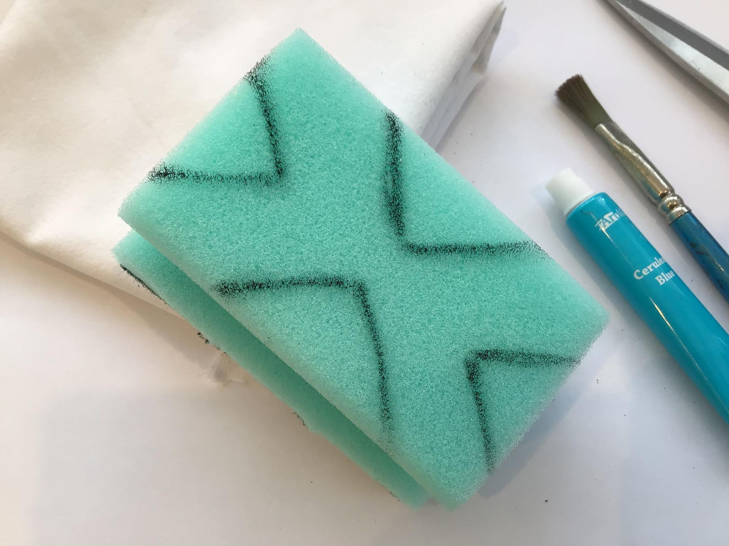
Step 1
Draw the individual tessellation shape onto a Sponge
Here we've used 4 triangles
Notes:
The image can be drawn on with a felt tip pen.

Slide 6
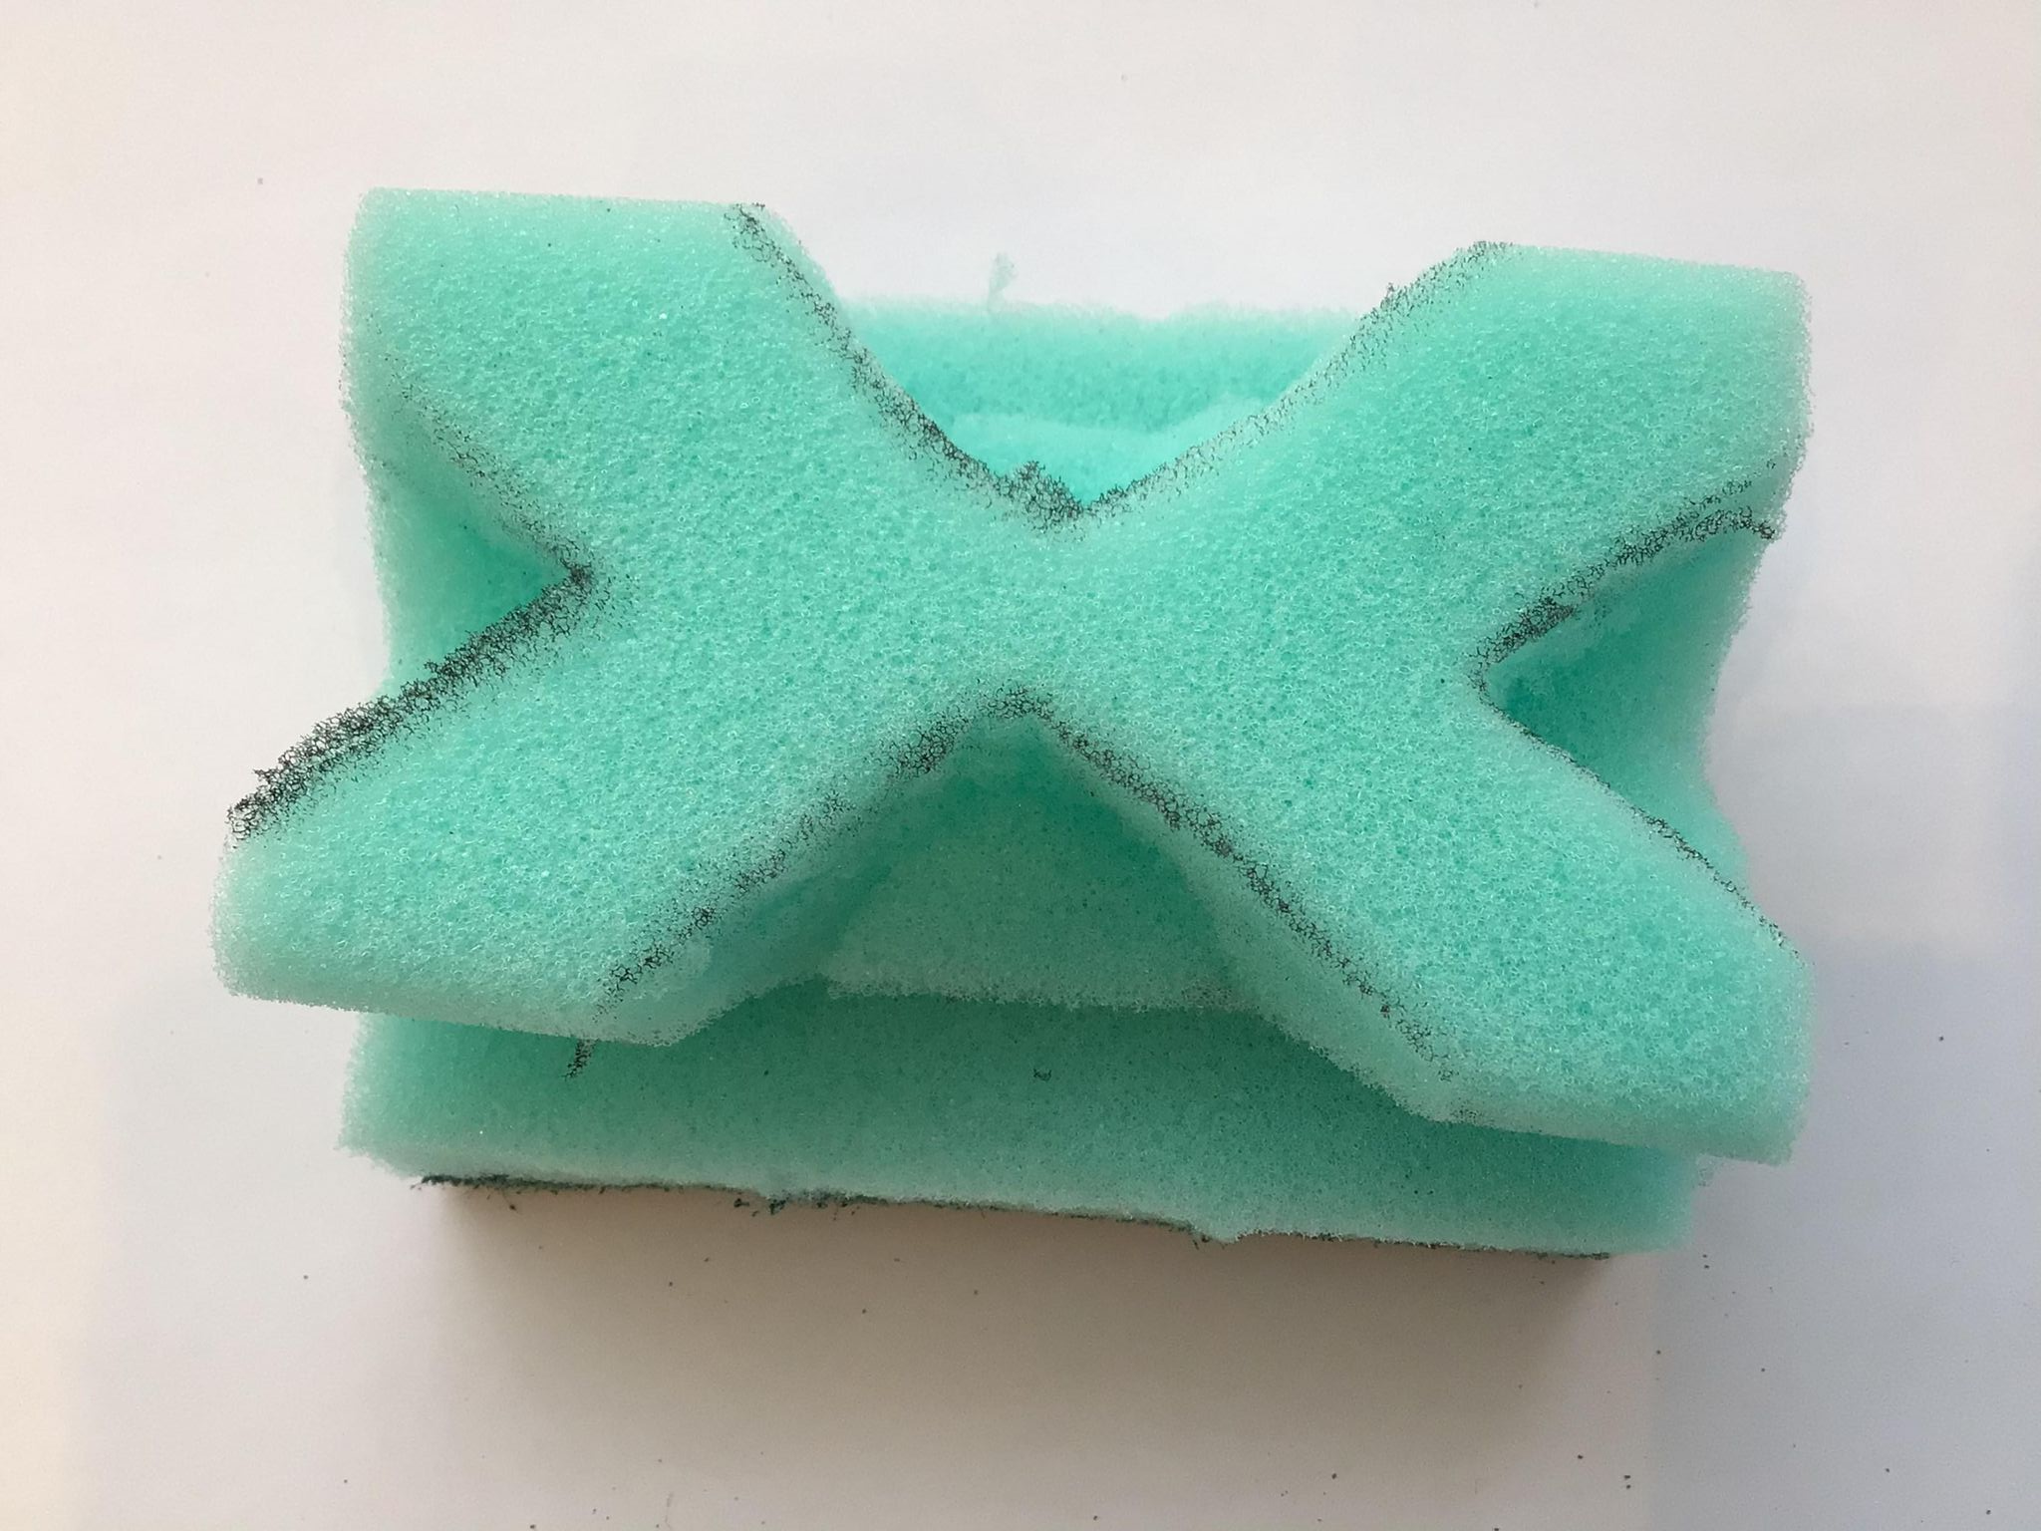
Step 2
Cut the design into the sponge
Notes:
The sponge can be cut using scissors.
If using potatoes, a knife may be required (with appropriate supervision).
If using lino: a reasonably sharp pencil can be used to score into the lino. If too much pressure is applied the pencil will cut through the block. If not enough pressure is applied then the marks made will not be deep enough and will not show when it comes to printing. It is important to establish that any positive pencil mark made, will actually come out as a white negative line when the block is printed up.

Slide 7
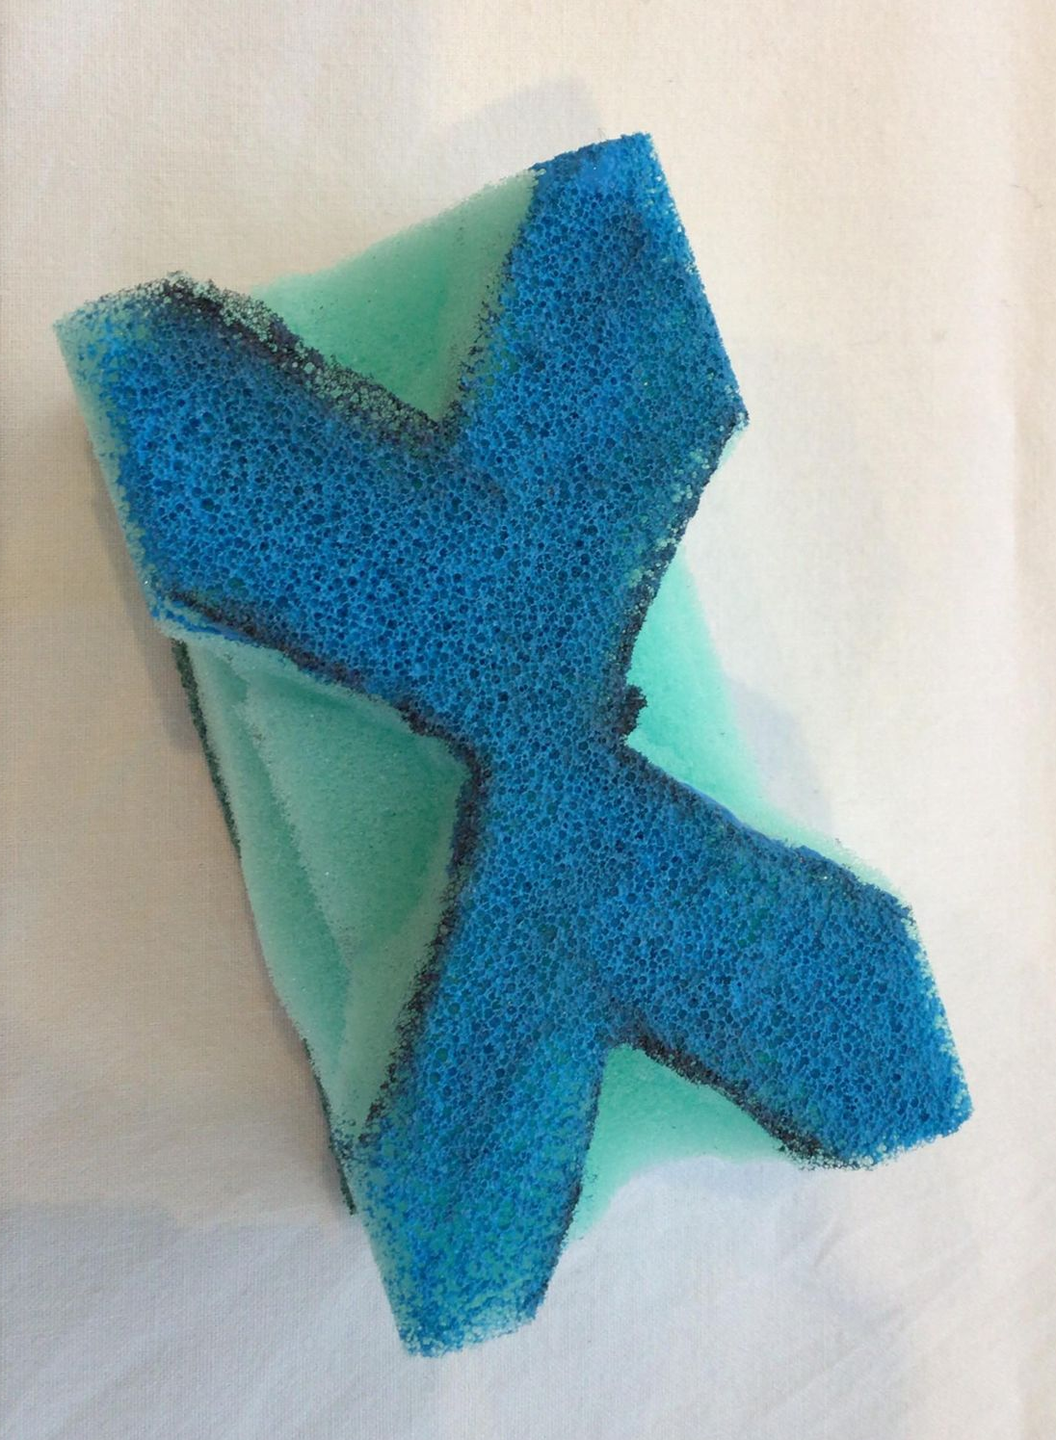
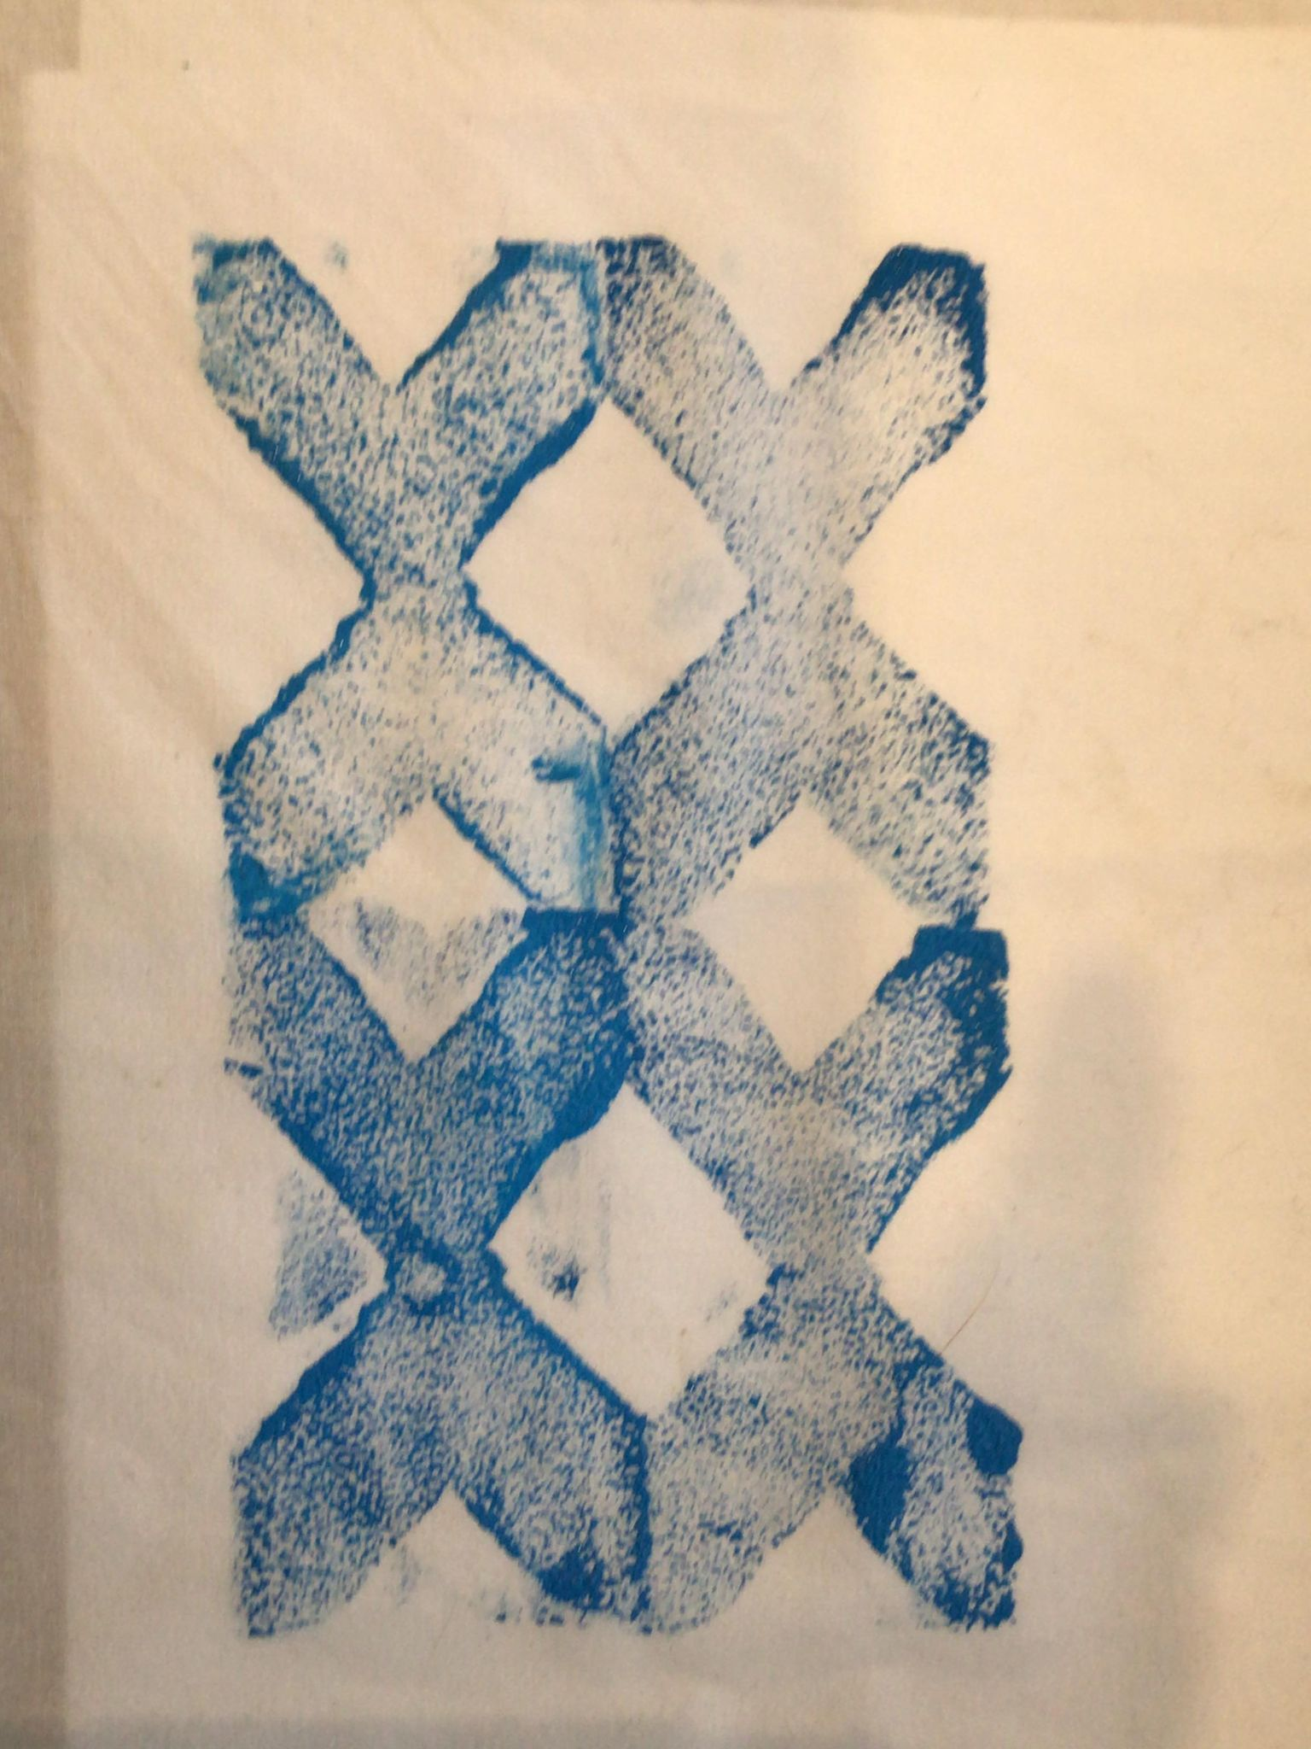
Step 3
Select your paints and prepare your fabric to print
Print your design onto your fabric
**Don’t forget to tesselate**
Notes:
The prints need to be placed correctly to tesselate.

Slide 8
Step 4
Let the prints dry overnight
Notes:
Extension: Overlay the prints with another colour
The prints can then be used for display of printing skills, made into a wall hanging, or as part of a textiles item for example a cushion or a pocket on a garment.

Slide 9
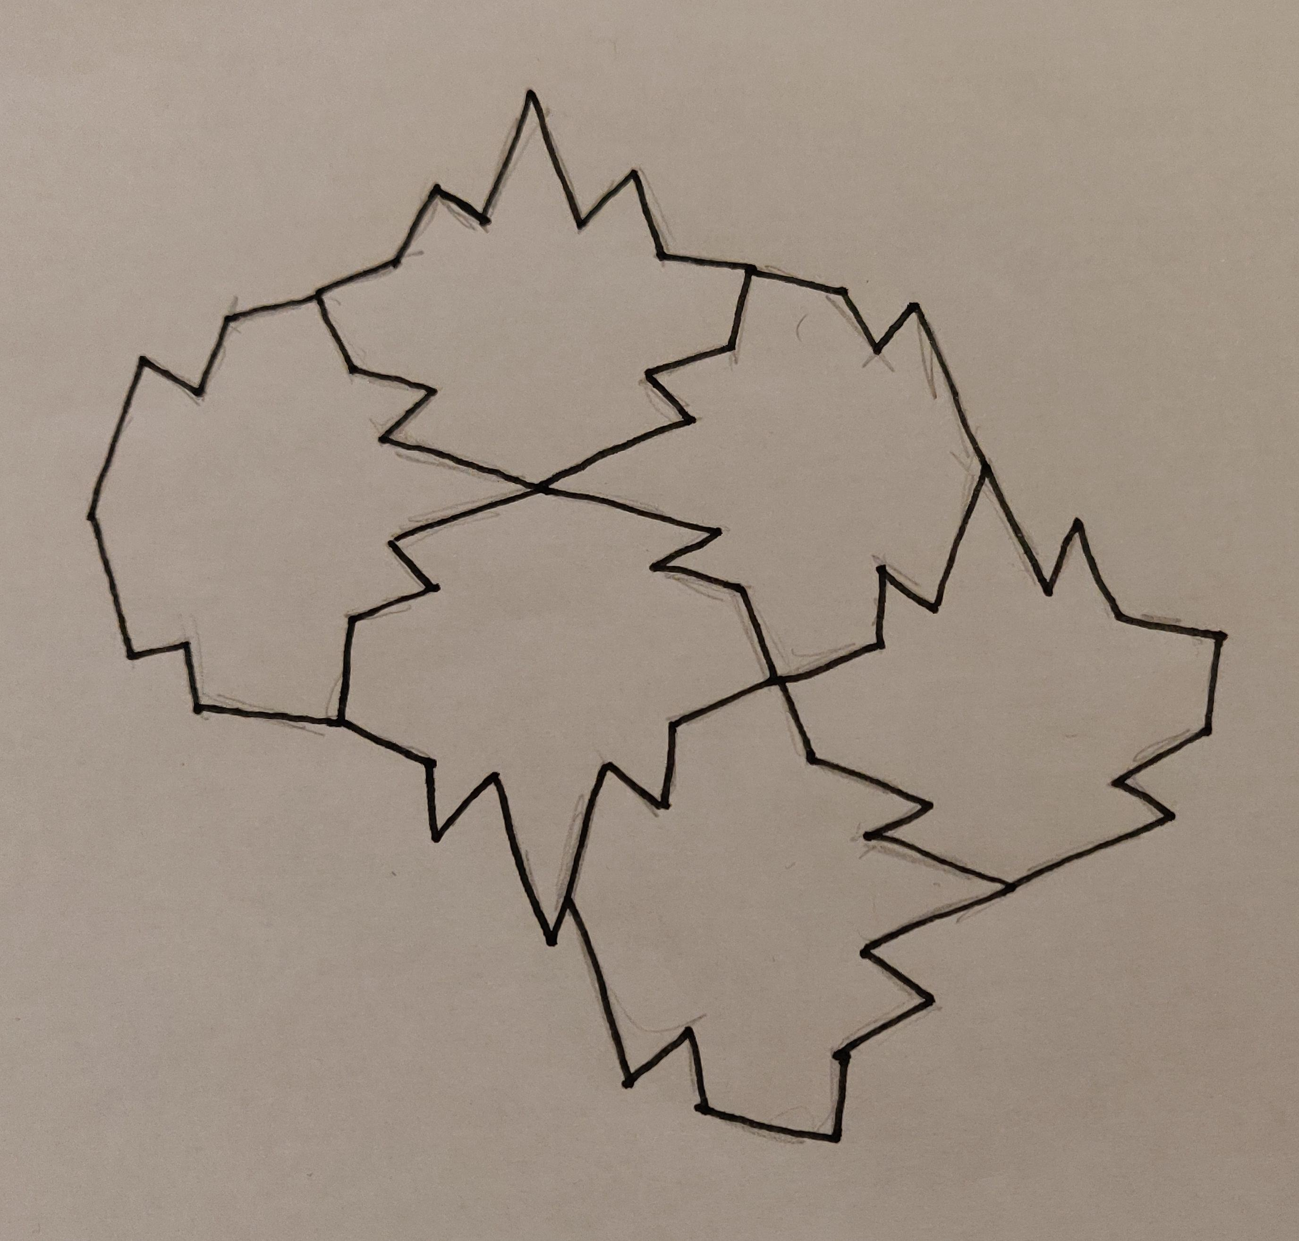
Extension
In Islamic art, many tessellated patterns are based on plants (such as flowers and leaves)
Create your own tessellation pattern inspired by plants – you could use a basic shape as a guide or design your own shape
Leaf influence

Slide 10
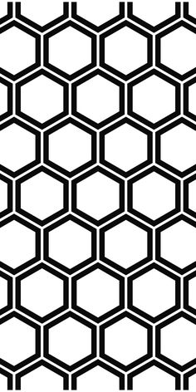
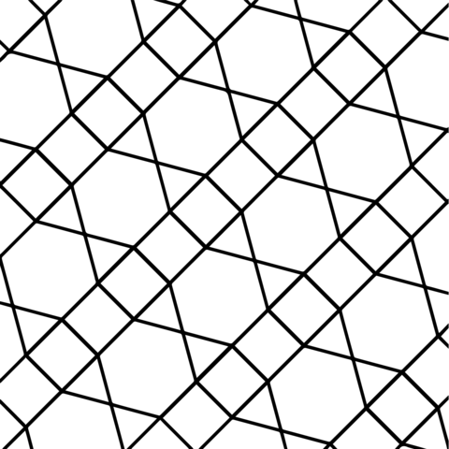
Extension 2
Triangle
Square
Hexagon
Square and Triangle
Hexagon, triangle and square.
Use different combinations of shapes to create your tessellated design
Hexagon

Slide 11
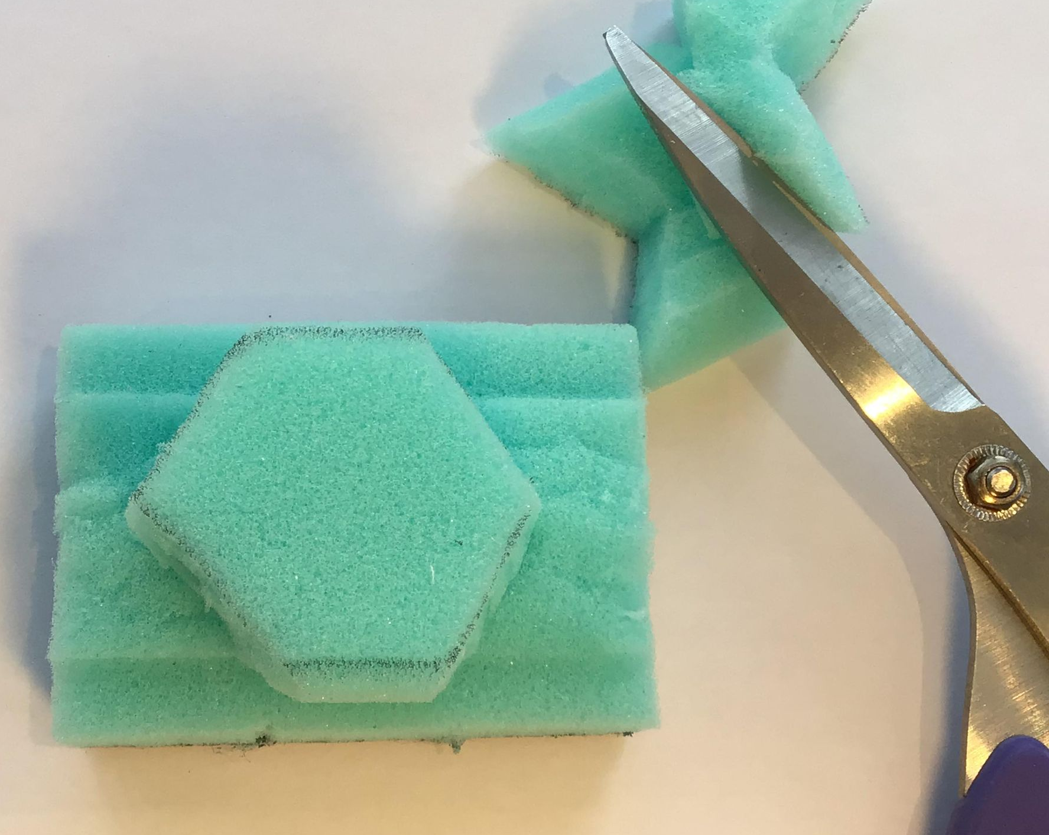
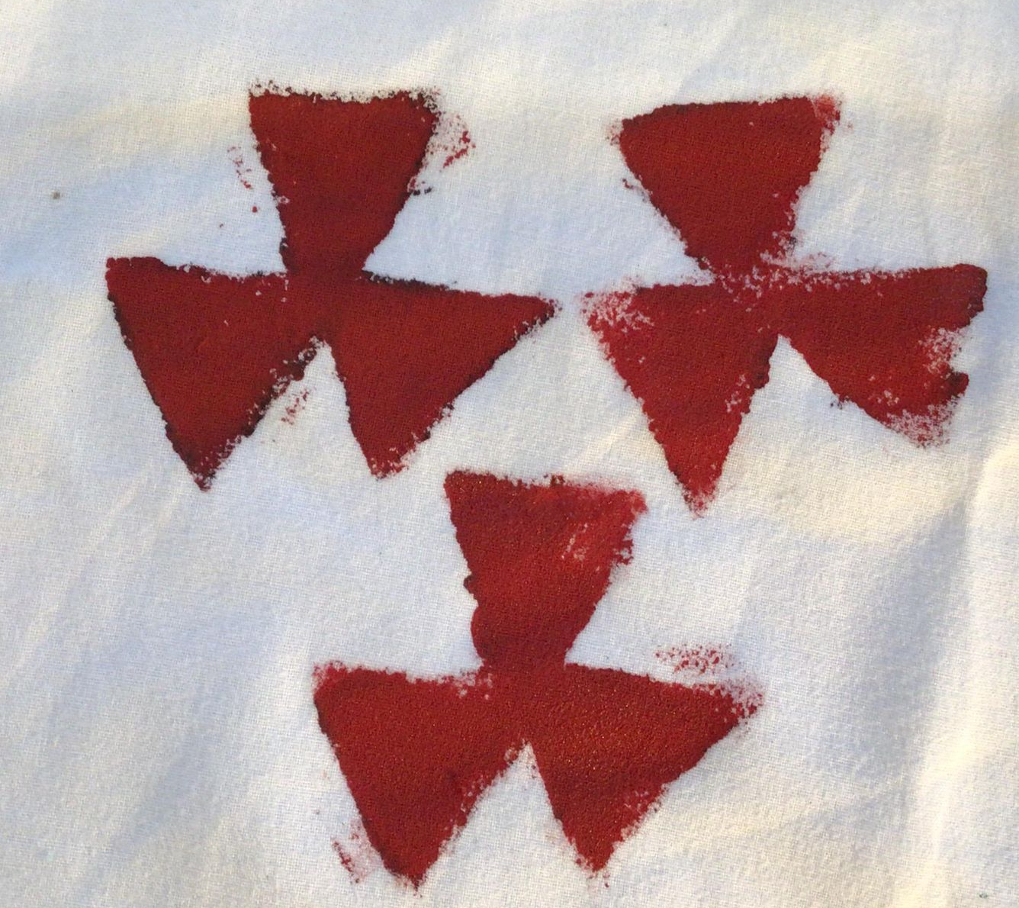
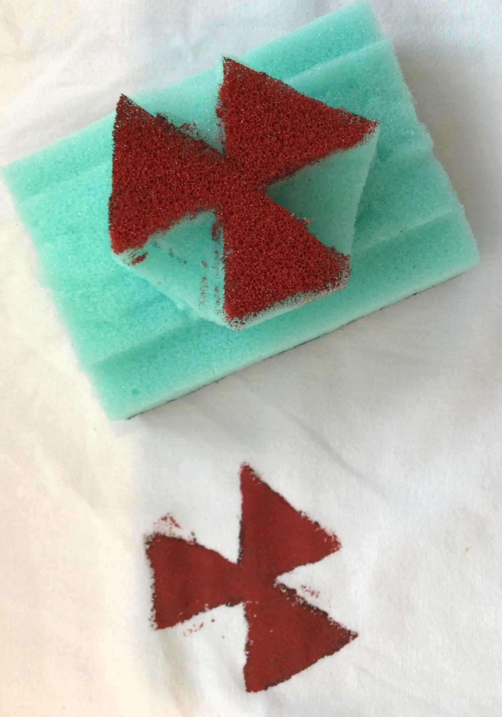
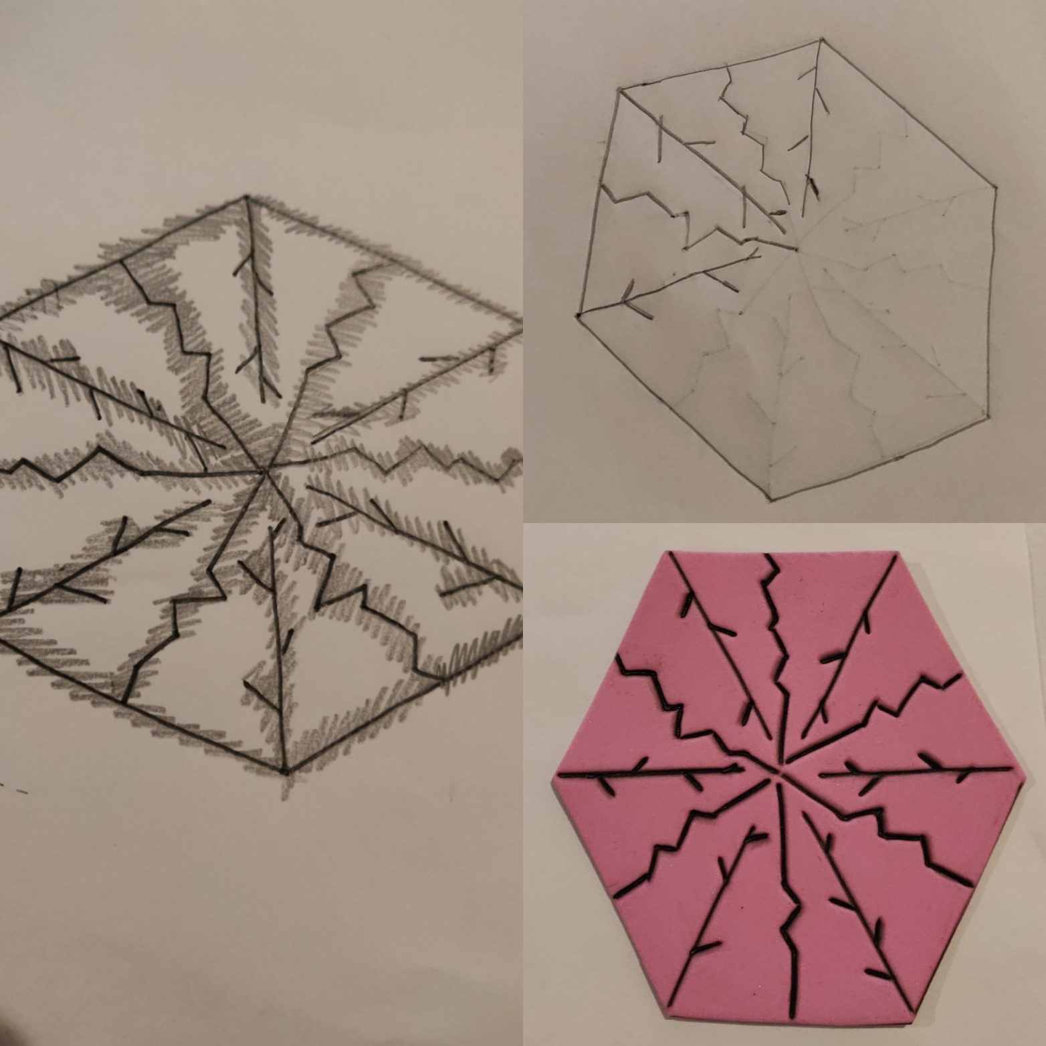
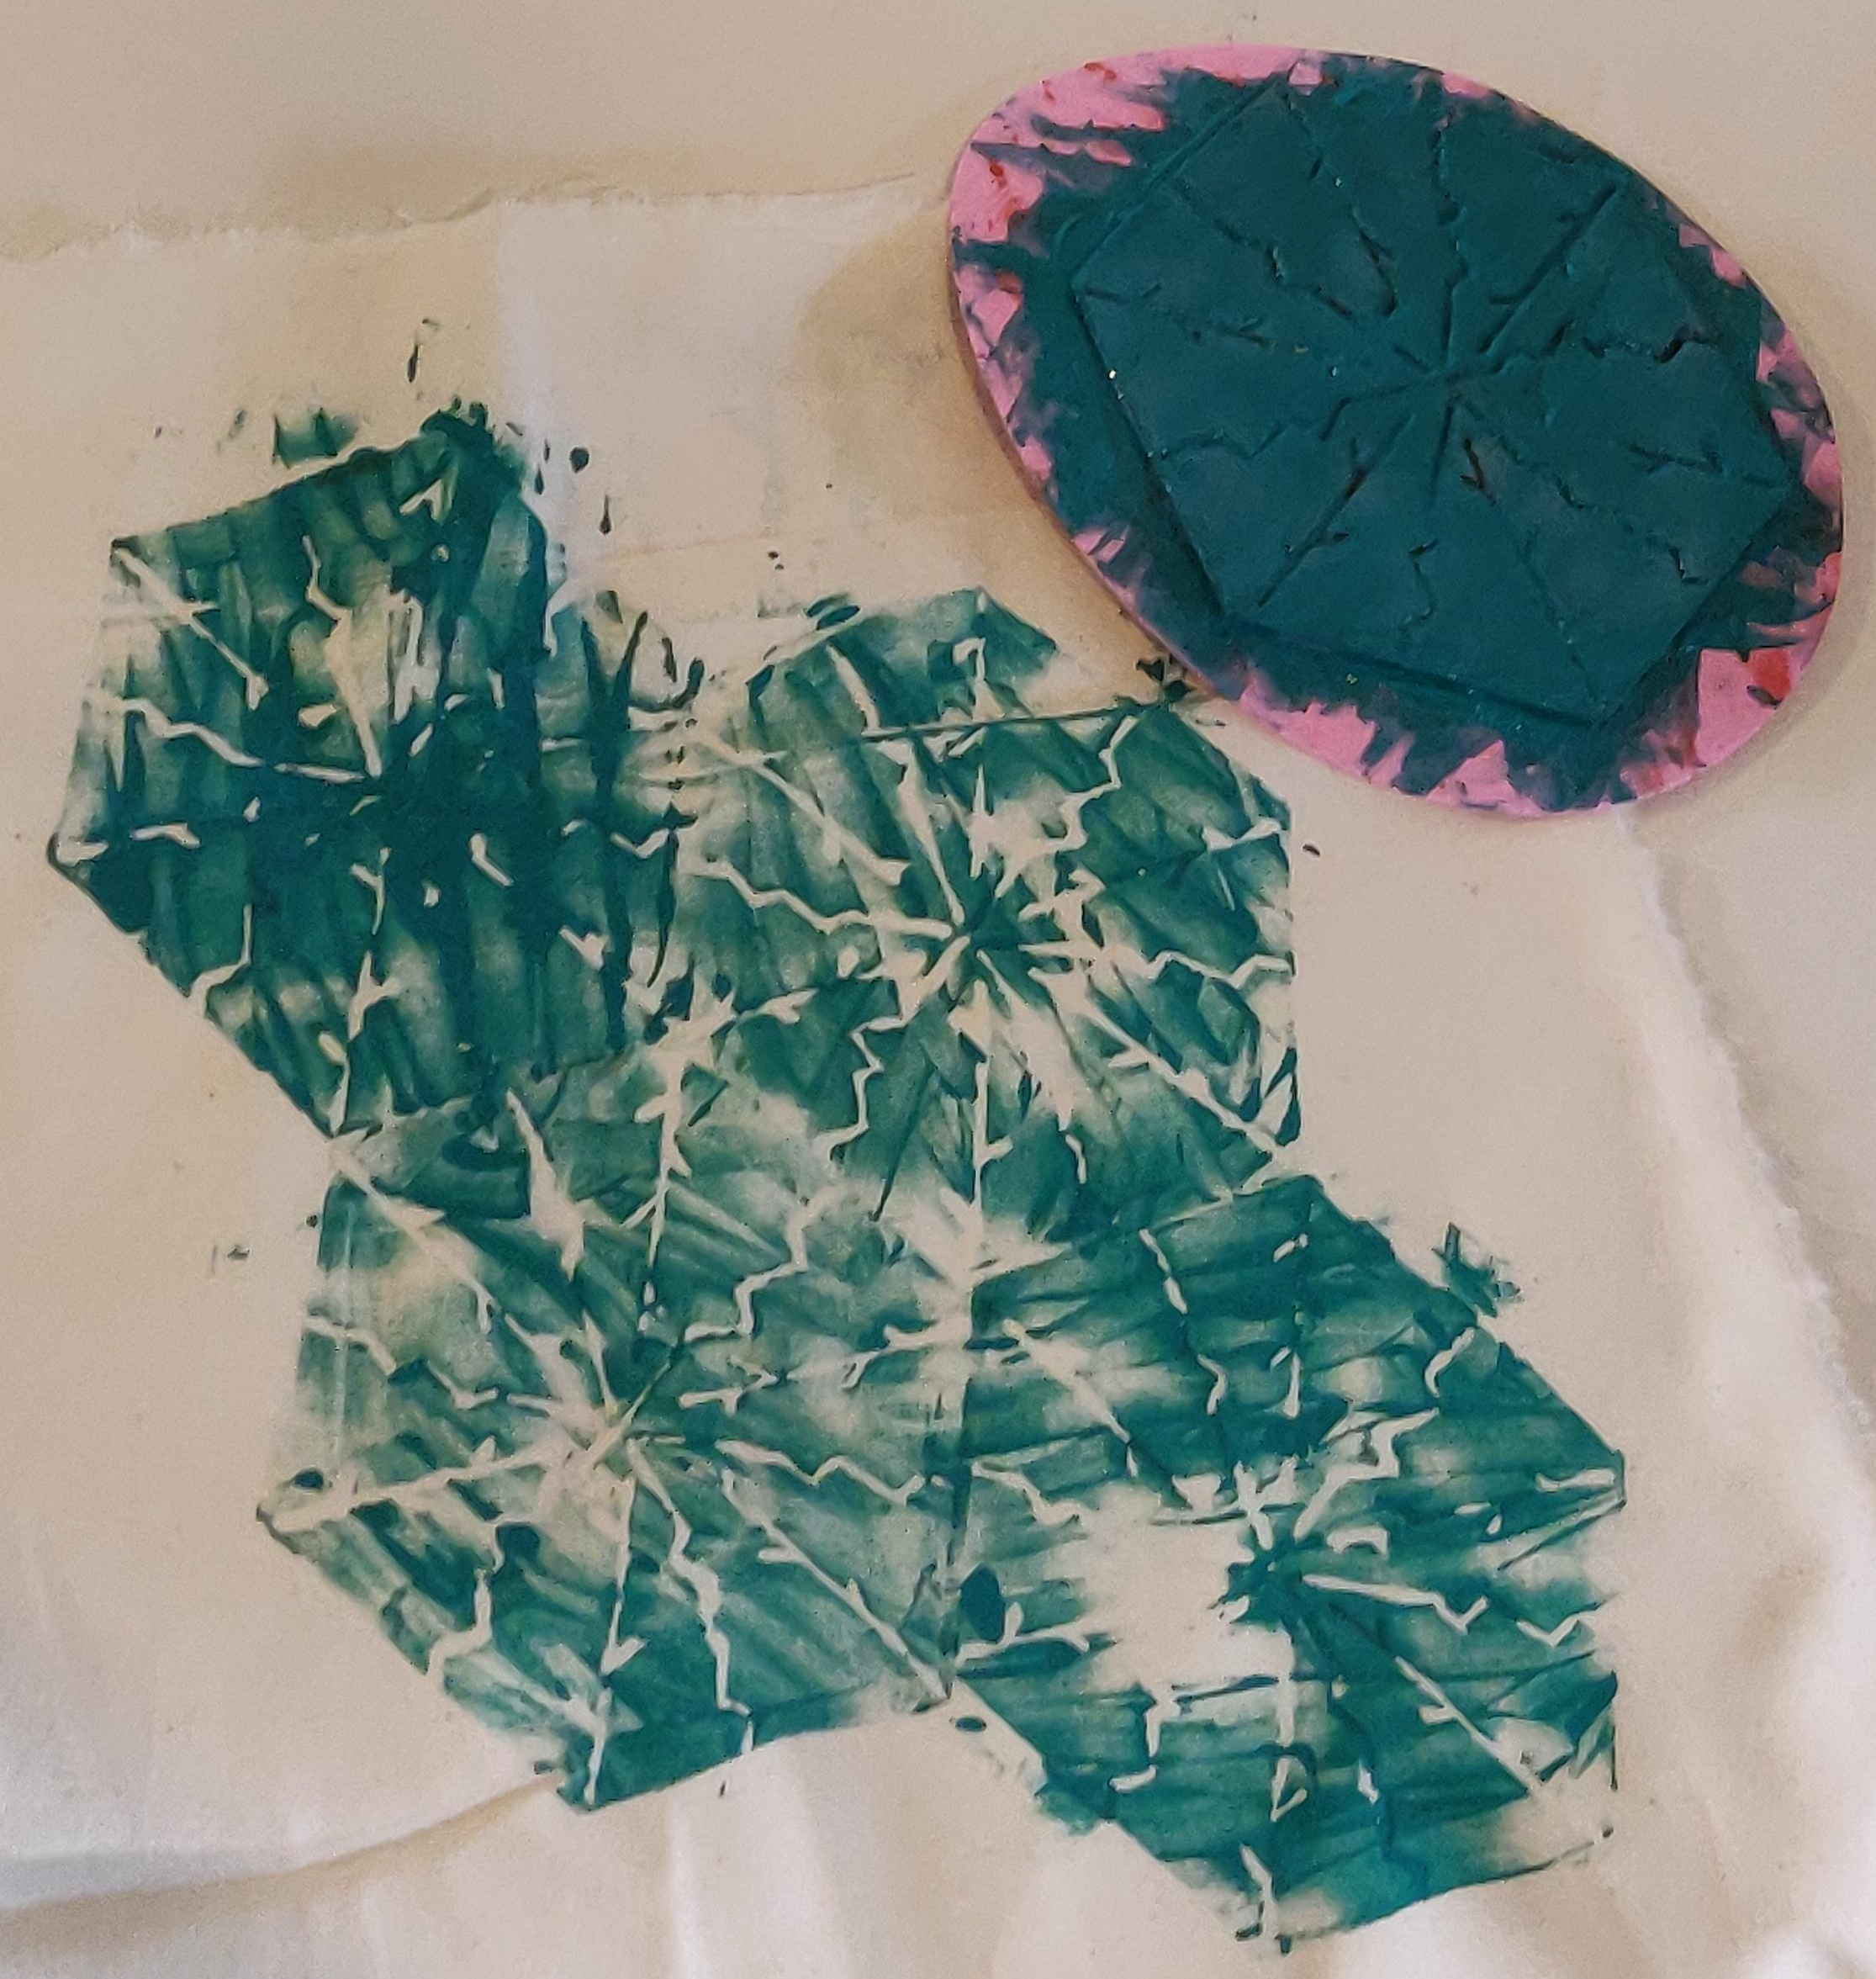
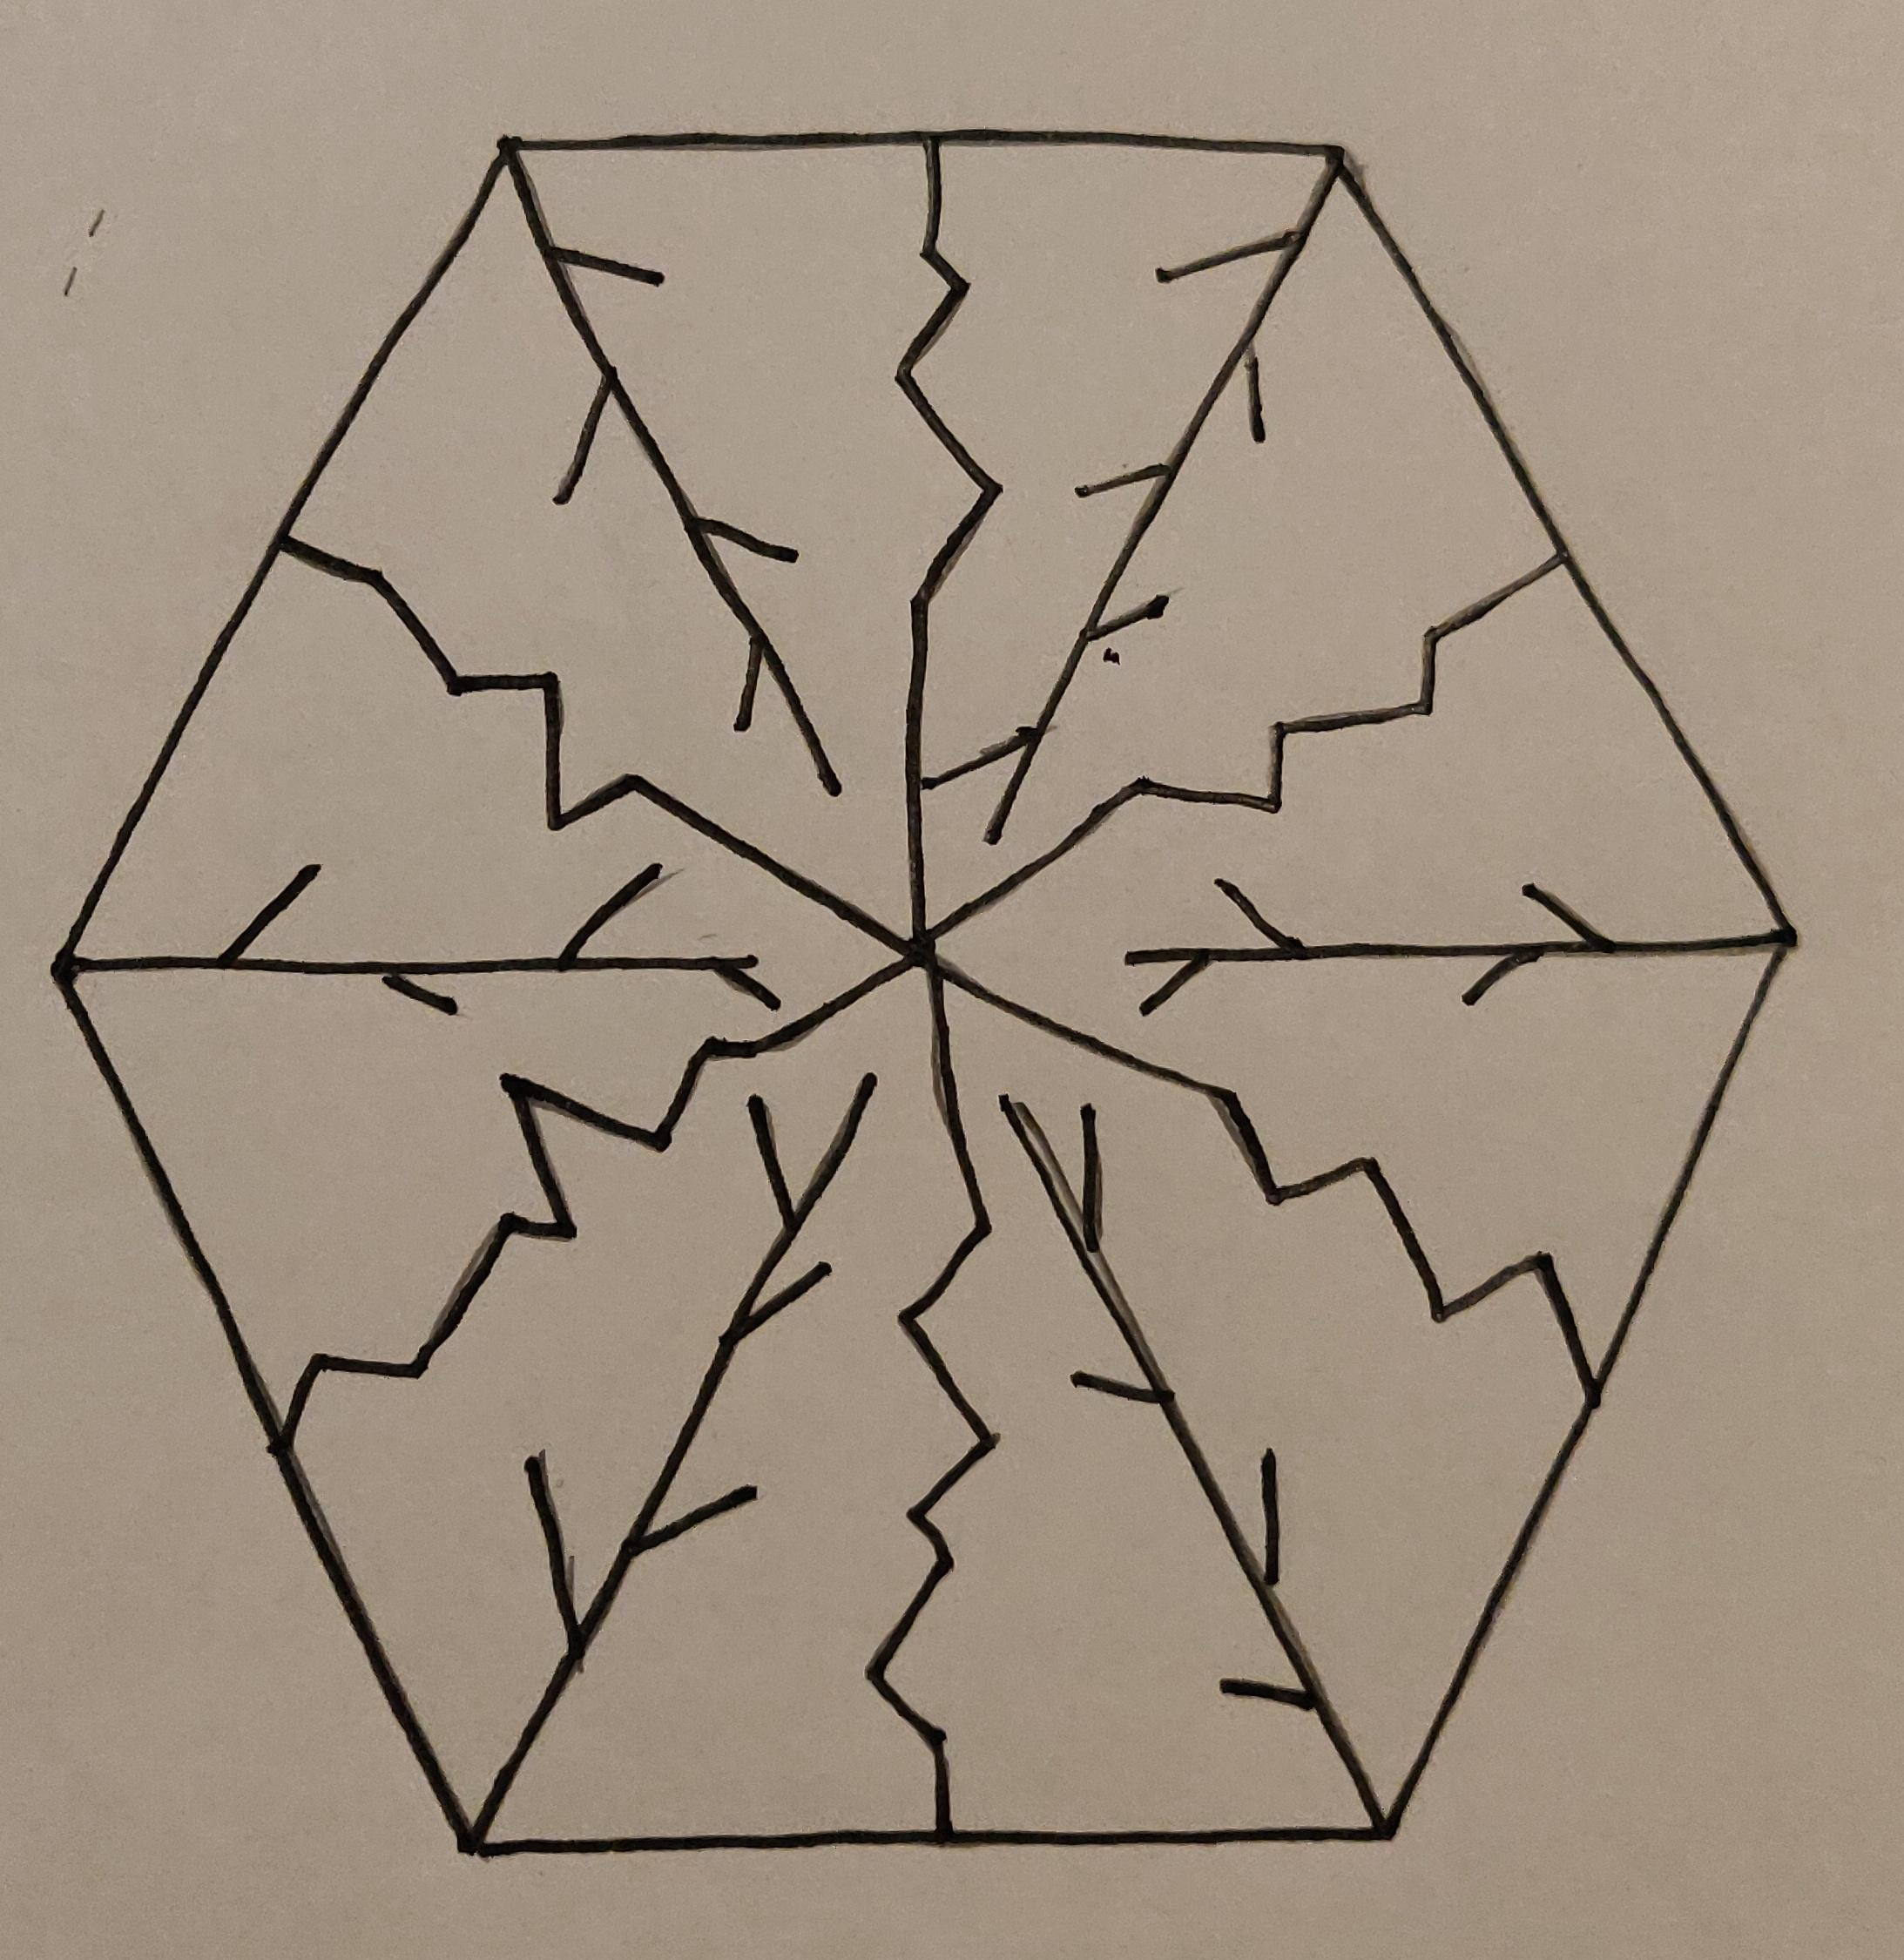
Examples of Learners Work
Sam made a tessellated shape after cutting the sponge into a hexagon:
Laura scored her design into lino (rather than sponge) to make this plant inspired print

