Slide 1
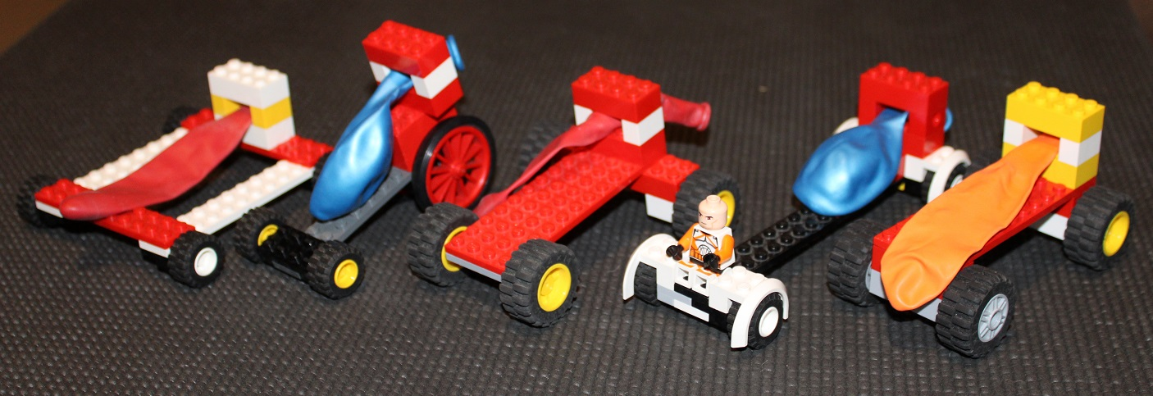
Air Powered Cars
Using air power to race cars!

Slide 2
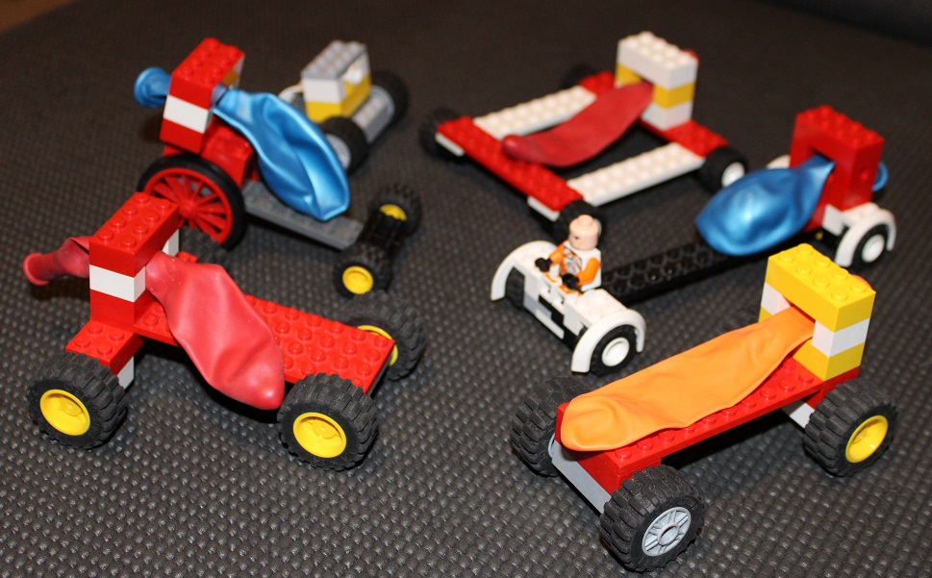
Resources
You will need:
Plastic construction bricks, including wheels
Balloons
Stopwatch
If available: a tape measure to measure the distance of the course

Slide 3
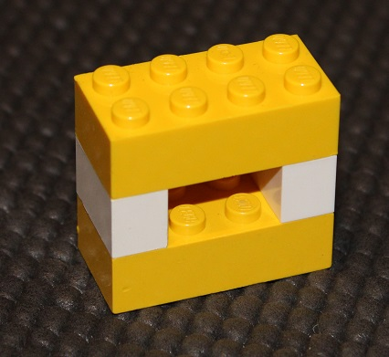
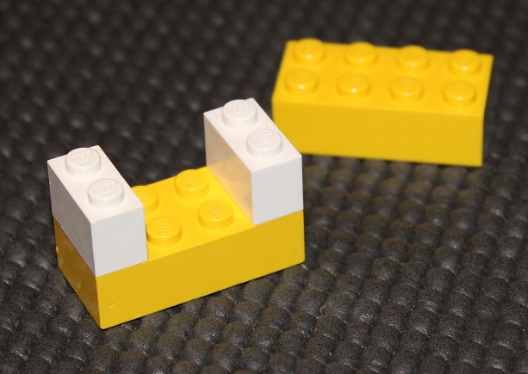
Step 1 – Build your balloon holder
This is a block to hold the balloon in place
Keep the space in the middle small – otherwise the balloon will fly out of it!

Slide 4
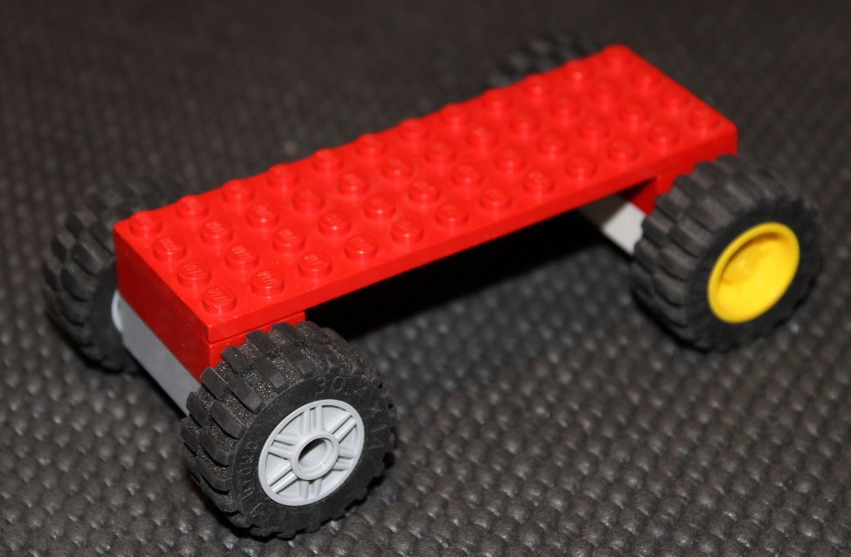
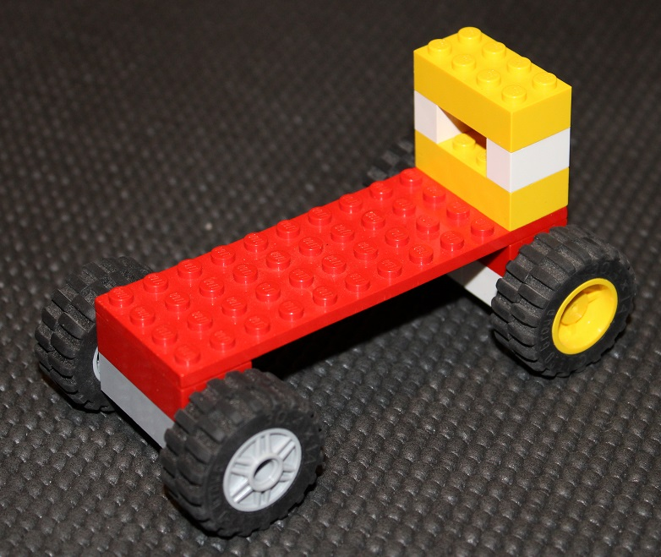
Step 2 – Build your base
You can have as many wheels as you want – 3? 4? 6? 8?
Put the balloon holder at the back of the base
It helps to raise up the balloon holder slightly, to give more space for the balloon

Slide 5
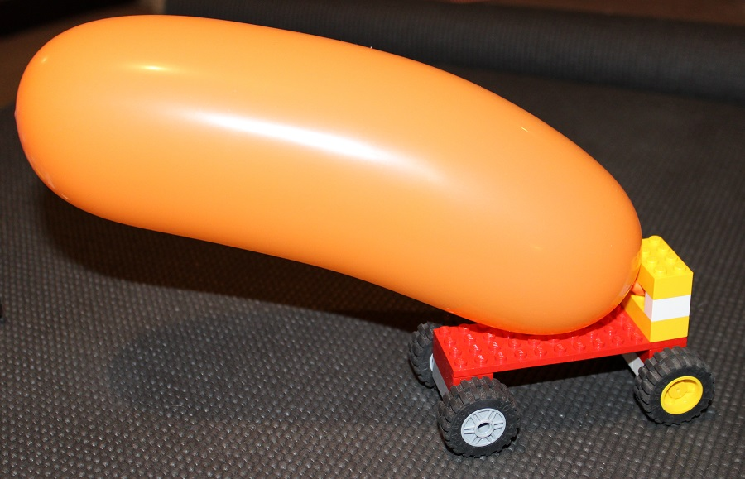
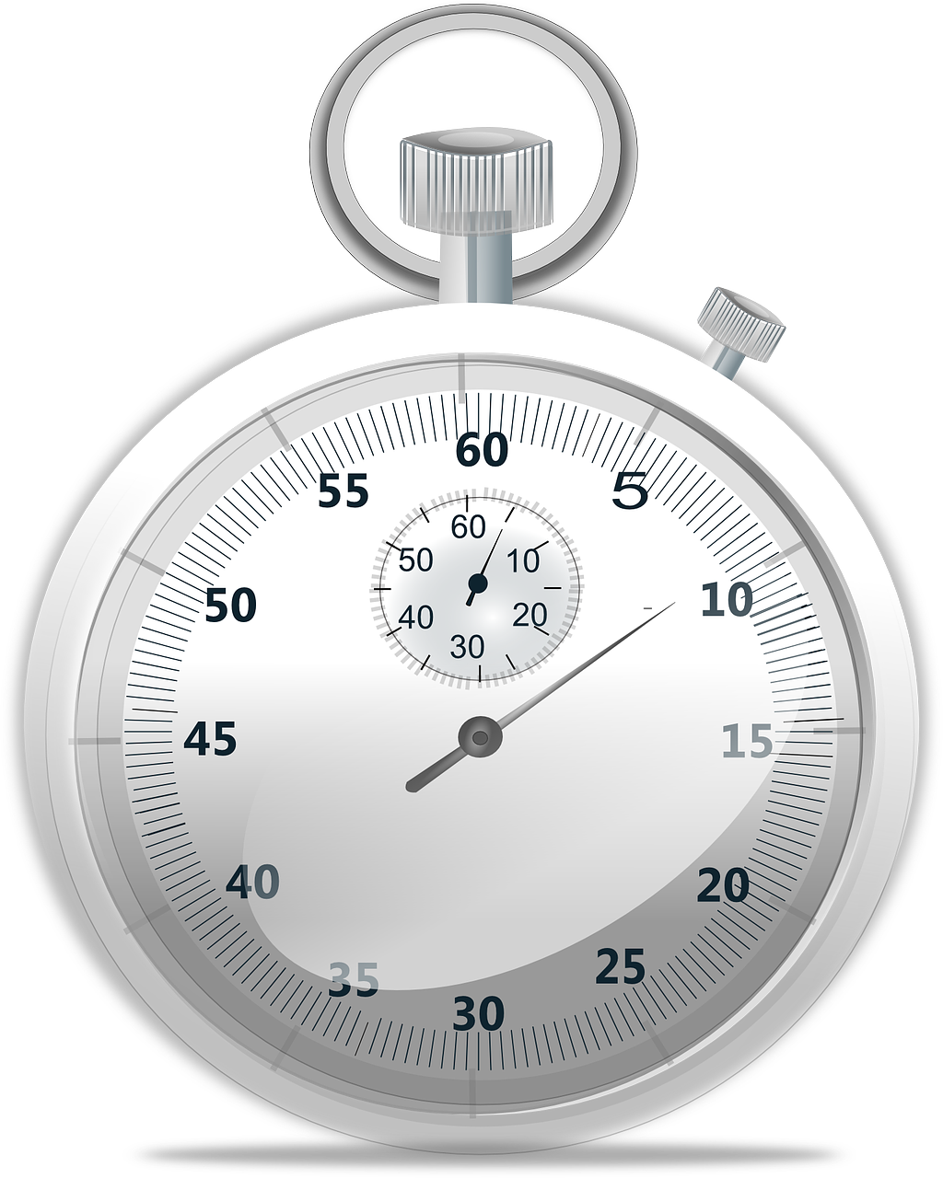
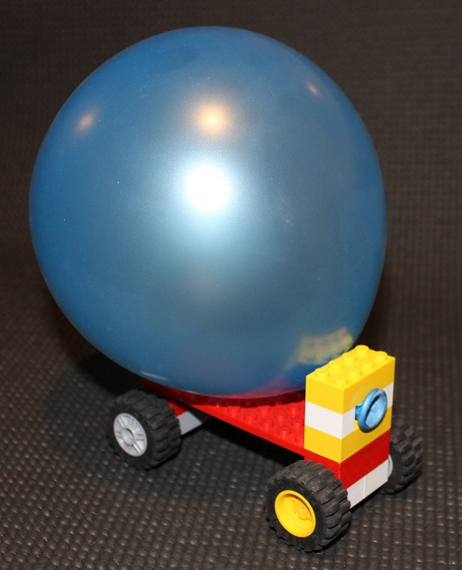
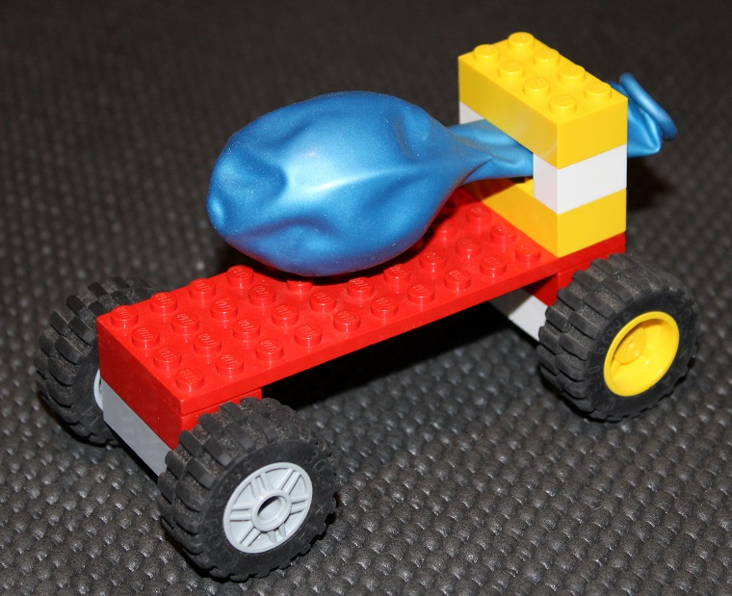
Step 3 – Race!
Put your balloon in place
Time how long it takes the car to go the distance
Calculate the speed of your vehicle by dividing the distance it travels by the time
Top tip:
blow up the balloon,
hold the end,
lift the top block from the balloon mount,
put the balloon in place,
reattach the top block –
then you are ready to let go of the balloon and race!

Slide 6
Create a table of the results for your class
Who Made It | Time, seconds | Speed
(Speed = distance / time, m/s)

Slide 7
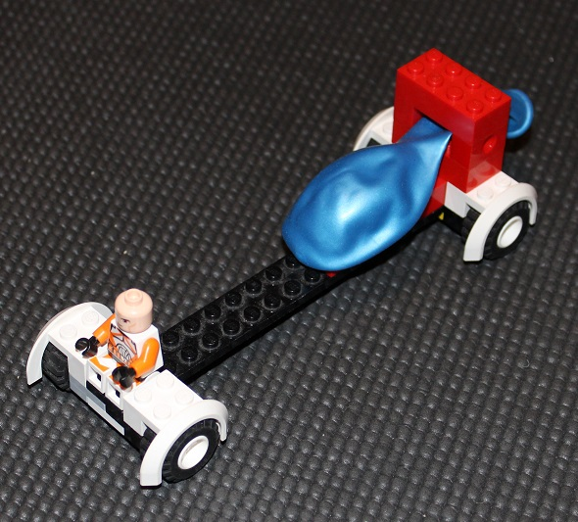
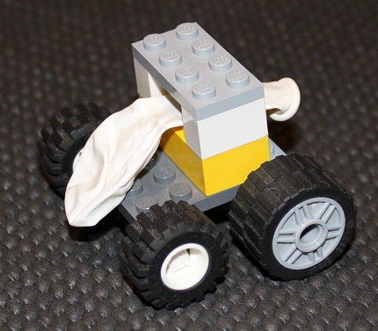
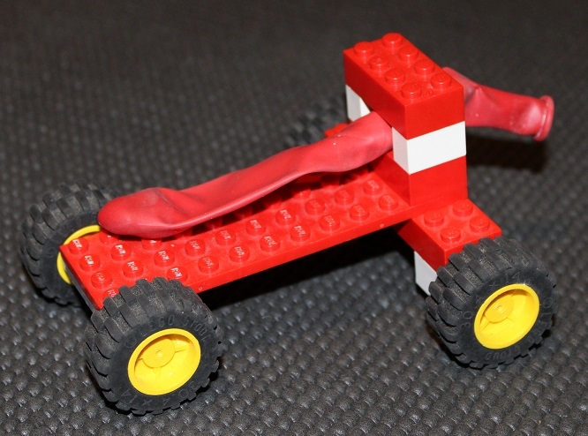
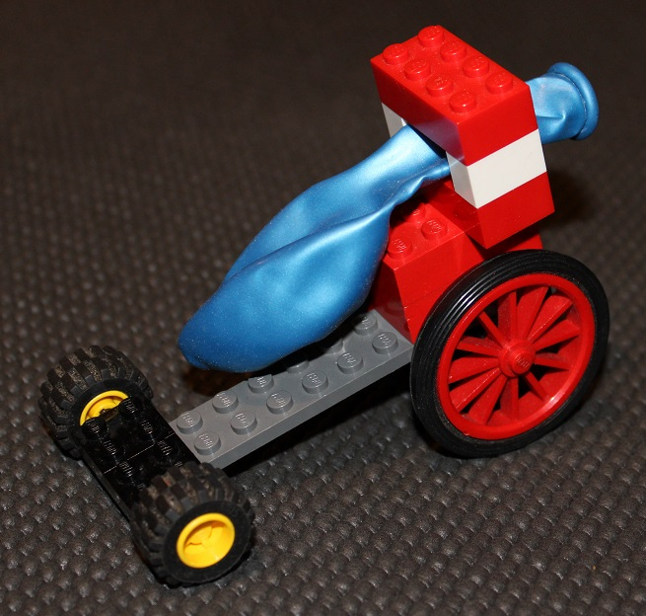
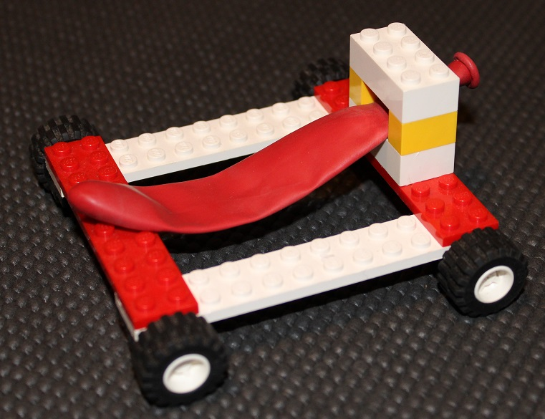
Extension
Try making different designs of car – which is the fastest? Why?
Try using different sizes of balloon – do these change how fast the car is?
Investigate how fast other vehicles move – and compare the speed of your car
Top tip – to compare it to a car:
2.24 x meters/second = miles/hour

