Slide 1
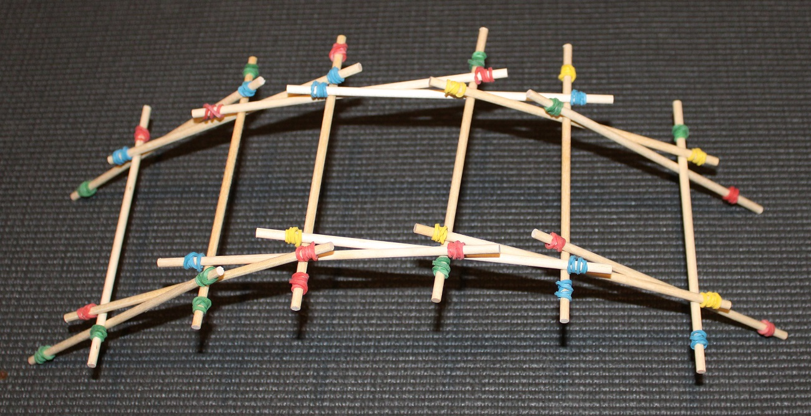
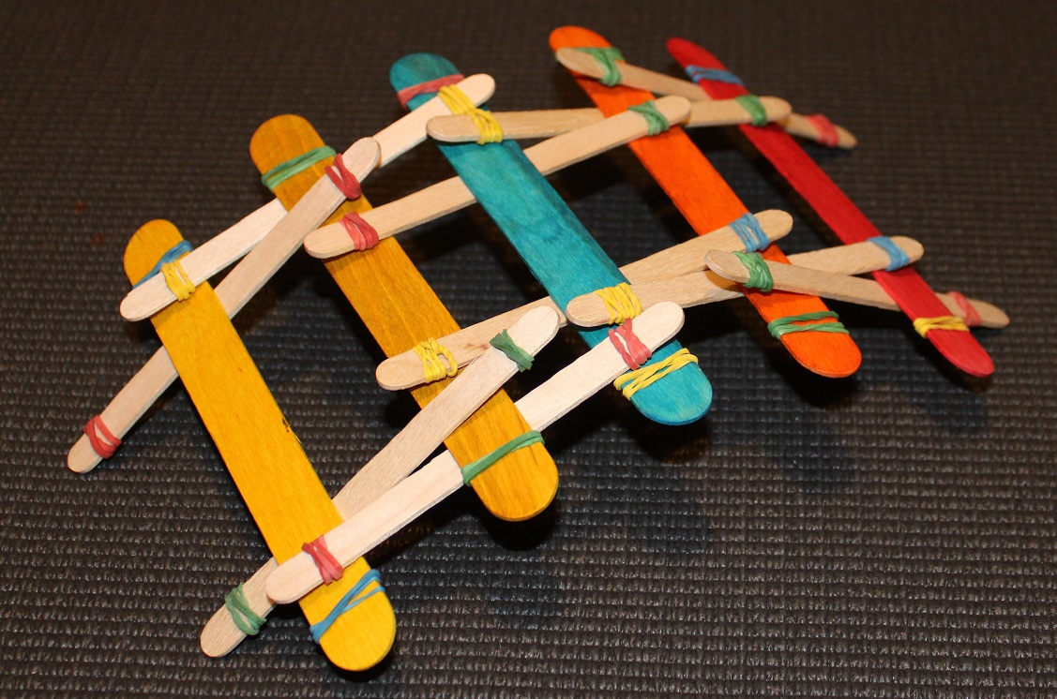
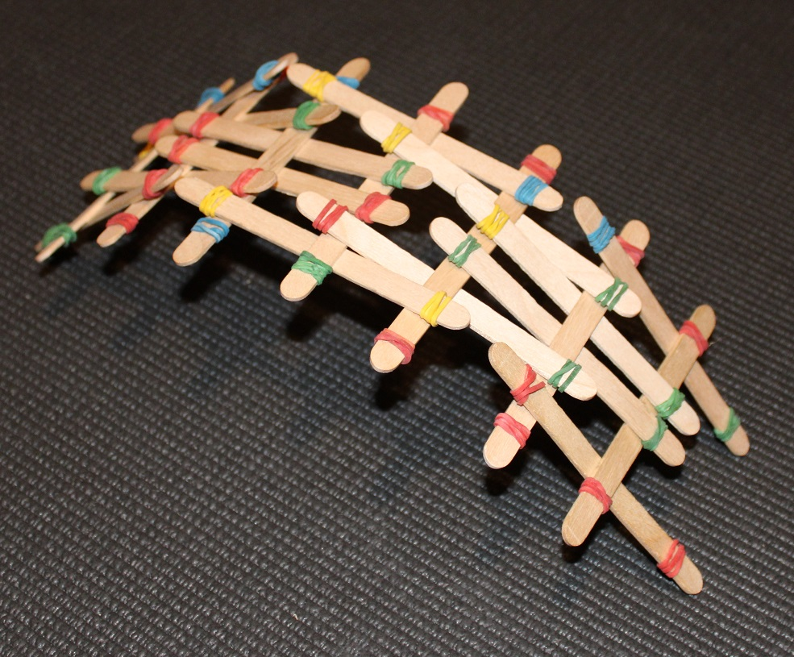
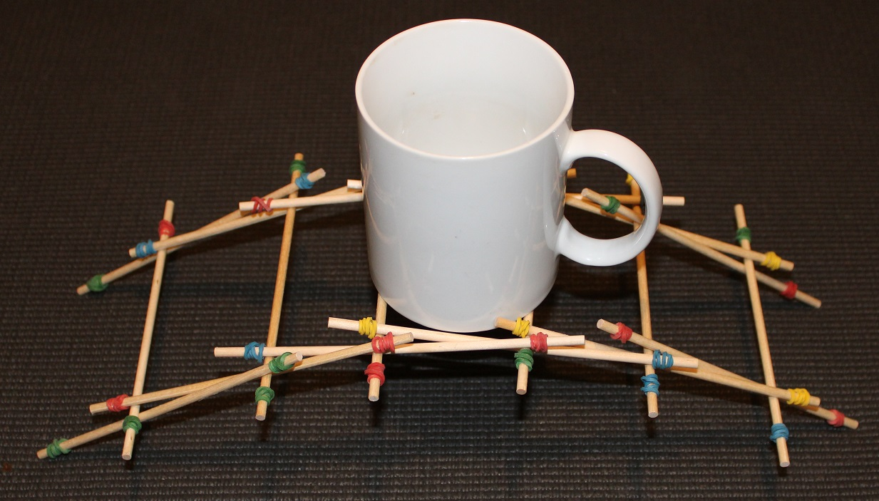
DaVinci Bridge
Making a bridge where the parts are not joined together!

Slide 2
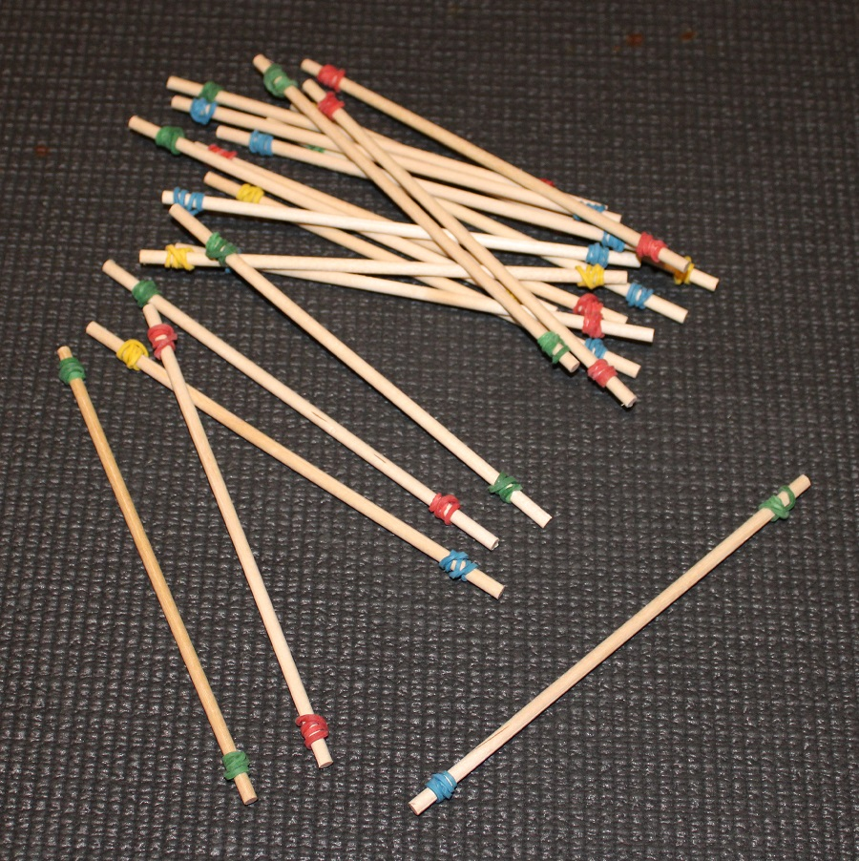
Resources
You will need:
16 pieces of dowel rod (or craft sticks)
32 small elastic bands
Wrap an elastic band around 10 mm from each end of the dowel (as in the picture)

Slide 3
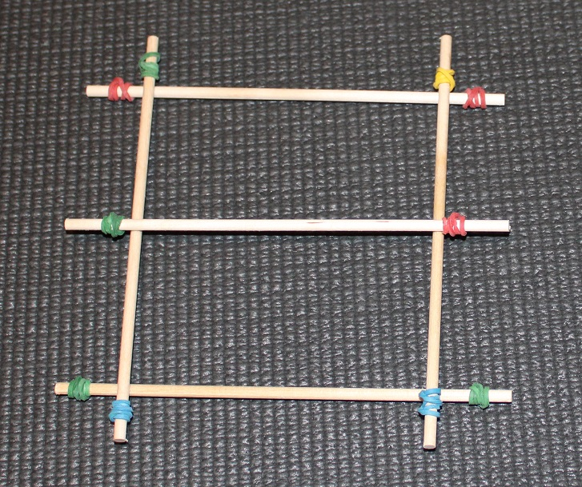
Making the Bridge – Step 1
Make the shape shown
Put the two end cross pieces A1 & A2 down first…
… then place the two side pieces B1 & B2 on top…
… then place the middle cross piece C1 on top.
A1
B2
C1
B1
A2

Slide 4
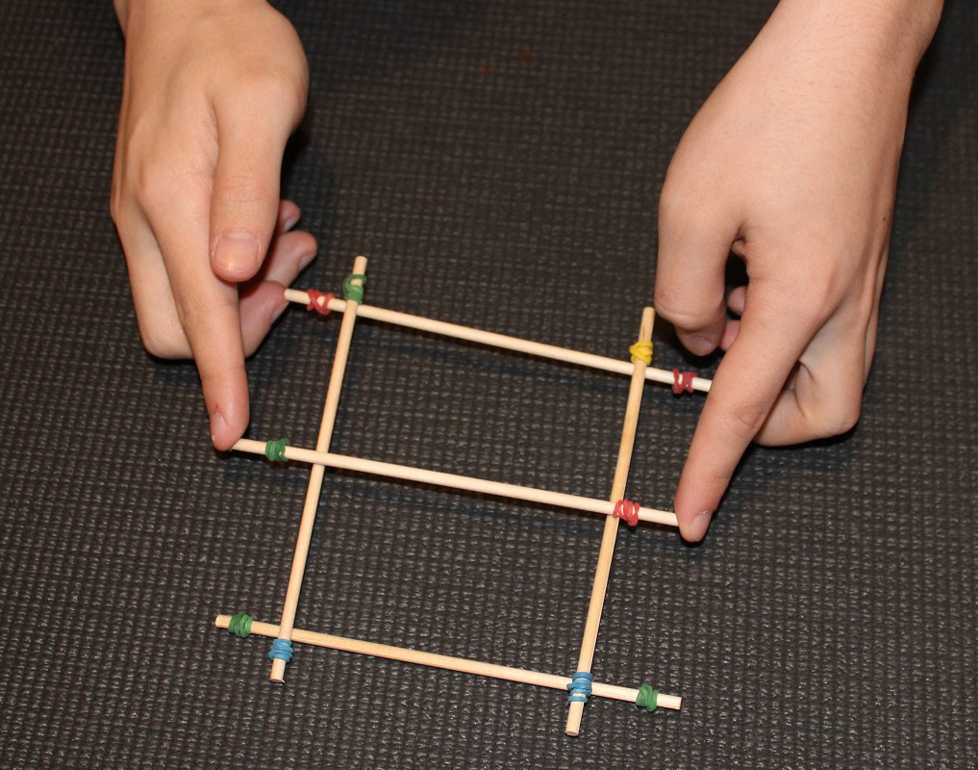
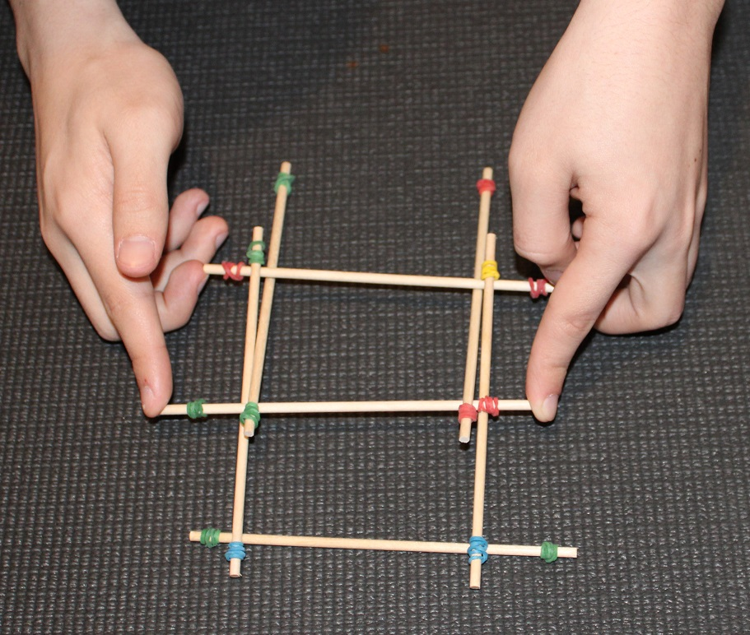
Making the Bridge – Step 2
Carefully holding the central piece C1 in place, lift the end cross piece A1 a few mm.
Slide the sidepieces B3 and B4 over the top of C1 and under A1.
B3
B4
A1
C1

Slide 5
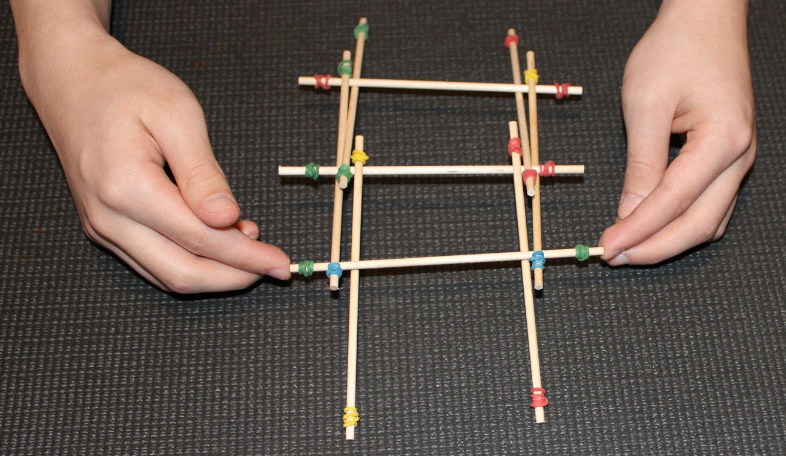
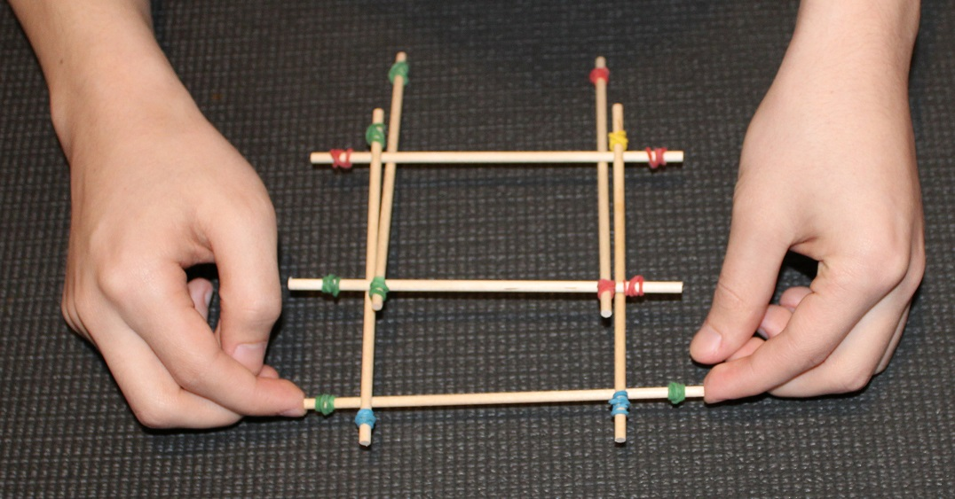
Making the Bridge – Step 3
Carefully lift the cross piece A2 a few mm.
Slide the side pieces B5 and B6 over the top of C1 and under A2.
C1
A2
B5
B6

Slide 6
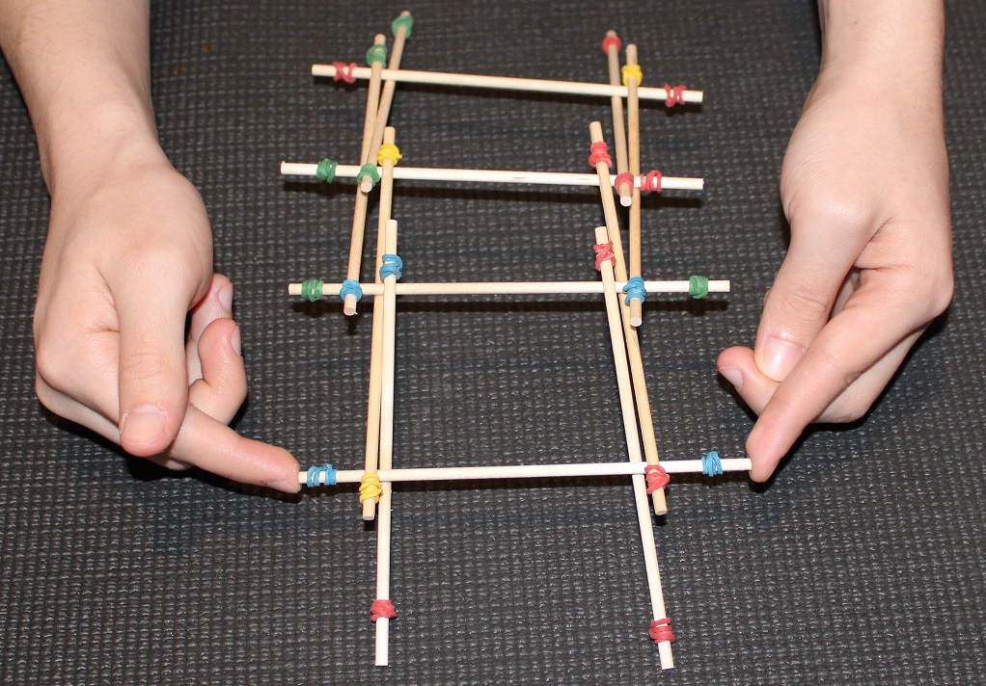
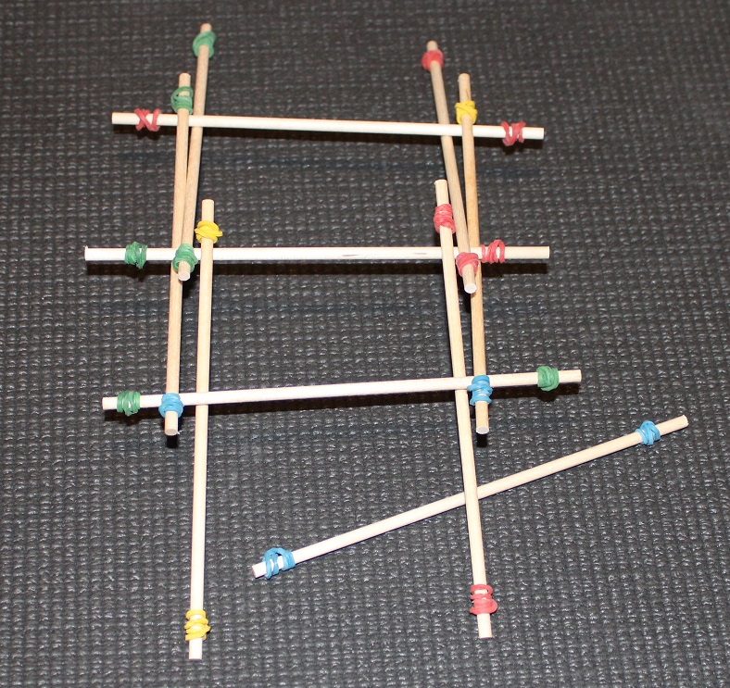
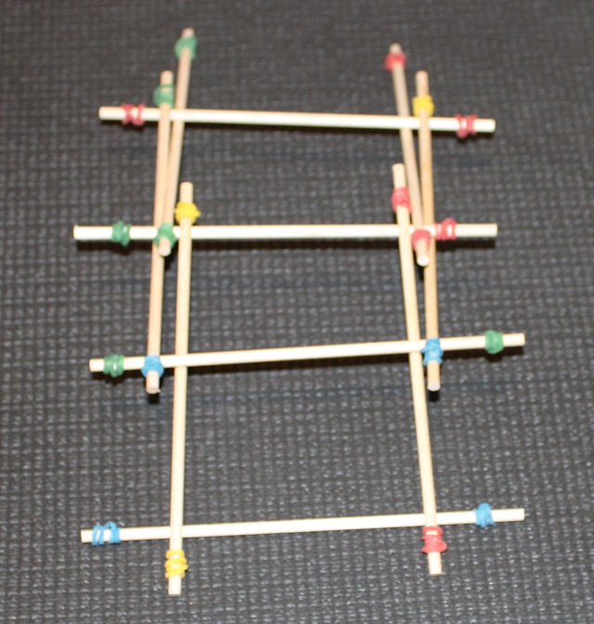
Making the Bridge – Step 4
Carefully slide a new cross piece A3 under one end.
Carefully lift the cross piece A3 a few mm.
Slide the side pieces B7 and B8 over the top of A2 and under A3.
A2
A3
A3
A3
B7
B8

Slide 7
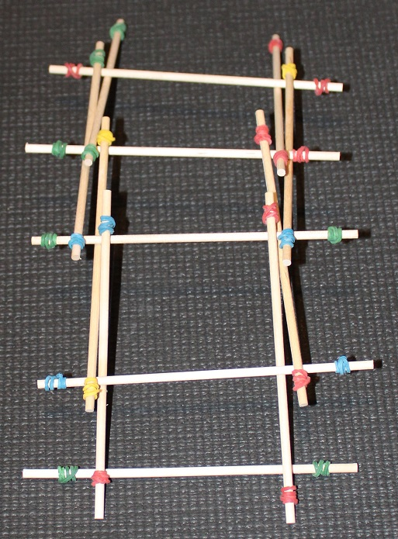
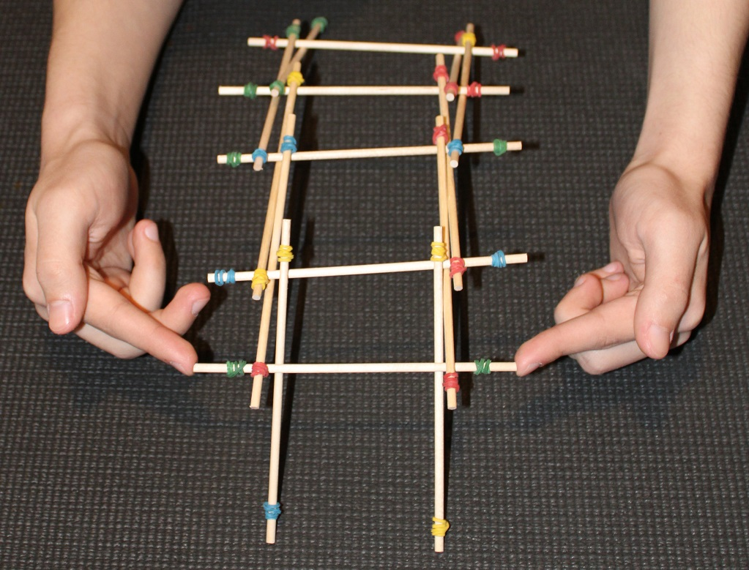
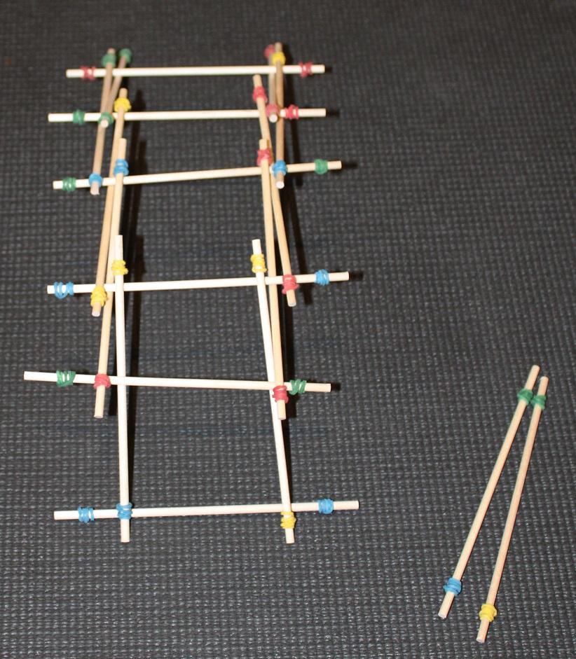
Making the Bridge – Step 5
Repeat the method in step 4 to extend the bridge:
Carefully slide a new cross piece under the end.
Carefully lift the new cross piece a few mm.
Slide new side pieces over the top of the previous cross piece and under the new cross piece.
Repeat until you have at least 6 cross pieces in place.

Slide 8
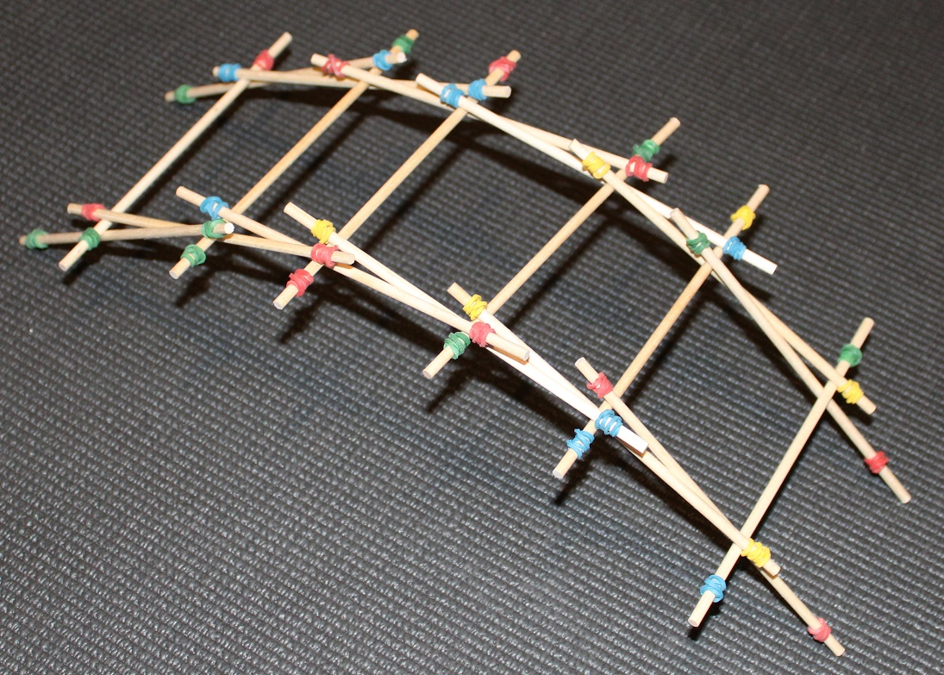
The Finished Bridge

Slide 9
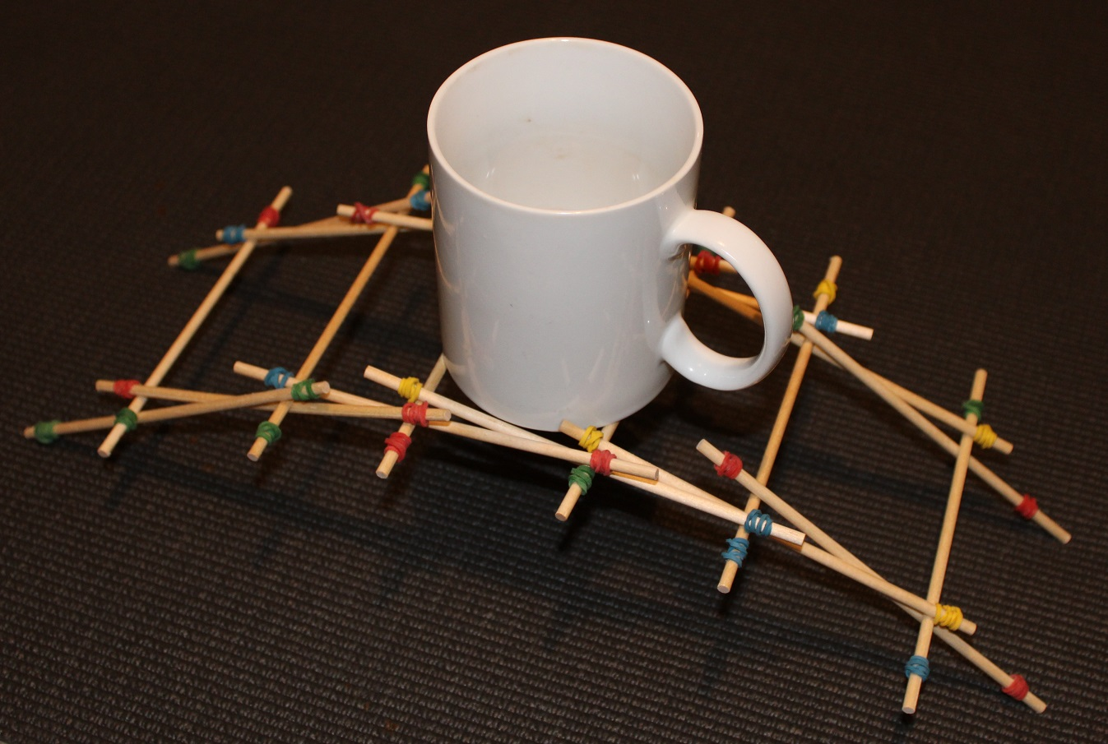
Testing the bridge
Carefully put weights on your bridge to see how much it will support.
Remember that the parts of the structure are not attached together!

Slide 10
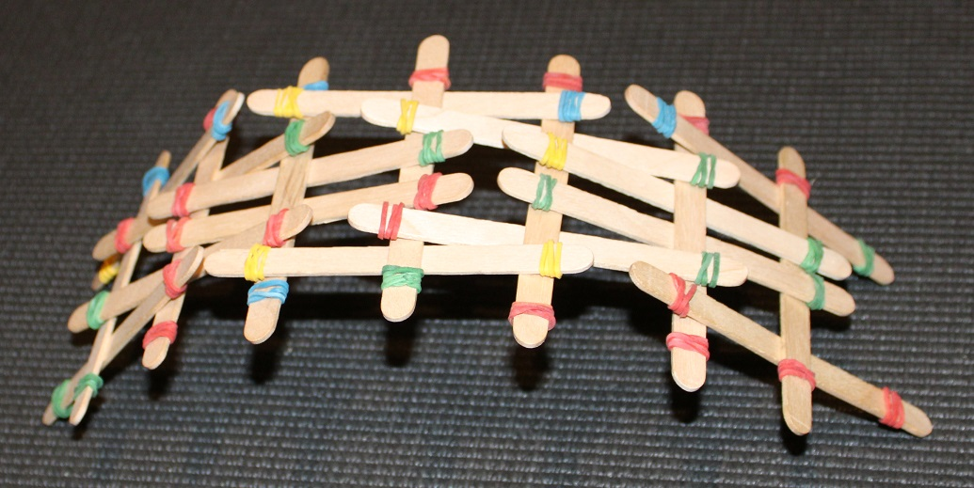
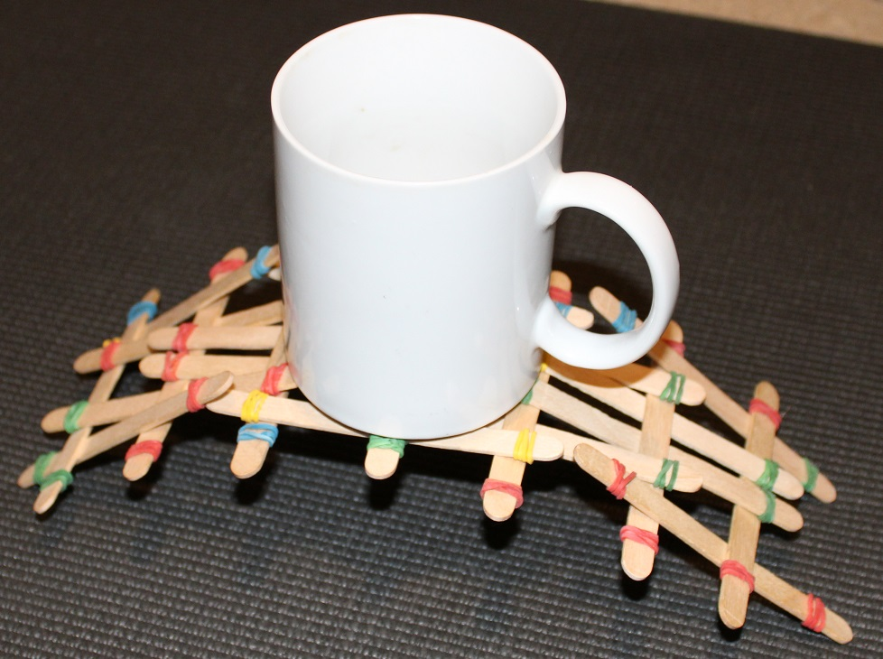
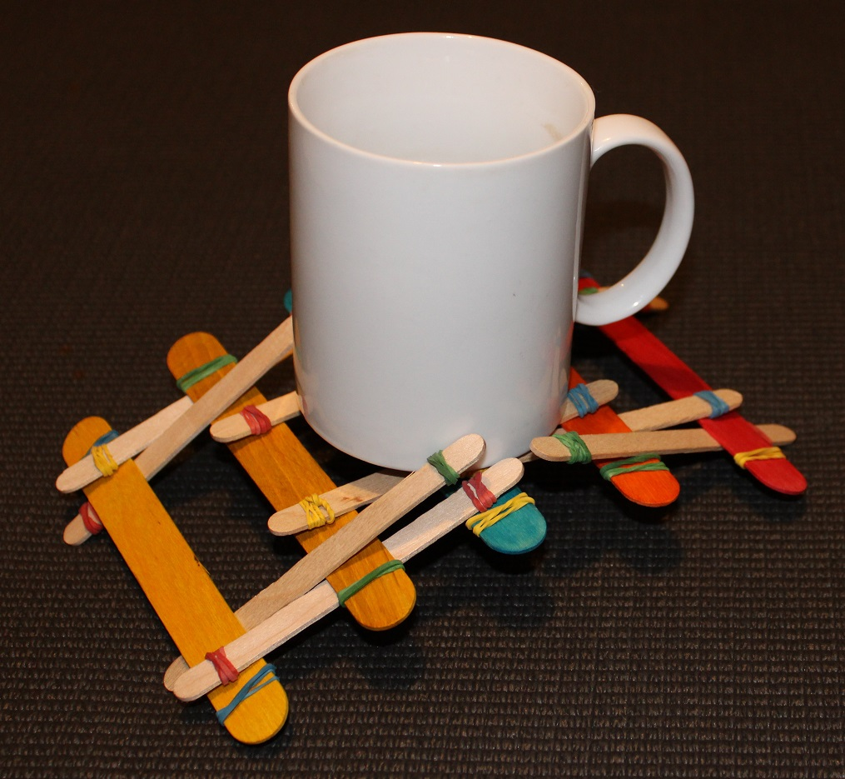
Examples of Pupil Bridges
Ben used craft sticks to make his bridge
Paula used a mixture of coloured and plain craft sticks

