Slide 1
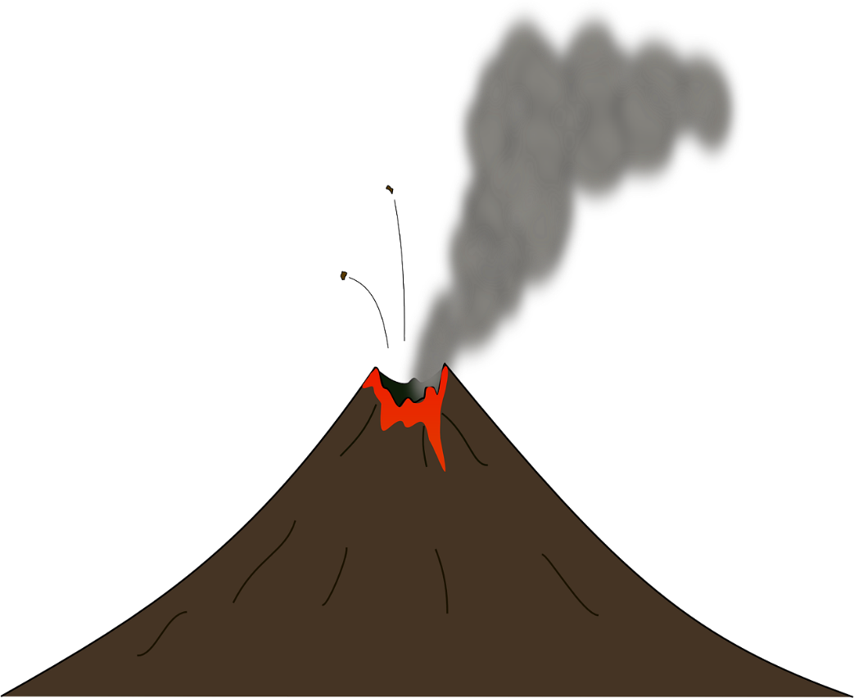
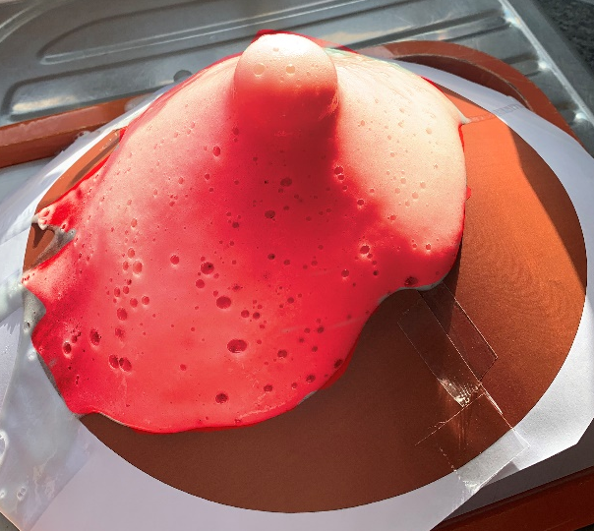
Erupting Volcano
Make an erupting volcano using
sodium bicarbonate and vinegar

Slide 2
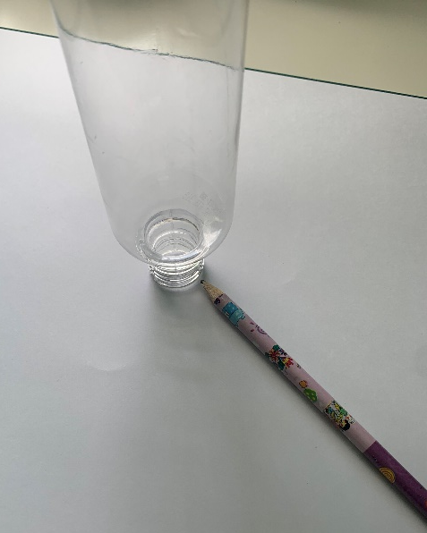
Step 1 – Shape the card
Place the bottle upside down in the centre of the A3 thin card
Trace around the bottle neck
Carefully cut out the circle with scissors

Slide 3
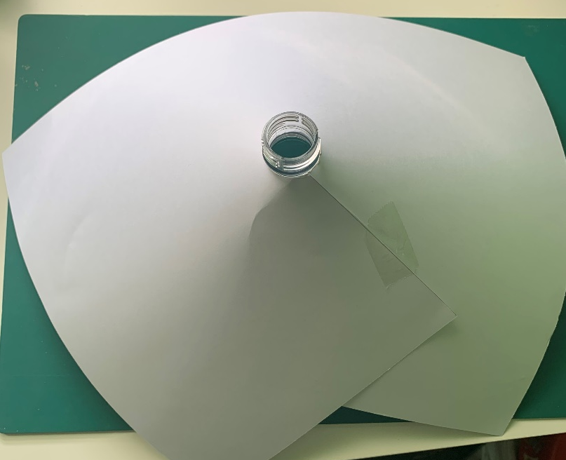
Step 2 – Volcano shape
Wrap the card around the bottle
Sticky tape the card in place
Cut around the cone to make a volcano shape

Slide 4
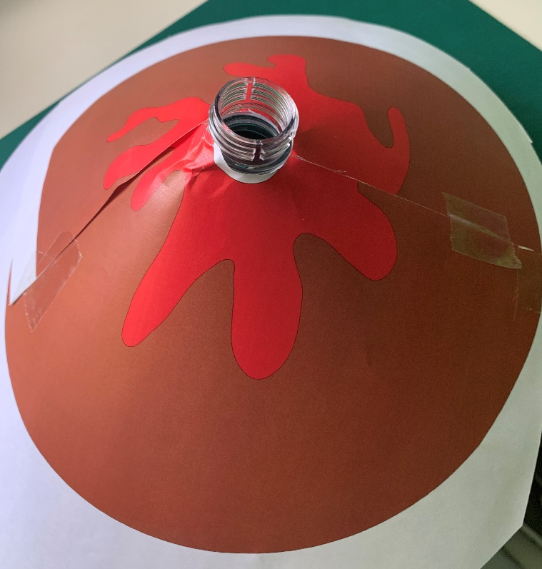
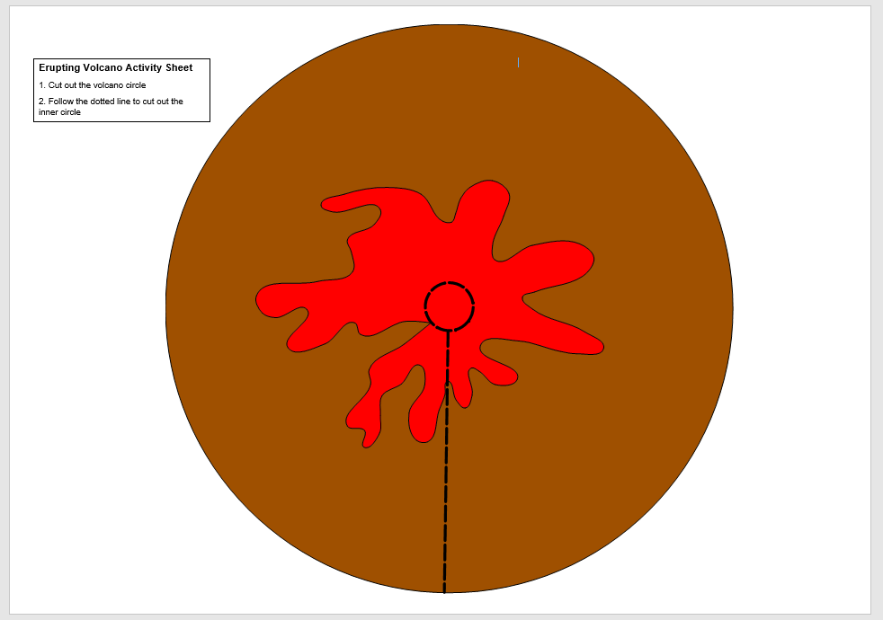
Step 3 – Decorate the volcano
Decorate your volcano

Slide 5
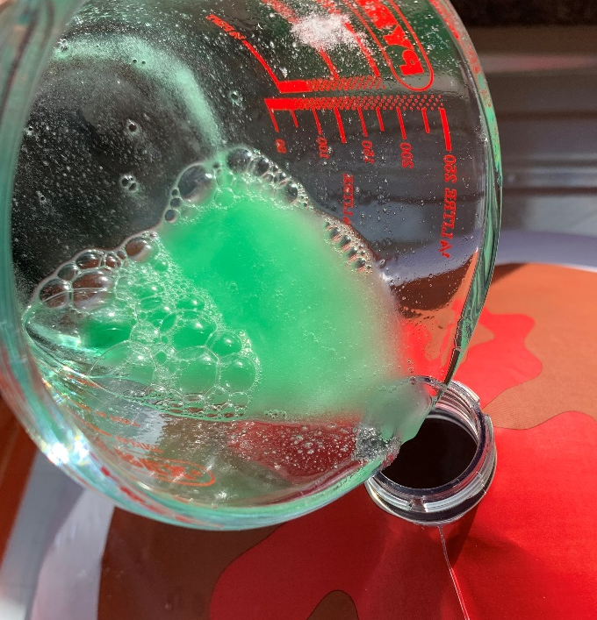
Step 4 – Make the lava
Mix one tablespoon each of sodium bicarbonate and washing-up liquid
Add two tablespoons of water and mix
Pour the mixture into the bottle

Slide 6
Step 5 – Volcano testing
Mix one tablespoon of food colouring with half a cup of vinegar (125 ml)
Add the mixture to the bottle
Watch the volcano erupt!

